Slide 1

SF Beer Week 2020

Slide 2
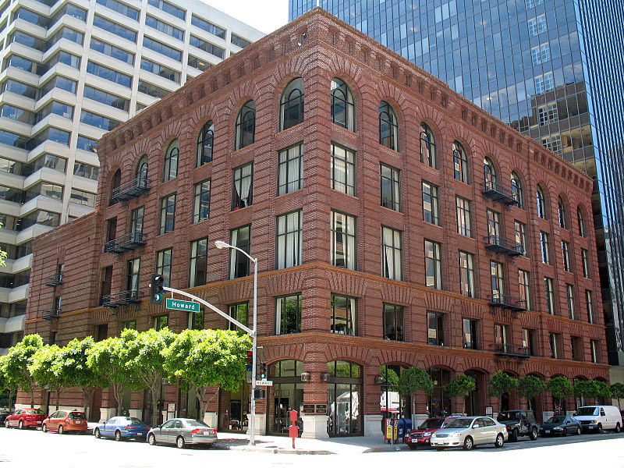
USF’s Data Institute
101 Howard Street
Located in downtown San Francisco, near the Embarcadero Bart!
USF’S Masters of Data Science Program

Slide 3
UPCOMING FRIDAY SEMINARS
Friday: February 21
You’re Probably A/B Testing Incorrectly
Nathaniel Stevens, University of Waterloo and Nick Ross, USF
Friday: March 20
MS in Data Science Student Machine Learning Presentations
Friday: March 27
Mar Hicks; Illinois Institute of Technology

Slide 4
Spring 2020 Certificate Courses
Deep Learning
Instructor:
Jeremy Howard
March 17 - May 5
6:30 - 9pm
SQL
Instructor:
Nick Ross
March 16 - April 27
6 - 9pm
usfca.edu/data-institute/certificates

Slide 5
MS Data Science
Application Deadline: March 1
Apply at datascience.usfca.edu

Slide 6
TONIGHT!!!!

Slide 7
TONIGHT!!!!
SPORTS!
DATA SCIENCE!
BEER!

Slide 8
SPEAKERS
Rushil Sheth : Positionless Baseball
Ben Rudy : Data Science at X10 Capital
Shirley li & Kyrill Rekun : GSW Marketing Analytics
Gaurav Misra : Starting a Sports Analytics Company?
Collin Prather : Moneyball is Dead

Slide 9




Stay up to date
twitter.com/datainstitutesf
twitter.com/usfca_msds
linkedin.com/company/the-data-institute-university-of-san-francisco
linkedin.com/company/10703201
instagram.com/usfca_msds
instagram.com/usfdatainstitute
facebook.com/usfca.msds
facebook.com/USFDataInstitute

