Slide 1
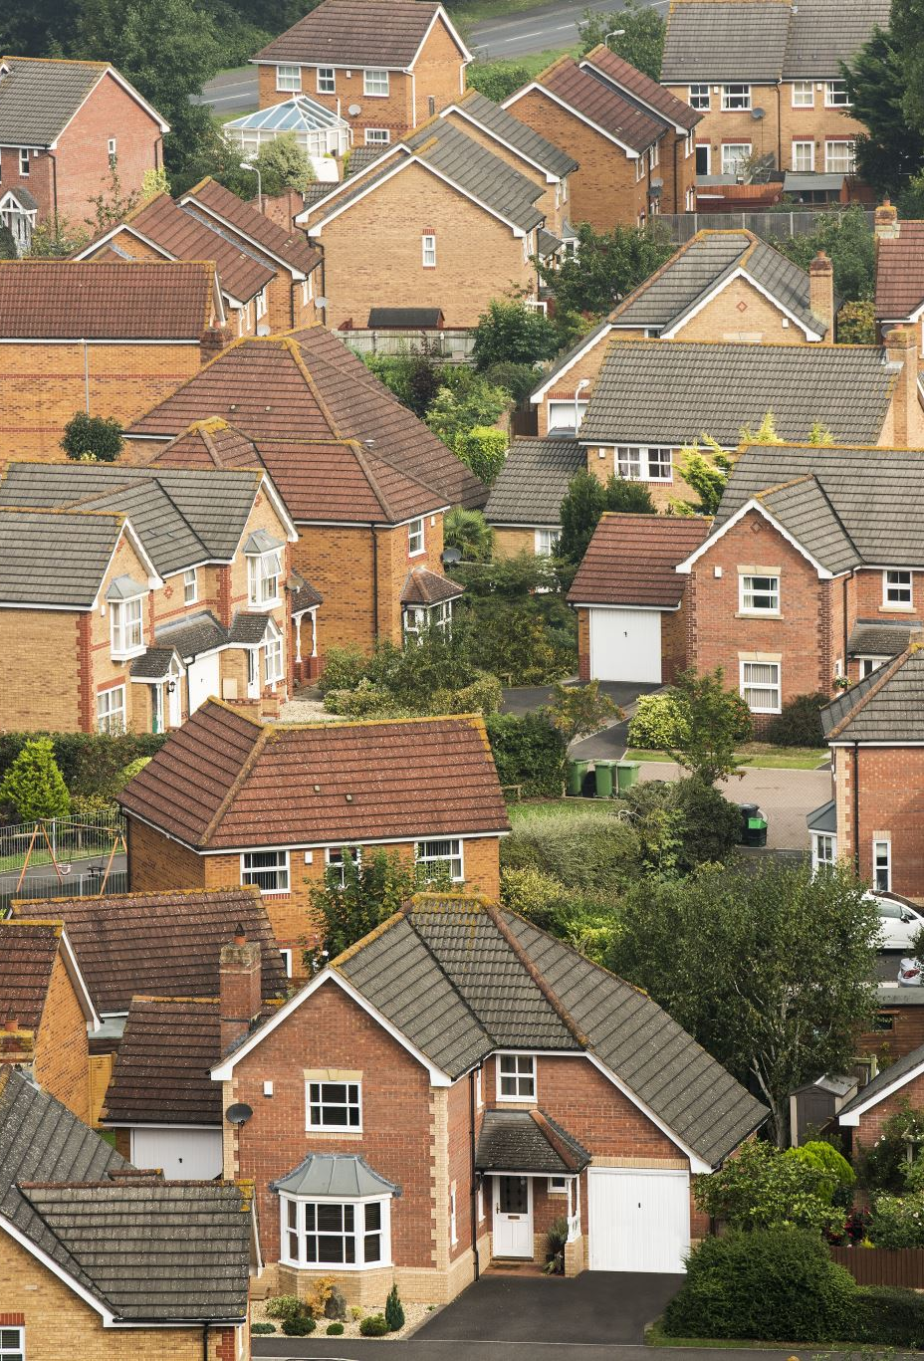
What are the achievements and unanswered questions in urban segregation?
(discussion based on group information)
Selcan Mutgan
Julien Migozzi
Workshop: Updating urban segregation computation with R
9-13th November 2026

Slide 2
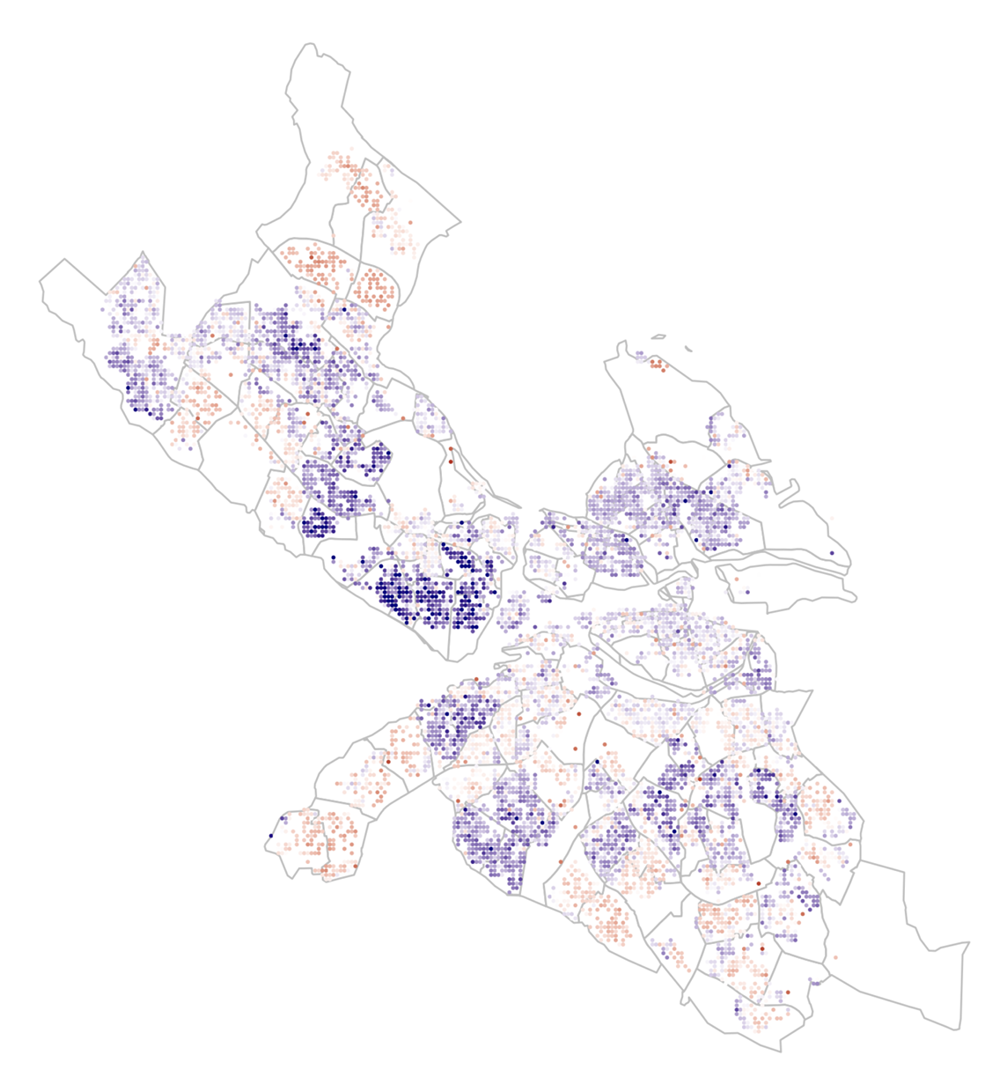
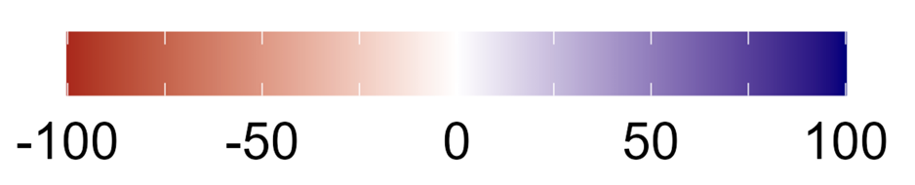
Shared interest: Segregation (obv)
- economic segregation
two or more axes of segregation
  Income and ethnicity (ancestry)
different data sources
different empirical focus: schools, workplaces, networks, urban forms
Stockholm, 2017
Divergence from city median income
Mutgan and Mijs 2023

Slide 3
What inspires us?

Slide 4
Inspiring earlier work: multidimensional phenomenon
Massey & Denton (1988) The Dimensions of Residential Segregation |  | five dimensions: evenness, exposure, concentration, centralization, clustering. |  | Shows segregation is multidimensional, with dimensions that can be tested empirically.
Google scholar: 6000+ citations
Following a long-tradition of the use of dissimilarity index as the “main” measure of separation across neighborhoods (Duncan and Duncan 1955, Tauber and Tauber 1965) and from 1970s new measures emerged
Massey and Denton uses factor analyses to categorize 20 of those measures and group them under 5 dimensions.
“We argue that segregation is a multidimensional phenomenon that should be measured by a battery of indices rather than one single index.”

Slide 5
Inspiring earlier work: spatial segregation
Reardon & O'Sullivan (2004) Measures of Spatial Segregation |  | Builds a local environment around every point, weighted by distance; separates evenness from exposure. |  | Moves beyond aspatial indices; transparent, in R (seg)
Group’s favorite!
They define spatial versions of evenness and exposure using distance-weighted local areas and propose the spatial information theory index
They end the paper: “the discussion begs the question of what is meant by urban community structure… ”

Slide 6
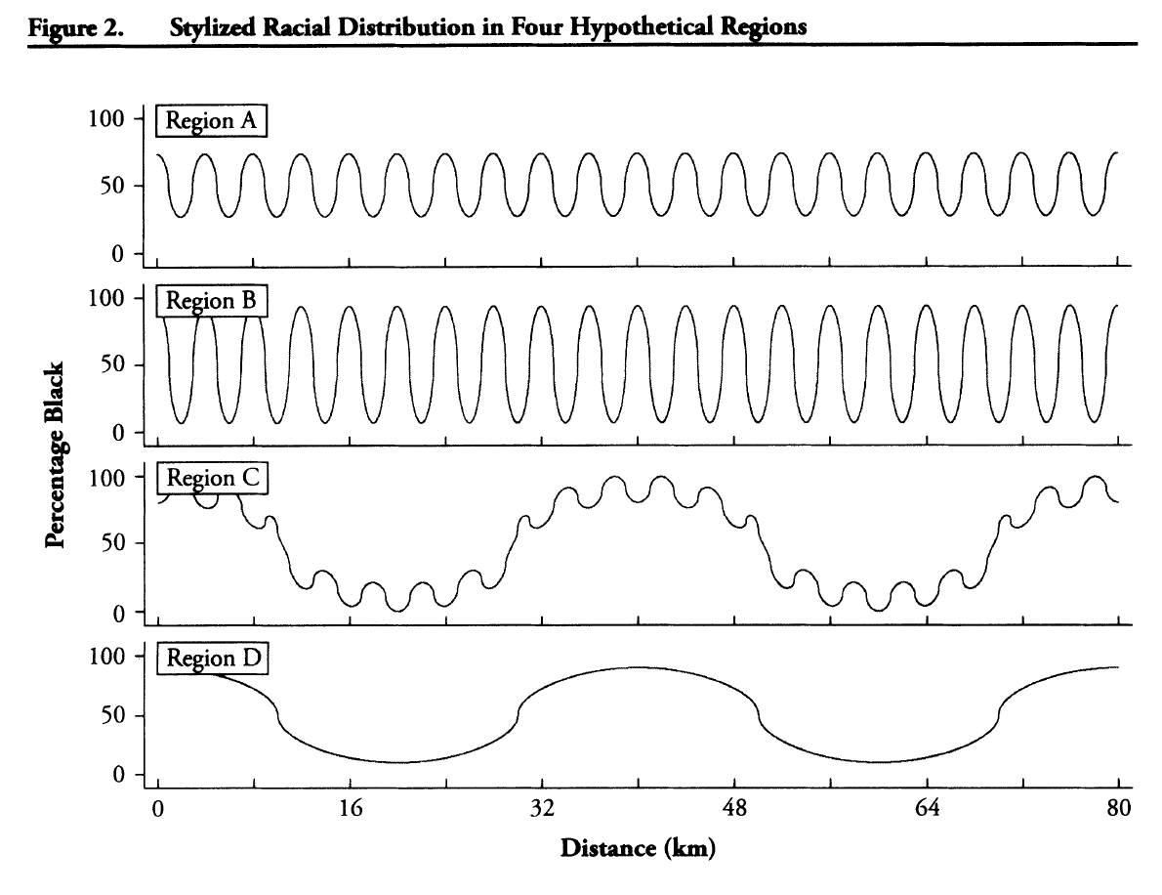
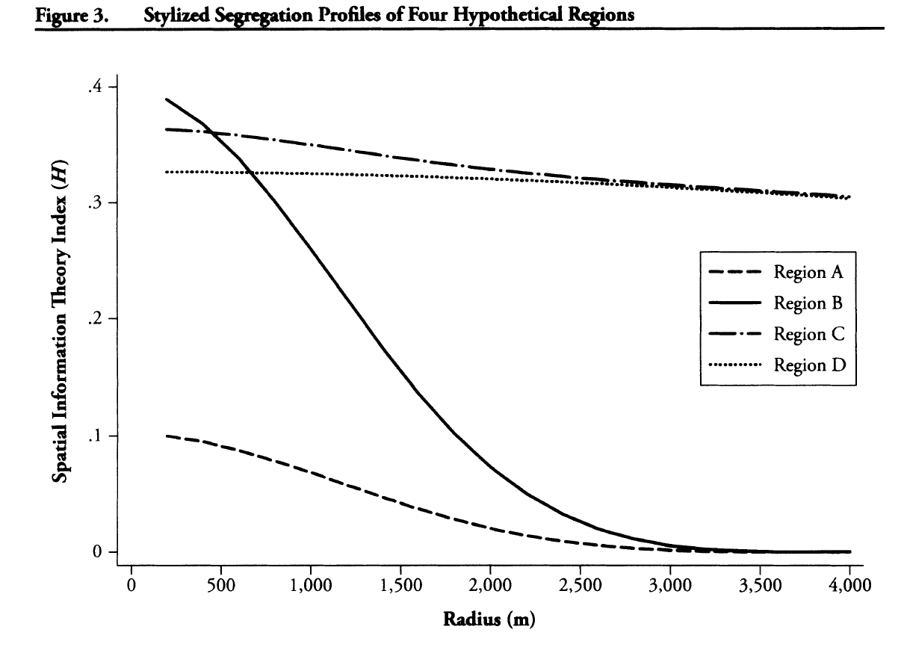
Inspiring earlier work: variation by scale
Reardon et al. (2008) Beyond the Census Tract |  | Segregation profiles at radii from 500 m to 4 km across US metropolitan areas. |  | Separates micro- from macro-scale segregation.
distinguishing micro- and macro-scale segregation and the dynamics between the two overtime!

Slide 7
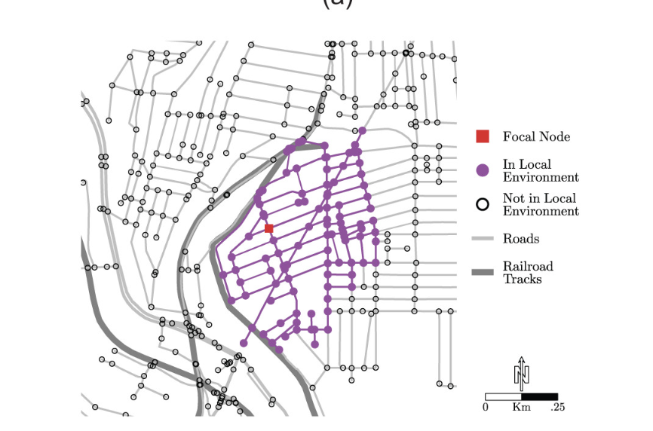
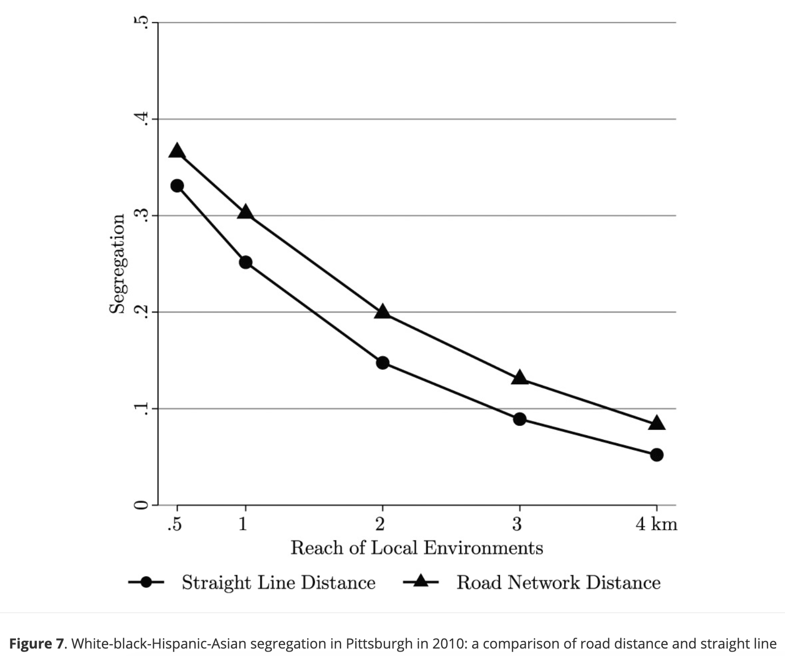
Inspiring earlier work: physical form matters
Roberto (2018) Spatial Proximity and Connectivity |  | Measures proximity along the road network. Highways, rivers and rail lines divide local environment. |  | Connects theories of place stratification and redlining to how we actually measure segregation.
replaces straight-line distance with road-network distance and connectivity, to understand how physical barriers affect proximity.

Slide 8
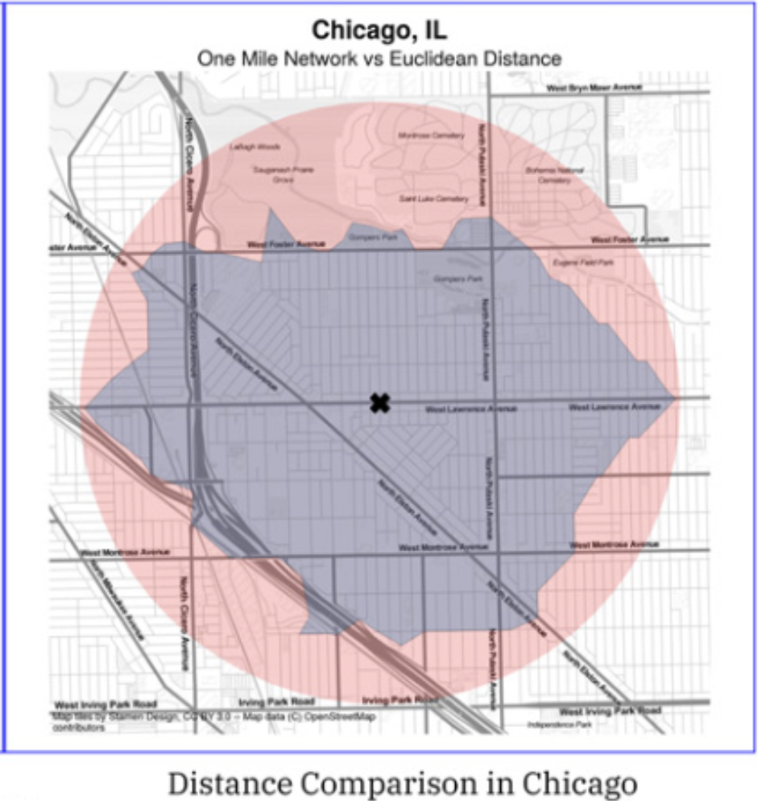
Inspiring earlier work: physical form matters
Knaap & Rey (2024) Segregated by Design? |  | Shows that street-network topology changes how segregated a city appears. |  | Treats the street network as a quiet sorter of people; speaks directly to planners.
They use spatial segregation measures
-using Euclidian distance
-using distances measured by road networks
Grannis 1998: The Importance of Trivial Streets: Residential Streets and Residential Segregation

Slide 9
Inspiring earlier work (ranked)
Reardon & O'Sullivan (2004) Measures of Spatial Segregation |  | Builds a local environment around every point, weighted by distance; separates evenness from exposure. |  | Moves beyond aspatial indices; transparent, in R (seg)
Massey & Denton (1988) The Dimensions of Residential Segregation |  | five dimensions: evenness, exposure, concentration, centralization, clustering. |  | Shows segregation is multidimensional, with dimensions that can be tested empirically.
Lee, Reardon et al. (2008) Beyond the Census Tract |  | Segregation profiles at radii from 500 m to 4 km across US metropolitan areas. |  | Separates micro- from macro-scale segregation.
Roberto (2018) Spatial Proximity and Connectivity |  | Measures proximity along the road network. Highways, rivers and rail lines divide local environment. |  | Connects theories of place stratification and redlining to how we actually measure.
Knaap & Rey (2024) Segregated by Design? |  | Shows that street-network topology changes how segregated a city appears. |  | Treats the street network as a quiet sorter of people; speaks directly to planners.

Slide 10
Inspiring earlier work: physical form matters
There were 35+ other references:
-Better measurement strategies: income segregation (Reardon and Bischoff 2011)
-Understanding processes and tipping: Bruch and Mare (2006), Card et al (2008)
-highways as barriers to social networks: Aiello et al (2025)
and many more
Each field brings their own questions: Economists, epidemiologists, network scientists, physicists, urban planners and critical urban scientists...

Slide 11
Achievements

Slide 12
1. Space and scale awareness
  We no longer treat units as isolated
  We no longer treat income as two bins.
Instead:
  Spatial exposure and information-theory indices with explicit distance
  Segregation measures across many scales at once
  High-resolution population grids (Dmowska, Stepinski and Nowosad 2021, raceland R package)
  Rank-order income segregation (Reardon and Bischoff 2011)
  Index of Concentration at the extremes (Massey 1996, 2001, Krieger et al. 2016)
Notes:
Reardon and Bischoff (2011) introduced a rank-order information theory index for income, which measures segregation across the whole income distribution and is not mechanically driven by rising inequality
Index of Concentration: captures concentrated affluence as well as concentrated poverty, which matters for economic segregation.
Dmowska, Stepinski and Nowosad (2021) compute mutual information and entropy directly on high-resolution population grids, making segregation measurable at any scale and directly mappable.

Slide 13
2. Understanding of process and patterns
Data availability (such as administrative registers) allow for decomposition of the change in segregation into its components:
  Who moves, who stays, who leaves/arrives…
Income sorting separated from in-situ neighborhood change
(Bailey, van Gent and Musterd 2017)
Migrants' residential and workplace trajectories followed for years
  -Income inequality tied to segregation across European capitals
(Van Ham et al. 2015; Tammaru et al. 2020)
Agent-based models linking individual choices to city-wide patterns
  -Beyond ethnoracial preferences: kinship (Jarvis et al 2025), opportunities (Mutgan et al 2026), population structure (Bruch 2014)

Slide 14
3. Segregation beyond home
Where people work, study, and form ties is now part of the picture.
Workplace segregation linked back to home neighborhoods (Ellis et al 2004, Hellerstein et al 2008, Åslund & Skans 2010, Chihaya et al 2022)
School segregation split into between-school and within-school sorting (Moody 2001, Boterman et al 2019, segregation R package)
Highways shown to affect social ties at urban scale (Aiello et al 2025)
Segregation emerging from ordinary network processes (DiMaggio and Garip 2012, McPherson et al 2001, Kossinets & Watts 2009, Abebe et al 2022)
Experienced segregation from daily mobility, across life domains (Le Roux, Vallée & Commenges 2017, Athey et al 2021, Moro et al 2021, Wang et al 2018)

Slide 15
What is not discussed (enough)?

Slide 16
Six areas to discuss
Dealing with multiplexity
Data: explosion or erosion?
Context dependence for segregation concepts
Comparative work: solving measurement bias
Portability of tools across settings
Meaningful measures beyond academia

Slide 17

Multiplexity of segregation
We have measures capturing different dimensions of a specific form of segregation
But, perhaps, we are not doing great at capturing segregation as a consolidated phenomenon
  i.e. segregation of multiple forms captured meaningfully

Slide 18
Data explosion or erosion?
  More data than ever (in volume and granularity)
  More computing power
  Strong institutional limits – the segregation of segregation research
    Proprietary datasets vs mock dataset
    Public systems of data collection under tension/strain

Slide 19
Do our concepts travel everywhere?
US-based conceptualization (of segregation and measures): still a limit?
Can one toolkit serve both register-rich and data-poor cities?
No sub-city income data: night lights, built-up area and surveys as proxies
Administrative city limits miss functional urban areas
Gated estates partition even similar groups, while multi-storey buildings mix potentially distant groups
  social mixing at one scale, but segregation at another

Slide 20
Issue with comparative studies
Our numbers depend on units, data sources and group sizes, not only on sorting.
Units differ: census sections, grids, cantons, tracts, functional urban areas, neighborhoods (?)
Evenness indices shift with overall group sizes
Harmonizing areas by interpolation adds its own error
What would a minimum reporting standard for segregation studies look like?
Notes:
physics of social systems: common evenness indices such as D, H and entropy turn out to depend strongly, and in similar ways, on overall group sizes once people actually sort, not just under random allocation. If confirmed, comparisons between cities with different compositions need care.
Can we agree on how to report units, scale and composition so studies become comparable?

Slide 21
Can our tools follow our theory?
We theorize barriers, networks and urban form; our software mostly measures straight-line distance
Most R tools use contiguity or Euclidean distance between areal units
Network distance and travel time exist in R, but not inside segregation packages
Morphometric analysis of urban form lives mainly in Python
Several segregation packages with overlapping, incompatible interfaces

Slide 22
Do our measures have meaning beyond computers?
Does measuring segregation helps reduce segregation, or simply move it elsewhere?
Combining measurement with experience (surveys, participatory mapping, interviews…)
Measuring better (knowing segregation) vs producing meaningful metrics/visuals that gain traction beyond academia (Why is segregation a problem? Acting against segregation)

