Slide 1

BUS PRODUCTION
TRACKER
MISSION VEHICLES · MADE IN UGANDA
Digital Production Tracking System
Kiira Motors Corporation
KMC BUS PRODUCTION TRACKER · FEATURE OVERVIEW

Slide 2
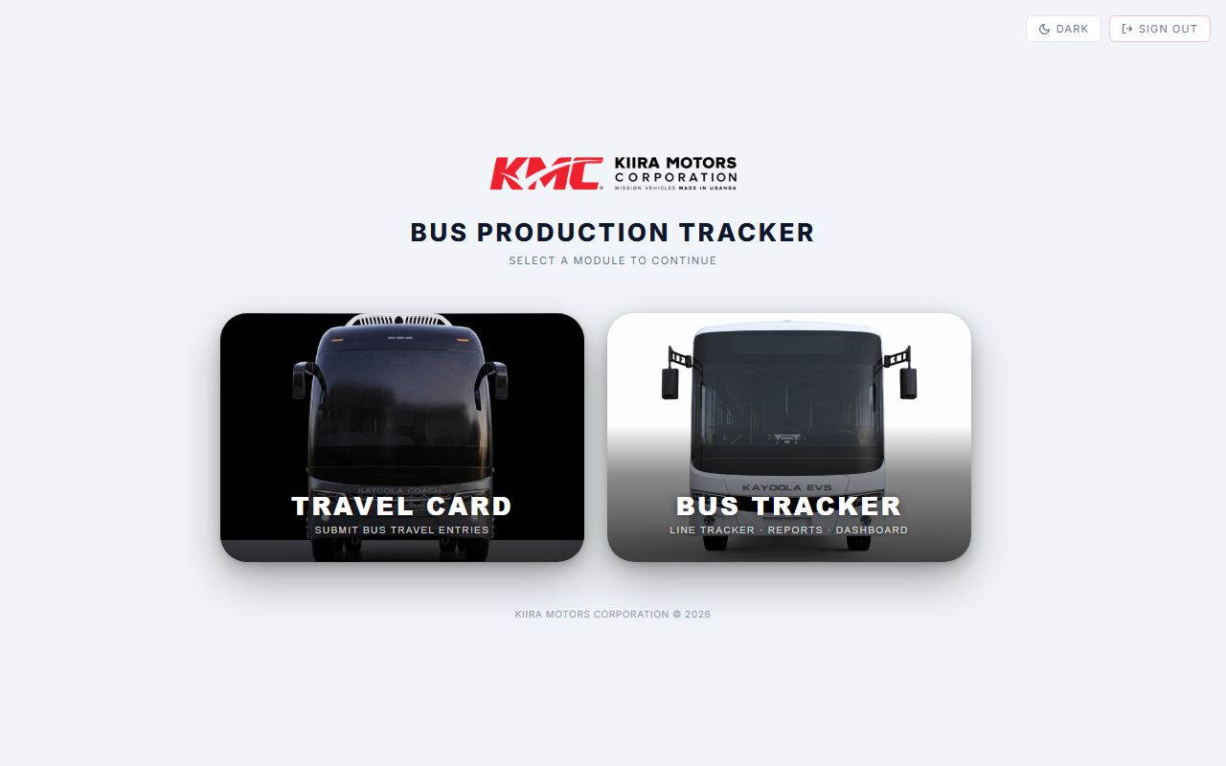
System Overview
Two integrated modules driving production visibility
TRAVEL CARD
BUS TRACKER

Slide 3
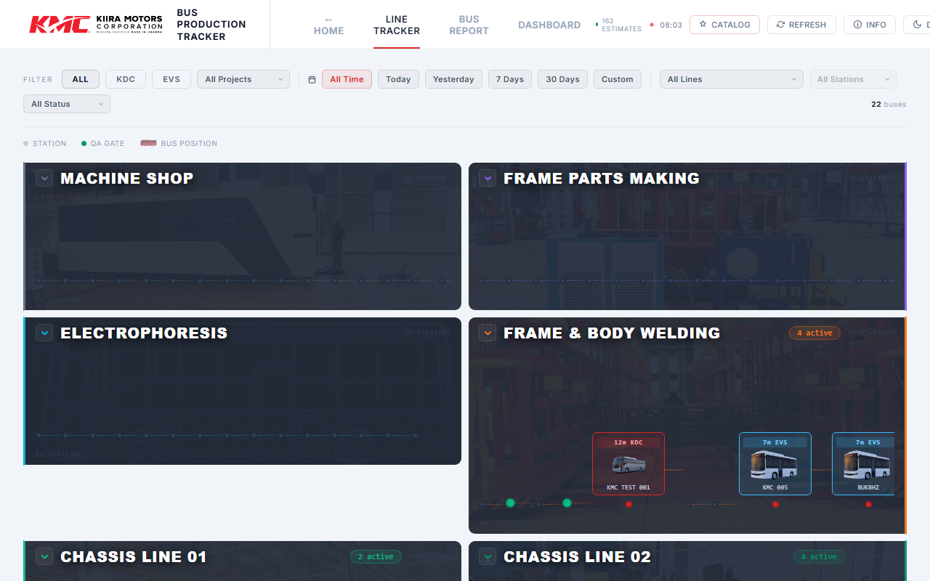
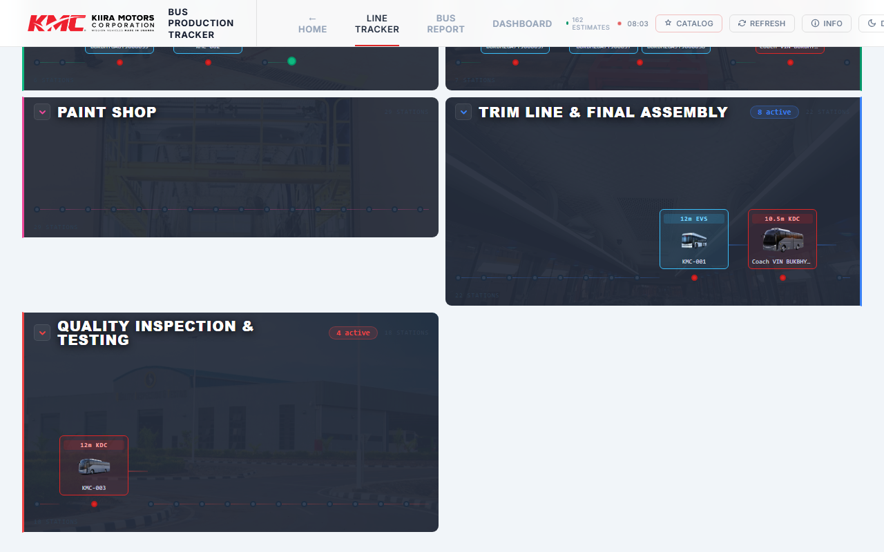
BUS TRACKER
Line Tracker
Live floor map — every bus at its current station across all production lines
9 production lines tracked
Bus cards show model, VIN & current station
Filter by model, project, station, status & date
Overrun & status badges at a glance

Slide 4
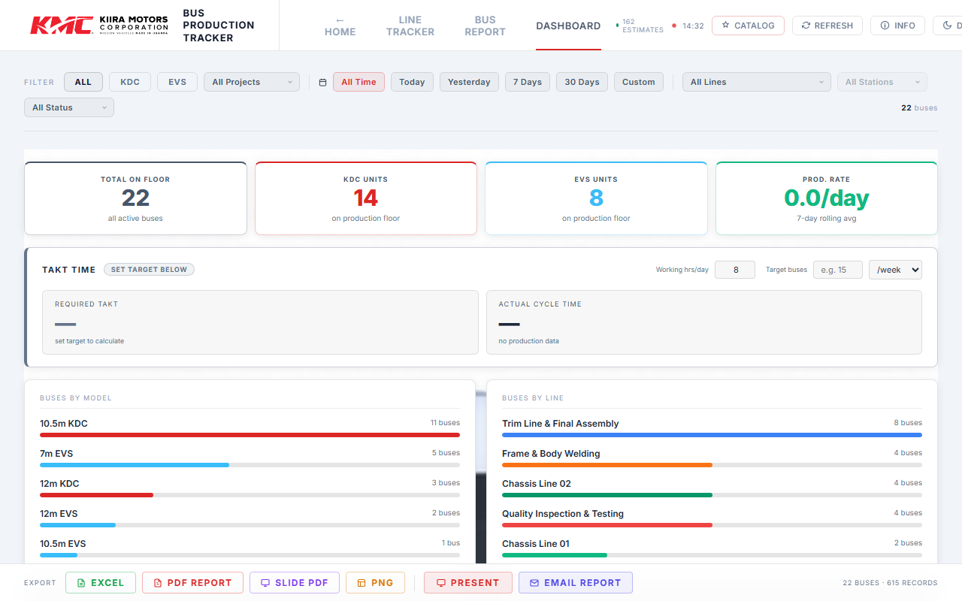
BUS TRACKER
Dashboard
Aggregate metrics — throughput, takt time, overruns, OHS and rework
TOTAL ON FLOOR
KDC UNITS
EVS UNITS
PROD. RATE
22 Buses
14
8
0.0/day

Slide 5
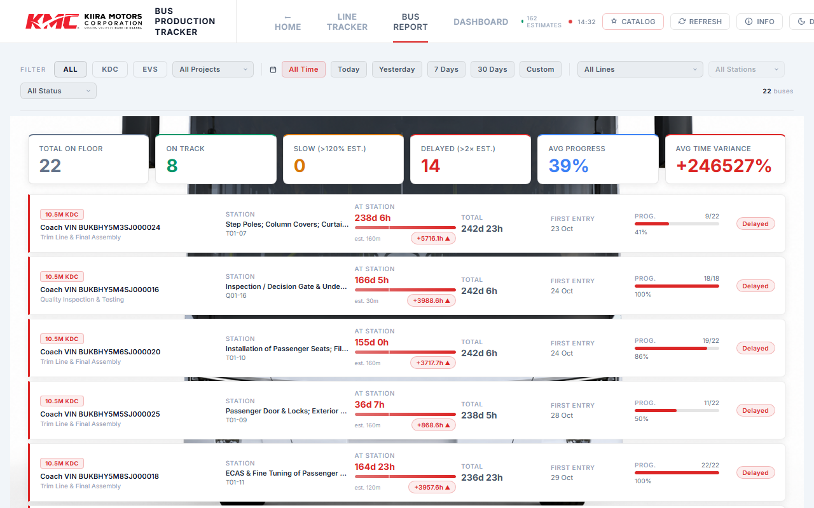
BUS TRACKER
Bus Report
Per-bus breakdown — station times, progress, delays and bottleneck detection
What you can see:
Per-bus station-by-station time breakdown
ON TRACK / SLOW / DELAYED status flags
Average time variance vs. estimate
Progress % at each station
First-entry date and total cumulative time
Export to Excel, PDF or Slide deck

Slide 6
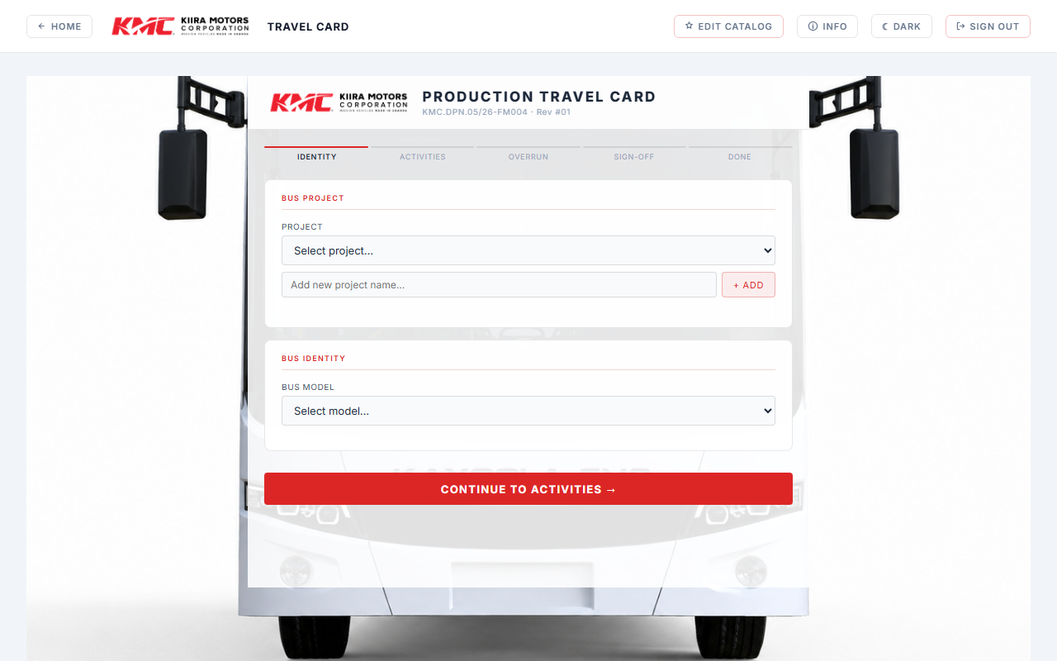
TRAVEL CARD
Production Travel Card
Guided multi-step form for submitting station data, clock-in/out, and overrun capture
5-Step Workflow
1
Identity
Select project, bus model & VIN
2
Activities
Log tasks, resources & clock-in
3
Overrun
Capture delays with root cause
4
Sign-Off
Station completion confirmation
5
Done
Submit to Google Sheets via Apps Script

Slide 7
Export & Sharing
Multiple formats to share production data with stakeholders
Excel Workbook
PDF Report
Slide PDF
Full bus data and station records in .xlsx
Formatted multi-page production status report
Slide-format summary ready for presentation
PNG Export
Email Report
Travel Card PDF
Quick image snapshot of current view
Scheduled or on-demand email to recipients
Printable PDF of the per-bus travel card

Slide 8
Roles & Administration
Two access tiers — everyone can submit data; admins manage the catalog
USER
ADMIN
Submit Travel Card data for any station
All User capabilities, plus:
View Live Line Tracker & bus positions
Edit Catalog (projects, lines, stations, activities, resources)
Browse Bus Reports & Dashboard
Adjust clock-out times on Travel Cards
Filtered views by model, project, line
Archive or deprecate catalog entries
Export reports to PDF / Excel / PNG
Manage shared Google Sheets data source

Slide 9
Built for
the factory floor.
Real-time bus positions across 9 production lines
Per-bus station timing, delays and progress tracking
Guided travel card data entry with overrun capture
Dashboard KPIs and exportable reports
Role-based access with admin catalog management
KIIRA MOTORS CORPORATION · MISSION VEHICLES MADE IN UGANDA

