Slide 1
CS-454 Computer Graphics
Lecture 5 & 6

Slide 2
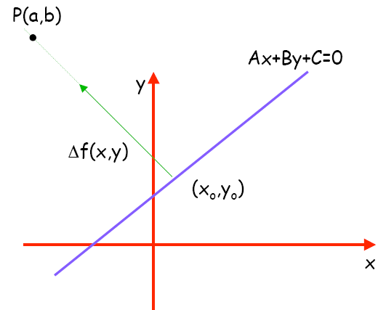
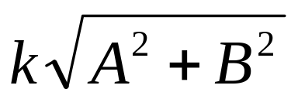
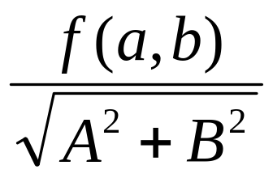
Signed Distance from a Point to a Line
The distance from a point
to a line is the length of the
vector k(A, B), which is:
For the point (x, y) + k(A, B),
the value of f(x,y) = Ax + By + c is
f(x+kA, x+kB) = k(A² + B²)
Signed distance from line Ax + By + C = 0 to point (a,b) is:
  distance =

Slide 3
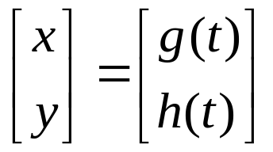
2D Parametric Curves
A parametric form of the curve is controlled by a single parameter and suggests the movement of a point through time
The parameter is the value t (time) and is used to distinguish one point on the curve from another.
Such curves have the form:

Slide 4
2D Parametric Curves
Here (x,y) is the point on the curve and t is the parameter that influences the curve
As t continuously changes, points are swept out in a continuous curve which is a nice feature because we can explicitly construct points on the curve using t.

Slide 5
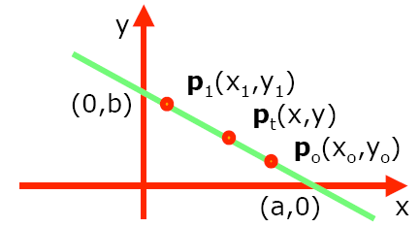
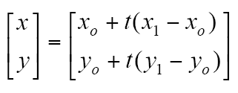
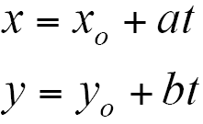
2D Parametric Lines
Parametric form of line equations:
p(t)=po+t(p1-po)
Parametric lines can also be described as just a point and a vector:
p(t) = o + t(d)

Slide 6
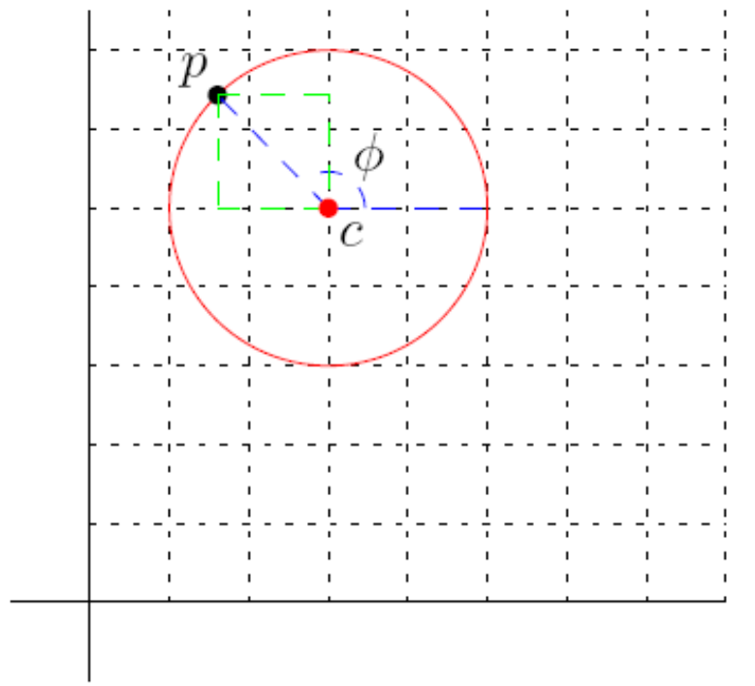
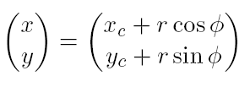
2D Parametric Circles
The parametric equation
of a 2D circle with center
c and radius r is

Slide 7
3D Parametric Curves
A 3D parametric curve operates much like a 2D parametric curve
x = f(t)
y = g(t)
z = h(t)
For example a spiral around z axis is
x = cos t
y = sin t
z = t

Slide 8
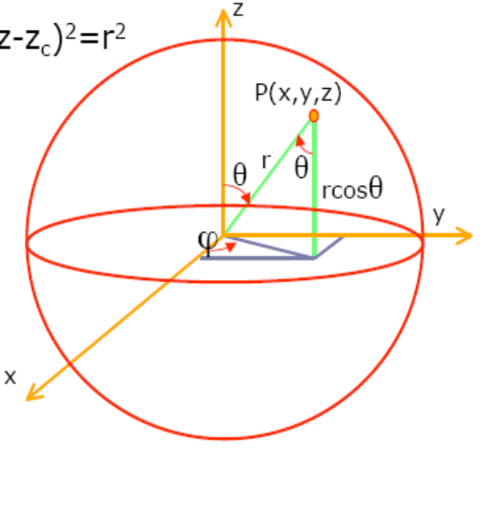
3D Parametric Surface
Sphere: The set of all points in three-dimensional Euclidean space that are located at a fixed distance from a given point.
(x-x_{c})²+(y-y_{c})²+(z-z_{c})²=r²
z=rcosθ
x=rsinθcosφ
y=rsinθsinφ

Slide 9
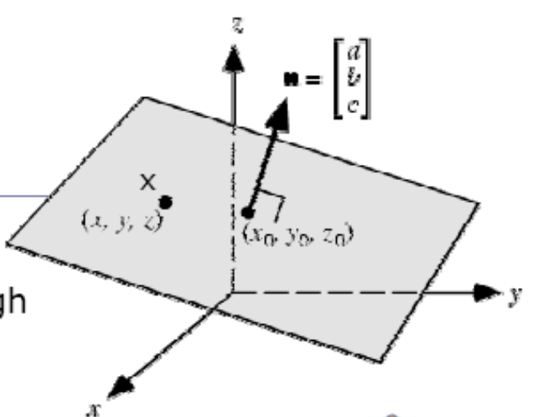
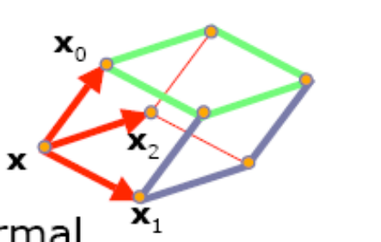
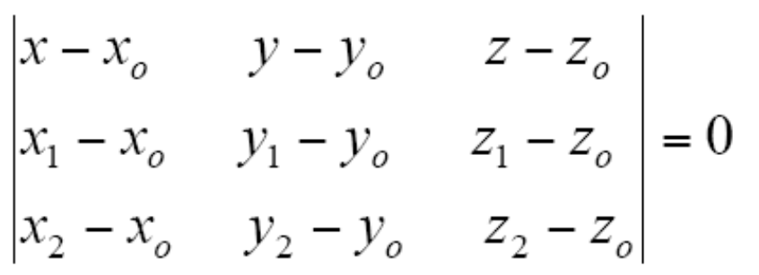
Equation of the Plane
Equation of a plane with non
zero normal vector n through
(xo,yo,zo) is given by:
(x-xo).n=0
General form of plane
equation: ax+by+cz+d=0 where
d=-ax_{o}-by_{o}-cz_{o}
For three points xo, x1, x2 plane
normal can be defined: n=(x1-xo)x(x2-xo)
Implicit plane equation:
(x-xo).((x1-xo)x(x2-xo))=0

Slide 10
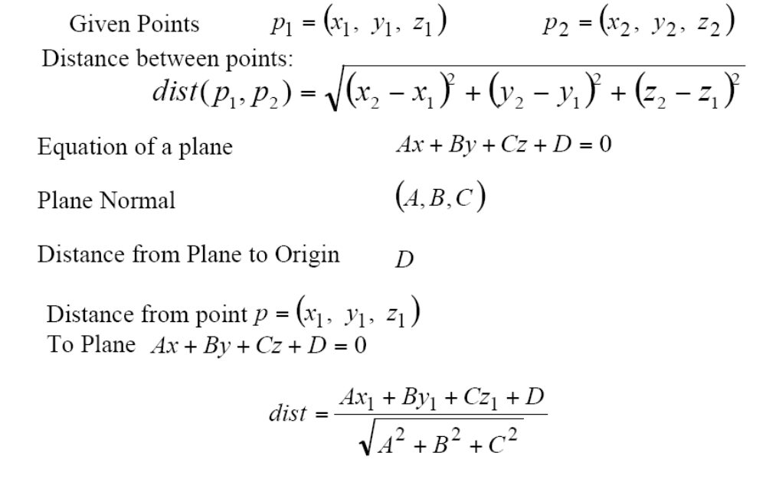
Points and Planes

Slide 11
Triangles
Fundamental modeling primitive in most graphics program.
Often information (e.g. color) is tagged onto triangle vertices, and this information is then interpolated across triangle.
The coordinate system that makes such interpolation straightforward is called barycentric coordinates.

Slide 12
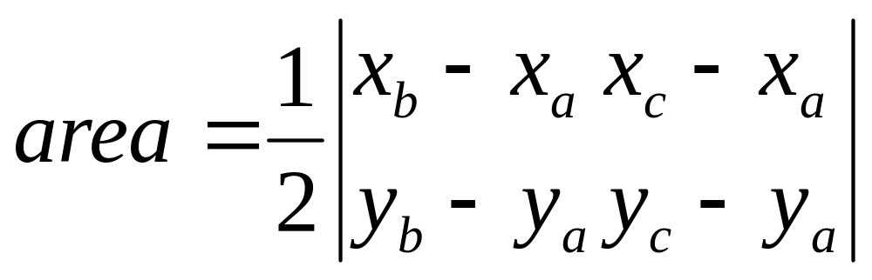
2D Triangles
If we have 2D triangle defined by 2D points a, b, and c, we can first find its area.
area = (x_{a}y_{b} + x_{b}y_{c} + x_{c}y_{a} – x_{a}y_{c} – x_{b}y_{a} – x_{c}y_{b})

Slide 13

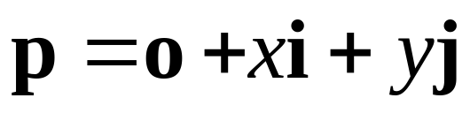



Basis Vectors and Origins
coordinate system: just basis vectors
  can only specify offset: vectors
coordinate frame: basis vectors and origin
  can specify location as well as offset: points

Slide 14
Working with Frames
F₁
F₁

Slide 15
Working with Frames
F₁
F₁
p = (3,-1)

Slide 16
Working with Frames
F₁
F₂
F₁
p = (3,-1)
F₂

Slide 17
Working with Frames
F₁
F₂
F₁
p = (3,-1)
F₂
p = (-1.5,2)

Slide 18
Working with Frames
F₁
F₂
F₁
p = (3,-1)
F₂
p = (-1.5,2)
F₃
F₃

Slide 19
Working with Frames
F₁
F₂
F₁
p = (3,-1)
F₂
p = (-1.5,2)
F₃
F₃
p = (1,2)

Slide 20
More: Working with Frames
F₁
F₁
F₂
F₁
p = (3,-1)
F₂
p = (-1.5,2)
F₃
F₃
p = (1,2)

Slide 21
More: Working with Frames
F₂
F₁
F₂
F₁
p = (3,-1)
F₂
p = (-1.5,2)
F₃
F₃
p = (1,2)

Slide 22
More: Working with Frames
F₃
F₁
F₂
F₁
p = (3,-1)
F₂
p = (-1.5,2)
F₃
F₃
p = (1,2)

Slide 23
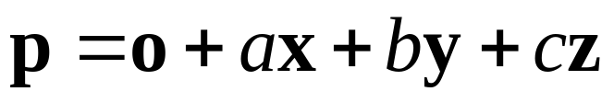
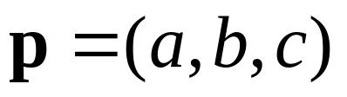
Named Coordinate Frames
origin and basis vectors
pick canonical frame of reference
  then don’t have to store origin, basis vectors
  just
  convention: Cartesian orthonormal one on previous slide
handy to specify others as needed
  really common ones given names in CG
    object, world, camera, screen, ...

Slide 24
Barycentric Coordinates
Often in graphics we wish to assign a property such as color at each triangle vertex and smoothly interpolate the value of that property across the triangle.
There are a variety of ways to do this, but the simplest is to use barycentric coordinates.
One way to think of barycentric coordinates is as a non-orthogonal coordinate system.

Slide 25
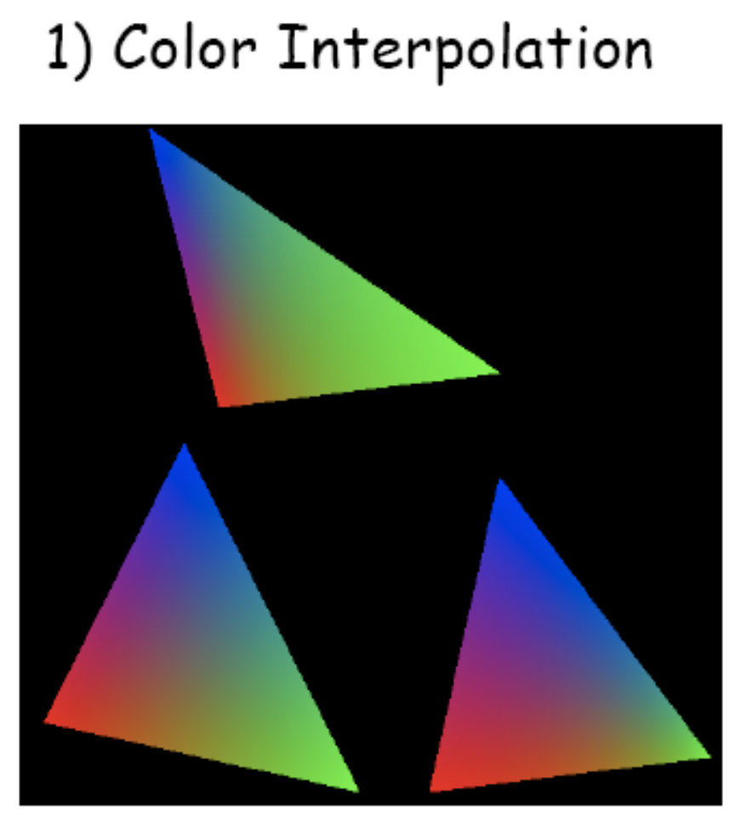
Barycentric Coordinates

Slide 26
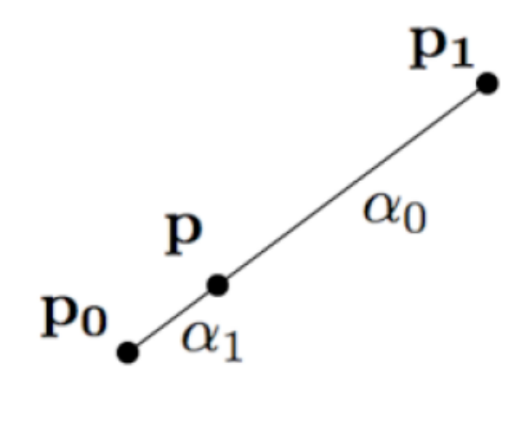
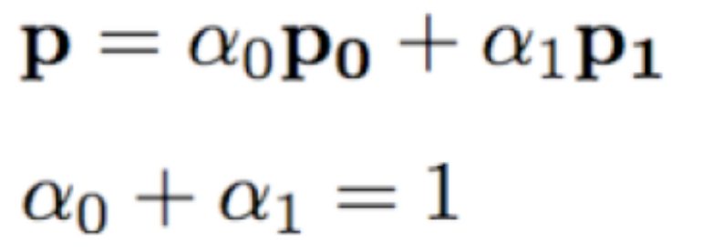
Barycentric Coordinates
Line
Triangle (weighted sum of points)
  Suppose the coordinate origin is at a and vectors from a to b and a to c are basis vectors. With the origin and 2 basis vectors, point p can be written as: p = a + β(b-a) + γ(c-a)
  or p = (1- β – γ)a + βb + γc
  α = (1- β – γ)

Slide 27
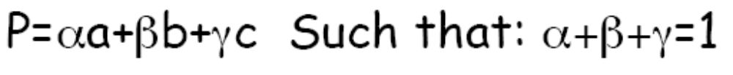


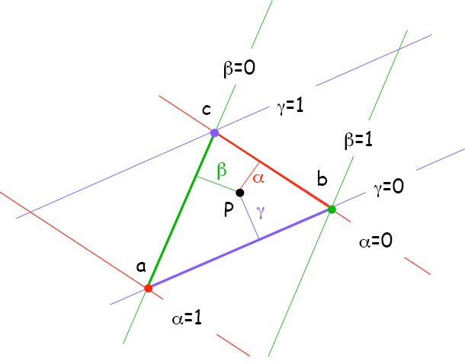
Barycentric Coordinates
Smooth mixing of color of three vertices
Inside abc:
On an edge of abc:
  One parameter is zero
On a vertex of abc:
  Two parameters are zero

Slide 28
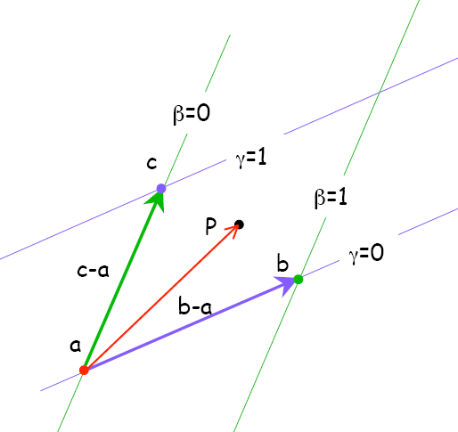
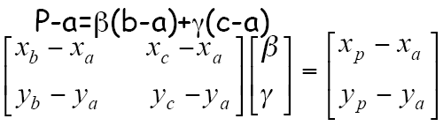
Computing Barycentric Coordinates
Given a point p, how do we compute barycentric coordinates? → various methods
p = a + β(b-a) + γ(c-a)

Slide 29
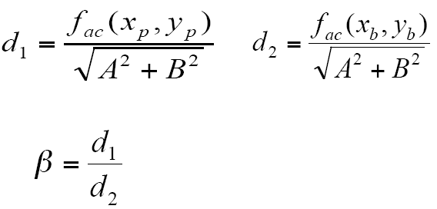
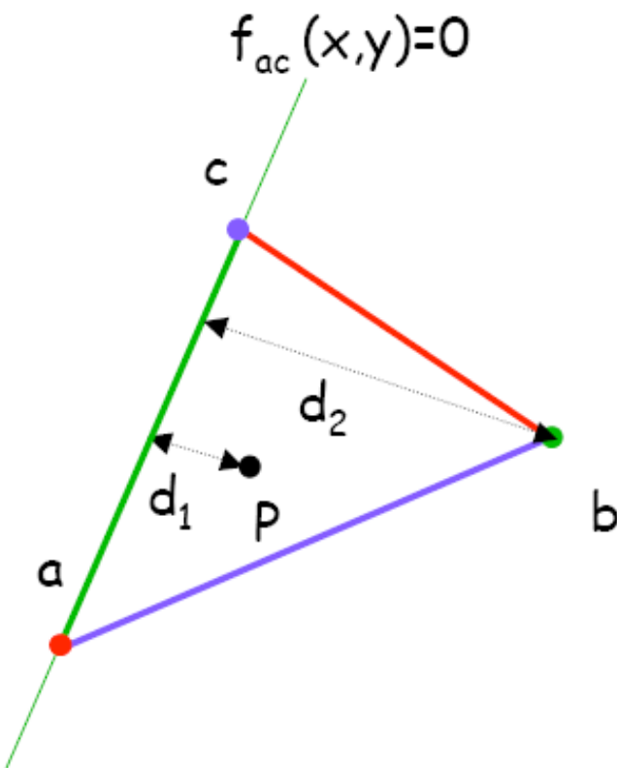
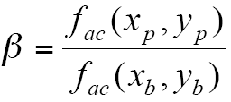
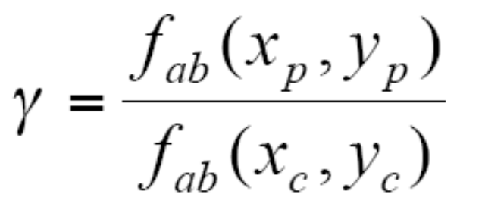
Computing Barycentric Coordinates
Method 2:
  Barycentric coordinates are signed scaled distance from the lines through the triangle sides

Slide 30
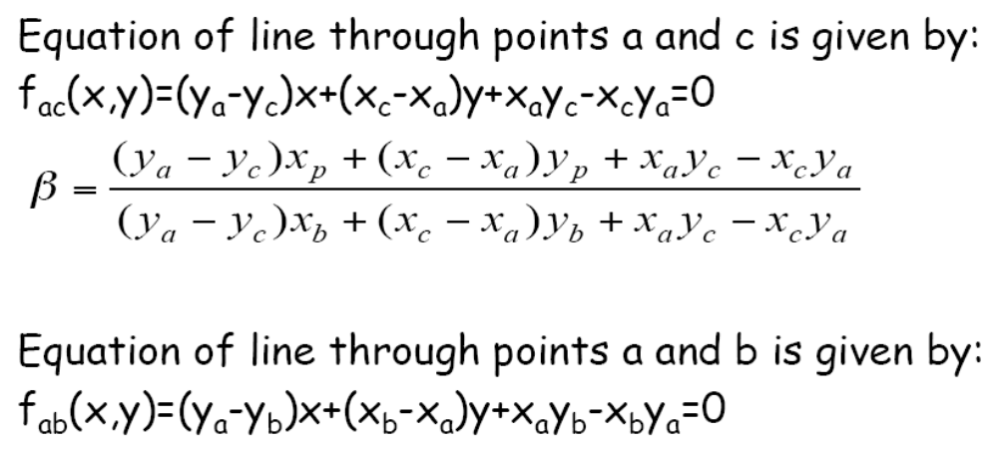
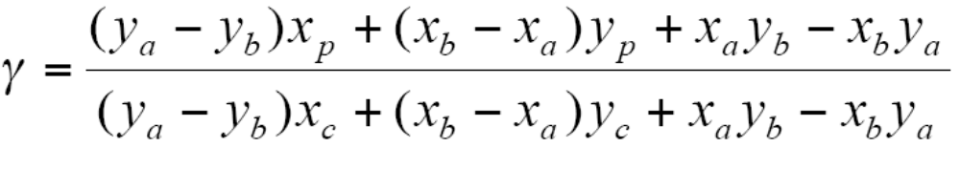
Computing Barycentric Coordinates

Slide 31
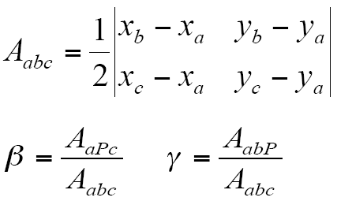
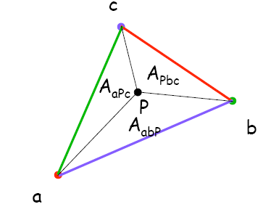
Computing Barycentric Coordinates
Triangle areas can be positive
or negative depending upon
the order of vertices traversal:
A_{abc}=-A_{acb} because:
(b-a)x(c-a)=-(c-a)x(b-a)

Slide 32
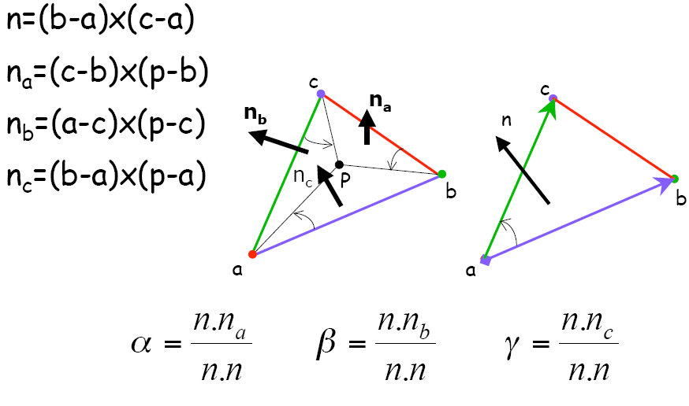
Barycentric Coordinates for 3D Triangles

Slide 33
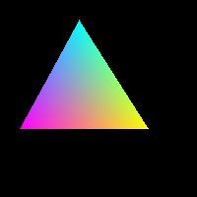
Assignment 2
Barycentric Coordinates
100 x 100 image
Black background
Vertices:
  a [80 20] red
  b [80 80] green
  c [20 50] blue

Slide 34
Assignment 2
Barycentric Coordinates
For each pixel,
  Compute its Barycentric coordinates with respect to the given triangle
  If inside the triangle, interpolate color values at the vertices to find color at current pixel
  If outside, skip

Slide 35
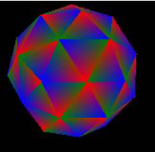
Assignment 2
Barycentric Coordinates
Once you know how to render one triangle…
  You can render multiple triangles on the same image!

Slide 36
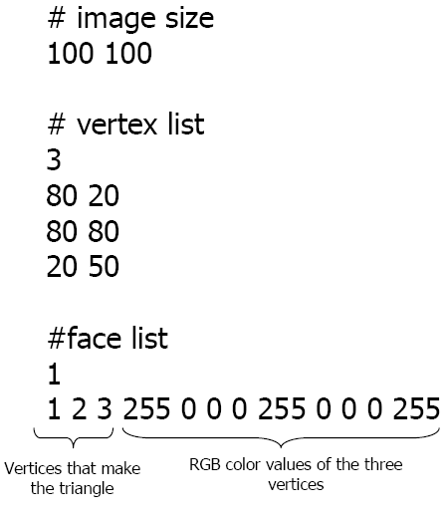
Assignment 2
Barycentric Coordinates
Your program must work in exactly the following format.
Program must accept a .txt file as input. Its format is shown here

Slide 37
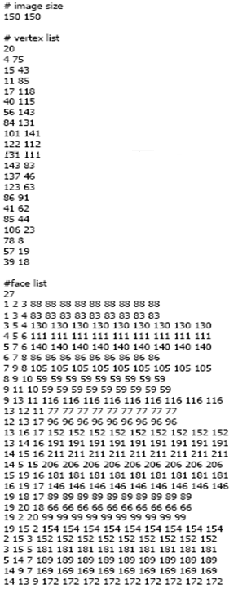
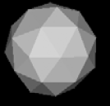
For multiple triangles, the file may be longer

Slide 38
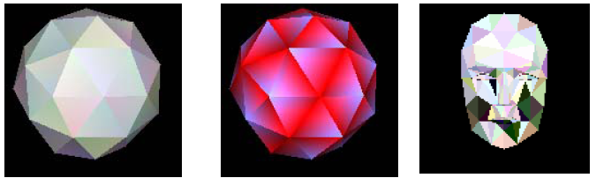
Once you are done, try making your own artwork from triangles

Slide 39
Assignment 2 Deliverables
DUE: Wednesday, 19th March, 11:00 pm
Short report, containing problem definition, description of classes/data structures, methods and steps taken to produce output images along with output images and image of your artwork
Should submit input text file of your artwork.
Code, executable… should take image names at run-time
Will test with unseen data

