Slide 1
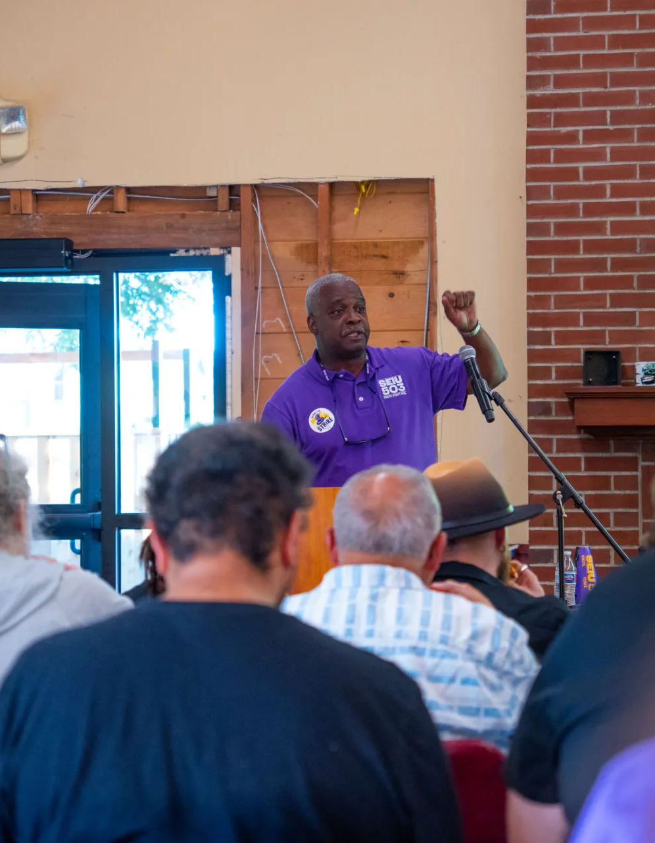

SEIU LOCAL 503 · LOCAL 083
Our strike.
Our questions.
Thursday, Sept. 17, 2026
Noon · MU 211 and Zoom
Strike authorization, pay and what comes next.
Then, time for your questions.
Notes:
WELCOME / about 1 minute
Welcome everyone in MU 211 and on Zoom. Thank members who came to strike school and took part in the authorization vote. Open with: “Today is about what this next step means for us and our households. We will keep the briefing short and make room for your questions.”
Suggested use of the hour: about 15 minutes for this briefing, 35 minutes for questions and five minutes to confirm follow-up and next steps. Leave a little room for the meeting to get started. Ask someone to watch the Zoom chat and someone else to keep a list of questions that need a researched answer. Invite people to ask privately about individual circumstances rather than share personal financial or medical information in the room.
The meeting organizer reports that our bargaining team has authorized a strike, that the declaration is today, Sept. 17, and that the planned start is Sept. 28. Use the latest direct bargaining-team communication if the situation changes during the meeting. Do not add a vote percentage or say formal notice has been served without the actual announcement.
Meeting details: /home/codex/Projects/seiu-website/events/2026-09-17-OSU-Member-Meeting.html
Photo: OSU strike school, Sept. 9, 2026. Repository asset: /home/codex/Projects/seiu-website/images/26c63802-e603-4192-a954-4f5494e9d918-osu-strike-school-2026-09-09-edit-57.webp

Slide 2
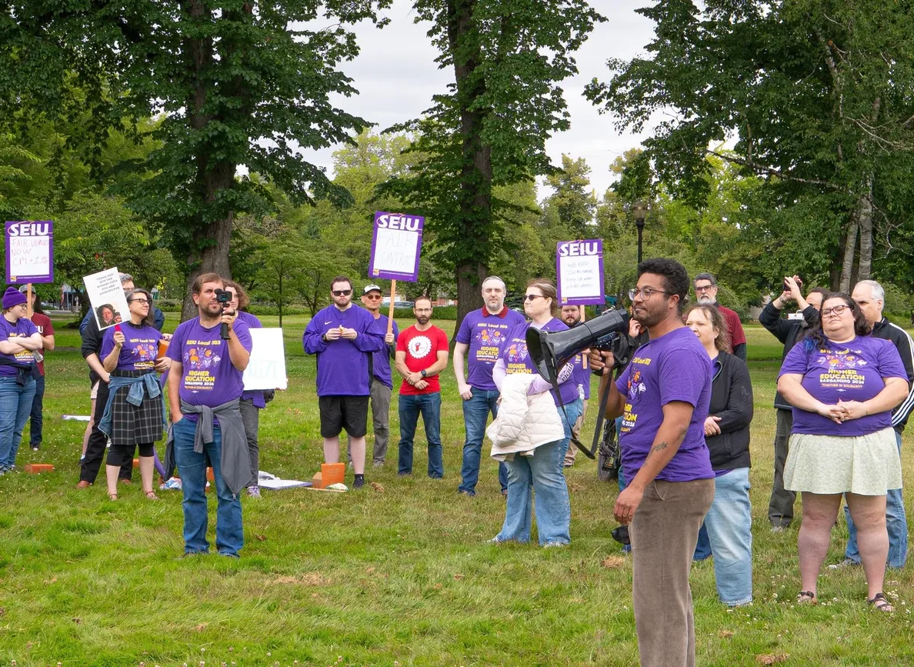
The vote gives our bargaining team authority
Our vote
Members authorize our team to call a strike.
Our bargaining team has authorized a strike. Today: strike declaration.
Planned start: Monday, Sept. 28. Our goal remains a fair contract.
Damien Manassa at McNary Field, June 30. Photo: Sylv Sharp.
STRIKE AUTHORIZATION
02
Notes:
AUTHORIZATION / about 2 minutes
Thank everyone who voted. SEIU 503’s Higher Ed FAQ explains that the authorization vote empowers our bargaining team to call a strike. A pledge, authorization vote and strike start are different steps. The Sept. 14–15 voting schedule came from our statewide bargaining update. The meeting organizer provides today’s update that our team has authorized a strike and is declaring it today, with Sept. 28 as the planned start.
Make the practical point calmly: members should follow the actual start instructions and updates from our bargaining team. Do not infer a walkout time from the meeting date. We are preparing together while seeking an agreement. If asked for the vote count or percentage, have the bargaining delegate give the confirmed result, or record the question for follow-up. No number is available in these sources.
The photo shows OSU bargaining delegate Damien Manassa speaking at our June 30 McNary Field rally. Use it to connect our preparation to the work members have already done. Invite Damien to explain today’s decision if he is present, without assuming he has agreed to speak.
Sources: https://seiu503.org/member_news/seiu-503-higher-ed-strike-pledge-frequently-asked-questions/
https://seiu503.org/get-involved/bargaining/higher-ed-bargaining-2026/
Today’s declaration and Sept. 28 plan: meeting organizer’s Sept. 17 briefing.
Photo and caption: https://www.local083.org/news/2026-07-01-mcnary-field-rally-recap.html

Slide 3
Our strike timeline
Cooling-off ended Sept. 13. Authorization voting took place Sept. 14–15.
Strike declaration
Solidarity in Marion County
Planned strike start
Our team declares a strike today. Follow the formal notice and start instructions.
Picketing begins Tuesday. Join a supporter shift if you can.
Prepare for Sept. 28 unless our bargaining team announces a change.
TODAY · SEPT. 17
TUESDAY · SEPT. 22
MONDAY · SEPT. 28
BARGAINING CONTINUES
03
Notes:
TIMELINE / about 2 minutes
Walk through the dates once, then leave this slide up for a moment so members can note them. USSE lists Sept. 13 as the end of cooling-off and requires 10-day strike notice. Our union scheduled authorization voting for Sept. 14–15. Today’s declaration and the Sept. 28 plan come from the meeting organizer’s current briefing. Formal service of notice is a separate fact: do not claim a filing date or precise walkout time unless our bargaining team confirms it.
Sept. 22 is Marion County’s picket start, not OSU’s strike start. We will show the supporter signup later. For OSU, plan around Monday, Sept. 28 and keep checking our union’s updates. USSE says negotiations continue after impasse. Preparation and continued bargaining can happen at the same time.
Facilitation: ask members whether these dates create practical needs around transportation, family care or communicating with coworkers. Record the needs so organizers can help plan. Avoid predicting a strike length. If asked whether a settlement could change the plan, direct members to the bargaining team’s next announcement rather than making a promise about timing.
Sources: https://usse-oregon.org/opu-seiu-negotiations/faq/
https://seiu503.org/get-involved/bargaining/higher-ed-bargaining-2026/
https://seiu503.org/stand-with-marion-county-workers/
Sept. 17 and Sept. 28: meeting organizer’s current briefing.

Slide 4
Strike pay: $80 a day, up to $400 a week
For workers who are striking and show up at a picket line.
$80
$400
Check in
Per day
Weekly maximum
At the picket line
Strike benefit for eligible participation.
Five eligible days reach the weekly cap.
Confirm eligibility and payment instructions with our union.
Source: Sept. 13 approval, reported by Local 083 on Sept. 15, 2026
STRIKE BENEFITS
04
Notes:
STRIKE BENEFITS / about 2 minutes
Lead with the answer members are waiting for: $80 per day, capped at $400 per week, for workers who strike and show up at a picket line. These are the amounts our Local 083 Sept. 15 report attributes to the Board and Hardship Committee’s Sept. 13 approval. The rate is a strike benefit, not a promise to replace a member’s entire paycheck.
A simple arithmetic example, subject to eligibility, is three eligible days at $80 equals $240. Five eligible days equals the $400 weekly cap. More days do not increase that published weekly maximum. Keep the example short and pause for immediate clarification.
Ask members to confirm their eligibility, membership record, attendance documentation and payment instructions with our organizer or strike captain. The published approval does not specify required hours per day, an application link, a payment method or the payment schedule. Do not guess at those details or promise that money arrives on the first day. Make sure anyone who needs an accessible participation arrangement has a private way to ask about it.
If someone remembers a different rule from an older strike, return to the current approval and ask our organizer to clarify the current process. Do not carry forward historical waiting-period rules without confirmation.
Source: https://www.local083.org/news/2026-09-15-strike-benefits-update.html

Slide 5
ADDITIONAL HELP WITH BILLS
Up to $1,000
Initial hardship assistance, capped at missed pay
For active strikers facing financial hardship
Submit a bill for support through our union’s process
Separate from the $80 daily strike benefit
SEIU LOCAL 503 · LOCAL 083
Notes:
HARDSHIP SUPPORT / about 90 seconds
Explain the distinction: daily strike benefits and hardship assistance are separate forms of support. Our Board is seeding a $500,000 hardship fund shared by striking workers in Higher Education and Marion County. The initial individual limit is up to $1,000, and assistance cannot exceed missed pay. Members requesting this help must have been active strikers and will be able to submit a bill for support.
Do not describe $1,000 as an automatic payment or an amount everyone receives. Do not add it to the weekly stipend and promise a total household payment. The approval establishes limits and a purpose, while the application and decision process still require current instructions.
Invite members who expect trouble with bills to speak privately with our organizer early. No one should have to describe debt, medical needs or family circumstances at the microphone to be heard. Offer to record a preferred personal contact method and arrange a follow-up conversation. If the organizer has the current application process, let them describe it. Otherwise, collect the question and identify who will obtain the answer.
This is also a good moment to ask for practical support ideas without committing our local to a program or payment that has not been approved.
Source: https://www.local083.org/news/2026-09-15-strike-benefits-update.html

Slide 6
Quick FAQ: participation and protection
USSE is management’s source. SEIU 503 is our union’s source.
Who can strike?
What about retaliation?
USSE includes SEIU bargaining-unit workers, including trial-service staff.
SEIU 503 says retaliation for protected union activity is unlawful. Report it promptly.
What can we do on a line?
What if I need support?
Picket, carry signs and leaflet. Keep entrances and traffic clear.
Talk privately with our organizer about access needs or your individual situation.
Follow our bargaining team’s instructions and stay connected with coworkers.
HIGHER ED FAQ
06
Notes:
PARTICIPATION FAQ / about 2 minutes
Read the short answers, then invite members to save individual situations for the question period or a private conversation. These are attributed summaries, not a claim that management and our union have jointly issued guidance. Keep the source distinction visible when answering follow-up questions.
USSE’s eligibility statement applies to a lawful strike. Check representation if a member is unsure about their status. Our union’s FAQ directs workers facing retaliation to a steward or organizer. Ask for the date, exact words and any written message, rather than speculating about an incident in front of the group.
For practical questions about the line, ask the strike captain to explain the local arrangements. Invite concerns about standing for long periods, transportation, caregiving or communication access without requiring anyone to disclose a diagnosis. Do not promise an alternative assignment qualifies for strike benefits until the responsible organizer confirms it.
Suggested facilitation prompt: “What would help you participate and stay connected with your coworkers?” Write down the answer in the member’s own words. If the question needs an individual response, make a clear handoff instead of letting it disappear into the general discussion.
Sources: https://usse-oregon.org/opu-seiu-negotiations/faq/
https://seiu503.org/member_news/seiu-503-higher-ed-strike-pledge-frequently-asked-questions/

Slide 7
Quick FAQ: leave, insurance and income
A few answers are published. Individual benefit questions need follow-up.
Can I use paid leave?
Unemployment benefits?
USSE restricts paid leave during a strike. Check your situation before relying on it.
USSE says lawful strikers may file. Filing does not guarantee payment.
What about health insurance?
When does strike pay arrive?
Ask our organizer and OSU Benefits about your coverage and premium requirements.
Confirm the current payment schedule and application steps with our union.
Bring your questions. We will record anything that needs a confirmed answer.
MONEY AND BENEFITS FAQ
07
Notes:
MONEY AND BENEFITS FAQ / about 2 minutes
Acknowledge that members need dependable answers for household planning. Read the slide without turning general guidance into a promise about someone’s specific situation.
USSE says sick and vacation leave do not accrue while striking, and restricts paid sick, personal and comp time. An already-started approved vacation is a distinct case. Refer individual cases for confirmation. For unemployment, the Oregon Employment Department determines eligibility and payment. Do not quote a waiting period, amount or payment date here.
For insurance, offer to help members obtain a written answer about their own coverage. Record questions about premiums, any work or pay threshold, and dependents. For strike pay, ask the organizer to explain the current administrative instructions if available. If there is no confirmed answer, say: “That matters. We are recording it and will get the current answer to you.”
Ask the note-taker to keep unresolved questions separate from confirmed answers. Give each question a person responsible for follow-up and agree with that person on a realistic response time. Do not ask members to put sensitive information into a public Zoom chat.
Sources: https://usse-oregon.org/opu-seiu-negotiations/faq/
Current strike benefit approval: https://www.local083.org/news/2026-09-15-strike-benefits-update.html
Coverage and payment-process questions on this slide are follow-up prompts, not statements of new policy.

Slide 8
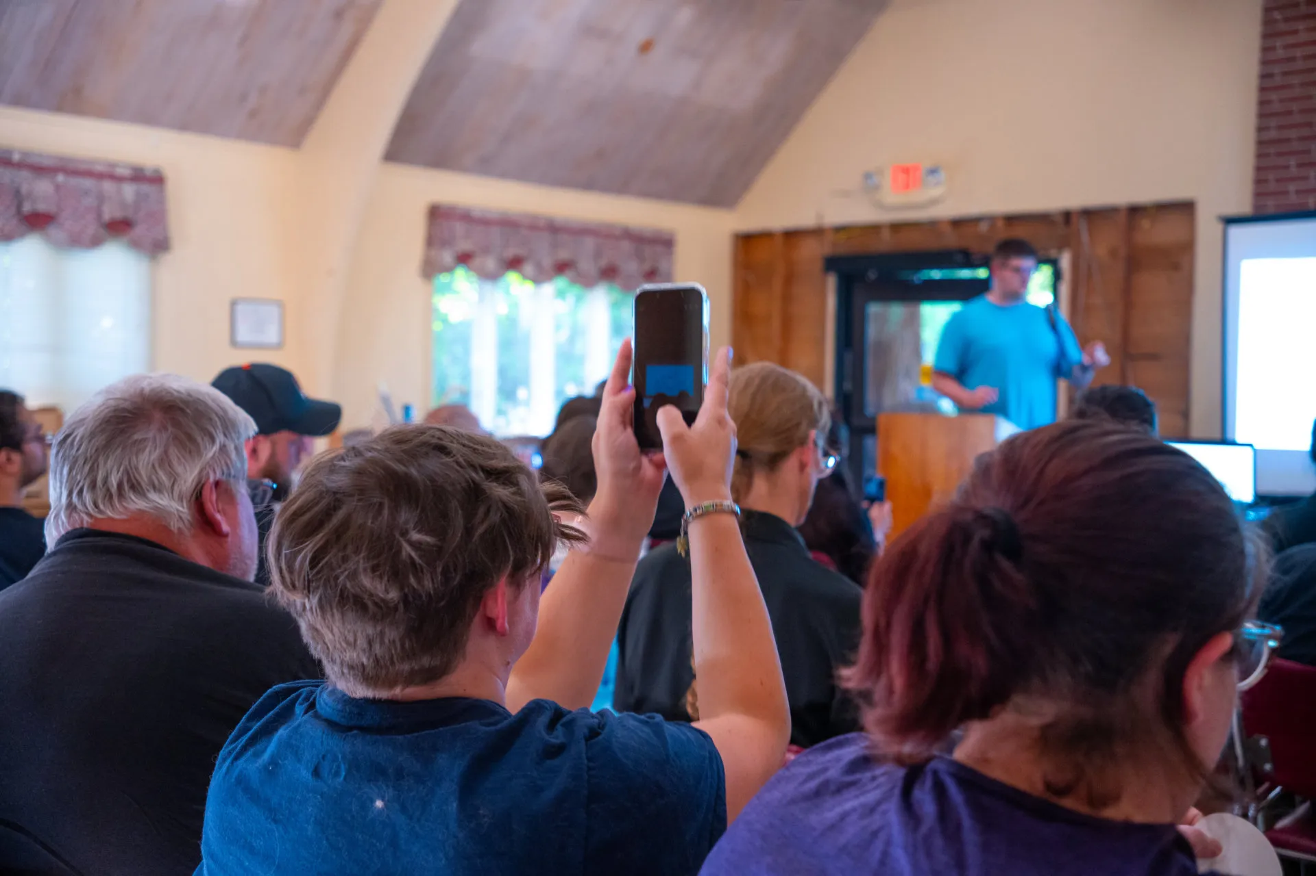
We prepare together
Before
Sept. 28
Our next steps at OSU
Confirm your personal contact information and watch our union’s updates.
Plan your picket participation. Raise support needs with our organizer early.
OSU strike school, Sept. 9, 2026. Local 083 photo archive.
STRIKE PREPARATION
08
Notes:
PREPARATION / about 90 seconds
Use this slide to turn the briefing into a manageable next step. Ask members to check that they can receive union updates through a personal email or phone, and to help a coworker who has missed the recent information. Encourage people to use our union’s official updates when passing information along.
The photograph shows participants at our Sept. 9 strike school. Connect preparation to members’ existing work: “We have been making time to learn together. Now we need to make sure every coworker knows where to get an answer.” Do not imply the people in this photo have committed to a particular role or shift.
Ask members to think through how they will get to the line, what support they may need and how they will stay in touch. Current campus-specific shifts, locations, attendance rules and any accessible assignments should come from our organizer or strike captain. Ask the organizer to explain what is available now and how remaining details will be communicated.
If members offer to help coworkers with rides or other practical needs, collect those offers without publishing anyone’s contact details or committing them to a schedule. End with one concrete request: have a conversation with a coworker and help them bring their unanswered question to our union.
Photo: /home/codex/Projects/seiu-website/images/ff6366fa-b741-4b81-9229-cb9d5e1e269b-osu-strike-school-2026-09-09-edit-21.webp
Context: https://www.local083.org/news/2026-09-16-bargaining-update.html
Strike start plan: meeting organizer’s Sept. 17 briefing.

Slide 9
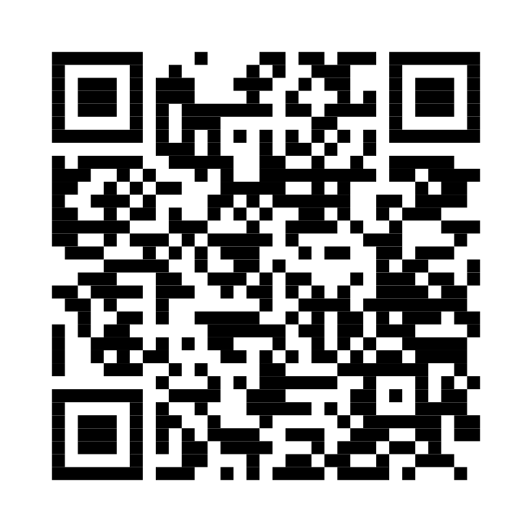
SOLIDARITY WITH MARION COUNTY
Tuesday, Sept. 22
Picketing begins. We can show up for our coworkers.
Choose a supporter shift through SEIU 503.
Wear purple. Invite a coworker to come with you.
Scan for the official signup and current details.
seiu503.org/stand-with-marion-county-workers
SEIU LOCAL 503 · LOCAL 083
Notes:
MARION COUNTY SOLIDARITY / about 90 seconds
Invite members to support Marion County workers on Tuesday, Sept. 22, when picketing is scheduled to begin. Our union’s supporter page invites allies to join the line. The QR code goes to that official page, which links to a supporter signup. This is the supporter route, distinct from the internal Marion County worker shift form.
Ask members who can attend to choose a shift through the official signup and check the current location and time there. Do not use the Sept. 16 strike-school address as a picket location. We have no verified local carpool departure or single gathering time to announce. Members can discuss ride-sharing after the meeting, but should confirm arrangements directly.
Make the invitation concrete: wear purple, ask a coworker to join you and share the supporter link. Attend outside your scheduled work time or arrange appropriate approved time away. Marion County’s action begins before our planned Higher Ed start, so do not confuse this solidarity invitation with an instruction to leave OSU work on Sept. 22.
Pause long enough for people to scan. Ask the Zoom host to paste the official supporter page into chat. For anyone who cannot scan, the page address is also printed on the slide and linked from the deck.
Official supporter page: https://seiu503.org/stand-with-marion-county-workers/
Supporter signup linked there: https://forms.cloud.microsoft/pages/responsepage.aspx?id=MZMXYTkvsU-7KsfN-dhFUqdQP5Z9ZH5Hmrz7I6iBL9hUQ0dSSUlMNEwxOElWMzZNTzlSRkhTNVYyUC4u&route=shorturl
Start date corroboration: https://seiu503.org/member_news/%F0%9F%AA%A7picket-line-signup/

Slide 10
MEMBER QUESTIONS
What do you need
to know?
Pay, benefits, picket plans or your own situation.
Ask in the room or in the Zoom chat.
Private questions deserve a private conversation.
Follow-up: 083execteam@seiu503.org
SEIU LOCAL 503 · LOCAL 083
Notes:
OPEN Q&A / protect at least 30–35 minutes
Leave this slide on screen. Start with: “What is your biggest unanswered question about going on strike?” Give people a moment to think. Alternate between the room and Zoom so remote members get equal access. Let people finish and repeat the question into the microphone before answering.
Suggested order if several hands go up: household income and strike pay first, then participation and picket logistics, then bargaining process and timing. Invite our bargaining delegate or organizer to answer within their role. Avoid making a member explain a private financial, medical or employment situation to the entire meeting.
Use a simple response pattern: give the answer we can support, name the relevant source, and distinguish anything still unresolved. If the answer is not available, record the question, identify who will get it and agree on how to report back. Do not fill silence with an estimate about strike length, payment timing, insurance or an individual legal situation.
For a report of possible retaliation, thank the member and connect them privately with a steward or organizer. For a request for hardship assistance, offer a private follow-up. For questions about Sept. 28, use the latest direct bargaining-team instructions.
Close by reading back the outstanding questions and follow-up owners. Remind members of the Marion County supporter invitation for Sept. 22, the planned Higher Ed start Sept. 28 and the importance of checking our union’s updates. Ask everyone to help one coworker get the information they need.
Contact from Local 083’s retained presentation template: 083execteam@seiu503.org. Sources for answers appear in the preceding slides’ notes.

