Slide 1


SOVEREIGN TECHNOLOGY FOR INDIA
IDEAS FOR INDIA 2026 · FINAL ROUND
अंतरिक्ष रक्षा
ANTARIKSHA- RAKSHA
Space Domain Awareness & Conjunction Assessment Decision Support
PHYSICS FIRST
AI SECOND
HUMAN DECISION LAST
FUNCTIONAL PROTOTYPE
Notes:
A. WHAT IS SHOWN
Title: ANTARIKSHA-RAKSHA, a Space Domain Awareness and conjunction-assessment decision-support prototype; Physics first / AI second / Human decision last.
B. WHAT TO SAY (narration)
Imagine two objects crossing the same orbital highway. It looks dangerous — but crossing paths alone does not mean a collision. The real question is whether they arrive at the same place at the same time. ANTARIKSHA-RAKSHA is built around answering that question — with physics first, AI second, and a human making the final decision.
C. JURY TAKEAWAY
A defence-relevant Space Domain Awareness (SDA) and conjunction-assessment decision-support prototype, built on one principle: physics first, AI second, human decision last.
D. CAVEAT
Research/demo decision-support prototype; the hosted deployment is a jury validation environment, not an operational service.

Slide 2

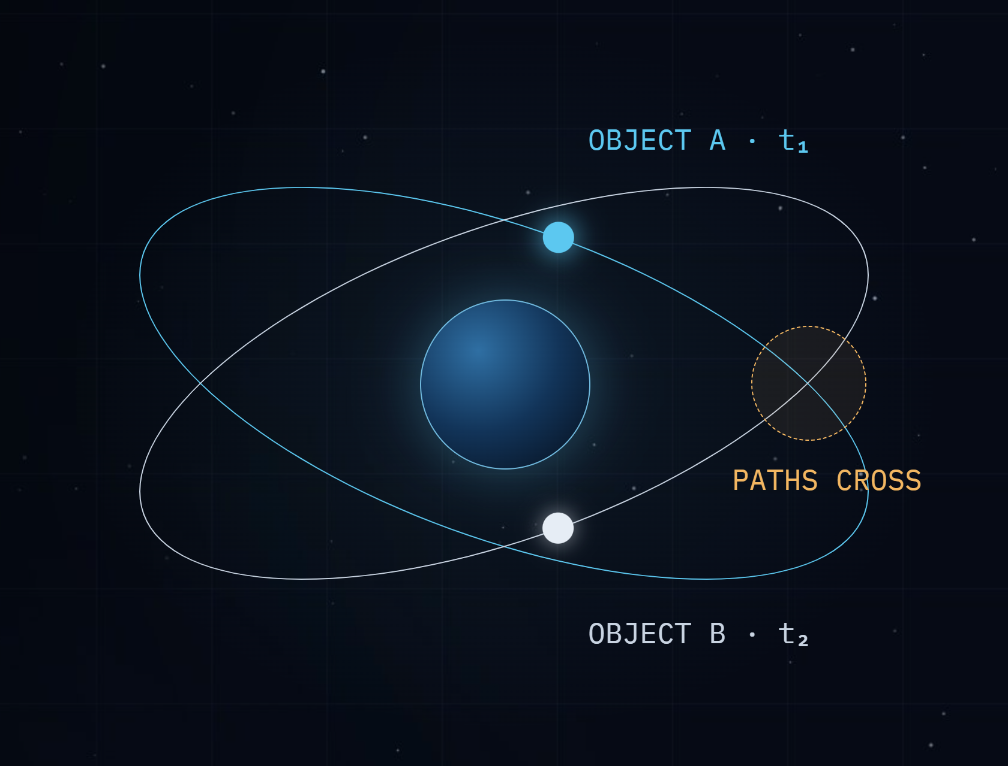
02
THE THOUGHT EXPERIMENT
PROBLEM
SOLUTION
PROTOTYPE
VALUE
If two orbital paths cross, do the objects collide?
Orbit is a 3D highway with no visible lanes.
—
Satellites and debris move at several km/s.
—
Crossing paths alone do not mean collision.
t₁ ≠ t₂
Different time → safe pass
t₁ ≈ t₂
Same place + same time → conjunction
ANTARIKSHA-RAKSHA · IDEAS FOR INDIA 2026
02 / 15
Notes:
A. WHAT IS SHOWN
Thought experiment: two crossing orbits; different time means a safe pass, same place and same time means a conjunction.
B. WHAT TO SAY (narration)
Orbit is a three-dimensional highway with no visible lanes. Satellites and debris move at several kilometres per second, and their paths cross all the time. Crossing paths alone is not a collision. If the two objects reach the crossing at different times, they pass safely. Only when they arrive at the same place at about the same time do we have a conjunction — and that is what must be predicted, measured and explained.
C. JURY TAKEAWAY
The core problem is timing in three dimensions, not just intersecting paths.
D. CAVEAT
The orbit illustration is schematic and not to scale.

Slide 3
03
THE PROBLEM
PROBLEM
SOLUTION
PROTOTYPE
VALUE
Why is tracking alone not enough?
01
More objects, busier orbits
The challenge is turning changing orbital information into a prioritised, explainable and auditable workflow.
Satellites and debris share active regimes
02
Information keeps changing
Every update can shift a prediction
03
Analysts need focus
SPACE IS BECOMING INCREASINGLY ACTIVE
Priority, reasons and a record
ANTARIKSHA-RAKSHA · IDEAS FOR INDIA 2026
03 / 15
Notes:
A. WHAT IS SHOWN
The problem: more objects, changing information, analysts need focus.
B. WHAT TO SAY (narration)
Space is becoming increasingly active. More objects share busy orbital regimes, and every new orbital update can shift a prediction. Tracking objects is necessary, but it is not enough. Analysts need to know which close approaches matter and why, and they need a record of what was decided. The challenge is turning changing orbital information into a prioritised, explainable and auditable workflow.
C. JURY TAKEAWAY
The gap addressed is decision support: prioritisation, explanation and auditability on top of tracking.
D. CAVEAT
No claim is made that existing systems lack these functions; this is a prototype exploring the workflow.

Slide 4
04
WHY INDIA, WHY NOW?
PROBLEM
SOLUTION
PROTOTYPE
VALUE
Why India, why now?
India already has the foundations of Space Situational Awareness. ANTARIKSHA-RAKSHA explores how an explainable, human-gated decision-support layer could help scale the analyst experience as India's space ecosystem and orbital complexity grow.
01
India's space ecosystem is expanding
More missions, more operators, more activity
02
Orbital congestion is increasing
Space-traffic complexity keeps growing
03
Space assets matter more
To development and to national security
COMPLEMENTARY TO NATIONAL SSA · NOT A REPLACEMENT
04
Safe operations need capable support
Explainable, human-gated decision support
ANTARIKSHA-RAKSHA · IDEAS FOR INDIA 2026
04 / 15
Notes:
A. WHAT IS SHOWN
NEW. Why India, why now: four drivers (expanding ecosystem, congestion, importance of space assets, need for capable decision support) and the positioning statement.
B. WHAT TO SAY (narration)
Why India, and why now? India's space ecosystem is expanding, with more missions and more operators. Orbital congestion and space-traffic complexity are increasing, and space assets increasingly matter to both development and national security. India already has the foundations of space situational awareness. ANTARIKSHA-RAKSHA explores how an explainable, human-gated decision-support layer could help scale the analyst experience as India's space ecosystem and orbital complexity grow.
C. JURY TAKEAWAY
India already has national SSA capabilities. This prototype explores a complementary decision-support layer.
D. CAVEAT
Not a replacement for, and not integrated with, ISRO, IS4OM, NETRA or DRDO systems. Official context for the speaker: ISRO Indian Space Situational Assessment Reports (https://www.isro.gov.in/Indian_Space_Situational_Awareness_Report_2025.html ; https://www.isro.gov.in/ISSAR_2024.html ; https://www.isro.gov.in/Indian_Space_Situational_Assessment_Report_ISSAR2023.html), Indian Space Policy 2023 (https://new1.isro.gov.in/media_isro/pdf/IndianSpacePolicy2023.pdf) and Debris-Free Space Missions (https://new1.isro.gov.in/ISRO_EN/Debris_Free_Space_Missions.html).

Slide 5
05
THE SEVEN-STEP WORKFLOW
PROBLEM
SOLUTION
PROTOTYPE
VALUE
Which questions must the system answer?
01
02
03
04
05
06
07
SEE
PREDICT
DETECT
UNDERSTAND
PRIORITISE
EXPLAIN
DECIDE
Which objects matter?
When will they come closest?
What is the estimated risk?
How is the evidence explained?
Who makes the final call? A human.
How close will they be?
Which event comes first?
PHYSICS · DETERMINISTIC
RISK + AI
HUMAN
ANTARIKSHA-RAKSHA · IDEAS FOR INDIA 2026
05 / 15
Notes:
A. WHAT IS SHOWN
Seven-step workflow: SEE, PREDICT, DETECT, UNDERSTAND, PRIORITISE, EXPLAIN, DECIDE.
B. WHAT TO SAY (narration)
The system is organised around seven questions. See: which objects matter? Predict: when will they come closest? Detect: how close will they be? Understand: what is the estimated risk? Prioritise: which event comes first? Explain: how is the evidence explained? And decide: who makes the final call? The early steps are deterministic physics, the next are risk and AI explanation, and the last always belongs to a human.
C. JURY TAKEAWAY
SEE → PREDICT → DETECT → UNDERSTAND → PRIORITISE → EXPLAIN → DECIDE; the decision is always human.
D. CAVEAT
Each step is implemented at prototype level on public data.

Slide 6
06
HOW ANTARIKSHA-RAKSHA WORKS
PROBLEM
SOLUTION
PROTOTYPE
VALUE
How does orbital data become a decision?
→
→
→
A · DATA
B · PHYSICS · DETERMINISTIC
C · RISK + AI
D · HUMAN
Public orbital data
Risk prioritisation
Human decision
SGP4 propagation
Validation & provenance
Local AI explanation when enabled
Audit trail
Candidate pair screening
Refined TCA
Miss distance + relative velocity
Simplified collision-probability indicator
Deterministic fallback if AI is unavailable
No spacecraft commands
ANTARIKSHA-RAKSHA · IDEAS FOR INDIA 2026
06 / 15
Notes:
A. WHAT IS SHOWN
End-to-end flow: data, deterministic physics, risk plus AI, human decision and audit; no spacecraft commands.
B. WHAT TO SAY (narration)
Here is the end-to-end flow. Public orbital data from CelesTrak is validated and recorded with its provenance. The physics layer propagates every object with SGP4, screens candidate pairs, refines the time of closest approach, and computes miss distance, relative velocity and a simplified collision-probability indicator. Only then are events prioritised and explained, by a local AI when enabled, with a deterministic fallback. Finally, a human decides, and every decision is audited. No command is ever sent to a spacecraft.
C. JURY TAKEAWAY
Numbers come first from physics; explanation comes after; the human decides last.
D. CAVEAT
Telegram, where enabled, is only a notification channel after events are stored; it is not part of this computation.

Slide 7
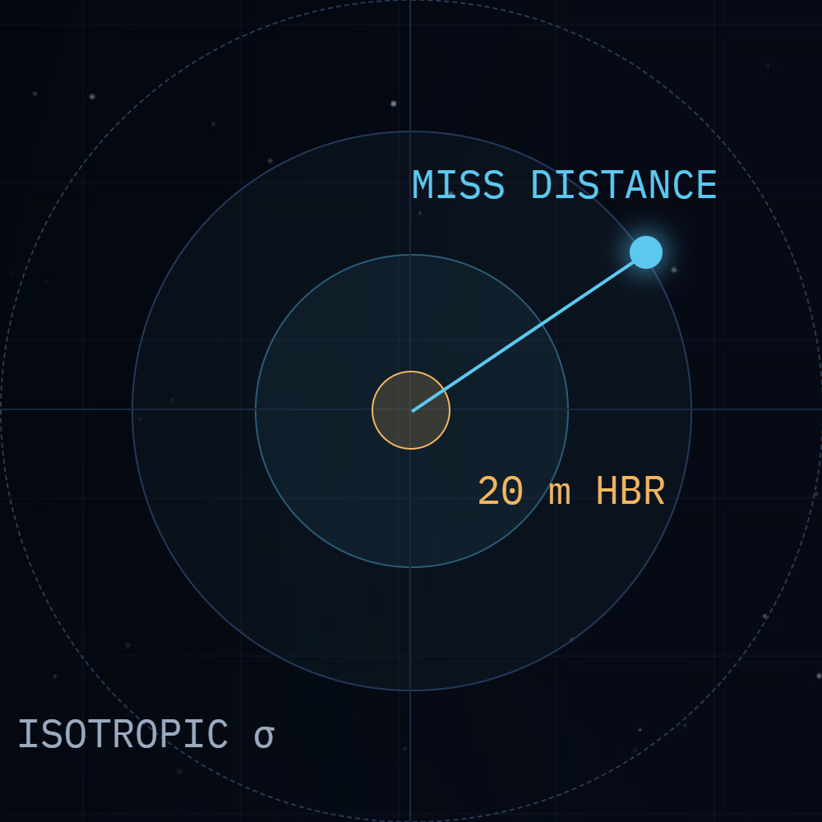
07
PHYSICS FIRST
PROBLEM
SOLUTION
PROTOTYPE
VALUE
How is each close approach computed?
01
SGP4
Propagates public GP/TLE data
02
Screening
Candidate pairs, configurable horizon
03
TCA
Refined time of closest approach
04
Miss distance
Separation at TCA
05
Relative velocity
Encounter speed and geometry
06
Collision indicator
Analytic, deterministic, no Monte Carlo
ENCOUNTER PLANE · SCHEMATIC
QUALIFICATION
Simplified analytic collision-probability indicator — NOT an operational covariance-based Pc.
ANTARIKSHA-RAKSHA · IDEAS FOR INDIA 2026
07 / 15
Notes:
A. WHAT IS SHOWN
Physics first: SGP4, screening, refined TCA, miss distance, relative velocity, analytic collision indicator; encounter-plane schematic.
B. WHAT TO SAY (narration)
Every number comes from deterministic physics. SGP4 propagates public orbital elements across a seventy-two hour horizon at sixty-second steps. Candidate pairs within ten kilometres are screened, and the time of closest approach is refined by bounded minimisation on re-evaluated SGP4 states. Miss distance and relative velocity are taken at that refined instant. The collision figure is a deterministic analytic encounter-plane indicator with simplified, isotropic uncertainty. It is not an operational covariance-based collision probability.
C. JURY TAKEAWAY
Deterministic, reproducible physics: same inputs, same numbers.
D. CAVEAT
Pc is a simplified analytic indicator, not an operational covariance-based collision probability. Per-object sigma is 0.1 km + 0.05 km per day to TCA (relative in-plane sigma = sqrt(2) x sigma); a 3D non-central chi-square fallback is used at very low relative velocity. Monte Carlo is only a test reference, not production scoring.

Slide 8
08
RISK + EXPLAINABILITY
PROBLEM
SOLUTION
PROTOTYPE
VALUE
Which event deserves attention first, and why?
→
→
01 · EVIDENCE
02 · PRIORITISATION
03 · EXPLANATION
Deterministic backend output
Ranked event queue
Human-readable assessment
TCA
Summarises the evidence
MISS DISTANCE
States why it was prioritised
RELATIVE VELOCITY
Second-pass consistency check when AI is enabled
COLLISION INDICATOR
PROXIMITY →
INDICATOR ↑
DATA PROVENANCE
Conceptual view
AI unavailable? Deterministic fallback.
ANTARIKSHA-RAKSHA · IDEAS FOR INDIA 2026
08 / 15
Notes:
A. WHAT IS SHOWN
Risk and explainability: deterministic evidence, ranked event queue, human-readable assessment, deterministic fallback.
B. WHAT TO SAY (narration)
Which event deserves attention first, and why? Deterministic evidence — time of closest approach, miss distance, relative velocity, the collision indicator and data provenance — places each event in a Low, Medium, High or Critical tier and a ranked queue. Asset criticality affects ordering, not the risk tier. The explanation then states the evidence and the reason for the priority. When AI is enabled, a second-pass consistency check reviews it; if AI is unavailable, a deterministic explanation is shown.
C. JURY TAKEAWAY
Prioritisation is evidence-based and every priority comes with a reason.
D. CAVEAT
Pc is a simplified analytic indicator, not an operational covariance-based collision probability. The second-pass check uses the same local model and is not independent validation.

Slide 9
09
AI BOUNDARY
PROBLEM
SOLUTION
PROTOTYPE
VALUE
Where does AI stop?
AI does
AI does not
EXPLAIN
COMPUTE · COMMAND
+
Summarise deterministic evidence
×
Calculate orbital positions
×
Calculate TCA or miss distance
+
Explain why an event was prioritised
×
Calculate collision probability
+
Write a human-readable assessment
×
Determine orbital mechanics
+
Run a second-pass consistency check when AI is enabled
×
Command spacecraft
×
Make autonomous manoeuvre decisions
ANTARIKSHA-RAKSHA · IDEAS FOR INDIA 2026
09 / 15
Notes:
A. WHAT IS SHOWN
AI boundary: what AI does (explain) and does not do (compute, command).
B. WHAT TO SAY (narration)
Where does AI stop? AI is not used to perform orbital mechanics. The deterministic physics pipeline produces the evidence; AI converts that evidence into a concise analyst-oriented explanation, with fact checking, guardrails and human approval. It reduces cognitive load and keeps briefings consistent. It does not calculate positions, closest approach, miss distance or collision probability, it cannot override backend risk, and it never commands a spacecraft. On the hosted jury environment, AI is disabled and deterministic explanations are used.
C. JURY TAKEAWAY
AI is intentionally downstream of deterministic physics.
D. CAVEAT
Local AI is optional (Ollama, llama3.2:3b). A deterministic fact check flags wrong numbers; a tone guard replaces sensational drafts with the deterministic template. Hosted AI is disabled.

Slide 10
10
HUMAN GOVERNANCE + AUDIT
PROBLEM
SOLUTION
PROTOTYPE
VALUE
Who makes the final decision?
→
→
APPROVE
→
INPUT
DECIDES
RECORDED
AI explanation
Analyst / operator
DISMISS
Persistent audit trail
ACKNOWLEDGE
No command is sent to any spacecraft.
DESIGN BOUNDARY
TELEGRAM = NOTIFICATION ONLY · ALERTS REACH THE OPERATOR; DECISIONS STAY IN THE CONSOLE
AUTH + RBAC
Viewer
Operator
Asset Manager
Administrator
ANTARIKSHA-RAKSHA · IDEAS FOR INDIA 2026
10 / 15
Notes:
A. WHAT IS SHOWN
Human governance and audit: analyst or operator decides (approve, dismiss, acknowledge), persistent audit trail, four RBAC roles, Telegram = notification only.
B. WHAT TO SAY (narration)
Who makes the final decision? The analyst or operator reviews the evidence and the explanation, then approves, acknowledges or dismisses the assessment. Every decision is recorded with the acting account and role in a persistent audit trail, and access is controlled by four roles. Once a significant event is assessed, the system can notify the operator through Telegram. But the notification channel has no decision authority: the operator returns to the console to review the evidence and record the human decision, which is then audited. No command is sent to any spacecraft.
C. JURY TAKEAWAY
Telegram extends the system's reach to the operator, but it does not extend the system's authority.
D. CAVEAT
Telegram is an external notification channel only. It does not participate in orbital mechanics or risk calculation and cannot approve assessments or command spacecraft. Flow: deterministic assessment → stored event → notification decision → Telegram alert → operator opens the console → human decision → audit. Critical and High notify by default, Low never; alerts are de-duplicated per event track and repeated only on escalation, at most 5 per run; every attempt is audited without credentials; DEMO alerts are off by default and otherwise headed DEMO — CONTROLLED SIMULATION. Enabled in the current hosted jury environment; delivery depends on the external Telegram service. The audit log is local SQLite with no tamper protection.

Slide 11
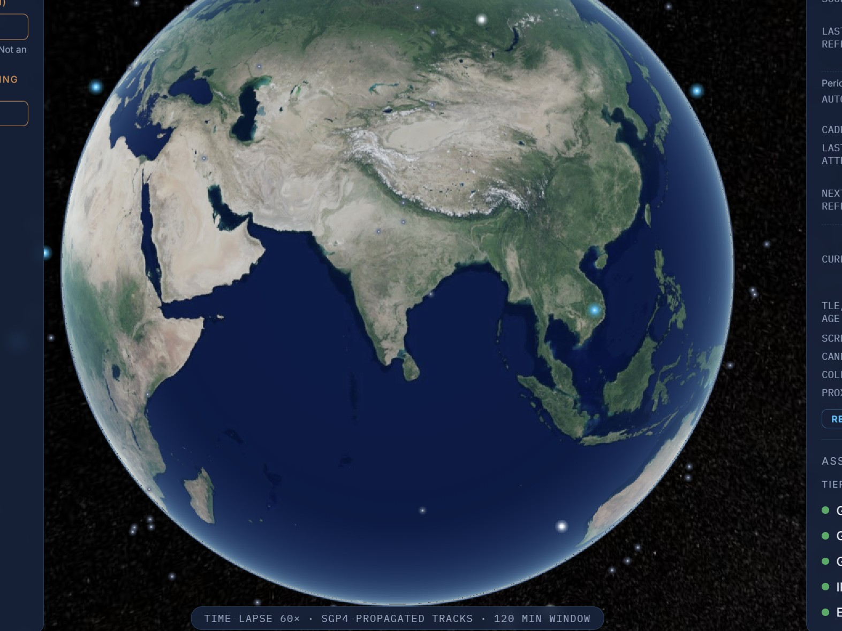
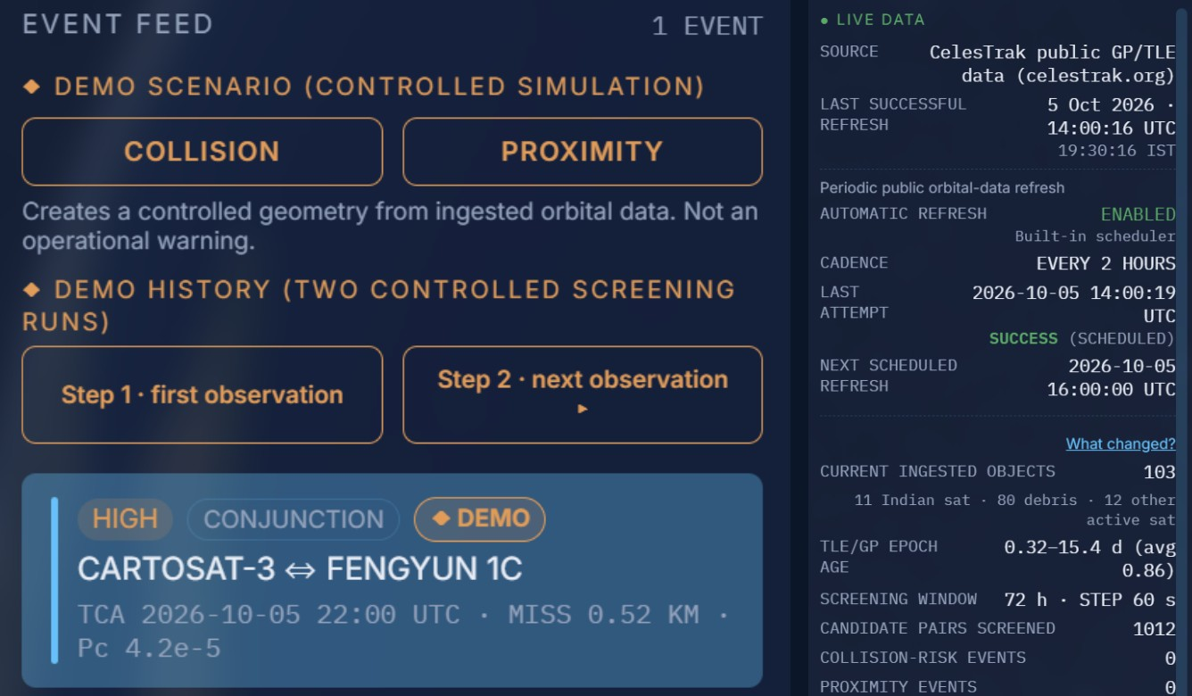
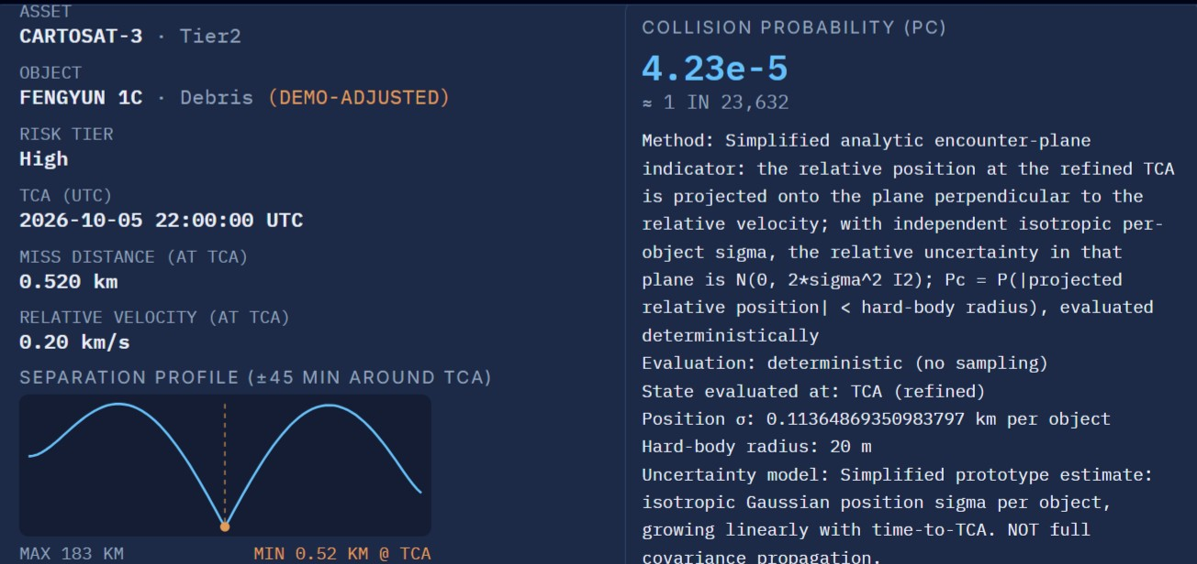
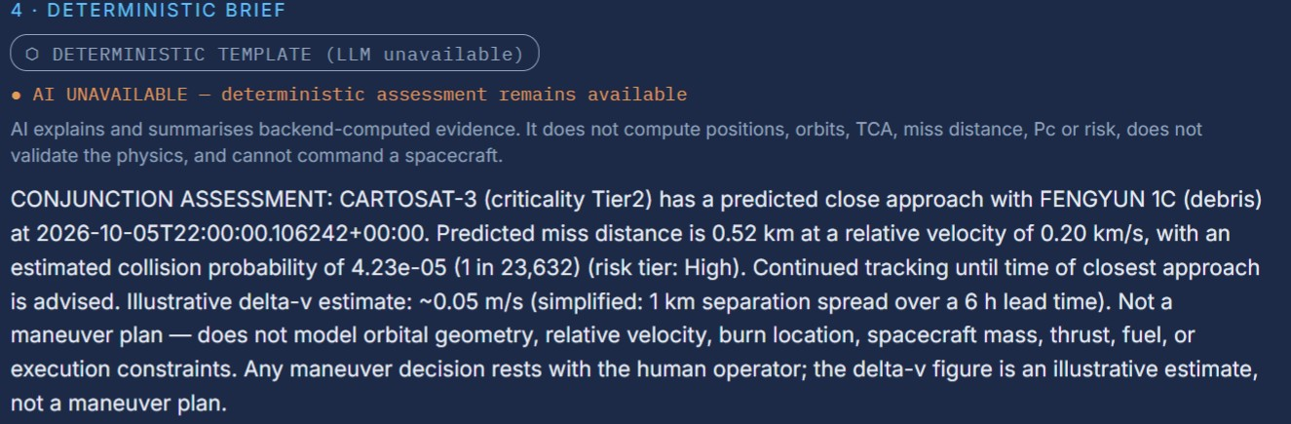
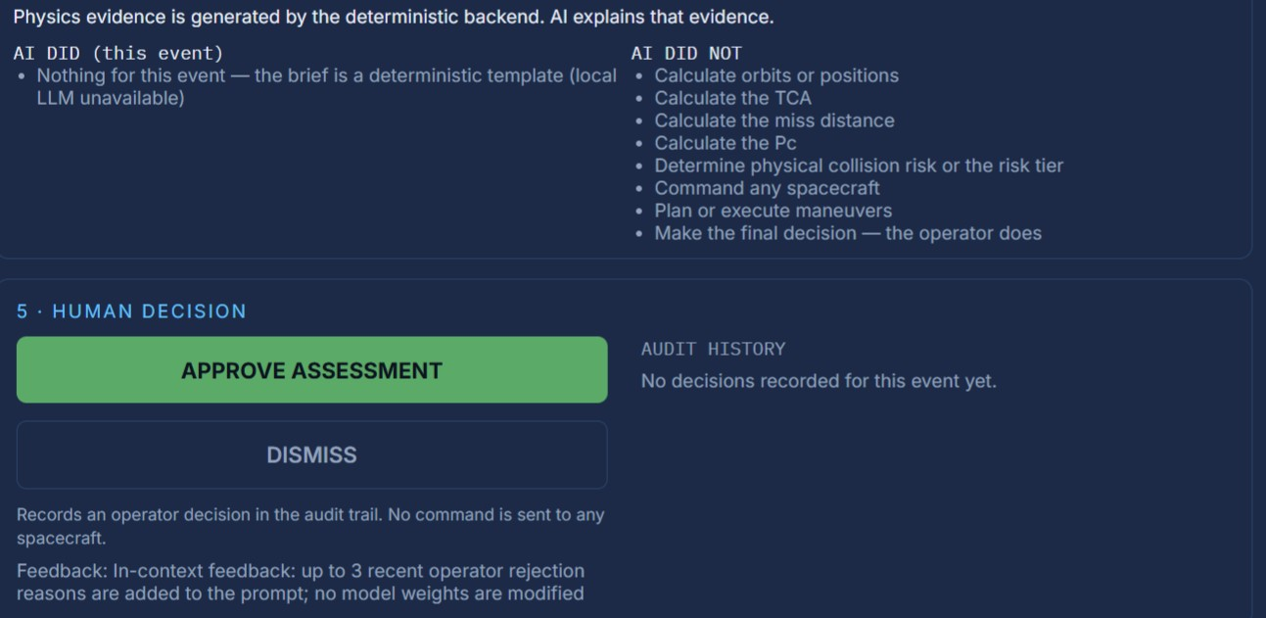
11
WORKING PROTOTYPE
PROBLEM
SOLUTION
PROTOTYPE
VALUE
What runs today?
DEMO SCENARIO — controlled geometry derived from ingested orbital data; not an operational warning.
01 · 3D ORBITAL VIEW
02 · LIVE DATA + EVENT FEED
03 · CONJUNCTION RISK
04 · EVIDENCE-BASED BRIEF
05 · HUMAN DECISION + AUDIT
■ Vercel frontend
■ Railway backend
■ Persistent database
■ 2-hour scheduler
■ Auth + RBAC
■ Public data refresh
ANTARIKSHA-RAKSHA · IDEAS FOR INDIA 2026
11 / 15
Notes:
A. WHAT IS SHOWN
Working prototype: real screenshots (3D orbital view, live data and event feed, conjunction risk, evidence-based brief, human decision and audit) and the deployment stack.
B. WHAT TO SAY (narration)
This is not a mock-up. The prototype is deployed: a Vercel frontend, a Railway backend with a persistent database, a two-hour public-data refresh, and authenticated, role-based access. You can see the 3D orbital view, the live data and event feed, the conjunction risk assessment, the evidence-based brief and the recorded human decision. Significant events can also notify the operator through Telegram. The collision shown is a controlled demonstration scenario derived from ingested orbital data — CARTOSAT-3 and a Fengyun-1C debris fragment. It is not an operational warning.
C. JURY TAKEAWAY
An end-to-end working prototype on real public orbital data, validated by 815 automated tests (652 backend, 1 skipped; 163 frontend).
D. CAVEAT
This is a controlled demonstration scenario derived from ingested orbital data; it is not an operational collision warning. Real catalogue rows are not modified. The recorded video shows a Pc of about 7.71e-3; later deterministic reruns can show about 7.67e-3. Telegram notification was enabled after the recorded jury video.

Slide 12
12
SOVEREIGN + STRATEGIC VALUE
PROBLEM
SOLUTION
PROTOTYPE
VALUE
Where does it fit in India's space capability?
India already has significant space surveillance and tracking capabilities. ANTARIKSHA-RAKSHA is a complementary software-layer prototype that turns orbital evidence into prioritised, explainable and auditable decision support.
MODULAR
OPTIONAL LOCAL AI
GOVERNED
EXTENSIBLE
Software layer that can sit alongside existing systems
Explanations from a local model when enabled, with deterministic fallback
Human-in-the-loop decisions with a persistent audit trail
Scalable architecture, ready for authoritative data sources
NASA, ESA and commercial SDA providers already run sophisticated conjunction assessment. Our contribution is the integrated workflow.
EVIDENCE → PRIORITY → LOCAL AI → HUMAN → AUDIT
ANTARIKSHA-RAKSHA · IDEAS FOR INDIA 2026
12 / 15
Notes:
A. WHAT IS SHOWN
Sovereign and strategic value: complementary software layer; modular, optional local AI, governed, extensible.
B. WHAT TO SAY (narration)
Where does this fit? India already has significant space surveillance and tracking capabilities, and international agencies and commercial providers run sophisticated conjunction assessment. ANTARIKSHA-RAKSHA is a complementary software-layer prototype. It is modular, it can use a local AI model without any cloud dependency, it is governed by human decisions with an audit trail, and it is built so that authoritative data sources could be added later. Our contribution is the integrated workflow from evidence to audit.
C. JURY TAKEAWAY
A complementary, potentially sovereign software layer: the value is the integrated, governed workflow.
D. CAVEAT
No ISRO, IS4OM, NETRA or DRDO integration, endorsement or partnership exists or is implied.

Slide 13
13
WHAT COULD THIS ENABLE?
PROBLEM
SOLUTION
PROTOTYPE
VALUE
What could this enable?
Potential future value, not implemented capability: what an explainable, human-gated decision-support layer could enable as orbital activity grows.
01 · PRIORITISE
02 · EXPLAIN
03 · SCALE
04 · GOVERN
Focus analyst attention on the most important conjunctions
Turn complex orbital evidence into concise, traceable assessments
Support analysts as object populations and event volumes grow
Keep AI bounded by deterministic evidence and human approval
Future foundation: authoritative ephemerides + covariance / CDM integration + institutional analyst workflows.
FUTURE FOUNDATION · POTENTIAL, NOT BUILT
ANTARIKSHA-RAKSHA · IDEAS FOR INDIA 2026
13 / 15
Notes:
A. WHAT IS SHOWN
NEW. What could this enable: prioritise, explain, scale, govern; future foundation (authoritative ephemerides, covariance/CDM, institutional workflows).
B. WHAT TO SAY (narration)
What could this enable in the future? It could help prioritise analyst attention on the conjunctions that matter most, explain complex orbital evidence as concise and traceable assessments, support analysts as object populations and event volumes grow, and keep AI assistance bounded by deterministic evidence and human approval. These are potential outcomes, not current capabilities. They would need a stronger foundation: authoritative ephemerides, covariance and CDM integration, and institutional analyst workflows.
C. JURY TAKEAWAY
The prototype shows a pattern that could scale analyst capacity if built on authoritative data.
D. CAVEAT
Everything on this slide is potential future value, not implemented capability.

Slide 14
14
LIMITATIONS + PATHWAY
PROBLEM
SOLUTION
PROTOTYPE
VALUE
What are the limits, and what comes next?
NOW · PROTOTYPE
NEXT · VALIDATION
LATER · INTEGRATION
Deployed end-to-end workflow on public orbital data
Independent validation of screening and TCA; covariance-based Pc where validated data exists
Authoritative data sources, analyst workflow integration, hardened security
PROTOTYPE LIMITATIONS
Current live ingestion uses public CelesTrak GP/TLE data — accuracy bounded by source
Simplified indicator, not operational covariance-based Pc
Demo scenario uses controlled geometry
Not a replacement for ISRO / IS4OM / NETRA / DRDO systems
Not a command, autonomous-avoidance or weapon system
Pathway above is potential, not committed
ANTARIKSHA-RAKSHA · IDEAS FOR INDIA 2026
14 / 15
Notes:
A. WHAT IS SHOWN
Limitations and pathway: now (prototype), next (validation), later (integration); prototype limitations.
B. WHAT TO SAY (narration)
We are candid about scope. Today this is a deployed prototype on public CelesTrak data, so accuracy is bounded by that source. The collision figure is a simplified indicator, not an operational covariance-based probability, and the demo uses controlled geometry. It is not a replacement for ISRO, IS4OM, NETRA or DRDO systems, and it is not a command, autonomous-avoidance or weapon system. The next steps would be independent validation, covariance-based probability where validated data exists, and integration with authoritative sources. This pathway is potential, not committed.
C. JURY TAKEAWAY
Honest limits and a credible pathway: validation first, then authoritative data and integration.
D. CAVEAT
No operational validation has been performed; the pathway is potential, not committed.

Slide 15
अंतरिक्ष रक्षा
Physics first.
AI second.
Human decision last.
From orbital data to explainable decision support.
DATA
→
PHYSICS
→
RISK
→
AI EXPLANATION
→
HUMAN DECISION
→
AUDIT
Notes:
A. WHAT IS SHOWN
Closing: Physics first. AI second. Human decision last. Data → physics → risk → AI explanation → human decision → audit.
B. WHAT TO SAY (narration)
Physics first. AI second. Human decision last. ANTARIKSHA-RAKSHA turns orbital data into physics, physics into risk, risk into a clear explanation, and explanation into a recorded human decision — from orbital data to explainable decision support. Thank you.
C. JURY TAKEAWAY
Physics first. AI second. Human decision last.
D. CAVEAT
Research/demo decision-support prototype; not an operational service.

