Slide 1

DATA ANALYTICS

Slide 2
Agenda:-
1. What is Data Analysis?
2. Data Analysis Process Overview
3. Real-Life Example: Bakery Sales Data
4. Tools and Next Steps
Notes:
First, we'll define data analysis, then look at the process steps. After that, we'll discuss a real-life example and finish with tools you'll need.

Slide 3
What is Data ?
It is information in raw or unorganized form. It may be a fact, figure, characters, symbols etc. This raw information can be in various forms, including numbers, text, images, or any other format.

Slide 4



Data Analytics
Analytics is the discovery, interpretation, and communication of meaningful patterns or summery in data. Data Analytics (DA) is the process of examining data sets in order to draw conclusion about the information it contains. Analytics is not a tool or technology, rather it is the way of thinking and acting on data.
Data analysis is the process of inspecting, cleaning, and modeling data to extract insights.
Data on its own is useless unless you can make sense of it!

Slide 5




Data Analyst
Data analysts primarily focus on understanding historical data, identifying trends, and providing insights to help businesses make informed decisions. They often use tools like SQL, Excel, and data visualization software to analyze structured data and create reports. .
Data Scientist
Data scientists, on the other hand, are more focused on the future and use advanced techniques to predict trends and develop data-driven solutions.

Slide 6
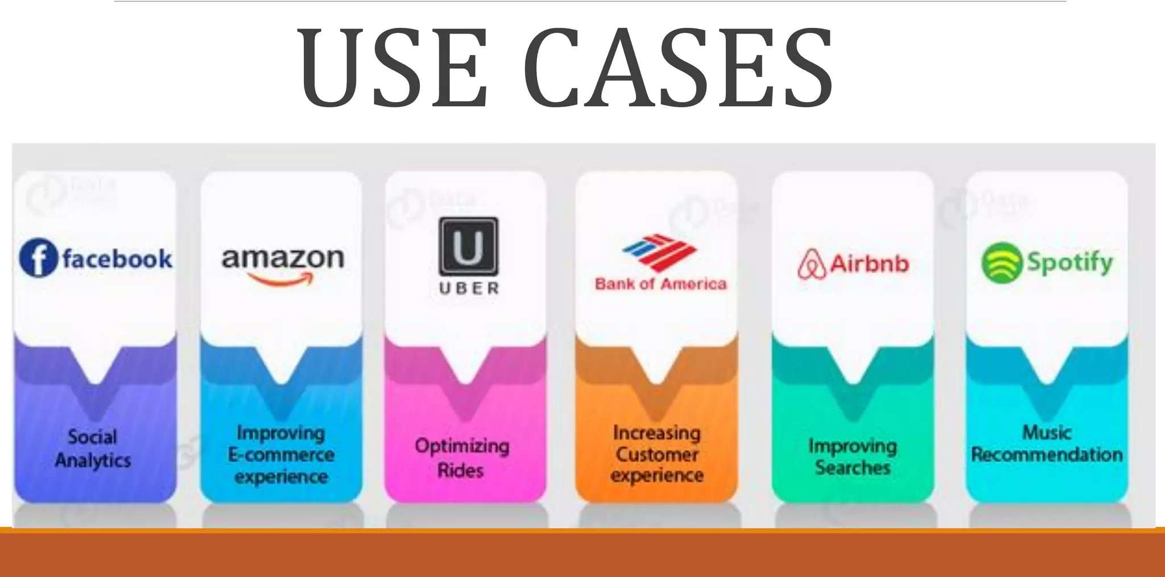

Slide 7


Data Ana ics - Examp
Finance, Healthcare, E-commerce, Government, Marketing, Sports, etc.

Slide 8
Data Analysis Process
1. Define the Question
2. Collect Data (from databases, APIs, surveys)
3. Clean Data (handling missing values, duplicates, outliers)
4. Analyze Data(pattern, trends etc)
5. Insights
6. Communicate Results through visuals
Notes:
Walk through each step with brief examples:
Define: e.g., what factors affect bakery sales?
Collect: sales records, customer footfall, weather data.
Clean: handle missing entries, remove duplicates.
Analyze: compute trends, correlations.
Communicate: prepare report or dashboards.

Slide 9
Skill and Tools
Technical Skills:
Excel – for quick data analysis
SQL – for querying databases
Python – for advanced analytics
Power BI / Tableau – for visualization
Statistics – foundational to all analysis

Slide 10
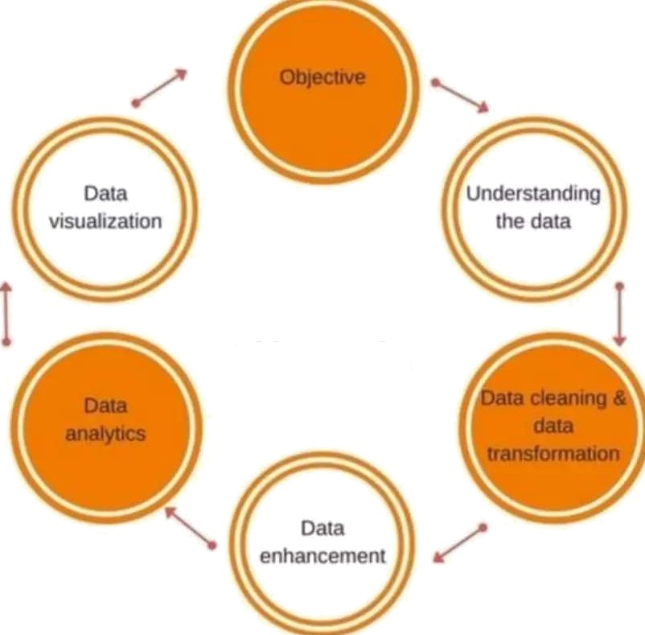
Data Anal
ics Life Cvcle
Data Analytics
Life Cycle

Slide 11
Types of DATA
Descriptive Analytics Predictive Analytics Prescriptive Analytics

Slide 12
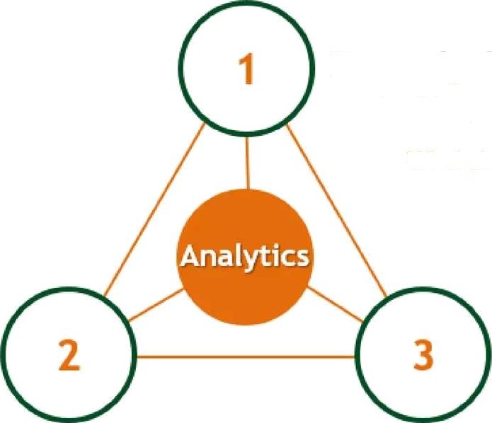
Types of Analytics in Real Life
Prescriptive Analytics
Enabling smart decisions based on data
What should we do?
Predictive analytics
Predicting the future based
Descriptive analytics
Ruining data to provide business insights
What has happened?
What could happen?

Slide 13
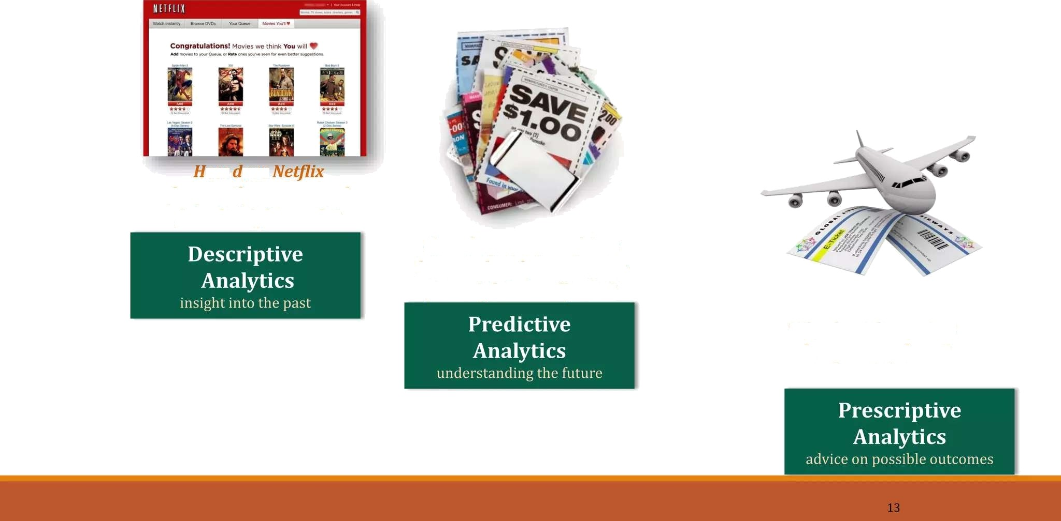
Types of Analytics
ow oes frequently recommend just the right movie?
How do grocery cashiers know to hand you coupons you might actually use?
Why do airline prices change every hour?

Slide 14
Real-Life Example: Bakery Sales Data
Scenario: A local bakery wants to understand what drives daily sales.
Data: Date, sales amount, items sold, promotions.
Sales have dropped this quarter. Can you figure out why?
Notes:
Describe: The bakery records daily sales and notes promotions and weather.
Ask: What factors do you think influence sales?
Guide: Show how we might analyze this dataset in upcoming sessions.

Slide 15
Think:-
“Can anyone think of a company that uses data every day?”
“Do you believe data can predict your next purchase?”

