Slide 1

Technical Presentation
By Team London
Team Members :
Kaviarasan
Dwayne
Infant Rufus Paul
Selvakumari k

Slide 2
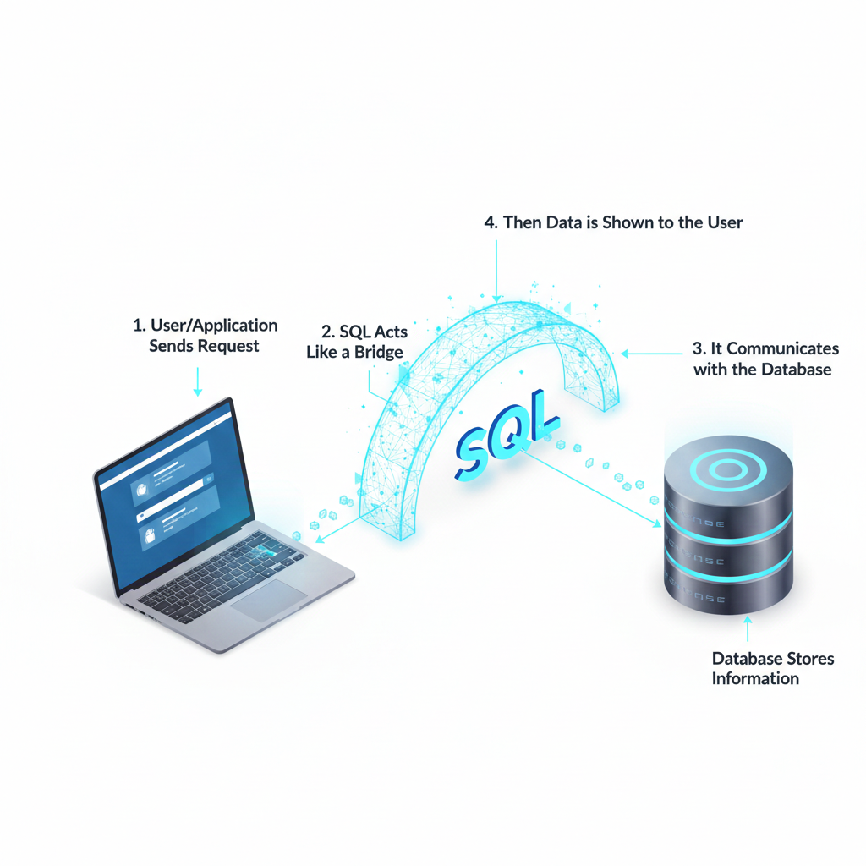
SQL - Structured Query Language
SQL is mainly used to store structured data (data in rows and columns)
SQL is used to manage data in databases
Used in banks, colleges, websites, and mobile applications
Helps to store, retrieve, update, and delete information easily
Chosen because it is simple, fast, reliable, and handles large data
Example :
Managing student details, bank accounts, and online
shopping data using SQL
Workflow

Slide 3
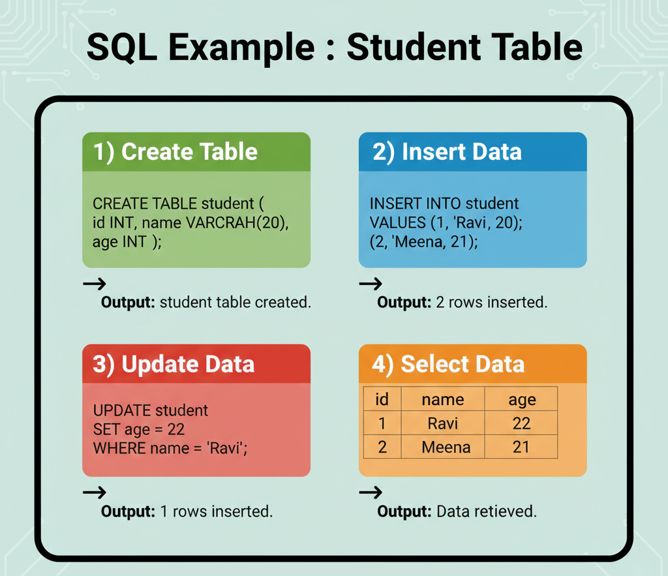
MySQL – Tool, Commands & output
Tool Used:
MySQL
Oracle Database
PostgreSQL
SQLite
Basic SQL Syntax :
SELECT * FROM table_name;
Basic Commands:
CREATE – create a table
INSERT – add data
UPDATE – change data
DELETE – remove data

Slide 4
Low Level vs High Level Languages
Low Level Language :
  Closer to hardware
  Machine dependent
  Very fast execution
  Difficult to read & write
  Examples: Machine, Assembly
High Level Language :
  Human readable
  Platform independent
  Easy to learn
  Supports OOP & security
  Examples: C, C++, Java, Python

Slide 5
Compiler vs Interpreter
Source Code
Compiler / Interpreter
Output
Interpreter
  Translates line by line
  Stops at first error
  Slower execution
  Examples: Python, JavaScript
Interpreter
  Translates line by line
  Stops at first error
  Slower execution
  Examples: Python, JavaScript

Slide 6
CCNA – Cisco Certified Network Associate
- Dwayne

Slide 7
Ticketing Tool
It is a type of help desk software design to efficiently process, manage and track customer issue from initial submission to resolution.
It can automatically organize and prioritize support of request in central dashboard.
User can apply tag, categories and assign tickets as they receive.
Features of Ticketing Tools
Create and track ticket.
Assign ticket to specific employees.
Prioritize ticket.
Knowledge base.
Service Level Agreements - SLAS

Slide 8
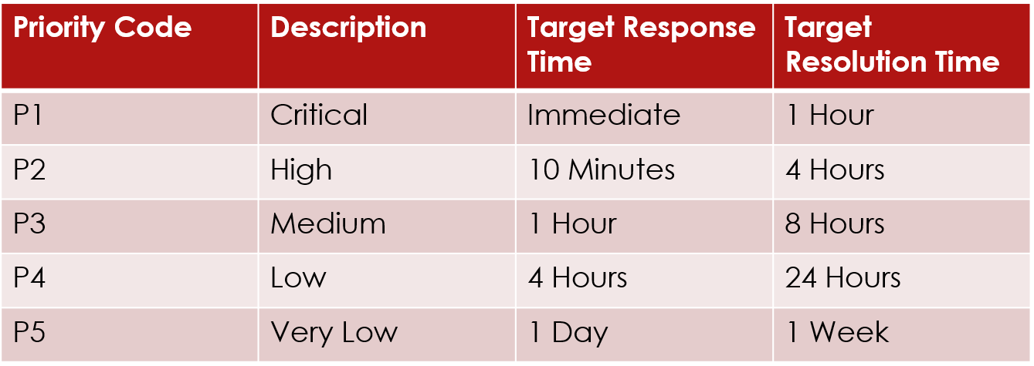
Priority Level in Ticket
There are five types of priority levels in ticket.
5 Stages Of Ticket Life Cycle :
New Ticket.
Open Ticket.
Pending Ticket.
Resolved Ticket.
Closed Ticket.

Slide 9
Service Level Agreements - SLAS
CONTRACT BASED :
    Contact between provider and customer.
    Service standards, responsibilities and penalties.
BENEFITS OF SLAS :
    Clear communication.
    Better performance tracking.
    Legal protection for both parties.
    Continuous service improvements.

Slide 10
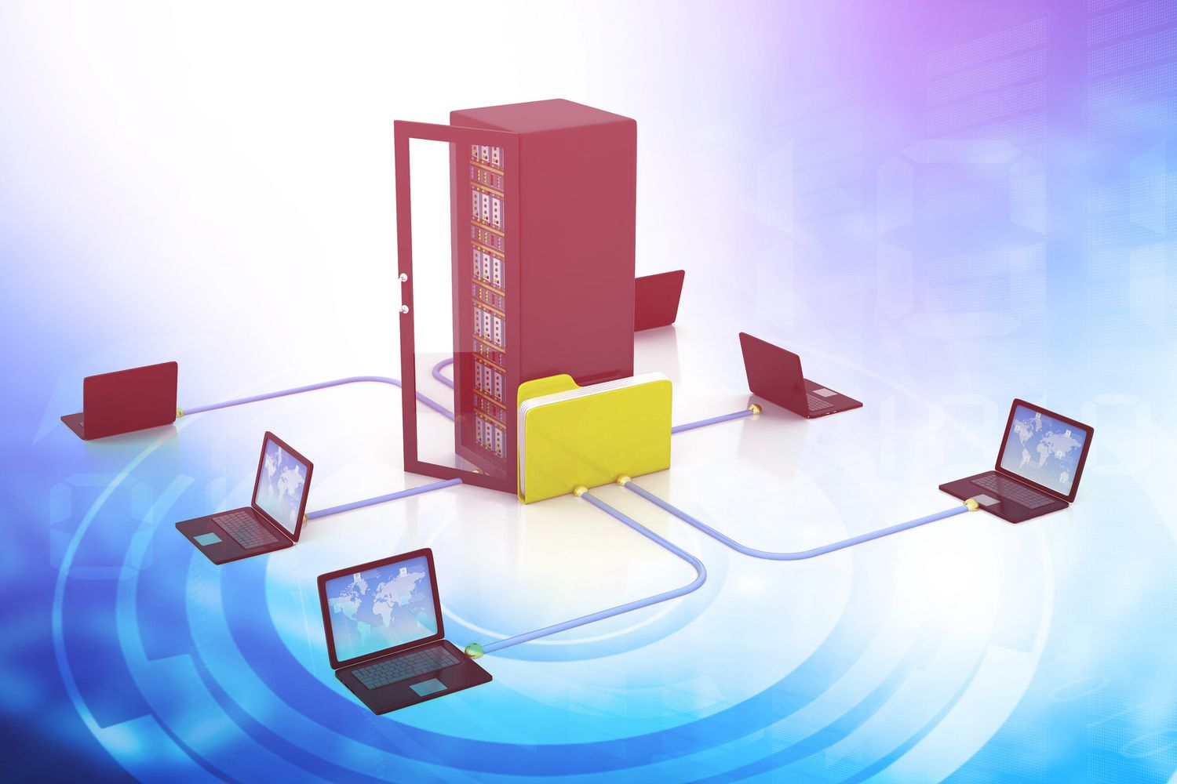
Introduction of Server
Store the data - Collection of documents
Share the files - Send from server to client
Manage the Active Directory - Create account to employee
Maintain the backup
    Increment Backup
    Full Backup
Security & Control

Slide 11

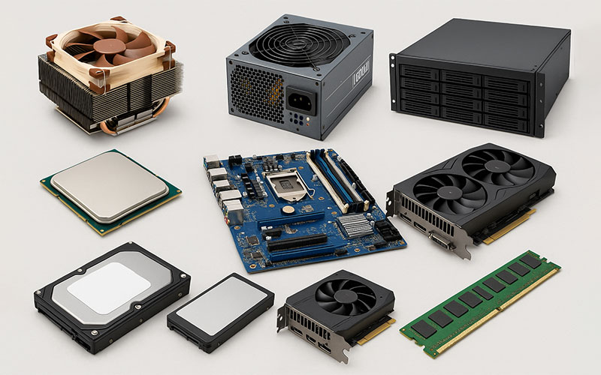
Types of Server
  Data Server
  File Server
  Web Server
  E-Mail Server
  Active Directory Server
  CPU
  RAM
  Power Supply port
  Cooling Fan
  NIC port
  Storage device
Server Hardware

Slide 12
Server OS
Windows Server -Microsoft windows OS
Linux Server - IGEL OS
Conclusion
Server is backbone of IT

