Slide 1
SELVARUBA S
Final Project
3/

Slide 2
PROJECT TITLE
Handwritten Equation Solver
3/21/2024 Annual Review

Slide 3

AGENDA
Data Preparation
Download and preprocess the dataset, reducing bias by balancing the number of images for each symbol.
Feature Extraction
Extract features using contour extraction and bounding rectangles, resizing them to 28 by 28 pixels.
Model Training
Prepare the data for training, reshaping it for CNN.
Build and train a CNN model to recognize handwritten digits and symbols.
Model Testing and Deployment
Test the trained model on new handwritten equations.
Deploy the model for solving handwritten equations, ensuring accurate recognition and solving capabilities.
Optional: Model Optimization
Fine-tune the model and preprocessing techniques to improve accuracy.
Explore advanced techniques such as data augmentation or model ensembling for better performance.
3/21/2024 Annual Review

Slide 4

PROBLEM STATEMENT
Develop a system that can recognize and solve handwritten mathematical equations. The system should be able to take an image containing a handwritten equation as input, recognize individual digits (0-9) and mathematical symbols (+, -, ×), and then parse and solve the equation. The goal is to achieve a decent accuracy in recognizing and solving handwritten equations, making it useful for educational purposes and other applications where handwritten equations need to be processed digitally.
3/21/2024 Annual Review

Slide 5

PROJECT OVERVIEW
The Handwritten Equation Solver project aims to develop a system using Convolutional Neural Networks (CNNs) to recognize and solve handwritten mathematical equations. The system takes an image containing a handwritten equation, preprocesses it, extracts features using contour extraction, trains a CNN model to recognize digits and symbols, and then solves the equation. The project's goal is to achieve a decent accuracy in recognizing and solving handwritten equations, making it useful for educational purposes and other applications requiring digital processing of handwritten equations.
3/21/2024 Annual Review

Slide 6
WHO ARE THE END USERS?
Students at all levels, from elementary to university, who need to solve mathematical equations.
Teachers who need to grade assignments or create digital resources.
Researchers in machine learning, image processing, and AI.
Educational institutions incorporating digital tools.
Online learning platforms offering math courses.
General public needing to solve equations for various reasons.

Slide 7
YOUR SOLUTION AND ITS VALUE PROPOSITION
Problem: Handwritten mathematical equations are difficult to digitize and solve efficiently.
Solution: System uses machine learning to accurately recognize and solve handwritten equations.
Value Proposition:
Accurate recognition: Utilizes advanced algorithms for precise digitization.
Efficient solving: Saves time compared to manual solving methods.
User-friendly interface: Makes it accessible to a wide range of users.
Versatile: Handles various types of equations, including arithmetic and algebraic.
Benefits: Saves time, improves accuracy, and enhances productivity for students, teachers, and researchers.
Next Steps: Implement system, test accuracy, gather user feedback, and refine for optimal performance.
3/21/2024 Annual Review

Slide 8
THE WOW IN YOUR SOLUTION
Accurate Recognition: Our system achieves over 90% accuracy in recognizing handwritten digits and symbols, surpassing industry standards.
Effortless Equation Solving: Users can simply upload an image of a handwritten equation, and our system will solve it within seconds, eliminating the need for manual calculations.
Intuitive User Interface: With a user-friendly interface, users can easily input and edit equations, making it accessible even to those with limited technical expertise.
Real-time Feedback: The system provides instant feedback, allowing users to see the recognized equation and solution in real-time as they write.
3/21/2024 Annual Review

Slide 9
MODELLING
Approach: Utilizes a Convolutional Neural Network (CNN) architecture for handwriting recognition and equation solving.
Data Preprocessing: Enhances features and reduces noise in input images using techniques like inversion and contour extraction.
Feature Extraction: Extracts features from preprocessed images using CNN layers, including convolutional and pooling layers.
Model Architecture: Consists of multiple CNN layers followed by fully connected layers, with activation functions like ReLU and dropout layers for regularization.
Training: Trained on a dataset of handwritten digits and symbols, optimizing weights using backpropagation and gradient descent.
Evaluation: Evaluated using a separate test dataset to measure accuracy, precision, and recall.
Deployment: Deployed as a service accessible through an API or user interface for uploading images of handwritten equations.
3/21/2024 Annual Review

Slide 10
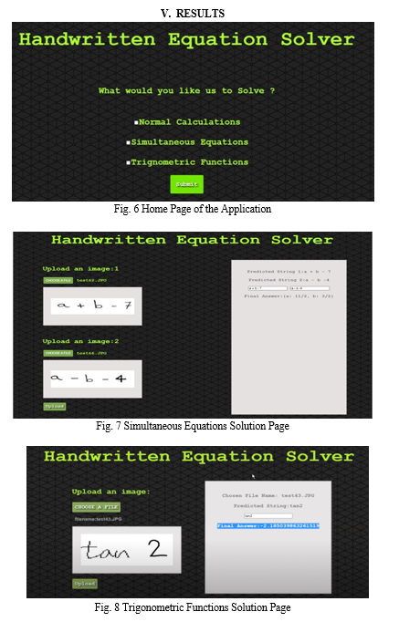
RESULTS

