Slide 1
JAVA APPLICATION · PROJECT 15
Restaurant Order,
Kitchen & Billing System
A Java-based restaurant management application
PROJECT PRESENTED BY
COURSE
COURSE CODE
Tallapragada Piyush Sreeniketh (2620040032)
Pallikkal Pranav Nair (2620040005)
Problem Solving Using Programming (Java)
26SC1101E
Project 15
Notes:
Introduce the project as a Java-based restaurant management application. Name the two presenters, the course, the course code, and Project No. 15.

Slide 2
ABSTRACT & INTRODUCTION · 01
Abstract & Introduction
ABSTRACT
OBJECTIVES
The Restaurant Order, Kitchen & Billing System is a Java-based application designed to simplify the process of managing customer orders in a restaurant. The system allows users to select food items, enter quantities, choose between Dine-In or Takeaway, maintain the order, and automatically calculate the total bill. The project demonstrates the application of fundamental programming concepts such as arrays, selection statements, switch, input, and arithmetic operations to solve a real-world problem.
Display the available menu
Allow Dine-In or Takeaway selection
Accept food-item choices
Allow multiple items to be added
Maintain the order
Calculate the total bill
Display the final bill
INTRODUCTION
In a traditional restaurant or tiffin centre, taking orders and calculating bills manually can require additional time and may lead to calculation errors. The proposed system provides a simple computerized approach for handling customer orders.
Notes:
Present the complete abstract, then explain the manual-ordering context and the seven project objectives.

Slide 3
SYSTEM COMPARISON · 02
Existing System vs Proposed System
EXISTING SYSTEM
PROPOSED SYSTEM
Food orders are recorded manually
Communication between customer and staff is manual
Bill calculation may require manual effort
Tracking the status of an order is difficult
Managing multiple orders becomes inconvenient
Menu display with prices
Service selection (Dine-In / Takeaway)
Item selection and order management
Automatic billing
Final bill generation
LIMITATIONS
Time-consuming process
Possibility of calculation errors
Difficult to manage repeated items
Less organized order management
CONCLUSION
Simple • Fast • Accurate
03
Notes:
Contrast every manual-system weakness with the proposed computerized approach, then close on the three-part conclusion: Simple, Fast, Accurate.

Slide 4
COURSE OUTCOMES · 03
CO Attainments
CO1
CO2
CO3
PROBLEM SOLVING AND JAVA FOUNDATIONS
SELECTION AND ITERATION
ARRAYS AND DATA PROCESSING
Uses switch for service selection
Uses if-else for validation and order type
Uses do-while loop for multiple item ordering
Uses arrays to store menu items and prices
Processes data using array indexing and traversal
Maintains order information and calculates the bill
Converts a real-world problem into a structured program
Uses primitive data types, variables, expressions and console I/O for input and output
04
Notes:
Connect the implementation to all three course outcomes: structured problem solving and Java foundations, selection and iteration, and arrays with data processing.

Slide 5
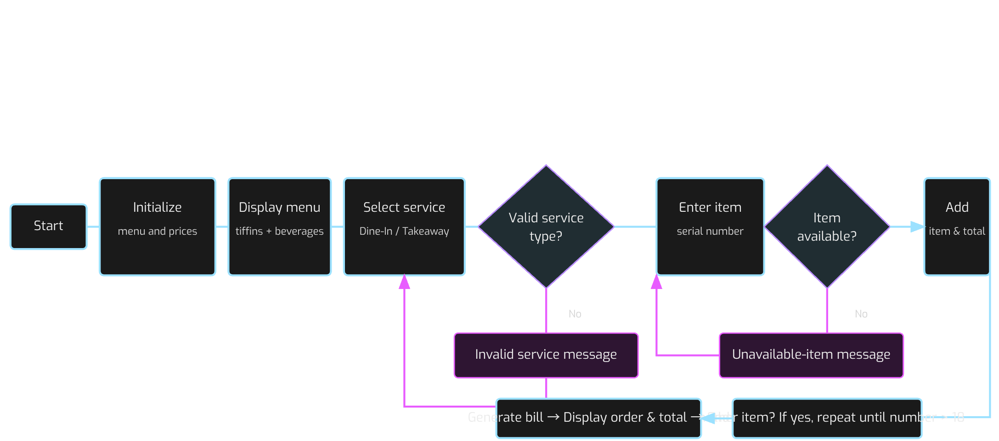
ALGORITHM & FLOWCHART · 04
Algorithm & Flowchart
ALGORITHM
FLOWCHART LOGIC
Start
Initialize menu items and prices
Display menu (tiffins and beverages)
Ask for Dine-In / Takeaway
Validate the service type
Enter item serial number
Check if item is available
Add item and update total
Ask for another item
Continue until number > 18
Display order type and items
Show total amount
Display confirmation message
End
Notes:
Walk through every numbered algorithm step. The flowchart validates service type, rejects unavailable items, loops for another item until number > 18, then generates the bill, displays the order and total, shows confirmation, and ends.

Slide 6
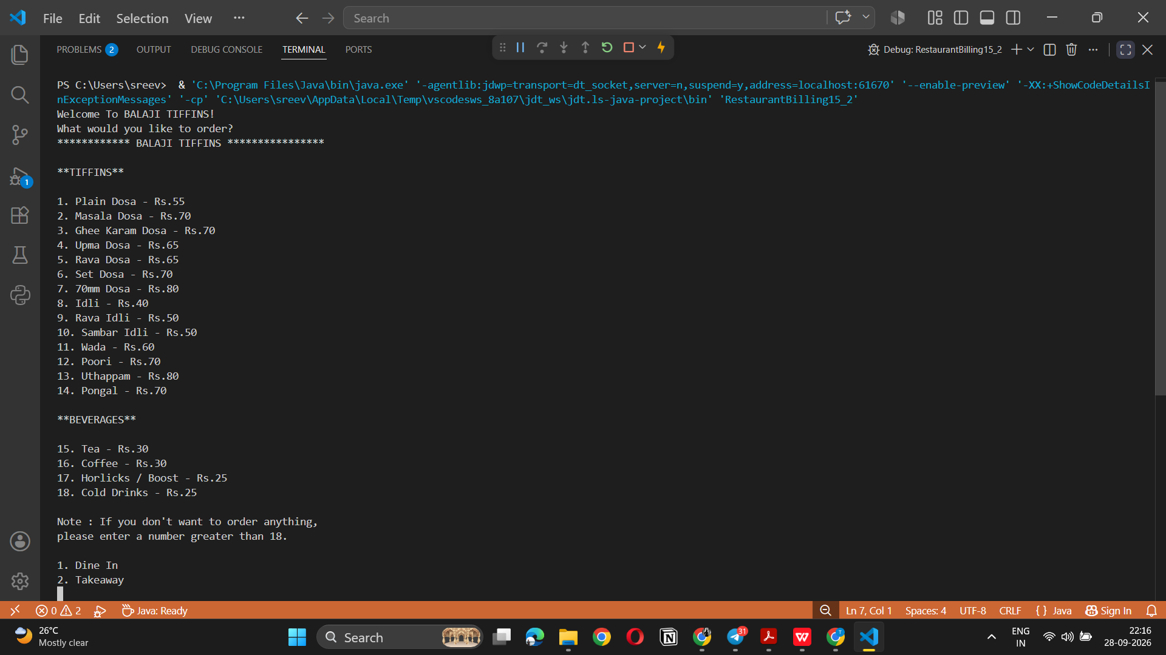

Slide 7
