Slide 1
Wizard Wreck

Slide 2
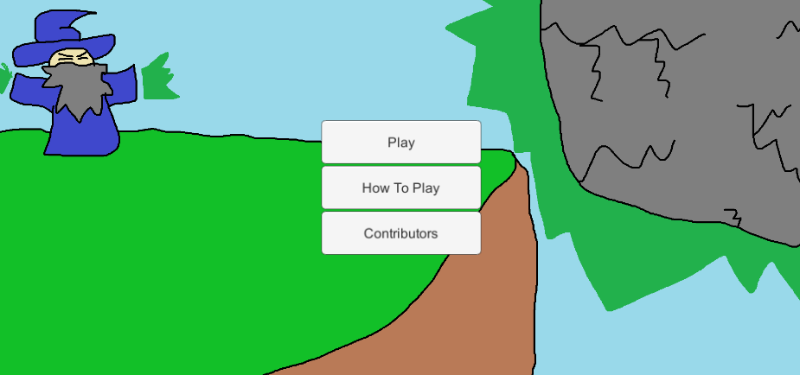
Basics
Small upgrade style game (think Learn To Fly)
The player constantly upgrades the rock in order reach further max distances
Various goblins try to stop the rock’s progression

Slide 3
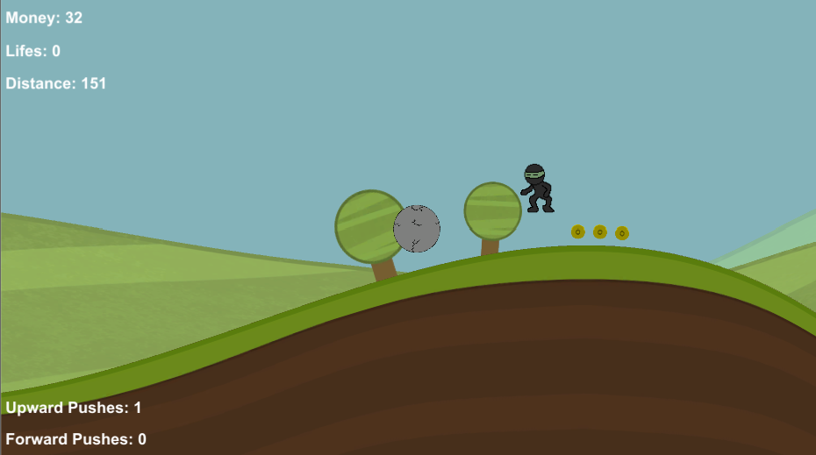
The Game
The player plays a bolder controlled by the wizard
Using forward and upward force pushes the player controls the bolder
The coins are then used to purchase upgrades after the ball runs out of momentum triggering the end of the game

Slide 4
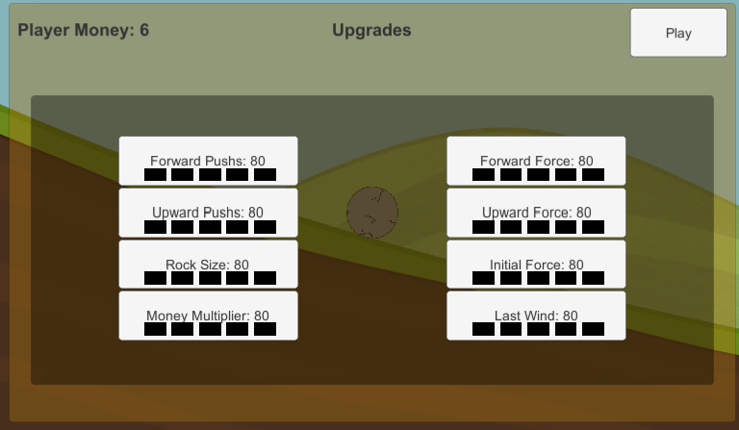
Upgrades
Each level of forward and upward pushes increase the total amount of pushes the player has
The force upgrade for each increase the amount of force applied to the bolder when each push is used
The initial force controls how much force the bolder starts the game with
Last wind corresponds essentially to lifes, instead of the game ending the ball will be pushed forward again

Slide 5

Goblin Types: Troll

Slide 6

Goblin Types: Ninja

Slide 7

Goblin Types: Chucker

Slide 8

Goblin Types: Bruiser

Slide 9

Goblin Types: Bird

Slide 10
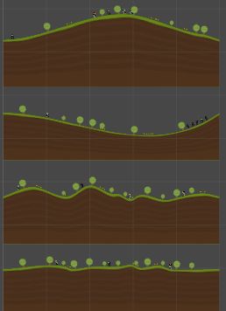
Zippy Terrain

