Slide 1
Set up Python environment using Conda
To set up your Python environment for SEN122A 2026, take the following steps:
A) Download the lab session files
B) Install Anaconda (if not already installed)
C) Create the Python environment from environment.yaml
D) Install Visual Studio Code and its extensions
E) Start your lab session
1

Slide 2
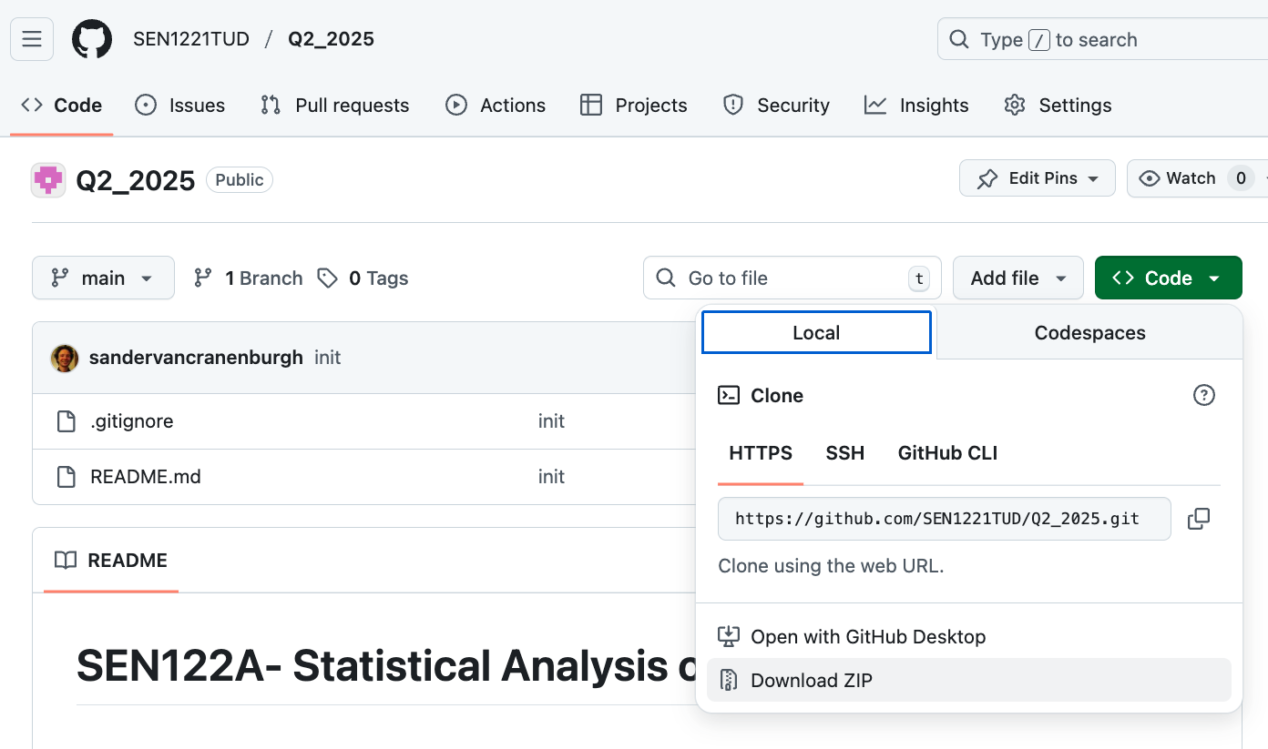
Set up Python environment using Conda
A) Download the lab session files
Go to: github.com/SEN1221TUD/SEN122A_2026
Download the materials
  • Click the green Code button (top right)
  • In the dropdown, select Download ZIP
Locate the ZIP file
  • Saved by default in Downloads: SEN122A_2026-main.zip
Copy to your course folder
  • Move to e.g. Documents\Courses\SEN122A
  • ⚠️ Do NOT use cloud drives (OneDrive, Dropbox)!
Unpack (extract) the ZIP
  • Right-click → choose Extract All…
  • Check that Lab_sessions, Assets, and environment.yaml are present.
2

Slide 3
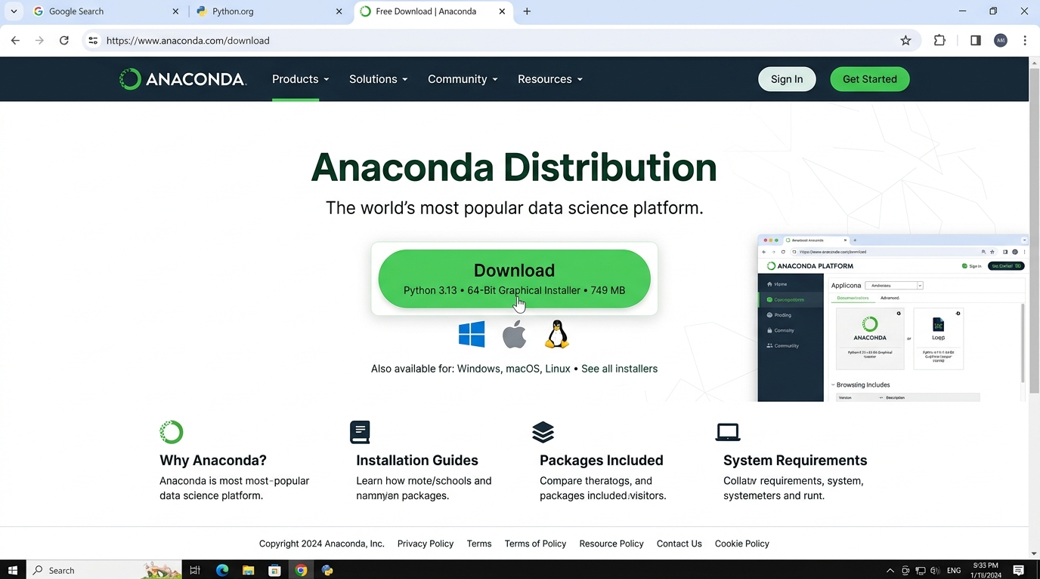
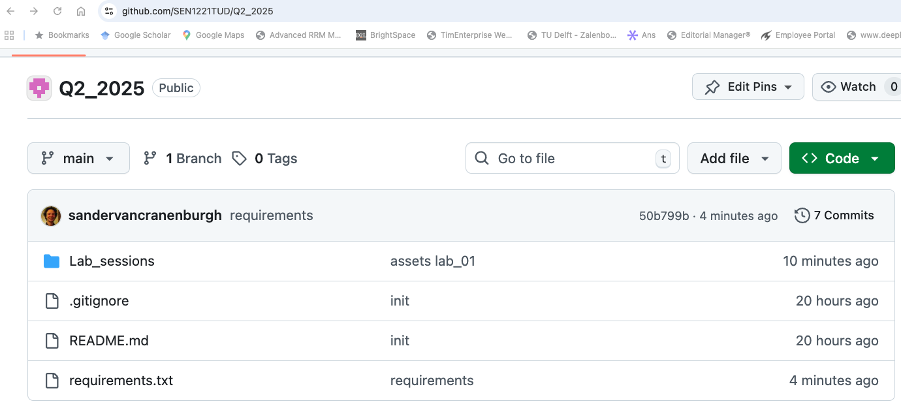
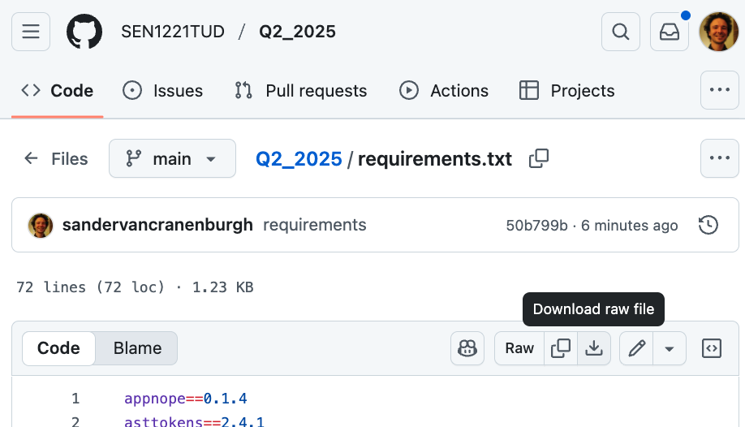

Set up Python environment using Conda
B) Install Anaconda (if not already installed)
Go to the Anaconda download page:
  docs.anaconda.com/anaconda/install/
Choose the installer for your operating system (Windows, macOS, Linux) and click Download.
Run the downloaded installer and follow the on-screen setup steps.
⚠️ If Anaconda is already installed on your machine, skip this step and proceed directly to step C.
3

Slide 4
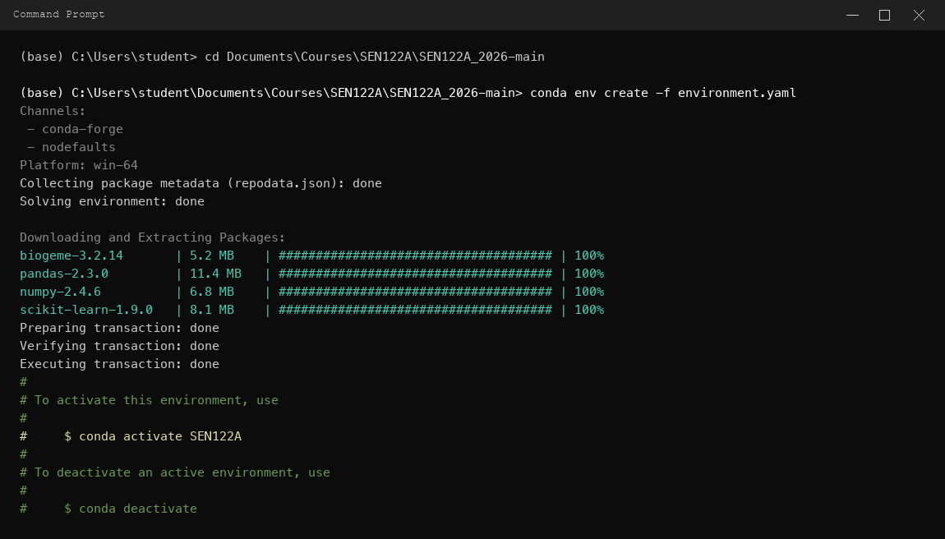
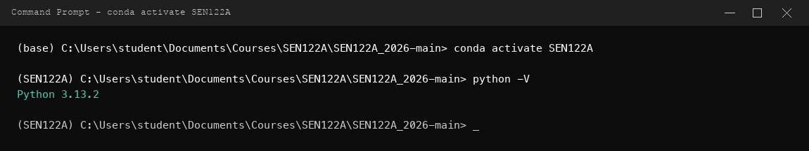
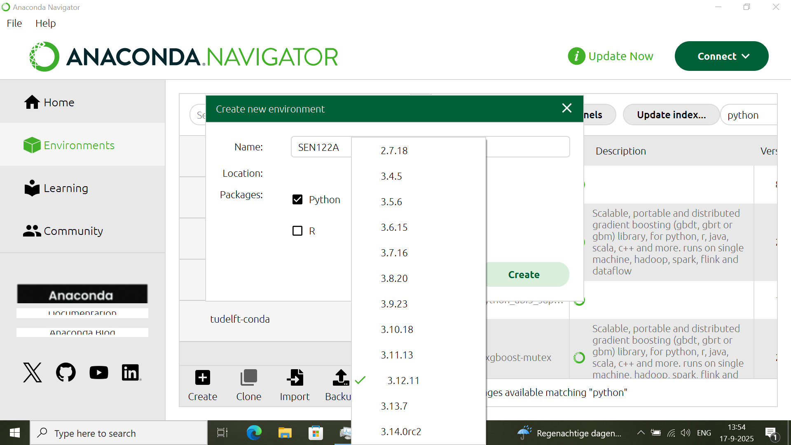
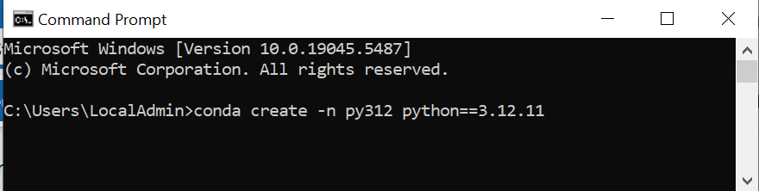
Set up Python environment using Conda
C) Create environment from environment.yaml
The environment.yaml file configures Python 3.13 and all required packages in a single step.
1. Open Anaconda Prompt (Windows) or Terminal (Mac/Linux)
2. Navigate to the extracted repository folder:
  cd Documents\Courses\SEN122A\SEN122A_2026-main
3. Create the environment by running:
  conda env create -f environment.yaml
  • Creates SEN122A. Be patient — this takes a few minutes.
4. Activate the environment:
  conda activate SEN122A
Backup: pip install -r requirements_SEN.txt for non-Conda setups.
4

Slide 5

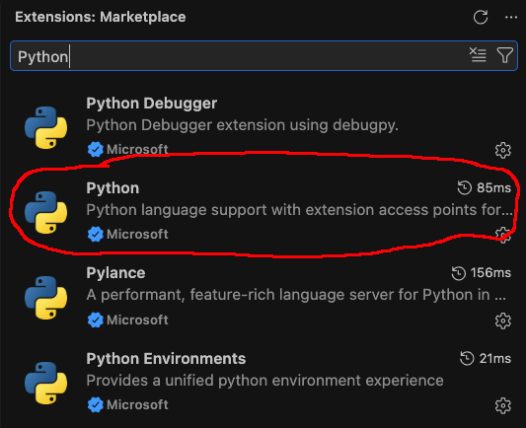
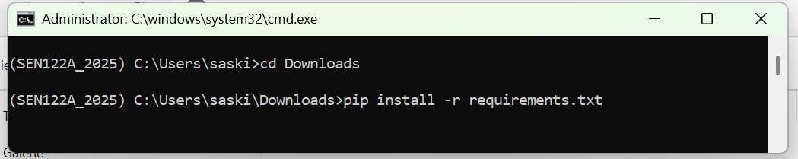

Set up Python environment using Conda
D) Install Visual Studio Code & Extensions
Download Visual Studio Code:
  code.visualstudio.com/Download
Run the installer and launch VS Code.
Install the Python extension:
  • Click Extensions icon on the left Activity Bar
  • Search for Python (by Microsoft) → click Install
Install the Jupyter extension:
  • Search for Jupyter (by Microsoft) → click Install
5

Slide 6
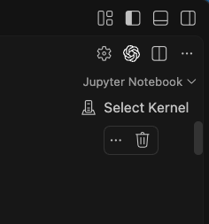
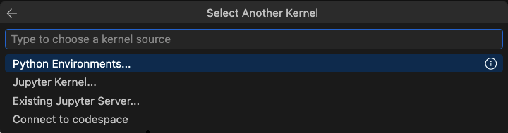
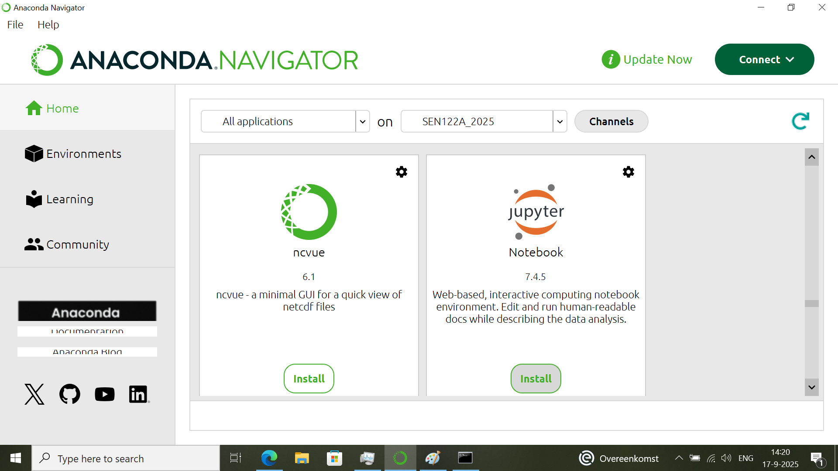
Set up Python environment using Conda
E) Start your lab session
1. Open Visual Studio Code.
2. Select File → Open Folder…
  • Choose repository ROOT folder (e.g. Documents\Courses\SEN122A\SEN122A_2026-main)
  • ⚠️ Do NOT open an individual lab session folder directly!
3. In Explorer sidebar, open Lab_sessions and click your notebook (.ipynb).
4. In top-right corner, click Select Kernel.
5. Click Python Environments… and choose SEN122A.
6. Run notebook cells using the play button!
6

