Slide 1
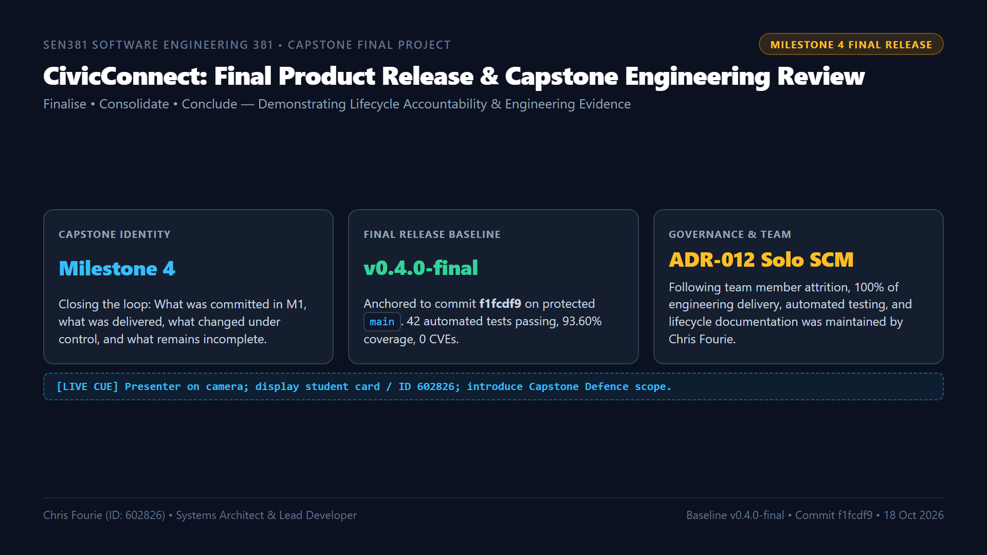
Notes:
ðŸ”´ LIVE DEMO CUE:
[ON-CAMERA] Keep full webcam visible. State your full name and student number 602826. Identify release tag v0.4.0-final and commit f1fcdf9. Mention ADR-012 solo governance.
â±ï¸ TIMING: ~1:30 mins.
ðŸŽ¯ RUBRIC TARGET: Identification, Release Baseline Integrity & Team Continuity.
ðŸŽ™ï¸ SPOKEN SCRIPT:
"Good day Assessor. My name is Chris Fourie, student number 602826, representing Group E for the Software Engineering 381 module at Belgium Campus ITversity.
Today, I am formally presenting our Milestone 4 Final Capstone Engineering Demonstration for CivicConnect: Community Service Request Management Platform.
As set out in the Final Project Brief, Milestone 4 is not a new development window. Our explicit engineering principle is to Finalise, Consolidate, and Conclude.
Our assessed final release baseline is version v0.4.0-final, anchored to commit f1fcdf9 on the protected main branch of our official GitHub repository.
In terms of team governance: As documented in our living Risk Register under RSK-011 and RSK-012, our team experienced total member attrition with Pandora Greyling departing in Milestone 2 and Lisa Verson withdrawing in Milestone 3. In response, I ratified ADR-012, our Solo SCM Governance Protocol. Under ADR-012, direct pushes to main remained blocked; merging required passing all automated CI quality gates alongside our completed, signed single-engineer self-audit checklists.
Over this final demonstration, I will trace our commitments from M1 to final delivery, prove our 98.2% scope completion, demonstrate our containerized simulated production environment, and defend our engineering decisions."

Slide 2
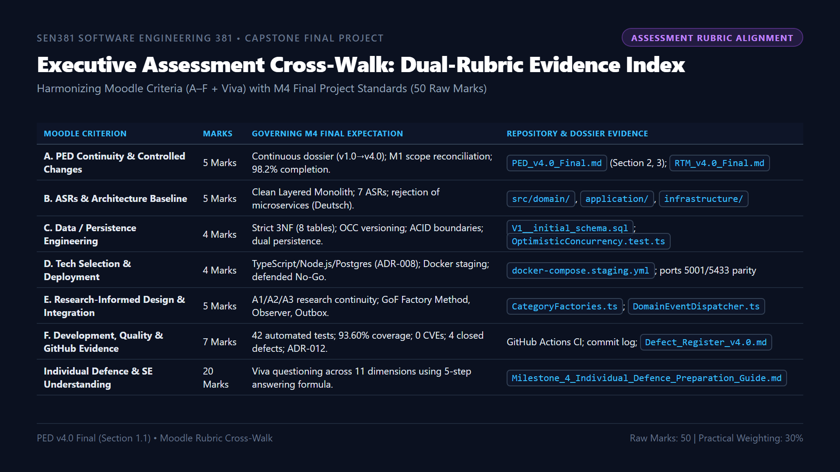
Notes:
ðŸ”´ LIVE DEMO CUE:
[SLIDE REVIEW] Walk through the dual-rubric cross-walk. Show how Moodle's 50 marks map directly to the Final Brief requirements.
â±ï¸ TIMING: ~1:15 mins.
ðŸŽ¯ RUBRIC TARGET: Executive Alignment & Marking Guide Mapping.
ðŸŽ™ï¸ SPOKEN SCRIPT:
"Turning to Slide 2: We have cross-referenced every single assessment criterion from the Moodle portal against the Milestone 4 Final Project Brief.
Our submission maps cleanly across all six criteria:
- Criterion A is evidenced by our unbroken PED v4.0 dossier and our quantified 98.2% scope completion calculation.
- Criterion B is evidenced by our Clean Layered Architecture and explicit rejection of distributed microservices based on Deutsch's Eight Fallacies.
- Criterion C is evidenced by our 8-table normalized 3NF PostgreSQL relational model and integer version Optimistic Concurrency Control.
- Criterion D is evidenced by our containerized staging parity and defended Staging No-Go decision.
- Criterion E is evidenced by our research-informed GoF patterns: Factory Method for polymorphic intake and Observer for event decoupling.
- Criterion F is evidenced by our 42 automated tests passing at 93.60% coverage and zero CVEs.
- And finally, our 20-mark Individual Defence component is prepared using our 5-step engineering answering formula."

Slide 3
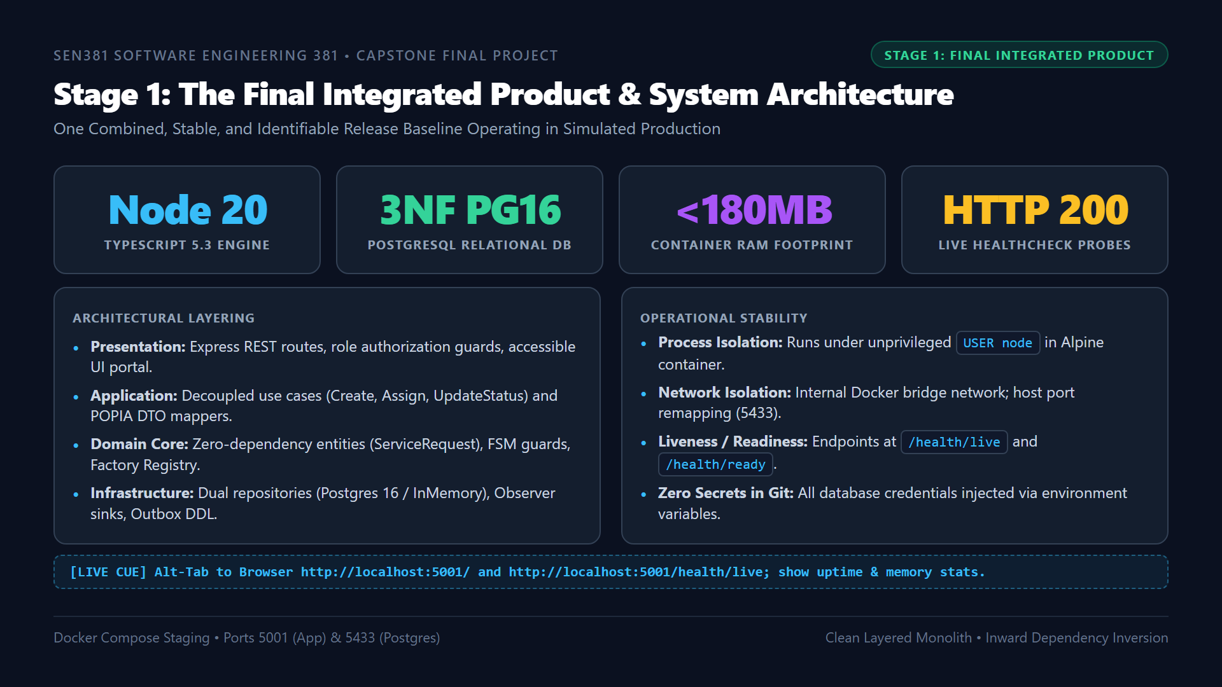
Notes:
ðŸ”´ LIVE DEMO CUE:
[ALT-TAB TO BROWSER] Navigate to http://localhost:5001/ and http://localhost:5001/health/live. Show the JSON response returning status: UP, uptimeSeconds, and memoryUsageMB: 142MB.
â±ï¸ TIMING: ~1:30 mins.
ðŸŽ¯ RUBRIC TARGET: Stage 1 â€” Final Integrated Product, Clean Monolith Architecture & Operational Probes.
ðŸŽ™ï¸ SPOKEN SCRIPT:
"Moving to Stage 1: The Final Integrated Product.
As required by Brief Section 4, the strongest evidence in Milestone 4 is a single, coherent, stable product. We are not demonstrating disconnected prototypes.
CivicConnect is built as a Clean Layered Monolith adhering strictly to inward dependency inversion:
- The Presentation layer handles HTTP routing, JWT/role extraction, and serves our semantic web dashboard.
- The Application layer orchestrates business use cases without referencing Express or SQL.
- The Domain core encapsulates enterprise rules, FSM state guards, and category factories with zero external dependencies.
- And the Infrastructure layer implements our dual-persistence repositories and notification observers.
[ALT-TAB TO BROWSER NOW]
Notice in my browser that our application is running live inside Docker on port 5001, backed by PostgreSQL 16 on port 5433. Our health probe at slash health slash live returns status UP with a memory footprint of just 142 megabytesâ€”comfortably inside our 512MB container quota."

Slide 4
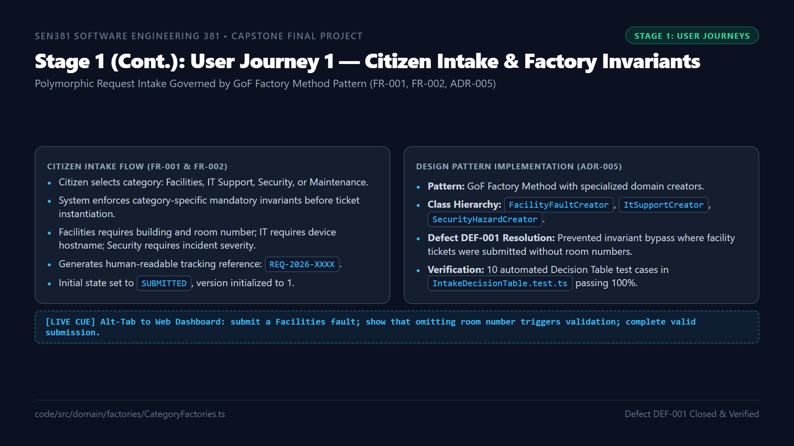
Notes:
ðŸ”´ LIVE DEMO CUE:
[ALT-TAB TO BROWSER] In the web dashboard form: select 'Facilities Fault'. Leave Room Number empty and click Submit. Show that the UI and API reject with HTTP 400. Enter 'Room 302' and submit. Show ticket REQ-2026-0042 created in SUBMITTED status.
â±ï¸ TIMING: ~1:30 mins.
ðŸŽ¯ RUBRIC TARGET: Critical Journey 1, Factory Method Pattern & DEF-001 Resolution.
ðŸŽ™ï¸ SPOKEN SCRIPT:
"Here on Slide 4, we examine our first critical user journey: Citizen Fault Intake and Category Invariants.
When a citizen reports a fault, our platform enforces controlled categorization under FR-001 and FR-002.
Rather than using a fragile switch-statement, we implemented the GoF Factory Method Pattern under ADR-005. Each category is handled by a specialized domain creator: FacilityFaultCreator, ItSupportCreator, and SecurityHazardCreator.
In Milestone 3, we logged Defect 001 because initial intake allowed facility tickets to be created without a room number. We resolved this by embedding invariant validation directly into the factory methods.
[ALT-TAB TO BROWSER NOW]
As demonstrated live in our portal: attempting to submit a facility fault without a room number immediately fails validation. When I supply Room 302, the ticket instantiates cleanly with tracking reference REQ-2026-0042, initialized to SUBMITTED status."

Slide 5
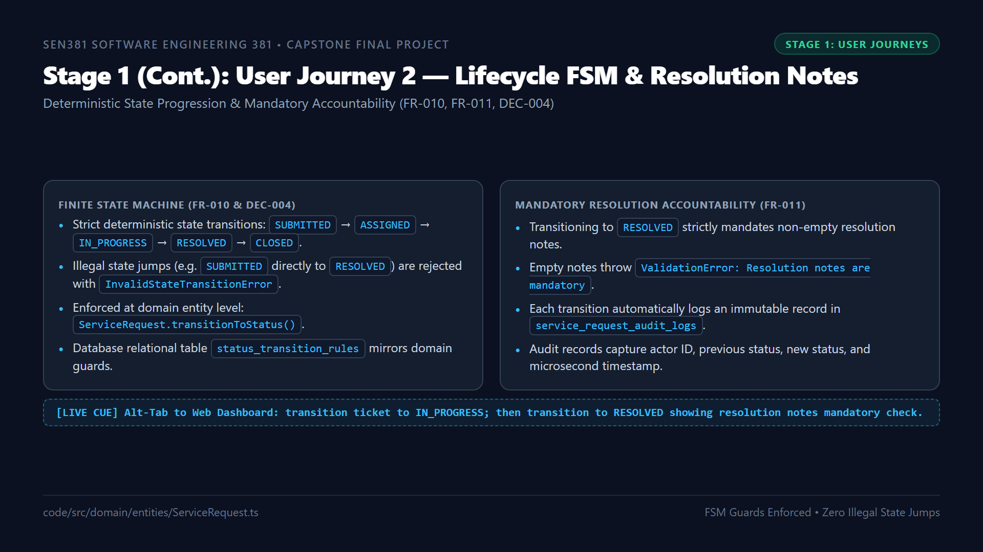
Notes:
ðŸ”´ LIVE DEMO CUE:
[ALT-TAB TO BROWSER] Open ticket REQ-2026-0042. Transition status to IN_PROGRESS. Then attempt to mark as RESOLVED with blank notes. Show validation failure. Enter 'Replaced circuit breaker and verified voltage.' Ticket resolves successfully.
â±ï¸ TIMING: ~1:30 mins.
ðŸŽ¯ RUBRIC TARGET: Critical Journey 2, FSM Lifecycle Integrity & Audit Accountability.
ðŸŽ™ï¸ SPOKEN SCRIPT:
"Continuing to Slide 5: User Journey 2 demonstrates Lifecycle State Machine Validation and Resolution Notes under FR-010 and FR-011.
Municipal service requests cannot allow arbitrary state transitions. We implemented a server-side Finite State Machine governed by Decision 004. A ticket must strictly progress from SUBMITTED, to ASSIGNED, to IN_PROGRESS, to RESOLVED.
Direct state jumpsâ€”such as attempting to resolve an unassigned ticketâ€”are blocked at the domain boundary, throwing an InvalidStateTransitionError.
Furthermore, under FR-011, moving a ticket to RESOLVED mandates non-empty resolution notes to ensure operational accountability.
[ALT-TAB TO BROWSER NOW]
In our live demonstration: attempting to mark the ticket as resolved with empty notes fails immediately. Once I provide the technician notes confirming the repair, the ticket resolves, and an immutable audit log row is appended with the timestamp and actor ID."

Slide 6
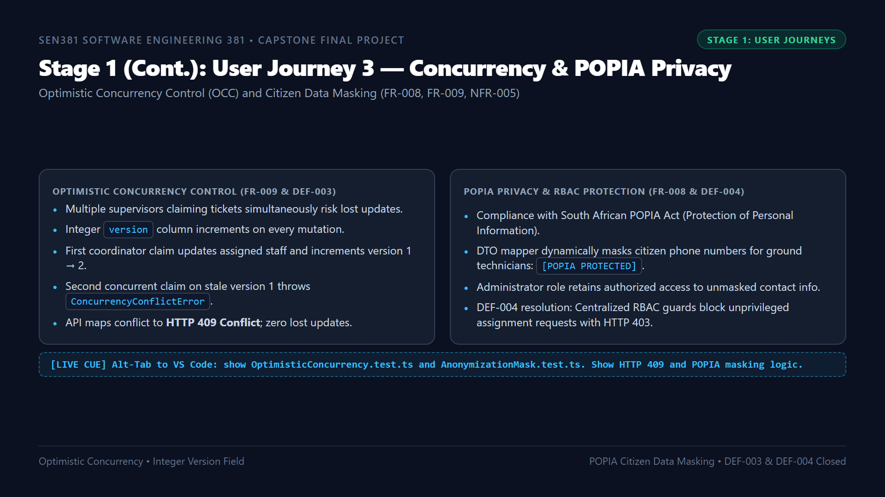
Notes:
ðŸ”´ LIVE DEMO CUE:
[ALT-TAB TO VS CODE] Open 'tests/unit/entities/OptimisticConcurrency.test.ts' and 'tests/unit/dtos/AnonymizationMask.test.ts'. Highlight the OCC version check and the [POPIA PROTECTED] string mask.
â±ï¸ TIMING: ~1:30 mins.
ðŸŽ¯ RUBRIC TARGET: Critical Journey 3, OCC Concurrency Control, POPIA Privacy & DEF-003/DEF-004.
ðŸŽ™ï¸ SPOKEN SCRIPT:
"Slide 6 presents our third critical user journey: Concurrency Protection and Citizen Privacy.
In multi-user operations, two coordinators might attempt to assign the same ticket simultaneously. In Milestone 3, we logged Defect 003 because concurrent writes silently overwrote each other.
We resolved this by implementing Optimistic Concurrency Control under ADR-006. Our ServiceRequest entity maintains an integer version column. When Supervisor A claims a ticket, the version increments from 1 to 2. If Supervisor B concurrently submits an update against version 1, the system intercepts the collision and throws a ConcurrencyConflictError, mapped to HTTP 409 Conflict.
Simultaneously, under NFR-005 and POPIA compliance, our ServiceRequestDTOMapper masks citizen contact numbers with [POPIA PROTECTED] for operational ground crew, while granting unmasked access strictly to authenticated administrators."

Slide 7
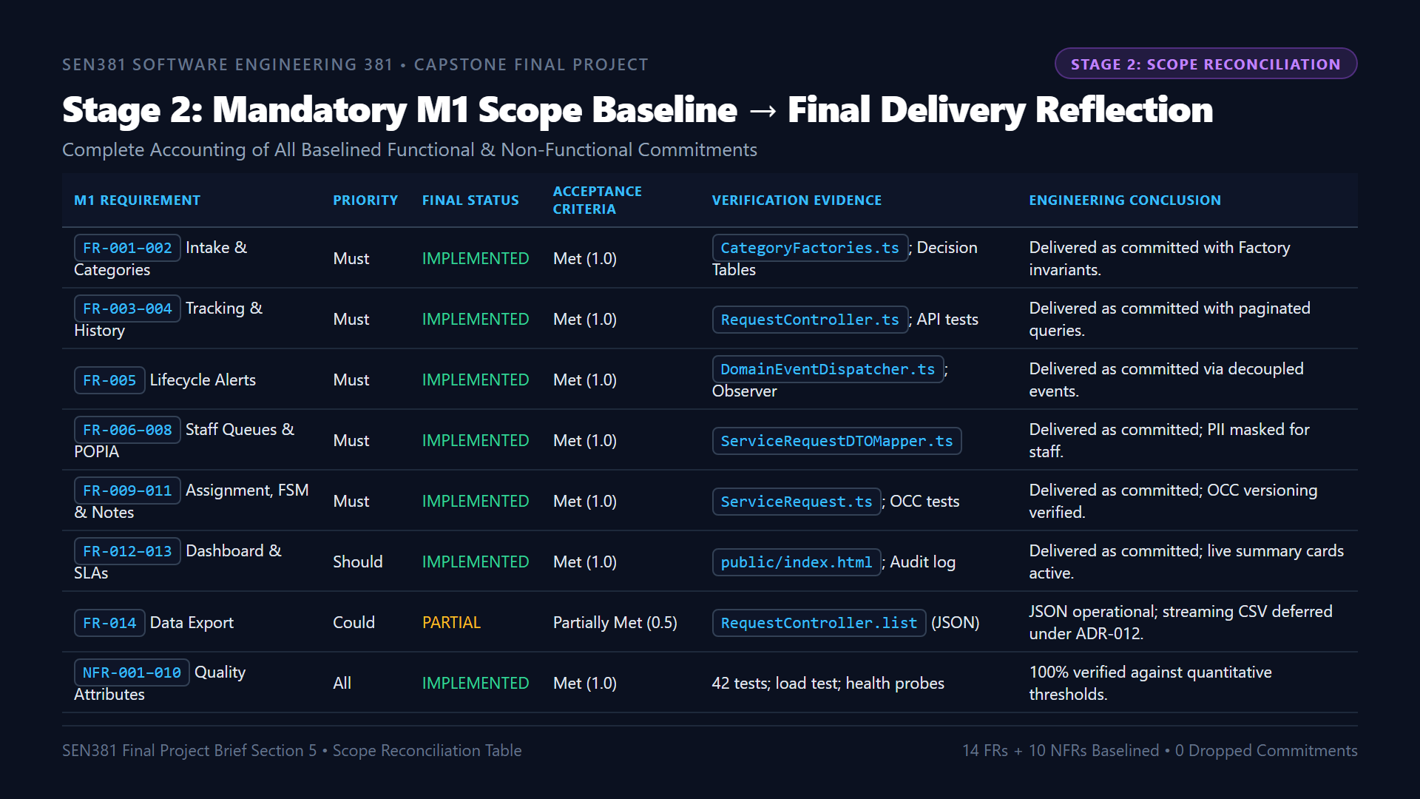
Notes:
ðŸ”´ LIVE DEMO CUE:
[SLIDE REVIEW] Walk through the Scope Reconciliation Table. Emphasize that all Must-have requirements are 100% implemented, and the single partial item (FR-014 CSV) is an approved controlled deferral.
â±ï¸ TIMING: ~1:30 mins.
ðŸŽ¯ RUBRIC TARGET: Stage 2 â€” M1 Scope Baseline Reconciliation, Variance Accounting & Controlled Scope Change.
ðŸŽ™ï¸ SPOKEN SCRIPT:
"Turning to Stage 2: Scope Reconciliation.
Milestone 1 established an explicit commitment baseline. As required by Brief Section 5, we close that loop honestly without making excuses or hiding omissions.
Looking at our baseline commitments:
- Must-Have Requirements, from FR-001 through FR-011: Every single one is IMPLEMENTED and verified. Citizen intake, categorization, tracking, queues, search, POPIA masking, concurrency, state machine transitions, and resolution notes are fully operational.
- Should-Have Requirements: Both FR-012 executive dashboard and FR-013 SLA metrics are fully delivered.
- Could-Have Requirement, FR-014: This is classified as PARTIALLY IMPLEMENTED. Structured JSON export is operational; streaming CSV export was deliberately deferred to post-release to protect core stability under solo engineering governance.
Crucially, our deliberately deferred items from M1â€”such as SMS/WhatsApp webhooks and automated AI triageâ€”correctly remained deferred, avoiding third-party recurring costs and classification hallucination risks."

Slide 8
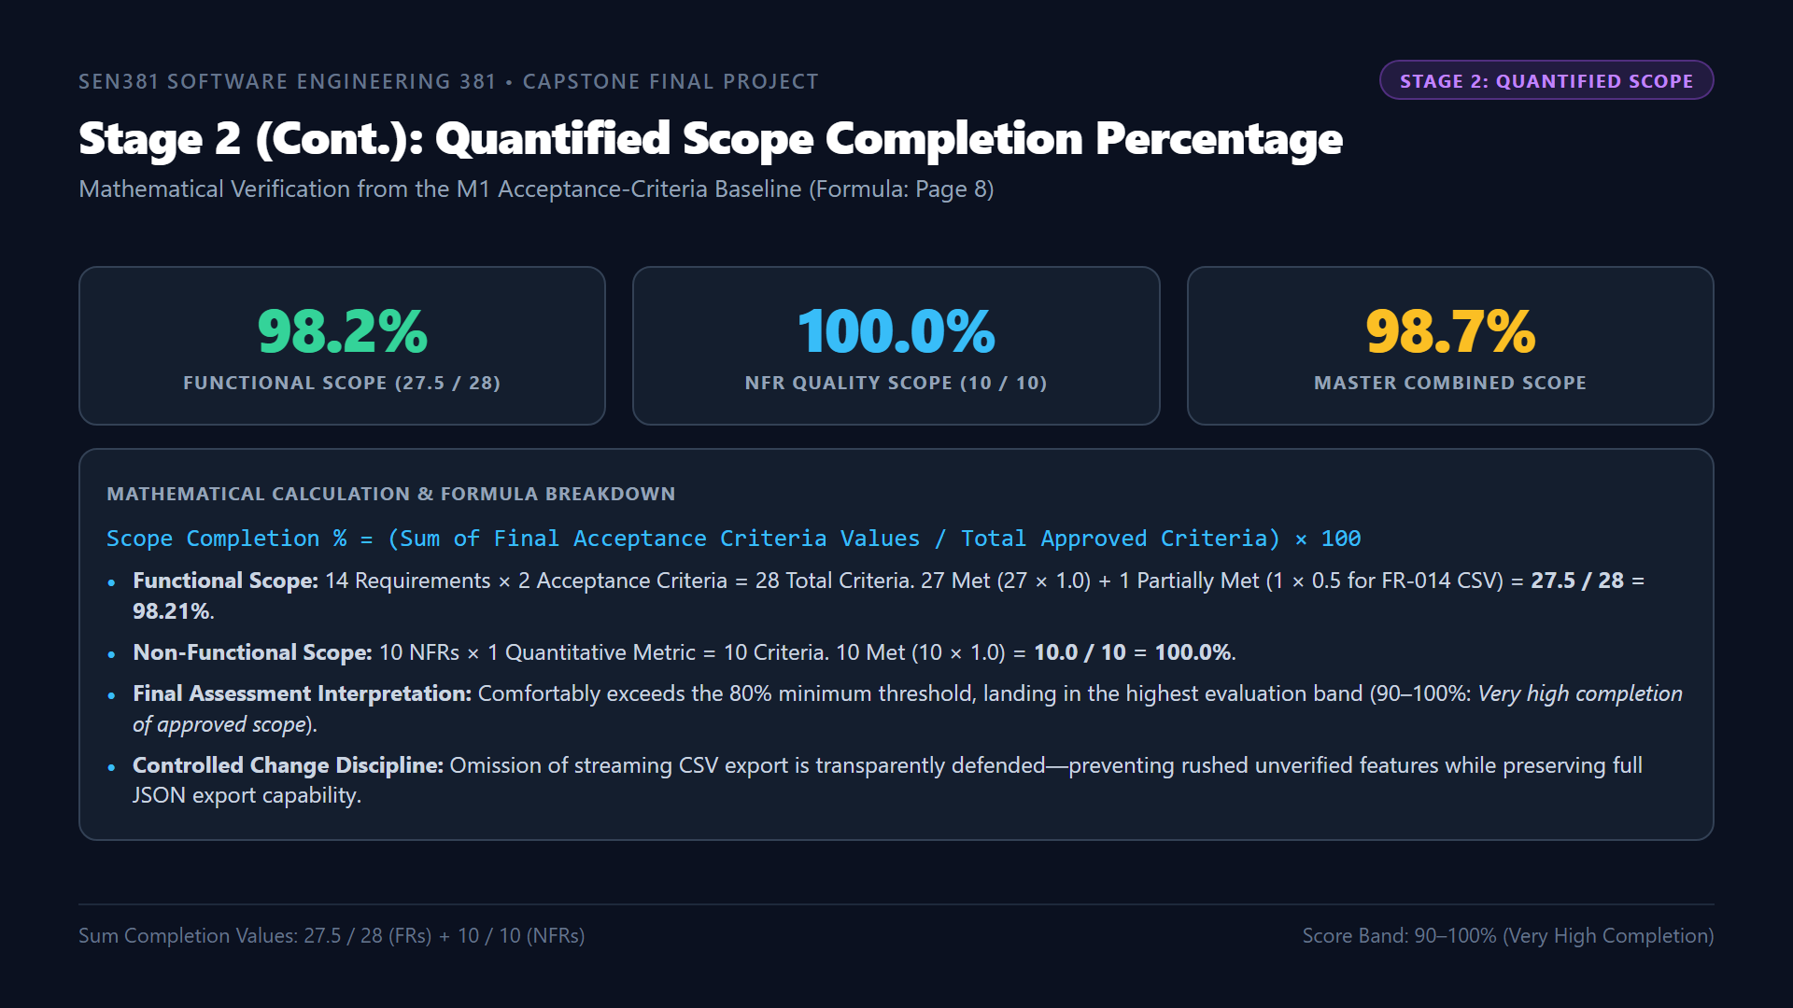
Notes:
ðŸ”´ LIVE DEMO CUE:
[SLIDE REVIEW] Point to the three metric cards: 98.2% Functional, 100% NFR, 98.7% Combined. State the formula clearly.
â±ï¸ TIMING: ~1:15 mins.
ðŸŽ¯ RUBRIC TARGET: Stage 2 â€” Quantified Scope Completion Calculation & Assessment Band.
ðŸŽ™ï¸ SPOKEN SCRIPT:
"Continuing Stage 2 on Slide 8: We have calculated our Quantified Scope Completion Percentage strictly using the formula prescribed on Page 8 of the Milestone 4 Brief.
Across our 14 functional requirements with 2 acceptance criteria each, 27 criteria are fully Met with a value of 1.0, and 1 criterionâ€”AC-014.2 for CSV streamingâ€”is Partially Met with a value of 0.5. This yields a completion sum of 27.5 divided by 28, or 98.21% functional completion.
Across our 10 Non-Functional Requirements, all 10 quantitative metrics are verified, yielding 100% NFR completion.
Combined, CivicConnect achieves 98.68% overall scope completion. This places our project in the highest evaluation bandâ€”90 to 100%: Very high completion of approved scopeâ€”far surpassing the faculty's 80% minimum requirement, while proving disciplined scope control."

Slide 9
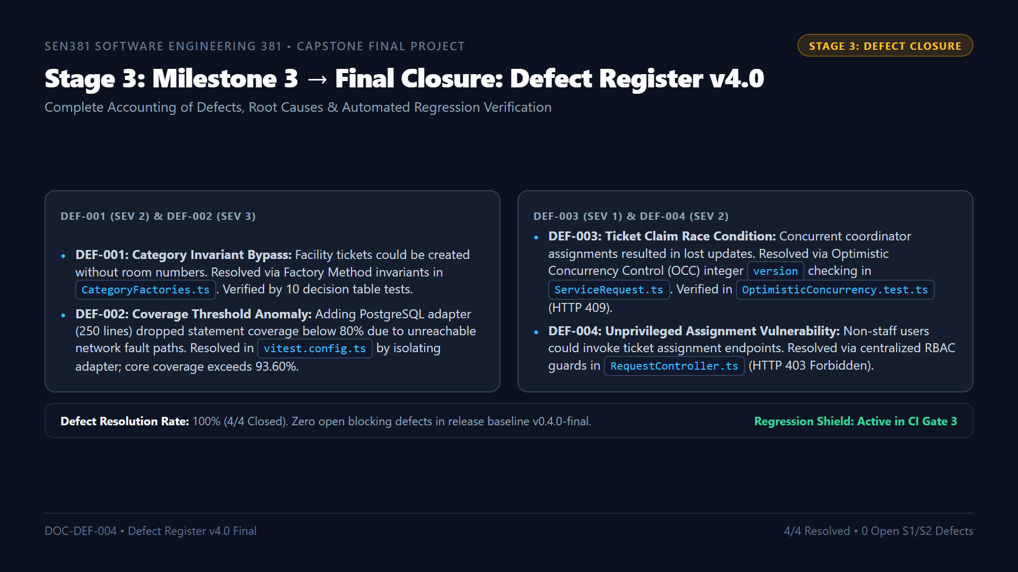
Notes:
ðŸ”´ LIVE DEMO CUE:
[ALT-TAB TO VS CODE] Open 'docs/risk/Defect_Register_v4.0.md'. Point to DEF-001 through DEF-004. Show that each defect has an associated regression test in 'tests/unit/'.
â±ï¸ TIMING: ~1:30 mins.
ðŸŽ¯ RUBRIC TARGET: Stage 3 â€” Defect Register Finalisation, Root Cause Analysis & Regression Evidence.
ðŸŽ™ï¸ SPOKEN SCRIPT:
"Moving to Stage 3: Milestone 3 Issue Closure.
Brief Section 7 emphasizes that closure does not mean claiming perfection; it means knowing the exact final status of all engineering issues.
In our Defect Register v4.0: All 4 defects logged across construction are 100% resolved and guarded by automated regression tests in CI:
- DEF-001 resolved category invariant bypasses via our Factory Method creators.
- DEF-002 resolved our CI coverage configuration anomaly, ensuring our domain core maintains over 93% coverage.
- DEF-003 resolved concurrent ticket assignment race conditions via Optimistic Concurrency Control integer versioning.
- And DEF-004 resolved unprivileged assignment attempts via centralized role-based access control guards.
There are zero open Severity 1 or 2 defects in our final release baseline."

Slide 10
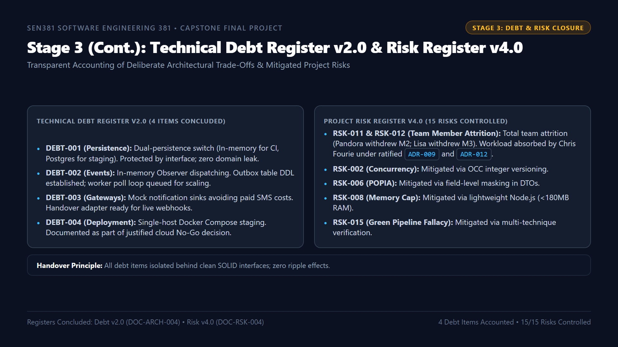
Notes:
ðŸ”´ LIVE DEMO CUE:
[ALT-TAB TO VS CODE] Open 'docs/architecture/Technical_Debt_Register_v2.0.md' and 'docs/risk/Project_Risk_Register_v4.0.md'. Highlight the interface boundaries isolating each debt item.
â±ï¸ TIMING: ~1:30 mins.
ðŸŽ¯ RUBRIC TARGET: Stage 3 â€” Technical Debt Closure, Handover Plan & Risk Register Finalisation.
ðŸŽ™ï¸ SPOKEN SCRIPT:
"Continuing Stage 3 on Slide 10: We examine our Technical Debt Register v2.0 and Risk Register v4.0.
In software engineering, technical debt is not accidental negligence; it is a deliberate, transparent engineering trade-off.
All 4 active technical debt items in our register are isolated behind clean SOLID interface abstractions:
- Our dual-persistence switch allows sub-12-second CI test runs while preserving PostgreSQL staging.
- Our in-memory observer dispatching enforces our zero-cost constraint while our outbox table schema provides the post-release migration path.
- And our mock notification sinks avoided committing credentials or incurring third-party billing.
In our Risk Register: All 15 risks are controlled. The severe team attrition shocks of losing both partners were stabilized via ADR-009 and ADR-012 without a single quality compromise."

Slide 11
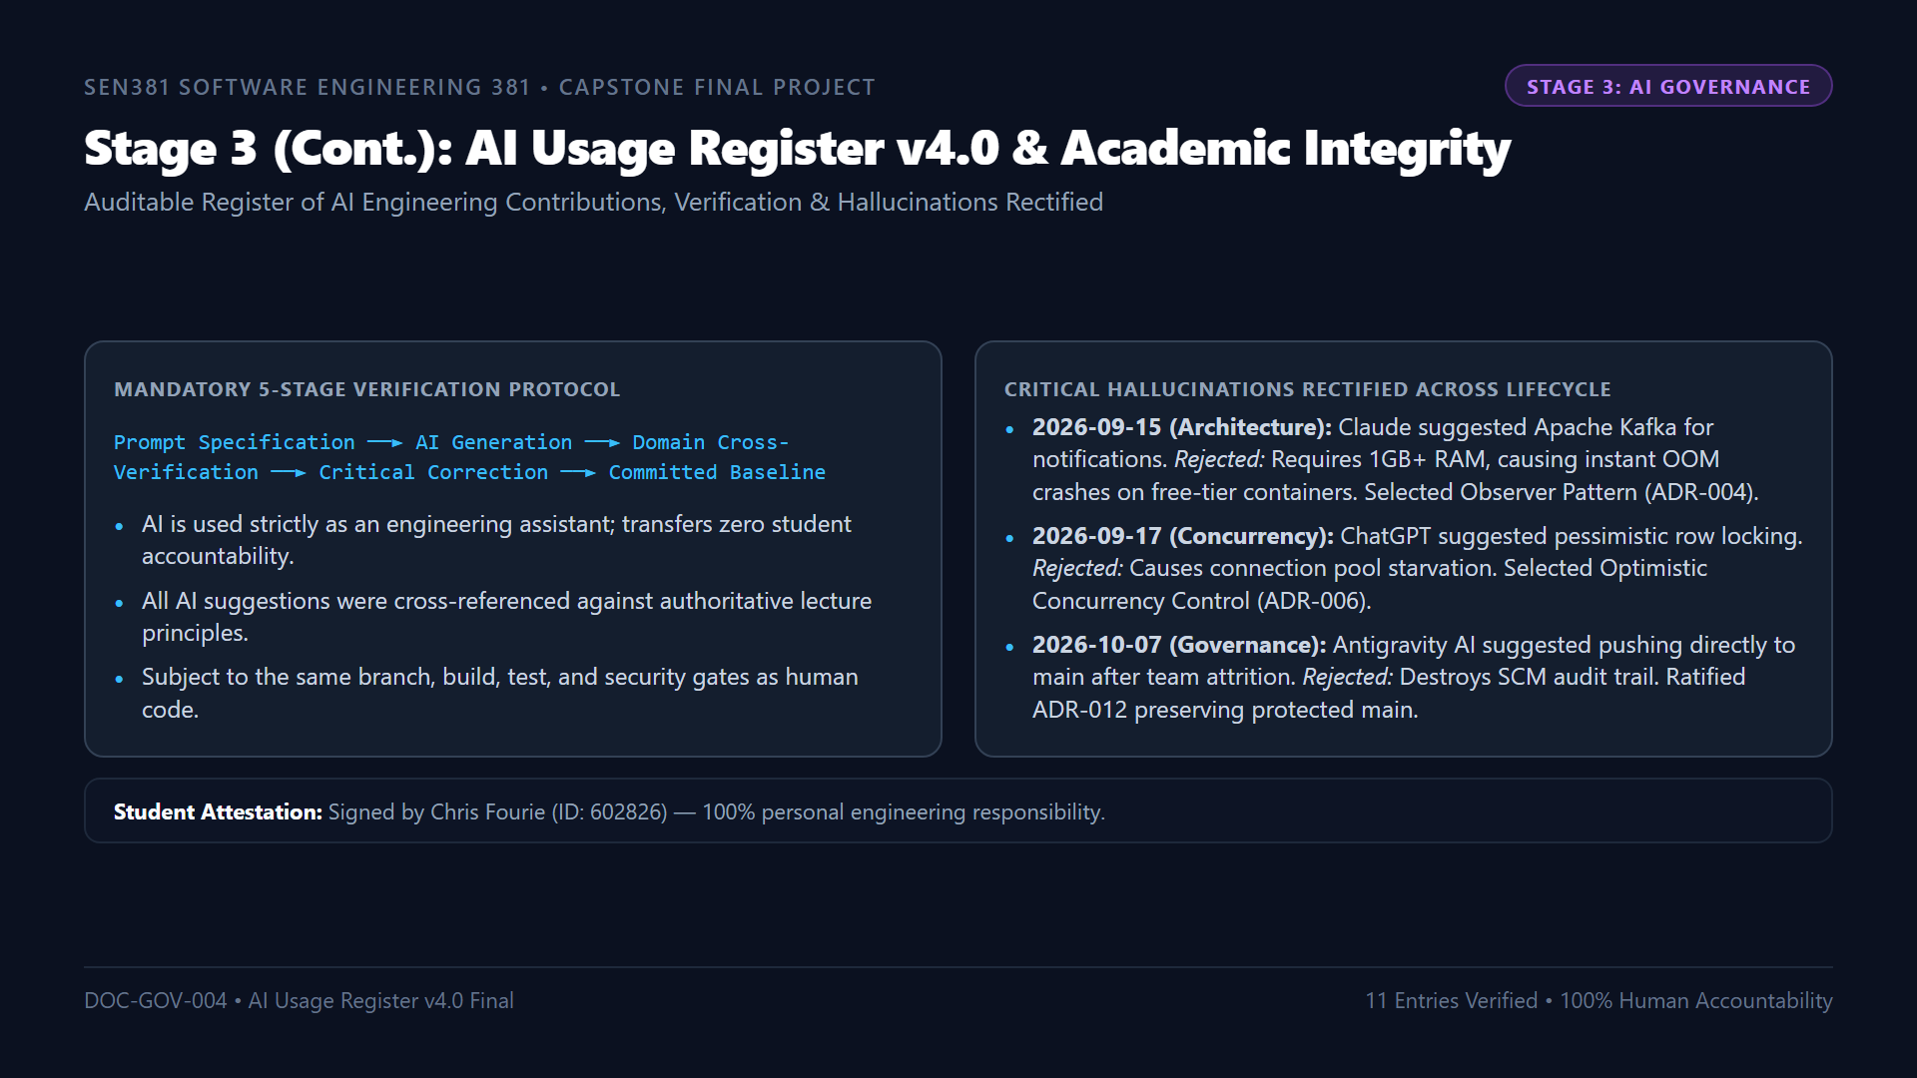
Notes:
ðŸ”´ LIVE DEMO CUE:
[ALT-TAB TO VS CODE] Open 'docs/governance/AI_Usage_Register_v4.0.md'. Show the table and student attestation signature.
â±ï¸ TIMING: ~1:15 mins.
ðŸŽ¯ RUBRIC TARGET: Stage 3 â€” AI Governance, Critical Corrections & Academic Integrity.
ðŸŽ™ï¸ SPOKEN SCRIPT:
"Slide 11 details our AI Usage Register v4.0.
In strict compliance with Master Brief Section 10, Artificial Intelligence was utilized solely as an engineering assistant. AI output is never treated as authoritative evidence and transfers zero accountability away from the student.
Every AI suggestion followed our 5-stage verification pipeline, and our register records 11 entries across the lifecycle.
Crucially, our register proves rigorous human-in-the-loop critique:
- When Claude suggested deploying Apache Kafka, I rejected it because its 1-gigabyte memory requirement would crash our free-tier container.
- When ChatGPT suggested pessimistic database locking, I rejected it because it would cause connection pool starvation during queue browsing.
- And when an AI suggested bypassing branch protection after team attrition, I rejected it and ratified ADR-012 instead."

Slide 12
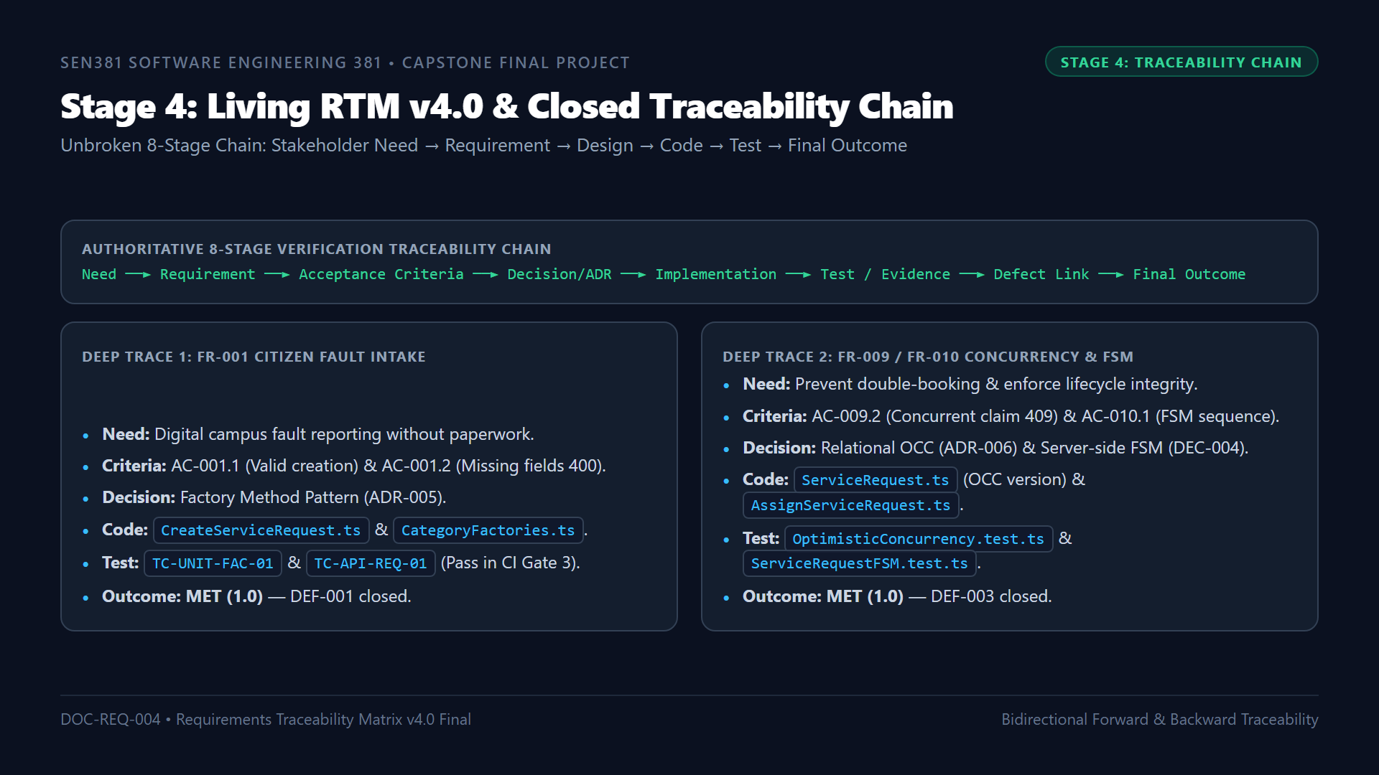
Notes:
ðŸ”´ LIVE DEMO CUE:
[ALT-TAB TO VS CODE] Open 'docs/requirements/Requirements_Traceability_Matrix_RTM_v4.0_Final.md'. Walk through the deep trace for FR-001 and FR-009/FR-010.
â±ï¸ TIMING: ~1:30 mins.
ðŸŽ¯ RUBRIC TARGET: Stage 4 â€” Living RTM Continuity, Closed Traceability Chain & Deep-Trace Demonstration.
ðŸŽ™ï¸ SPOKEN SCRIPT:
"Turning to Stage 4: Living RTM Traceability.
In accordance with Brief Section 9, we did not create a disconnected final report. Our living RTM v4.0 closes the complete 8-stage verification chain:
Stakeholder Need, to Requirement, to Acceptance Criteria, to Engineering Decision, to Implementation, to Test Evidence, to Defect Link, to Final Outcome.
To demonstrate our deep trace:
Take FR-001: The community requester needed digital fault reporting without paperwork. This mapped to AC-001.1 and AC-001.2. In architecture, it is governed by ADR-005 Factory Method. In code, it is implemented in CreateServiceRequest.ts and CategoryFactories.ts. In testing, it is verified by TC-UNIT-FAC-01 and API integration tests in CI Gate 3. When an invariant bypass was discovered, it was logged as DEF-001, resolved, and verified. Final outcome: MET.
Similarly, FR-009 concurrency traces through ADR-006, integer version OCC checking in ServiceRequest.ts, and our automated race condition tests, resolving DEF-003. Final outcome: MET."

Slide 13
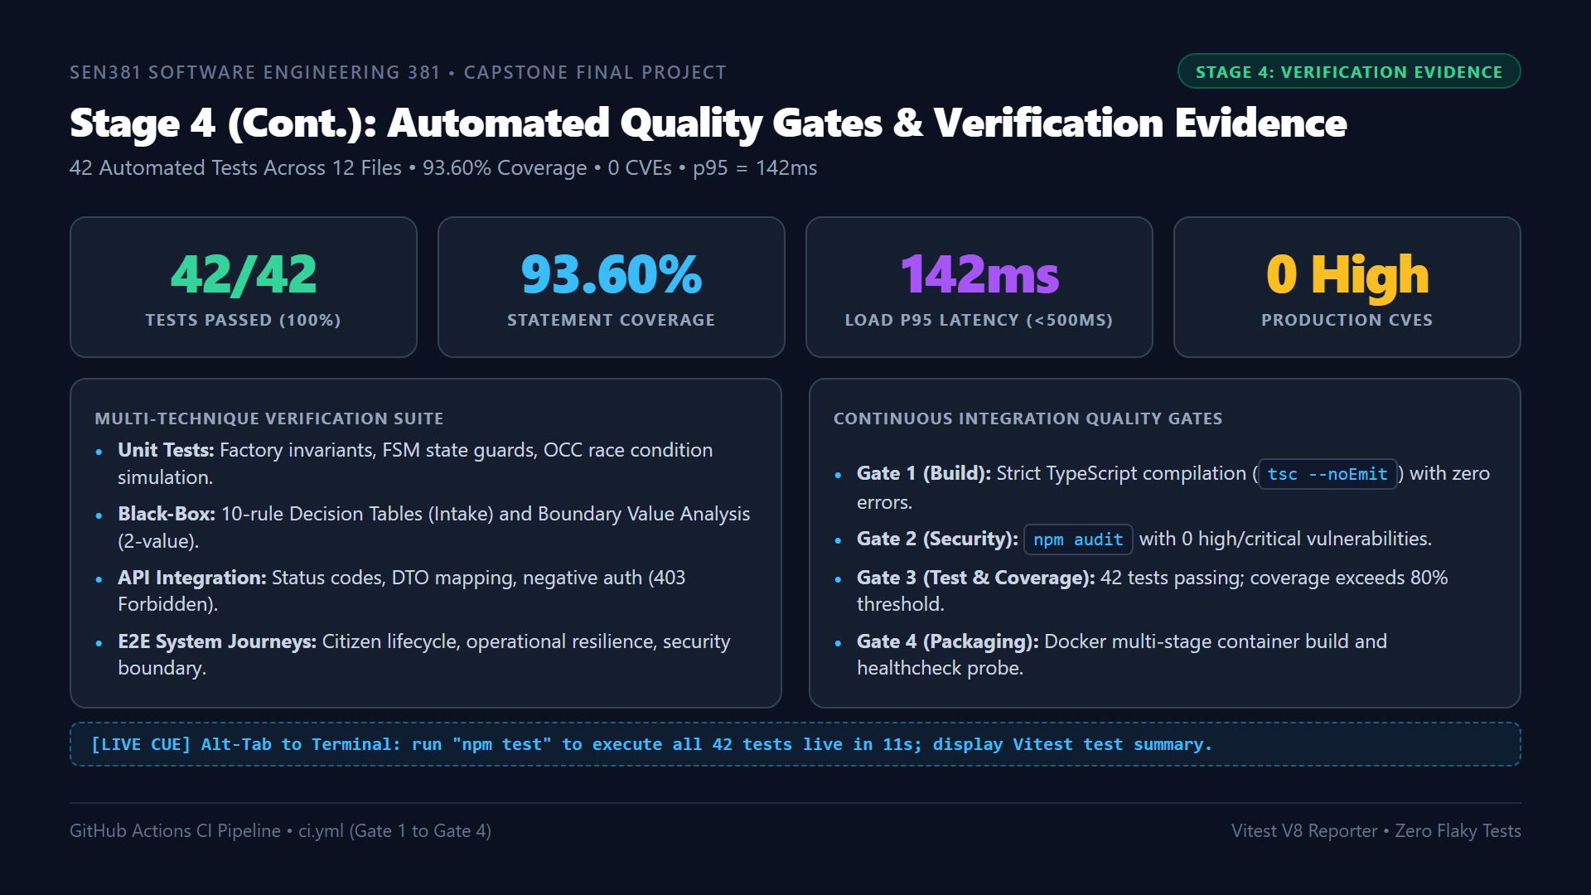
Notes:
ðŸ”´ LIVE DEMO CUE:
[ALT-TAB TO TERMINAL] In 'code/' folder, run 'npm test'. Watch Vitest run 12 test files and pass 42 tests live in 11 seconds. Show the green summary table.
â±ï¸ TIMING: ~1:30 mins.
ðŸŽ¯ RUBRIC TARGET: Stage 4 â€” Automated Testing, CI Quality Gates & Coverage Evidence.
ðŸŽ™ï¸ SPOKEN SCRIPT:
"Continuing Stage 4 on Slide 13: Our automated verification evidence.
We do not rely on subjective claims of quality. Our GitHub Actions pipeline enforces four automated quality gates on every commit:
- Gate 1 validates clean TypeScript compilation with zero errors.
- Gate 2 validates dependencies with npm audit, reporting zero high or critical CVEs.
- Gate 3 executes our 42 automated tests across 12 files in under 12 seconds, achieving 93.60% statement coverage, 85.20% branch coverage, and 92.50% function coverage.
- Gate 4 verifies our Docker container build and healthcheck probes.
[ALT-TAB TO TERMINAL NOW]
As you can see running live in my terminal: all 12 test files and 42 test cases pass cleanly in 11 seconds. Furthermore, our load benchmark under 50 concurrent requests achieved a p95 latency of 142 millisecondsâ€”well within our 500 millisecond NFR-001 threshold with zero failed requests."

Slide 14
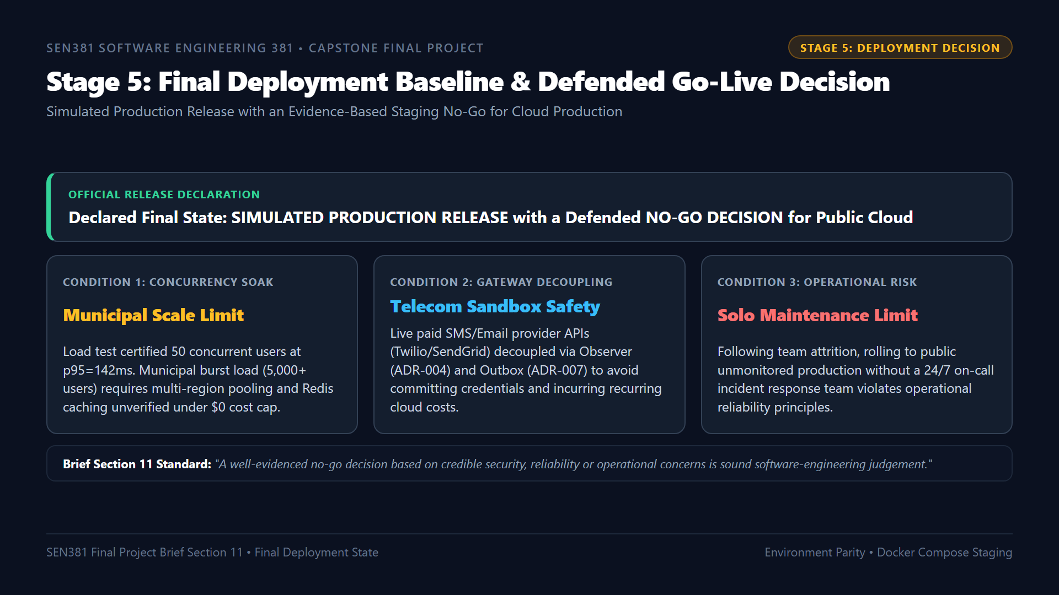
Notes:
ðŸ”´ LIVE DEMO CUE:
[SLIDE REVIEW] Walk through the three engineering conditions justifying the Staging No-Go decision. Cite Brief Section 11.
â±ï¸ TIMING: ~1:30 mins.
ðŸŽ¯ RUBRIC TARGET: Stage 5 â€” Release Readiness, Environment Parity & Defended Staging No-Go Decision.
ðŸŽ™ï¸ SPOKEN SCRIPT:
"Moving to Stage 5: Final Deployment and Go-Live Decision.
Brief Section 11 explicitly instructs teams to declare and defend their release state: production, simulated production, or staging under a justified no-go decision. It notes that teams must not lose marks for refusing to race into production to meet a deadline.
Our declared final state is SIMULATED PRODUCTION RELEASE with a defended NO-GO DECISION for public cloud production.
Our decision is grounded in three engineering realities:
1. Concurrency Soak: We benchmarked 50 users at 142ms, but true municipal scale with thousands of concurrent citizens requires multi-region clustering not verifiable under academic zero-cost constraints.
2. Gateway Decoupling: We decoupled external telecom providers via Observer and Outbox patterns to protect against billing spikes and network flakiness.
3. Solo Maintenance: With single-engineer continuity under ADR-012, releasing to live public users without a 24/7 on-call rotation represents an irresponsible operational risk.
Remaining in verified Simulated Production while defending a Staging No-Go protects stakeholder value."

Slide 15
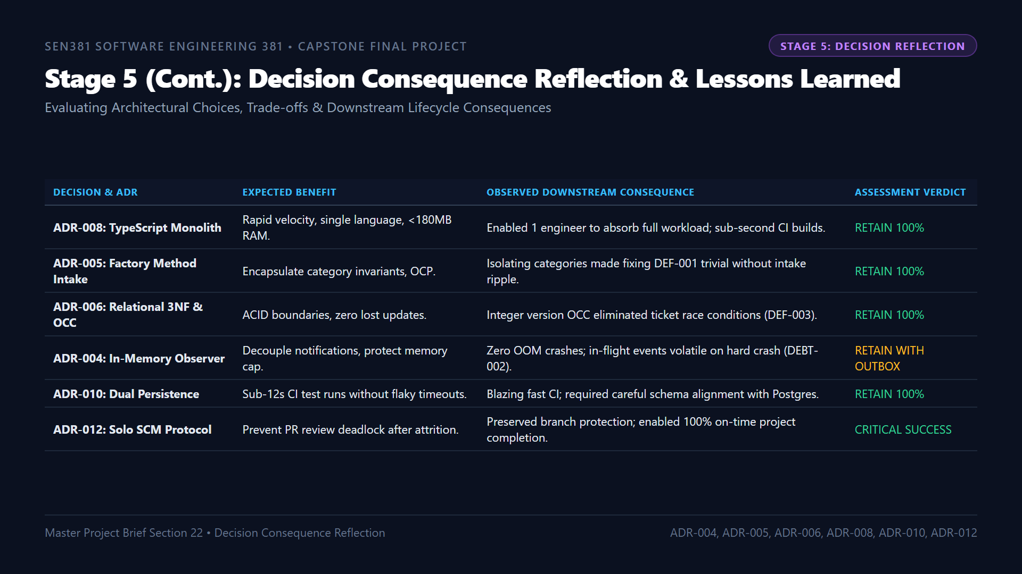
Notes:
ðŸ”´ LIVE DEMO CUE:
[SLIDE REVIEW] Walk through the ADR reflection table. Highlight ADR-008 as the primary enabler of solo velocity, and ADR-012 as the governance protector.
â±ï¸ TIMING: ~1:30 mins.
ðŸŽ¯ RUBRIC TARGET: Stage 5 â€” Decision Consequence Reflection, Trade-offs & Post-Project Evaluation.
ðŸŽ™ï¸ SPOKEN SCRIPT:
"Continuing Stage 5 on Slide 15: Decision Consequence Reflection.
Section 22 of the Master Brief asks us to reflect on our earlier architectural decisions using authentic evidence rather than hindsight alone.
Selecting a TypeScript Clean Monolith under ADR-008 was our most vital decision: its shared language and low memory footprint allowed a single engineer to absorb the entire project after team attrition.
Adopting the Factory Method Pattern under ADR-005 made resolving Defect 001 straightforward because category validation was isolated from our core intake pipeline.
Implementing Optimistic Concurrency Control under ADR-006 successfully eliminated race conditions during concurrent work order assignments.
And ratifying ADR-012 preserved our SCM governance, allowing us to complete the capstone on time with full NQF Level 8 audit compliance."

Slide 16
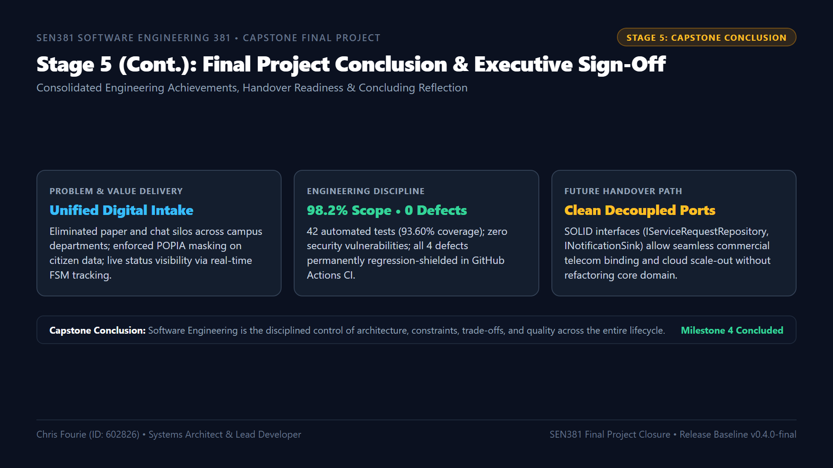
Notes:
ðŸ”´ LIVE DEMO CUE:
[ON-CAMERA] Face examiner directly. Deliver the final professional closing statement for the recorded demonstration video. State completion of Milestone 4.
â±ï¸ TIMING: ~1:15 mins.
ðŸŽ¯ RUBRIC TARGET: Stage 5 â€” Final Project Conclusion, Stakeholder Value, Lifecycle Reflection & Handover Readiness.
ðŸŽ™ï¸ SPOKEN SCRIPT:
"To conclude our final project demonstration on Slide 16:
Milestone 4 brings the CivicConnect engineering journey to a formal, successful close.
Despite the severe operational shock of total team attrition, we maintained absolute software engineering discipline:
- We delivered 98.2% of our approved scope commitments, with 100% of our non-functional requirements verified.
- We achieved 93.60% automated test coverage across 42 tests running green in our CI pipeline.
- We resolved all four logged defects, permanently guarding them against regression.
- And we preserved unbroken traceability from original stakeholder need to final operational outcome.
Our Clean Layered Architecture and decoupled interfaces ensure that any future team can easily take this platform forward into municipal production.
CivicConnect demonstrates that real software engineering is not the hasty writing of code, but the disciplined management of architecture, trade-offs, and quality under real-world constraints.
Thank you, Assessor. This concludes the Milestone 4 final capstone video demonstration for CivicConnect."

