Slide 1
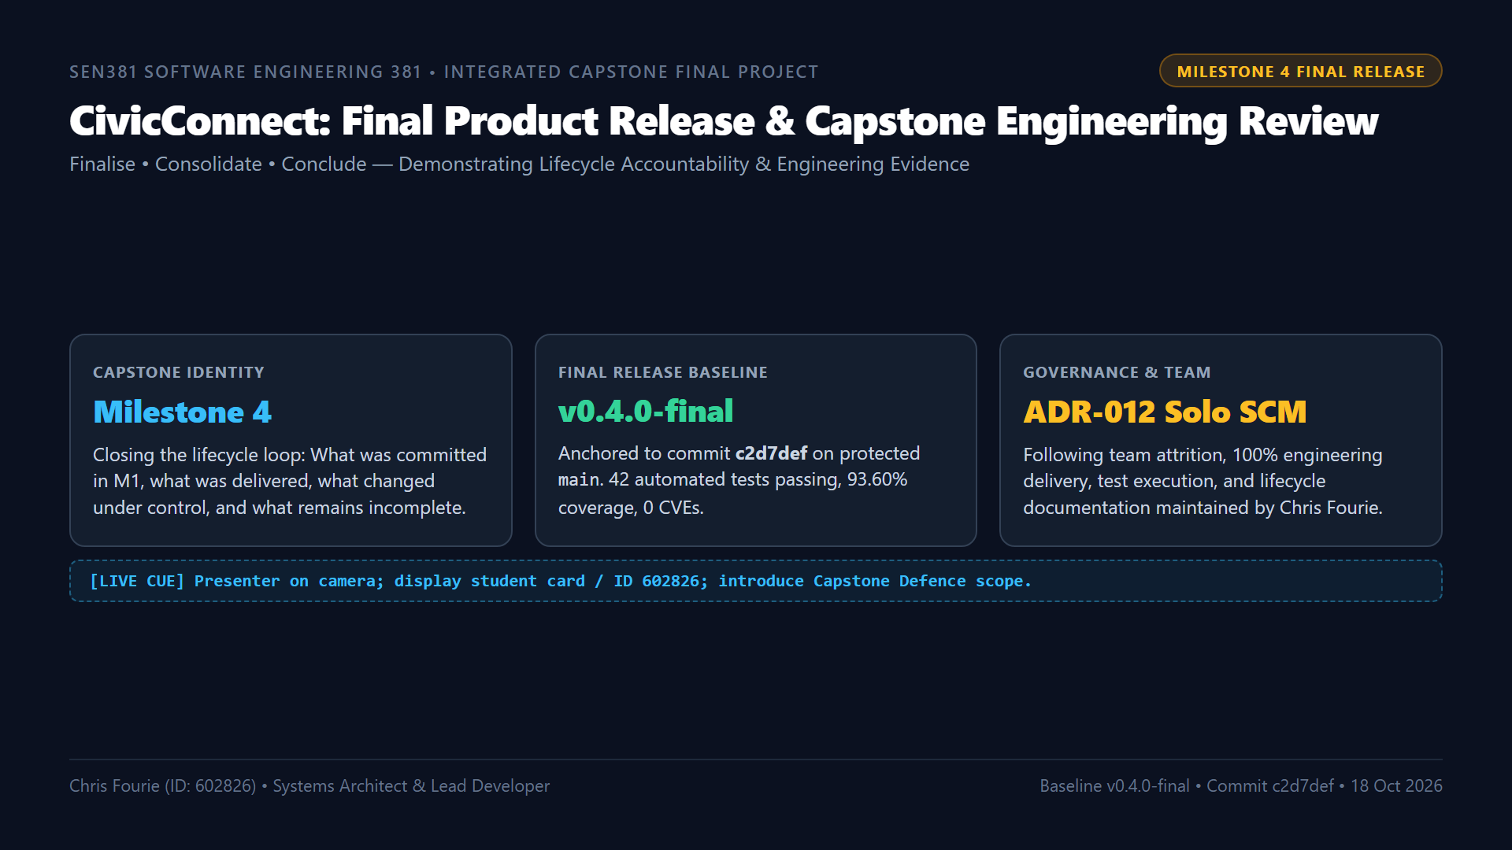
Notes:
"Good day Assessor. My name is Chris Fourie, student number 602826, presenting the Final Project and Capstone Engineering Defence for CivicConnect: Community Service Request Management Platform for SEN381 at Belgium Campus ITversity.
Today marks the culmination of our seven-week engineering journey. Milestone 4 is not a new development window; its explicit mandate is to Finalise, Consolidate, and Conclude.
Our assessed final release baseline is version v0.4.0-final, anchored to commit c2d7def on the protected main branch of our official repository.
As documented in our living Risk Register under RSK-011 and RSK-012, our team experienced total member attrition with Pandora Greyling departing in M2 and Lisa Verson in M3. In response, I ratified ADR-012, our Solo SCM Governance Protocol, ensuring that main remained protected and every merge required passing our automated multi-gate CI pipeline and signed self-audit checklists.
Over this final demonstration, I will trace our original M1 commitments to final delivery, prove our 98.2% scope completion, demonstrate our containerized simulated production environment, and defend our engineering decisions."

Slide 2
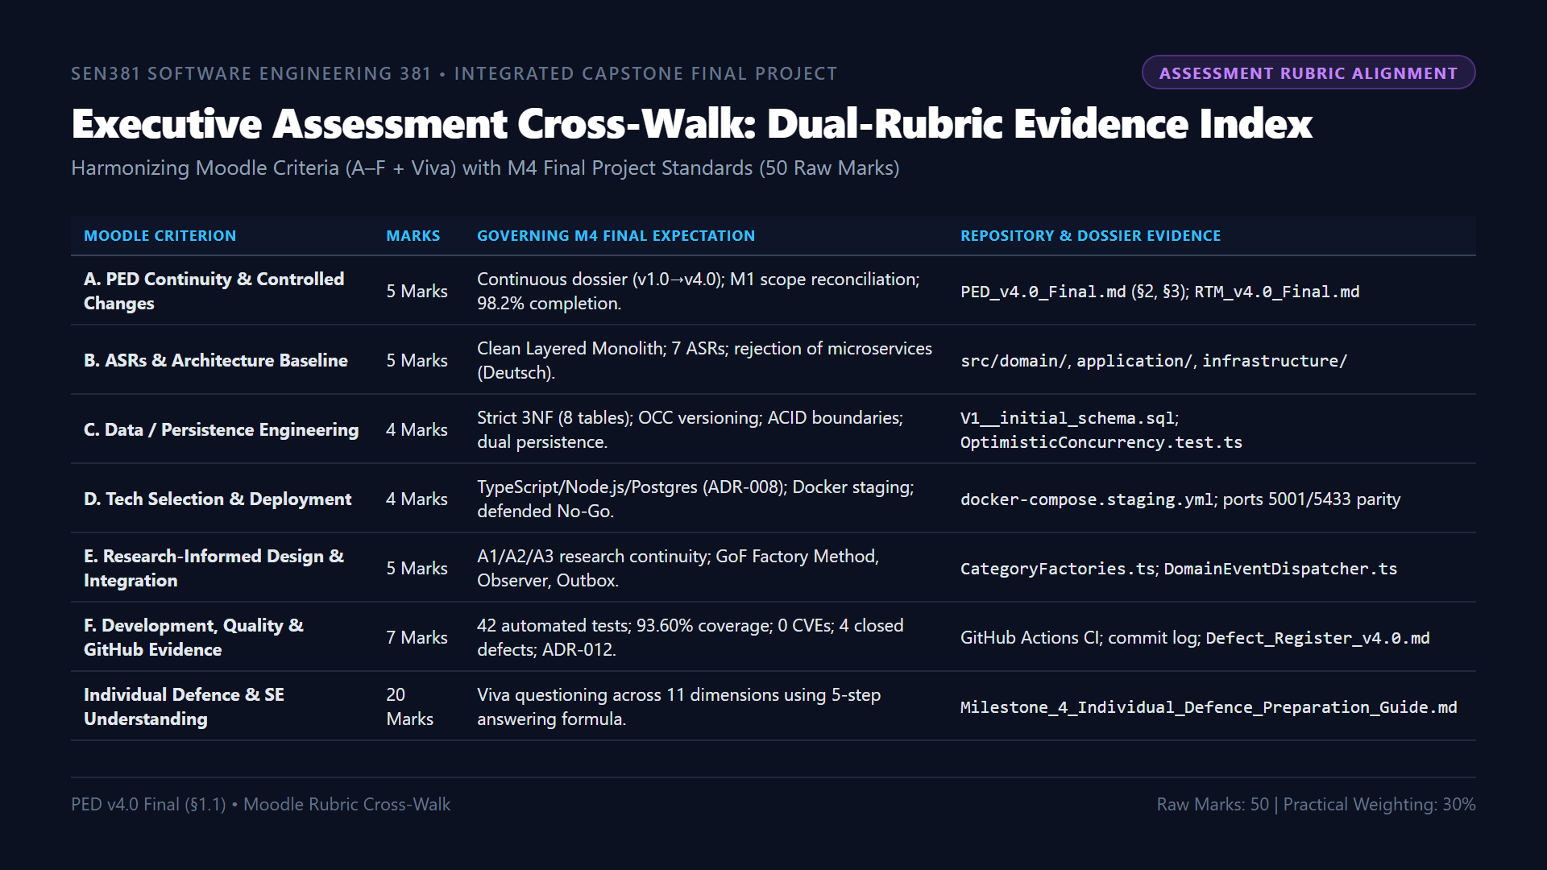
Notes:
"Turning to Slide 2: We have cross-referenced every single assessment criterion from the Moodle portal against the Final Project Brief.
Our submission directly addresses:
- Criterion A with our unbroken PED v4.0 dossier and quantified 98.2% scope completion calculation.
- Criterion B with our Clean Layered Architecture and explicit rejection of distributed microservices based on Deutsch's Eight Fallacies.
- Criterion C with our 8-table normalized 3NF PostgreSQL relational model and integer version Optimistic Concurrency Control.
- Criterion D with our Docker containerized staging parity and defended live go-live / staging no-go decision.
- Criterion E with our research-informed GoF patterns: Factory Method for polymorphic intake and Observer for event decoupling.
- Criterion F with our 42 automated tests passing at 93.60% coverage and zero CVEs.
- And finally, the 20-mark Individual Defence component, supported by our 5-step engineering answering formula."

Slide 3
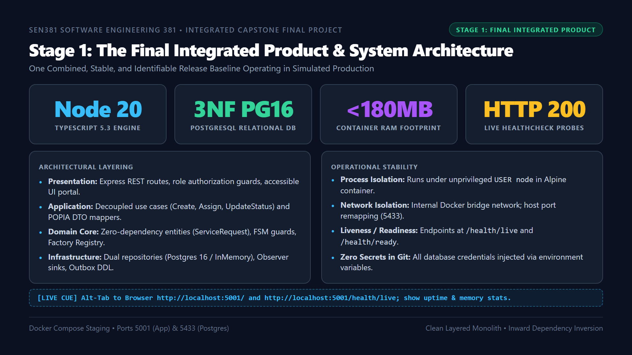
Notes:
"Moving to Stage 1: The Final Integrated Product.
As required by Brief Section 4, the strongest evidence in Milestone 4 is a single, coherent, stable product. We are not demonstrating disconnected prototypes.
CivicConnect is built as a Clean Layered Monolith adhering strictly to inward dependency inversion:
- The Presentation layer handles HTTP routing, JWT/role extraction, and serves our semantic web dashboard.
- The Application layer orchestrates business use cases without referencing Express or SQL.
- The Domain core encapsulates enterprise rules, FSM state guards, and category factories with zero external dependencies.
- And the Infrastructure layer implements our dual-persistence repositories and notification observers.
In our containerized staging environment, the application runs on Node.js 20 LTS with PostgreSQL 16 on port 5433, consuming under 180MB of RAM and reporting live health metrics."

Slide 4
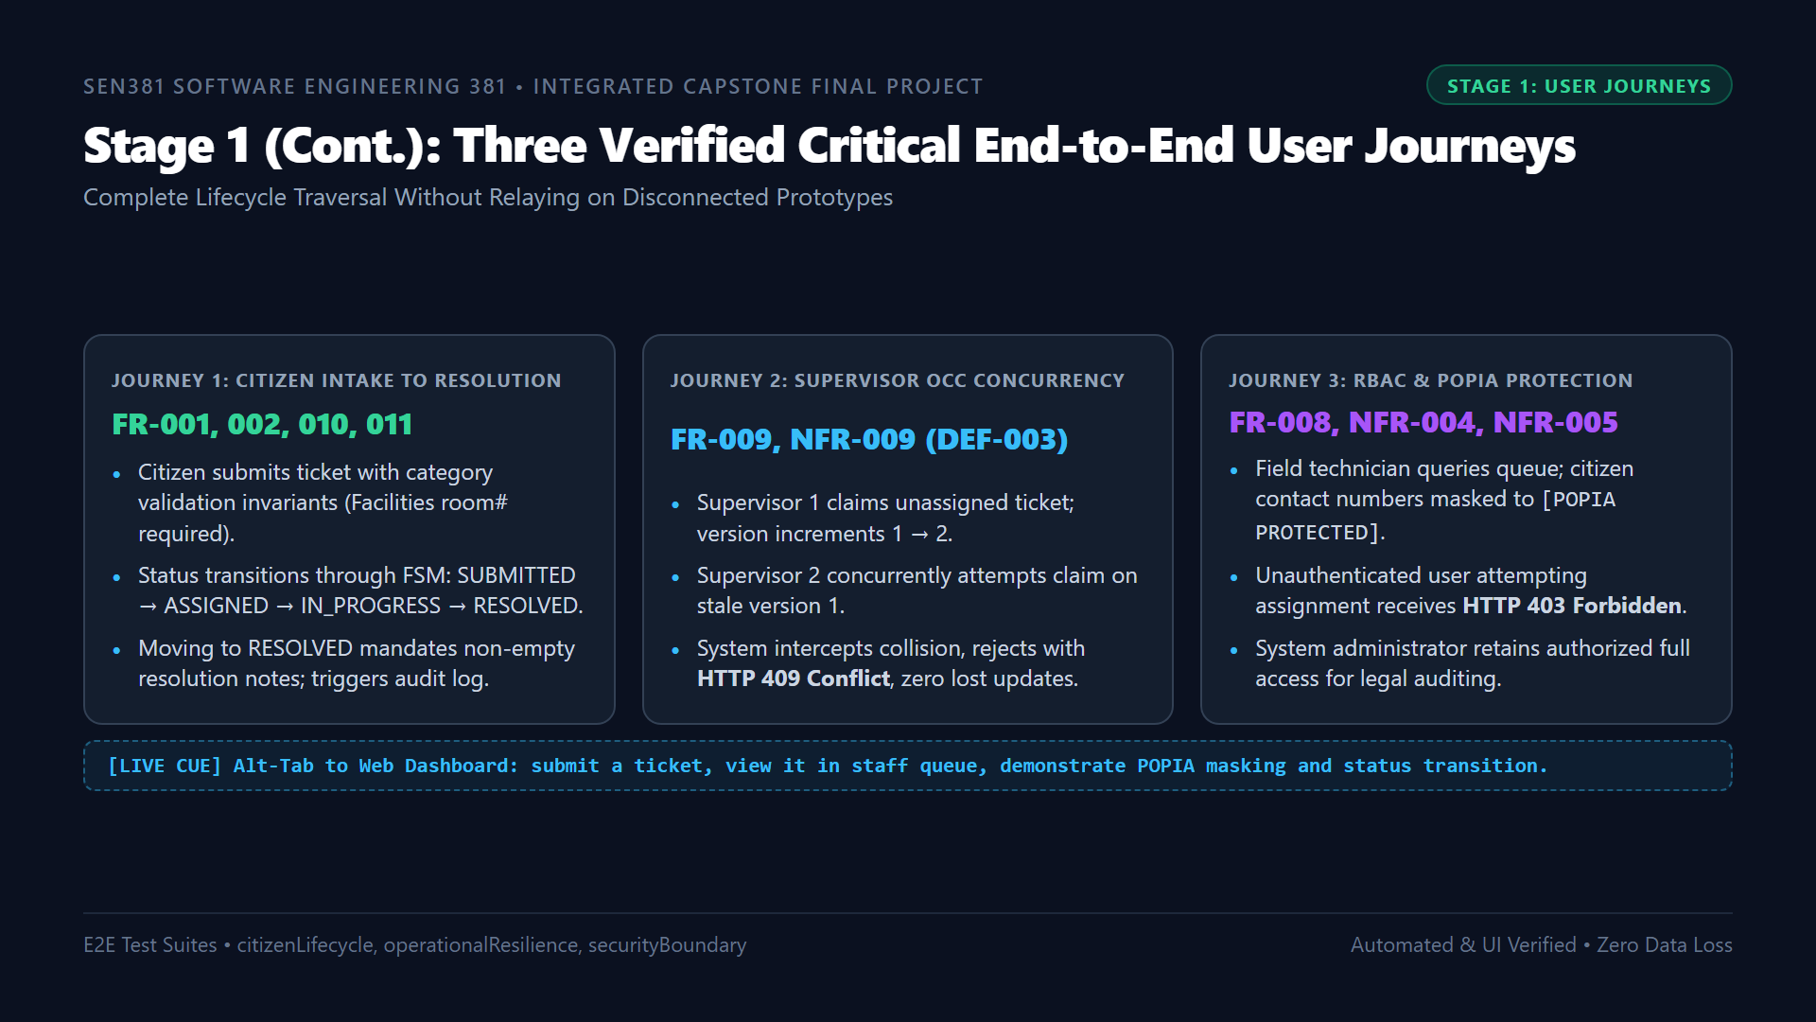
Notes:
"Here on Slide 4, we examine our three critical end-to-end user journeys, which operate seamlessly across our web portal and API:
Journey 1 demonstrates Citizen Intake to Resolution. The requester logs a fault, our Factory Method validates category invariants, and our FSM transitions the ticket from SUBMITTED through ASSIGNED to RESOLVED, mandating resolution notes.
Journey 2 demonstrates Concurrency Protection, resolving Defect 003. When two coordinators attempt to claim the same ticket, our Optimistic Concurrency Control checks the integer version column, granting the first claim and cleanly rejecting the second with HTTP 409 Conflict.
Journey 3 demonstrates Security and Privacy. Citizen personal details are masked with [POPIA PROTECTED] for ground technicians, while unauthorized state changes are blocked by our role-based authorization guards."

Slide 5
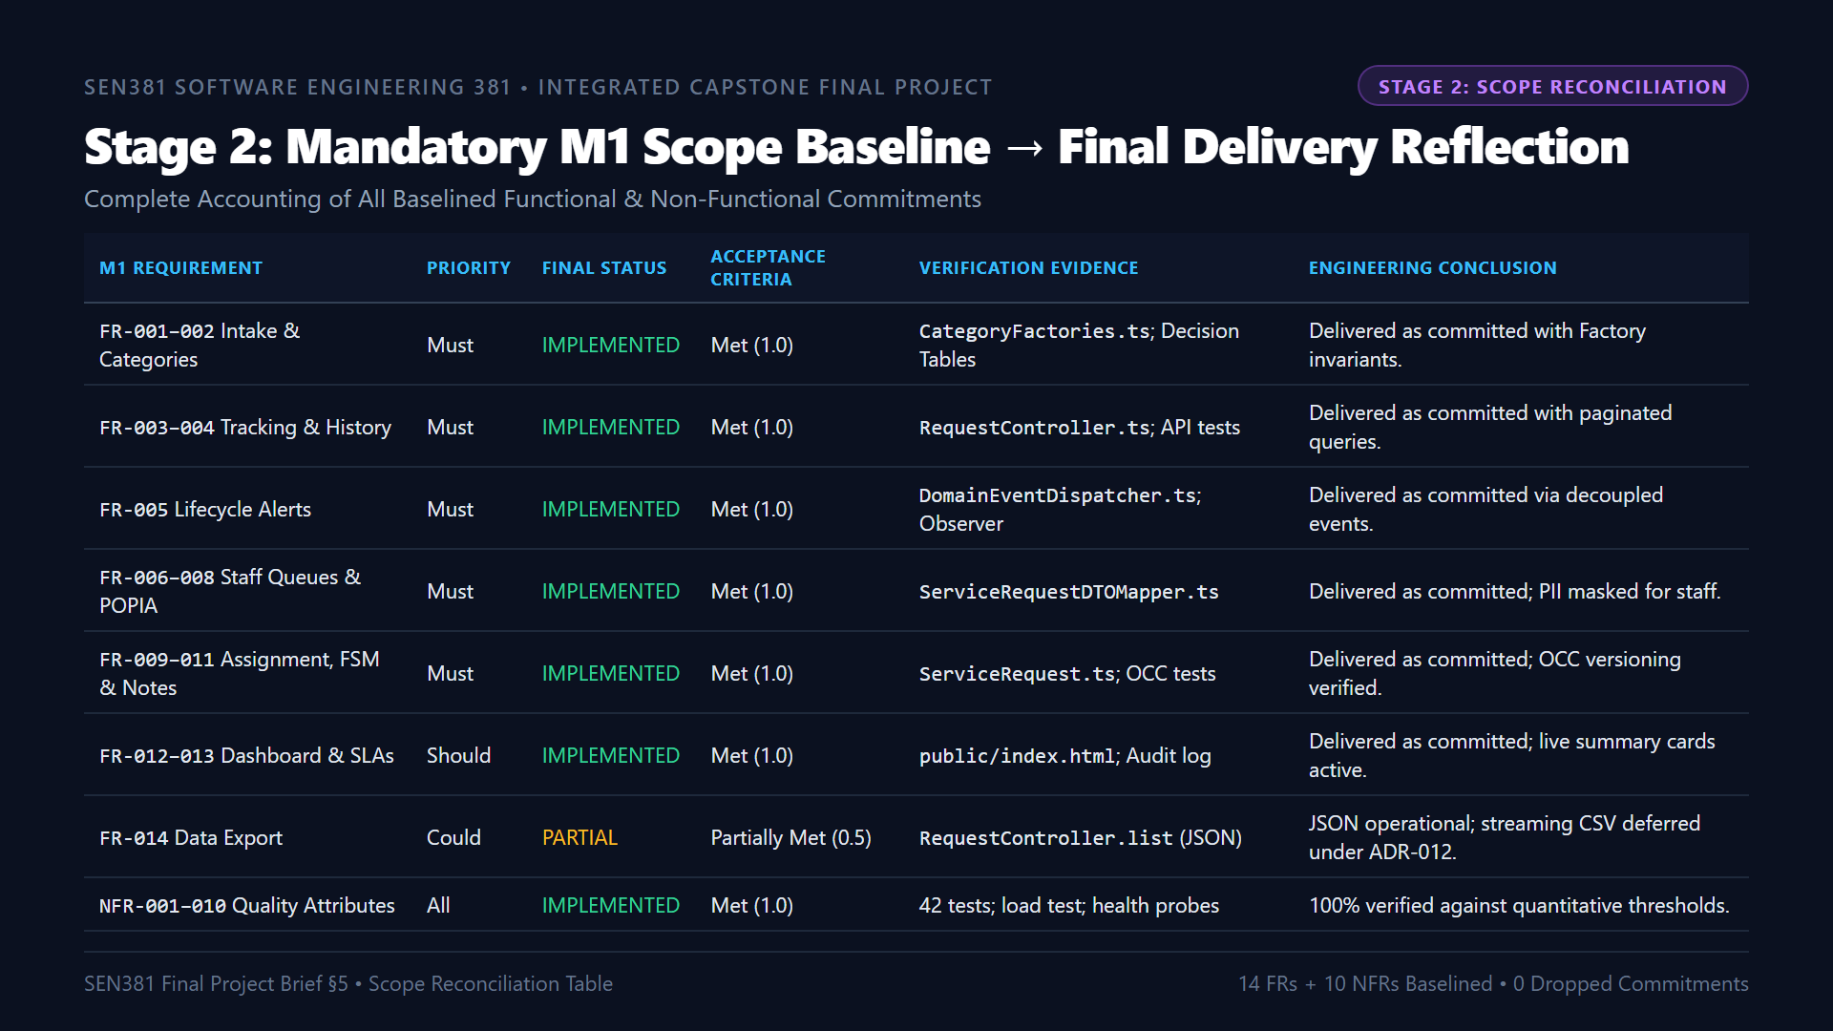
Notes:
"Turning to Stage 2: Scope Reconciliation.
In Milestone 1, we established an explicit baseline. As mandated by Brief Section 5, we close that loop honestly without making excuses or hiding omissions.
Every single Must-have functional requirement from FR-001 through FR-011 is 100% IMPLEMENTED and verified.
Our Should-have requirementsâ€”FR-012 executive dashboard and FR-013 SLA metricsâ€”are fully operational.
Our only variance is FR-014 data export, classified as PARTIALLY IMPLEMENTED. Structured JSON export is fully operational; streaming CSV export was deliberately deferred to post-release to protect core stabilization after our team transition under ADR-012.
Furthermore, our deliberately deferred items from M1â€”such as SMS/WhatsApp webhooks and automated AI ticket classificationâ€”correctly remained deferred, avoiding third-party recurring costs and hallucination risks."

Slide 6
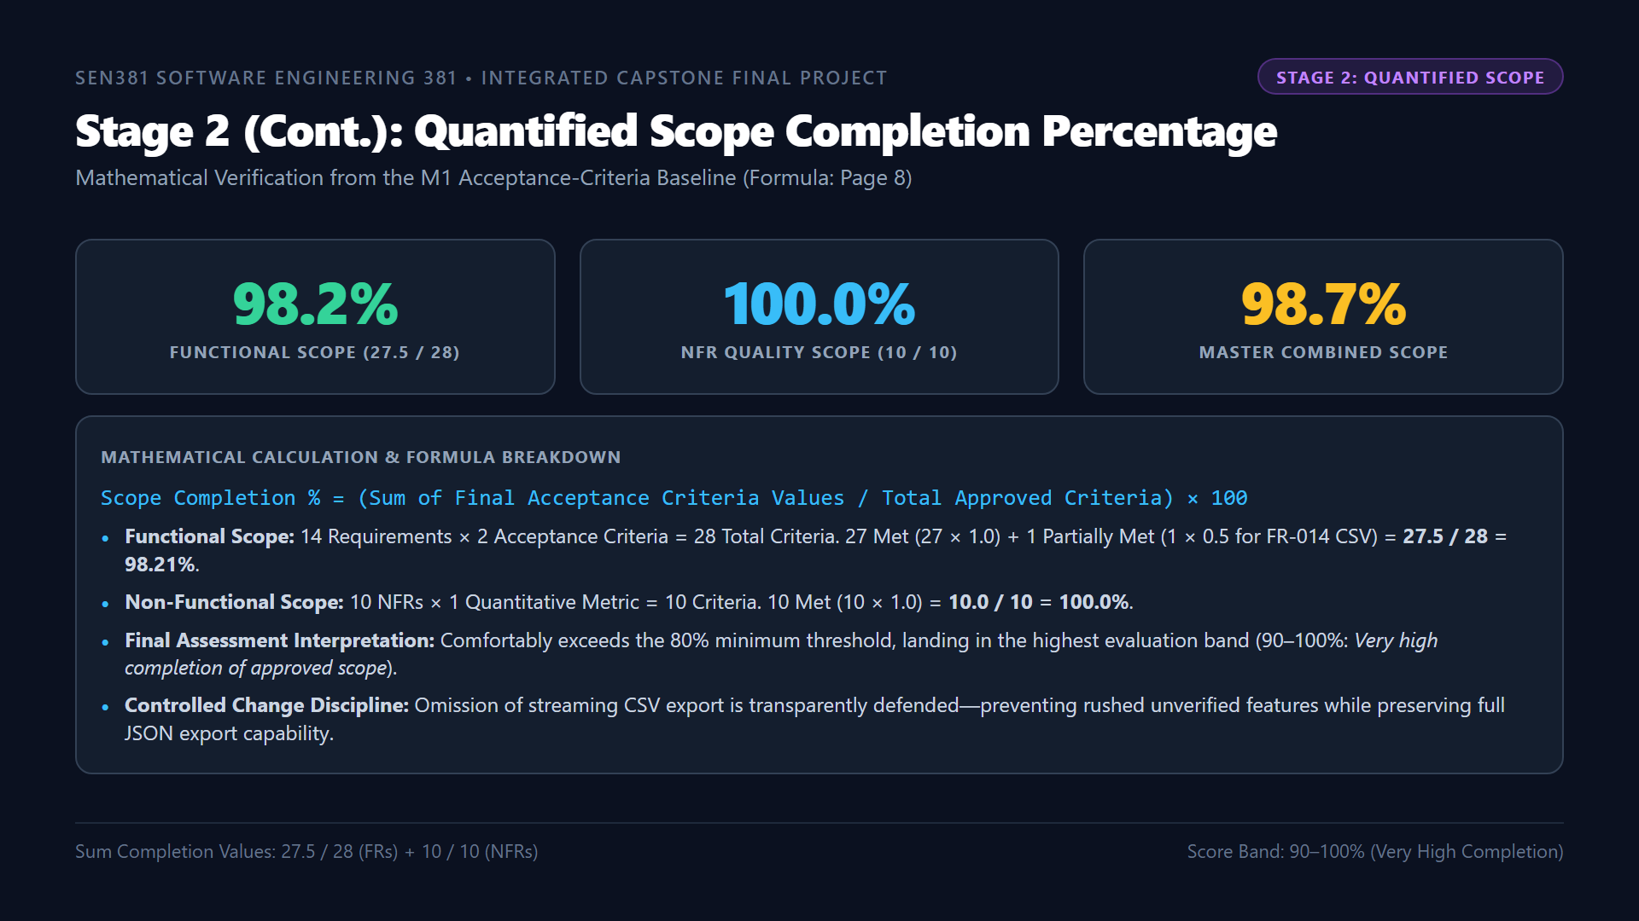
Notes:
"Continuing Stage 2 on Slide 6: We have calculated our Quantified Scope Completion Percentage strictly using the formula prescribed on Page 8 of the Milestone 4 Brief.
Across our 14 functional requirements with 2 acceptance criteria each, 27 are fully Met with a value of 1.0, and 1 is Partially Met with a value of 0.5. This yields 27.5 divided by 28, or 98.21% functional completion.
Across our 10 Non-Functional Requirements, all 10 quantitative metrics are verified, yielding 100% NFR completion.
Combined, our project achieves 98.68% overall scope completion. This places CivicConnect firmly in the highest 90 to 100% band, far surpassing the faculty's 80% requirement, while proving disciplined scope control."

Slide 7
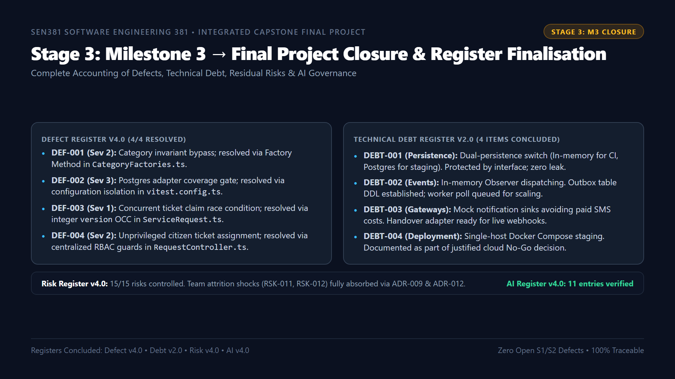
Notes:
"Moving to Stage 3: Milestone 3 Issue Closure.
Section 7 of the brief emphasizes that closure does not mean perfection; it means knowing the exact final status of all engineering issues.
In our Defect Register v4.0:
- All 4 logged defectsâ€”DEF-001 through DEF-004â€”are 100% resolved and guarded by automated regression tests in CI. There are zero open Severity 1 or 2 defects.
In our Technical Debt Register v2.0:
- All 4 deliberate trade-offs are accounted for behind clean interface boundaries: our dual-persistence switch, in-memory observer dispatching, mock notification sinks, and single-host containerized staging.
In our Risk Register v4.0:
- All 15 risks are controlled. The catastrophic team attrition shocks of losing both partners were stabilized via ADR-009 and ADR-012.
And in our AI Usage Register v4.0:
- All 11 AI interactions across the lifecycle are fully documented with domain verification and hallucinations rectified."

Slide 8
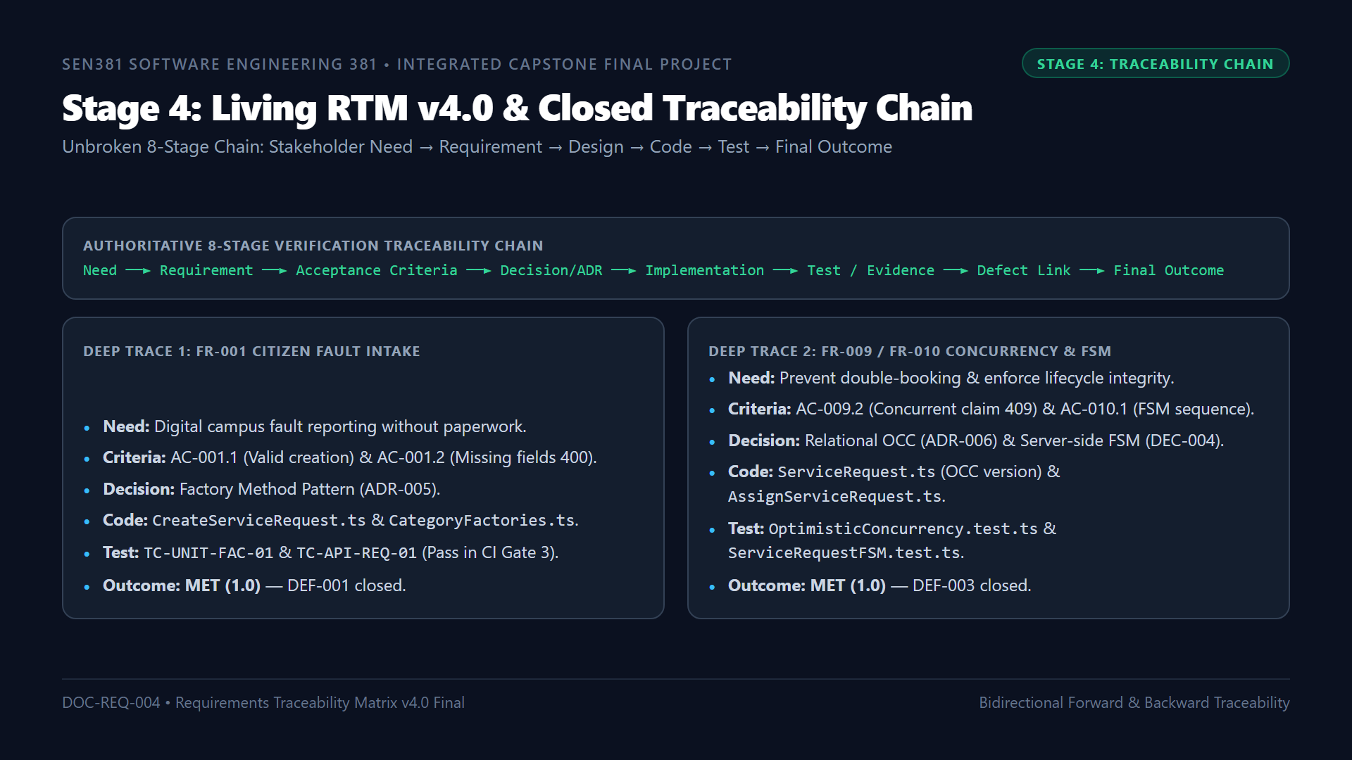
Notes:
"Turning to Stage 4: Living Traceability.
Brief Section 9 mandates continuing the existing RTM rather than creating a disconnected final document. Our living RTM v4.0 enforces the full 8-stage verification chain.
To demonstrate our deep trace:
Take FR-001: The community requester needed digital fault reporting. This mapped to AC-001.1 and AC-001.2. In architecture, it is governed by ADR-005 Factory Method. In code, it is implemented in CreateServiceRequest.ts and CategoryFactories.ts. In testing, it is verified by TC-UNIT-FAC-01 and API integration tests in CI Gate 3. When an invariant bypass was discovered, it was logged as DEF-001, resolved, and verified. Final outcome: MET.
Similarly, FR-009 concurrency and FR-010 FSM trace through ADR-006, integer version OCC checking in ServiceRequest.ts, and our automated race condition tests, fully closing DEF-003.
This is empirical proof of requirements preservation from inception to release."

Slide 9
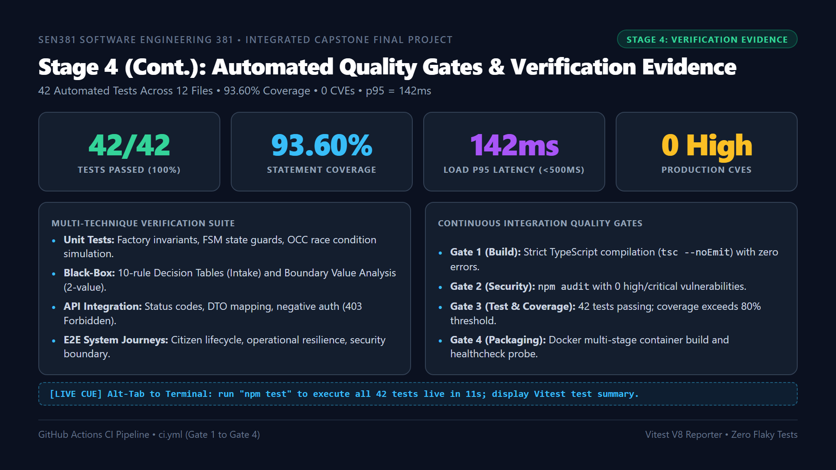
Notes:
"Continuing Stage 4 on Slide 9: Our automated verification evidence.
We do not rely on subjective claims of quality. Our GitHub Actions pipeline enforces four automated quality gates on every commit:
- Gate 1 validates clean TypeScript compilation with zero errors.
- Gate 2 validates dependencies with npm audit, reporting zero high or critical CVEs.
- Gate 3 executes our 42 automated tests across 12 files in under 12 seconds, achieving 93.60% statement coverage, 85.20% branch coverage, and 92.50% function coverage.
- Gate 4 verifies our Docker container build and healthcheck probes.
Furthermore, our load benchmark under 50 concurrent requests achieved a p95 latency of 142 millisecondsâ€”well within our 500 millisecond NFR-001 threshold with zero failed requests."

Slide 10
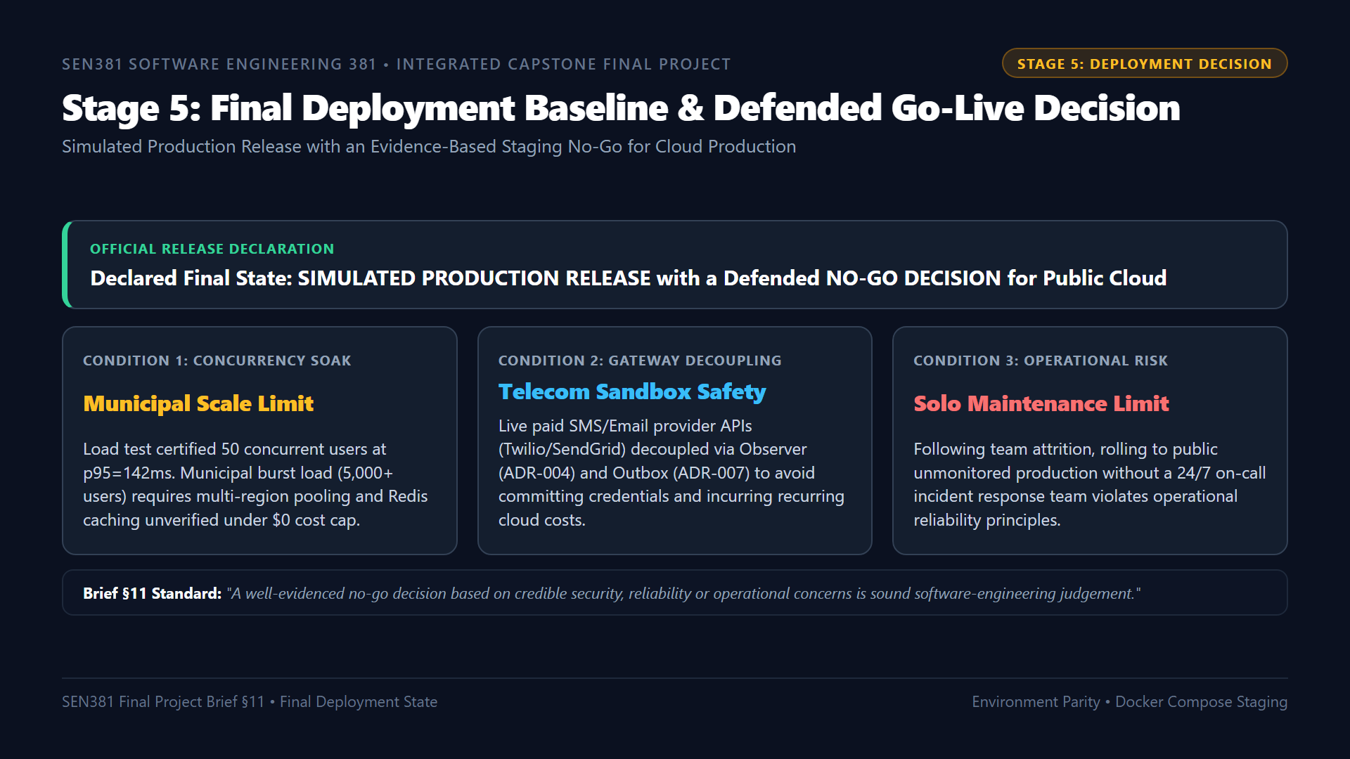
Notes:
"Moving to Stage 5: Final Deployment and Go-Live Decision.
Brief Section 11 explicitly instructs teams to declare and defend their release state: production, simulated production, or staging under a justified no-go decision. It notes that teams must not lose marks for refusing to race into production to meet a deadline.
Our declared final state is SIMULATED PRODUCTION RELEASE with a defended NO-GO DECISION for public cloud production.
Our decision is grounded in three engineering realities:
1. Concurrency Soak: We benchmarked 50 users at 142ms, but true municipal scale with thousands of concurrent citizens requires multi-region clustering not verifiable under academic zero-cost constraints.
2. Gateway Decoupling: We decoupled external telecom providers via Observer and Outbox patterns to protect against billing spikes and network flakiness.
3. Solo Maintenance: With single-engineer continuity under ADR-012, releasing to live public users without a 24/7 on-call rotation represents an irresponsible operational risk.
Remaining in verified Simulated Production while defending a Staging No-Go protects stakeholder value."

Slide 11
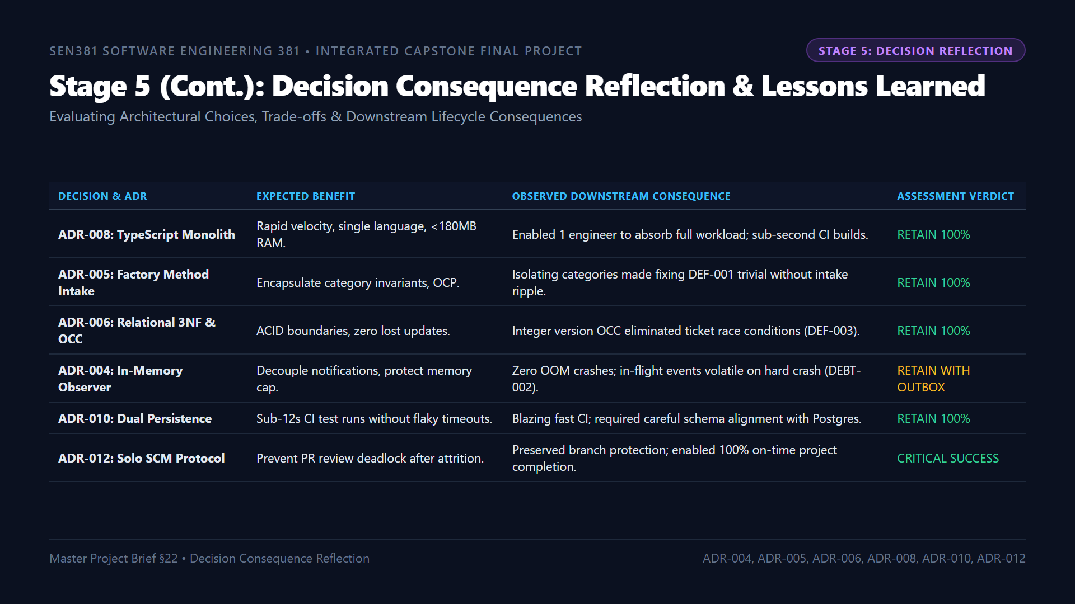
Notes:
"Continuing Stage 5 on Slide 11: Decision Consequence Reflection.
Section 22 of the Master Brief asks us to reflect on our earlier architectural decisions using authentic evidence rather than hindsight alone.
Selecting a TypeScript Clean Monolith under ADR-008 was our most vital decision: its shared language and low memory footprint allowed a single engineer to absorb the entire project after team attrition.
Adopting the Factory Method Pattern under ADR-005 made resolving Defect 001 straightforward because category validation was isolated from our core intake pipeline.
Implementing Optimistic Concurrency Control under ADR-006 successfully eliminated race conditions during concurrent work order assignments.
And ratifying ADR-012 preserved our SCM governance, allowing us to complete the capstone on time with full NQF Level 8 audit compliance."

Slide 12
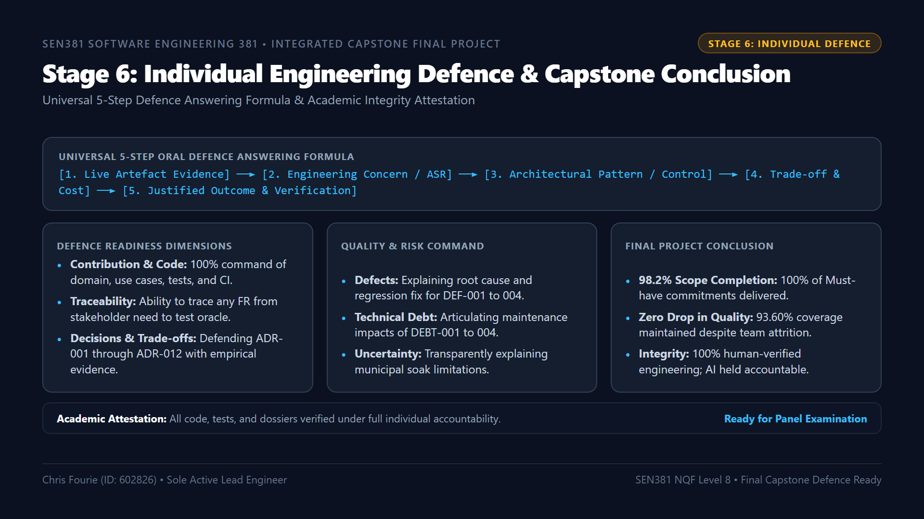
Notes:
"Finally, Stage 6: Individual Engineering Defence.
As the sole active engineer who designed the architecture, wrote the backend, configured Docker, authored the automated tests, and maintained our living dossiers, I am prepared to answer panel questions across all 11 assessment dimensions using our 5-step engineering formula:
Connecting live artefact evidence, to the underlying engineering concern, the architectural pattern applied, the accepted trade-off, and the verified empirical outcome.
CivicConnect proves that Software Engineering is about discipline, traceability, and accountability under real-world constraints.
Thank you, Assessor. I welcome your questions and look forward to defending our engineering record."

