Slide 1
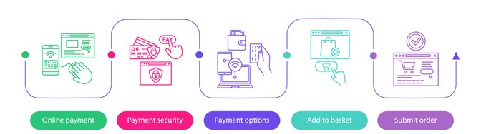





HTTP
URL
HTML
Servidor web HTTP
Alojamiento web
https://www.shutterstock.com/es/image-vector/online-shopping-vector-infographic-template-digital-1439101076
https://www.flaticon.es/icono-gratis/http_1674969
https://www.flaticon.es/icono-gratis/http_1674969
https://www.flaticon.es/icono-gratis/html_1197396
https://www.flaticon.es/icono-gratis/servidor-de-internet_59907
https://www.flaticon.es/icono-gratis/alojamiento-web_565143

