Slide 1
Tom
Toms skills

Slide 2
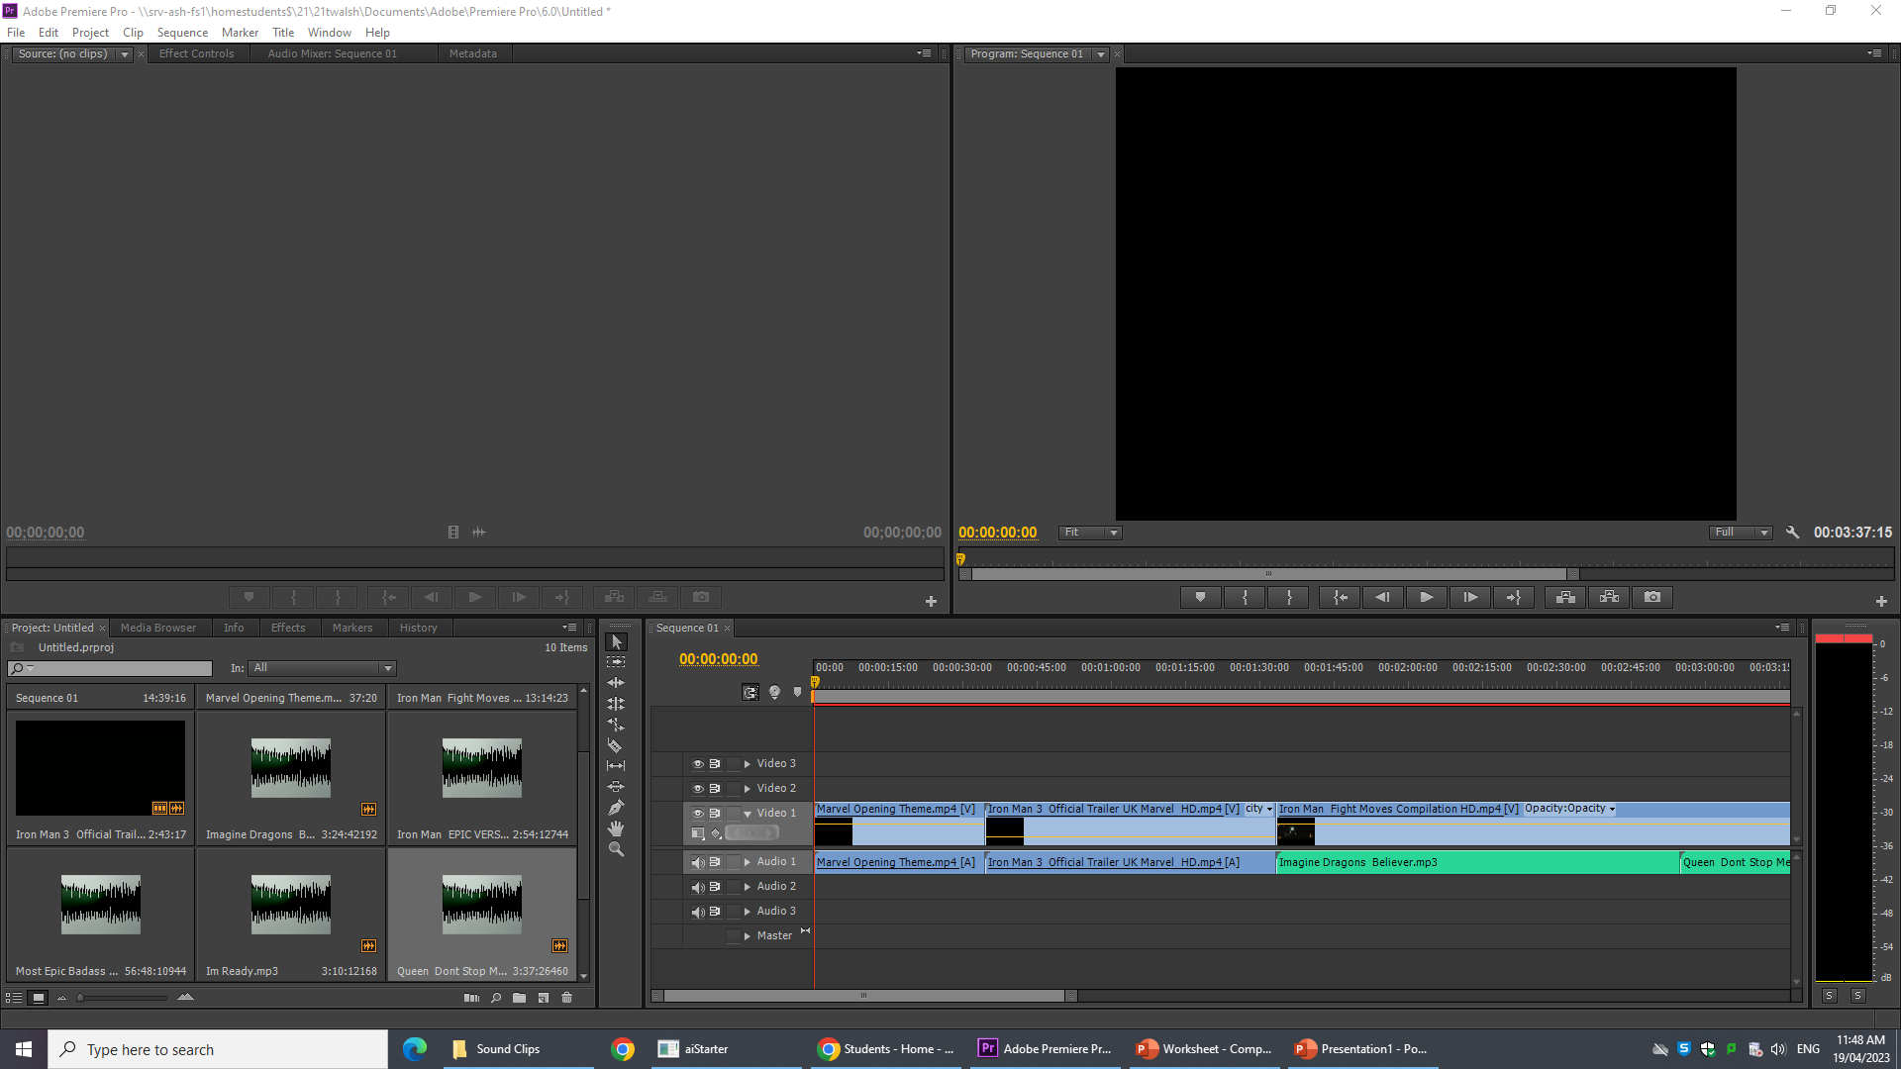
This shows my
Clips and music
Clips and vidoes
This is my work were
I have made my edited clips on iron man
this were the work
is show

Slide 3
I think my work went very well but could have been better because my computer turned of and my work was not saved

