Slide 1
How student sleep patterns & lifestyle affect academic performance.
GROUP PRESENTATION
Group 7 :-> Group members: Andrews Owusu
Kulwinder singh
Jai Vadhani
Shivani Shivani

Slide 2
Project Objective
Understand the relationship between student lifestyle and their academic performance.
Collect and integrate multiple public datasets from different sources (Kaggle, Mendeley, RPubs) for a comprehensive analysis.
Clean, transform, and store data in a relational database for easy access and reproducibility.
Use Big Data analytics tools to identify trends and correlations in student behavior.
Visualize and demonstrate the potential of data-driven decision-making in student wellness programs.

Slide 3
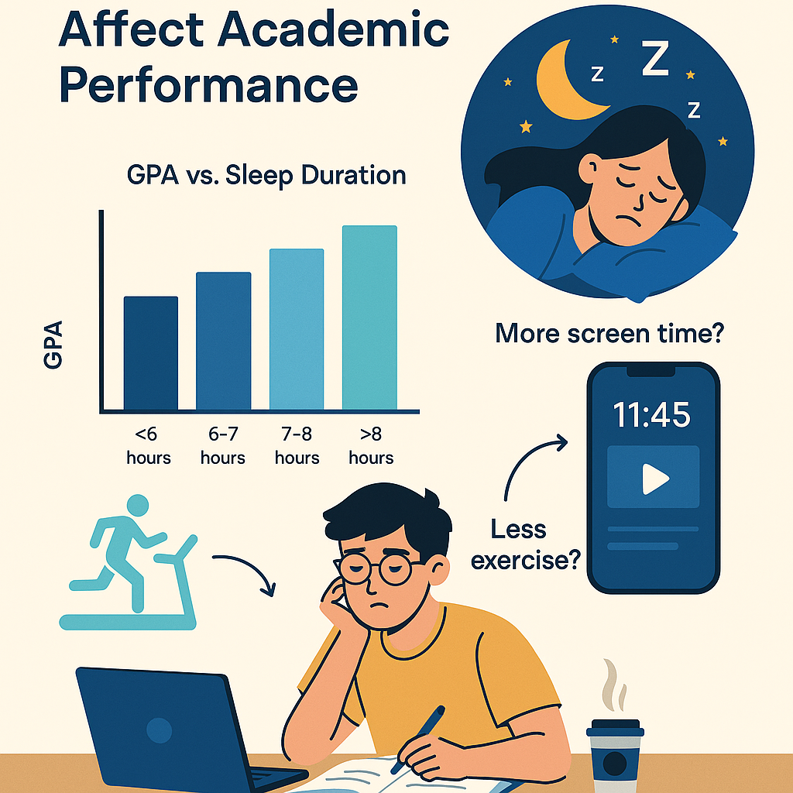
Why we picked this topic ?
Quality sleep is often overlooked in student wellness discussions.
Poor sleep habits linked to stress, burnout, and low GPA.
How lifestyle like alcohol use affects academic performance.

Slide 4
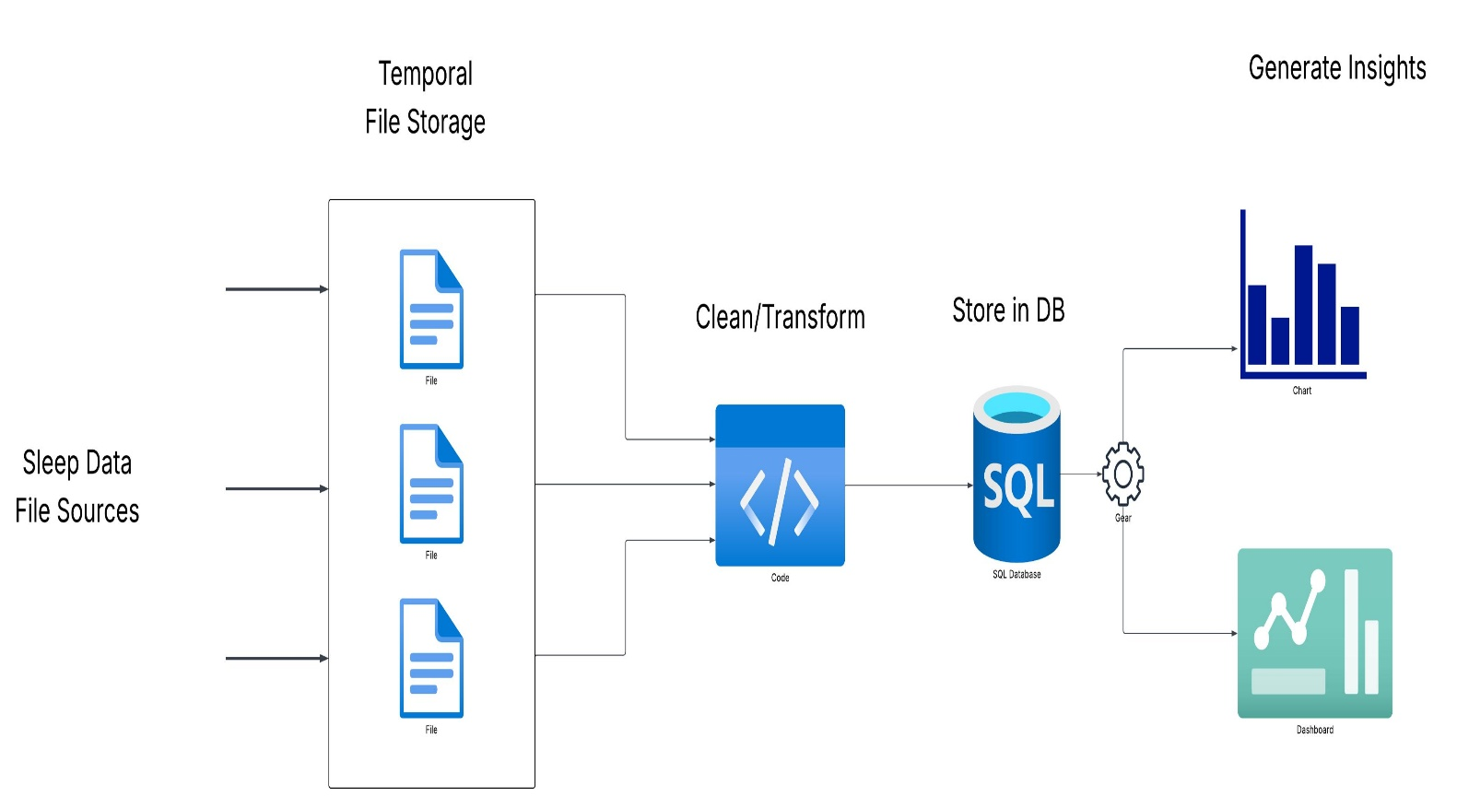
System Diagram

Slide 5
Datasets Overview
1. The Sleeping Habits of Students
Kaggle (by Arsalan Jamal)
Important Characteristics: The duration of sleep, time on screens, study time, physical activities, stress, and the quality of sleep.
2. Insomnia and Schoolwork
Mendeley Data
Key Attributes: The frequency of insomnia, academic GPA, and indicators of lifestyle.
3. The Sleep Study Dataset
The study dataset was cleaned in RPubs.
Key Features: Coded numeric values for sleep quality, lifestyle choices, and performance at the academic level

Slide 6

Data Cleaning Process
Removed missing & duplicate entries.
Renamed columns (lowercase + underscores).
Encoded categorical variables numerically.
Normalized responses using regex

Slide 7
Data Quality and Its Impact
Accuracy: Ensures correct values. Reduces misleading conclusions due to typos, wrong entries, or outliers.
Completeness: Incomplete records can reduce the power of correlation
Consistency: Standardized formats and column names
Reliability: Ensures meaningful comparisons and better statistical modeling
Validation: validation tests helped to make the data logically correct and prepared to be entered into RStudio to run logical analysis

Slide 8
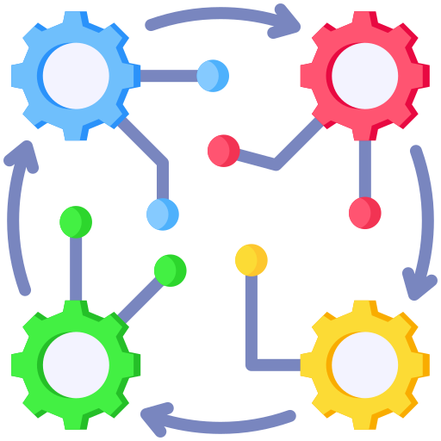
Integration Process
Used Python (pandas) for cleaning and transformation.
Renamed columns to lowercase_with_underscores for consistency.
Encoded categorical data.
Imported cleaned data to SQL Server using pyodbc.
Normalized categorical values using regex (regular expressions).
Connected R Studio to SQL Server for live data analytics

Slide 9
Main Tools Used
SQL Server - This is employed in unstructured storage of data
and performing relational queries.
PYODBC - a Python module that helps connect to SQL Server,
which was used to insert and retrieve data.
RStudio (DBI + ODBC) – provides the ability to connect and retrieve data from SQL Server within R Studio for analysis.
Shiny App (R Library) for dashboard creation

Slide 10
Visualizations & Patterns
Charts
Heatmaps
Correlation Plots
Bar Graphs
Dashboard
Shiny App (R Library)
Model
Regression Model

Slide 11

Extension Opportunities
IoT Integration- Smartwatch or a fitness band to record the sleep and fitness data in real-time
Full Automation: full end-to-end automation of the process from ETL to Dashboard.
Real-Time Sync - Even the data you get daily through wearable apps or mobile sleep trackers can be imported automatically into the SQL Server.

Slide 12


Conclusion & Takeaways
Student habits and lifestyle make a huge impact (especially sleep and screen time) on academic performance
Students who sleep better and avoid bad lifestyle habits regularly tend to perform significantly better in GPA
Excessive caffeine and alcohol consumption, and stress are strongly linked to poor performance.

Slide 13
Thank you!

