Slide 1
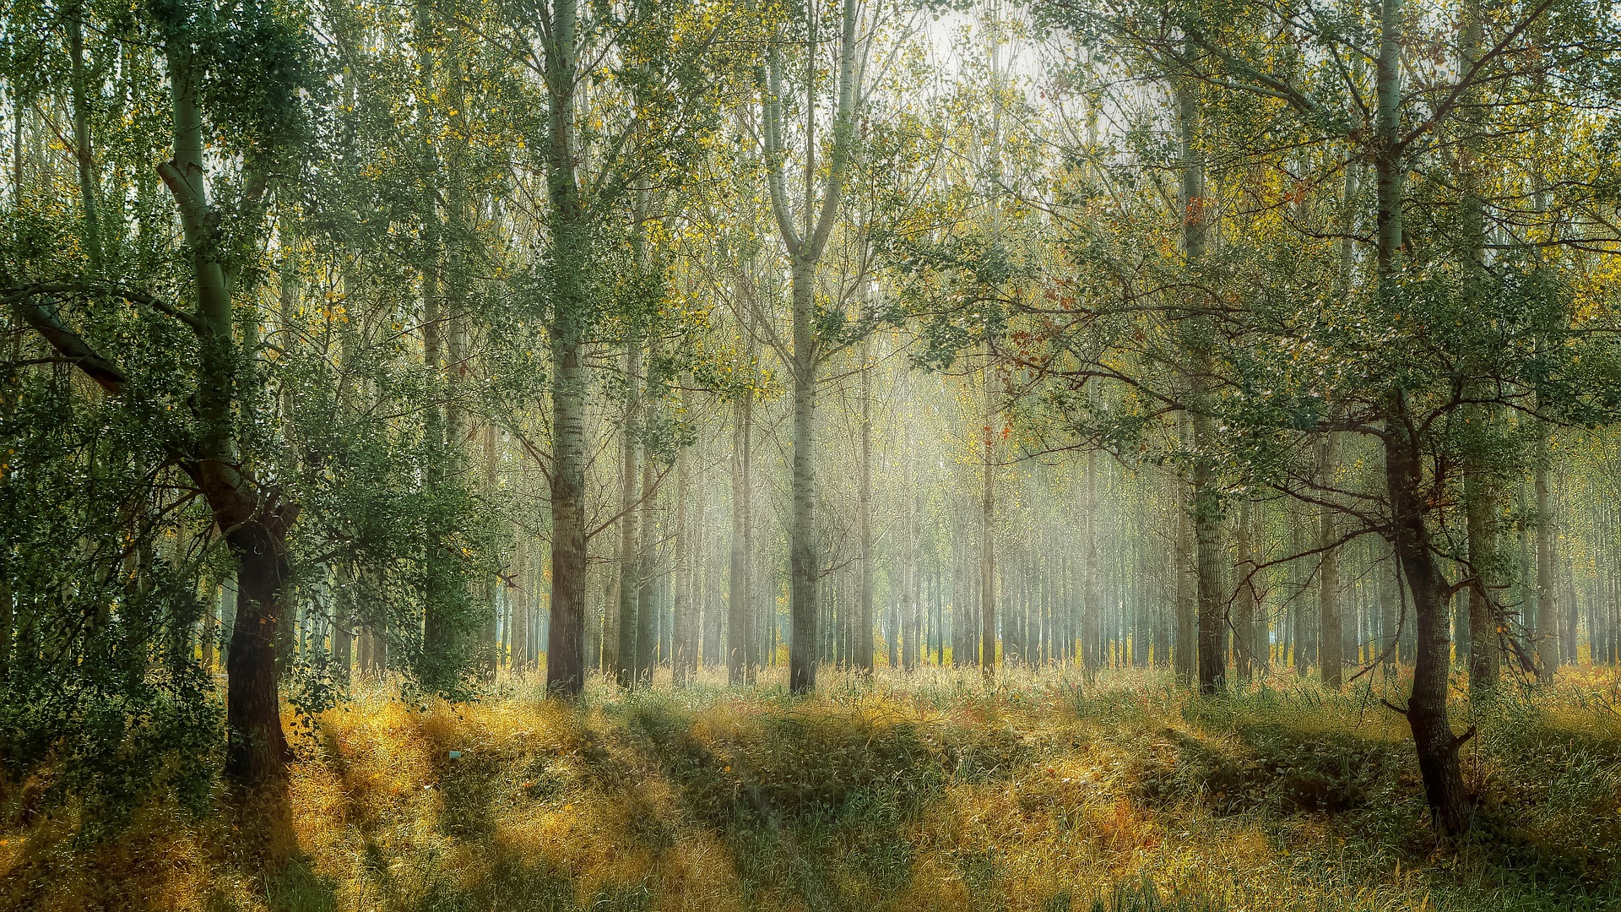
In 2010, cambodia had 7.22Mha of natural forest, extending over 42% of its land area.

Slide 2
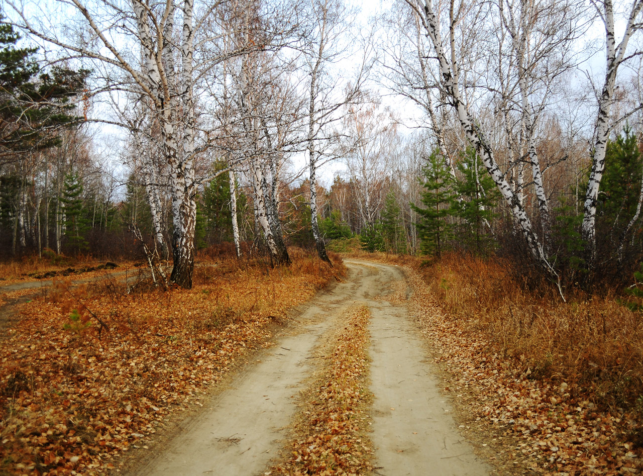
In2021, it lost 141kha of natural forest, eqquivalent to 83.2Mt of CO2 emissions.

