Slide 1
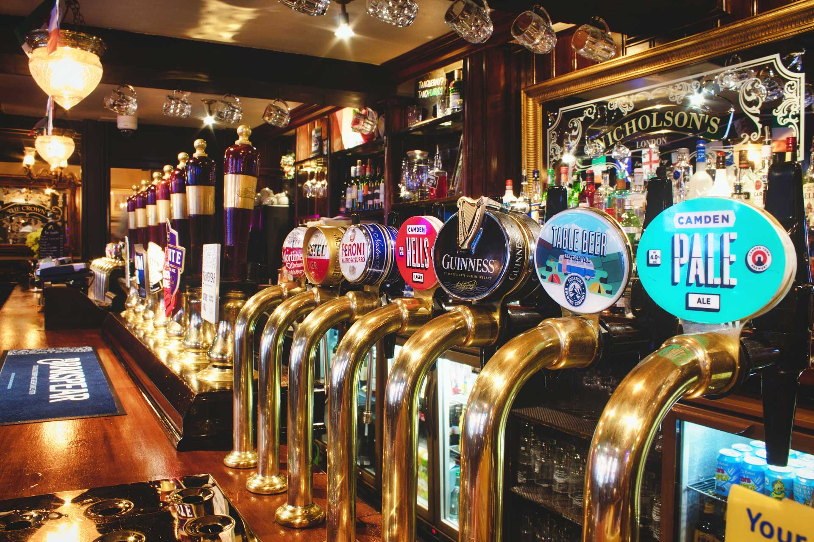

Project Title
PLAN YOUR CRAWL
FOR THE LOVE OF BEER
MAKE A COPY! DO NOT REQUEST EDIT ACCESS

Slide 2
Elevator pitch

Slide 3
Concept
PLAN YOUR CRAWL is an API call to design a brewery tour for the beer enthusiast or casual beer drinker.
MOTIVATION: As someone looking to enjoy a beer on holidays, the idea of having a “go to” website to plan an afternoon of spot on beer tasting truly appeals. With additional localised information to tell me the weather, my beer tours will be the best.
USER STORY: As someone looking to visit a new city, I want to enter that city into the application and find a list of breweries along with their location so that I can develop a route to visit different breweries and bottle-shops in that city, and find the best route between them, along with the weather for that day.

Slide 4
PROCESS
TECHNOLOGY USED: For this task we have used
HTML, Tailwind CSS, JS, Google Fonts, Font Awesome, 3rd Party API’s (OpenBrewery, OpenWeather)
BREAKDOWN OF TASKS: The lead for each task is
HTML – Dave | CSS – Daniel | JS – Ronald | Presentation - Thomas
CHALLENGES: Time, git requests, git approvals, meeting up out of class hours
SUCCESSES: Implementing Tailwind CSS, sticking to a design concept, working
to our strengths, collaboration, API requests working

Slide 5
Demo

Slide 6
DIRECTIONS FOR FUTURE DEV
ADDING A CONTACT FORM: Implementation of a contact form so users can share their best crawls
DATABASE INTEGRATION: Ability to store best tours in a database
SOCIAL INTEGRATION: Ability to share tours with friends and family via socials
PDF GENERATOR: Ability to PDF a tour so a driver can print out the instructions and for easy social and physical sharing
EXPAND OPENBREWERIES DB TO INTERNATIONAL: Gain greater reach by extending the OpenBrewery API to include international breweries, bottle-shops and craft brewers.

Slide 7
LINKS
GITHUB:
DEPLOYED:
OPENBREWERY: https://www.openbrewerydb.org/
OPENWEATHER: https://openweathermap.org/api

