Slide 1
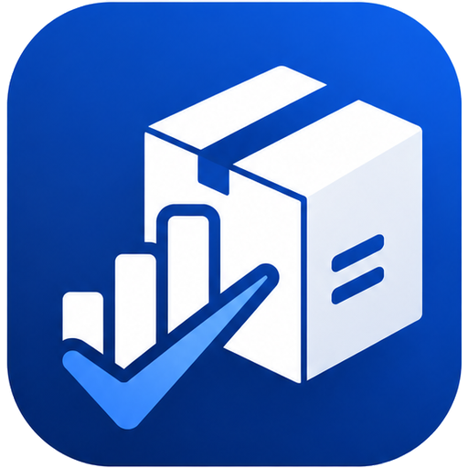
SmartStock+
Offline-First Inventory & Asset Management System
Team 2 | Mobile Programming 2 | MCO 2 Final Presentation
Jhon Clarence B. Rulona
Cris Gerard O. Carpon
Jasper Keith P. Teorica
Mark Jacob S. Allero
John Dennis Y. Chan
Leopoldo C. Villaflores III
Dustin Aaron D. Tocayon
Angel Mae S. Dura
Heizel D. Panugaling
Justin Jamaica P. Julaton
Roselyn B. Deguino
Lou Ariane Mae B. Delos Reyes
Rynel Jay V. Vallejos
Instructor: Mr. Aaron Jude Pael · May 19, 2026
Notes:
Open with the app running on the device. Greet Mr. Pael, introduce Team 2 and the course/section. One line: SmartStock+ is an offline-first Android inventory app with secure multi-tenant Supabase cloud sync.

Slide 2
01 · INTRODUCTION
Project Overview
02 / 09
Purpose & Problem
Target Users
Core Modules
Paper logs and always-online tools fail where connectivity is unreliable — data is lost or duplicated.
SmartStock+ replaces them with a reliable, offline-first app that syncs to the cloud automatically.
• Small businesses
• School & IT laboratories
• Field & maintenance teams
• Asset custodians of shared equipment
• Inventory CRUD + asset codes
• Barcode / QR scan & checkout
• Usage reports (CSV / PDF)
• Dashboard charts & low-stock alerts
• Stock-take / cycle count
• Multi-tenant cloud sync & auth
SmartStock+ · Mobile Programming 2 — MCO 2 Final Presentation
Team 2
Notes:
Stress the offline-first value proposition: never blocked by a dead network — Room is the source of truth, the cloud is a sync layer that reconciles automatically.

Slide 3
02 · HOW IT'S BUILT
Architecture — Offline-First MVVM
03 / 09
Jetpack Compose UI
screens & state
ViewModel
StateFlow / events
Repository
single mediator
instant write
Room DB
local source of truth
SyncWorker
WorkManager · bidirectional
HTTPS
Supabase
PostgREST · Auth · Storage · RLS
Offline-first: writes hit Room instantly so the UI never blocks. SyncWorker reconciles with Supabase when online — last-write-wins on updatedAt, soft-deletes, and natural-key (asset_code / name) matching so a re-installed or second device never duplicates rows.
Hilt wires every layer; ViewModels never touch DAOs or the network.
Clean separation
data · domain · ui layers
SmartStock+ · Mobile Programming 2 — MCO 2 Final Presentation
Team 2
Notes:
Walk left→right then down. The UI is fully decoupled from the data source — swapping the No-Op for the Supabase adapter took zero UI changes. Mention natural-key reconciliation as the fix that keeps sync duplicate-free across devices.

Slide 4
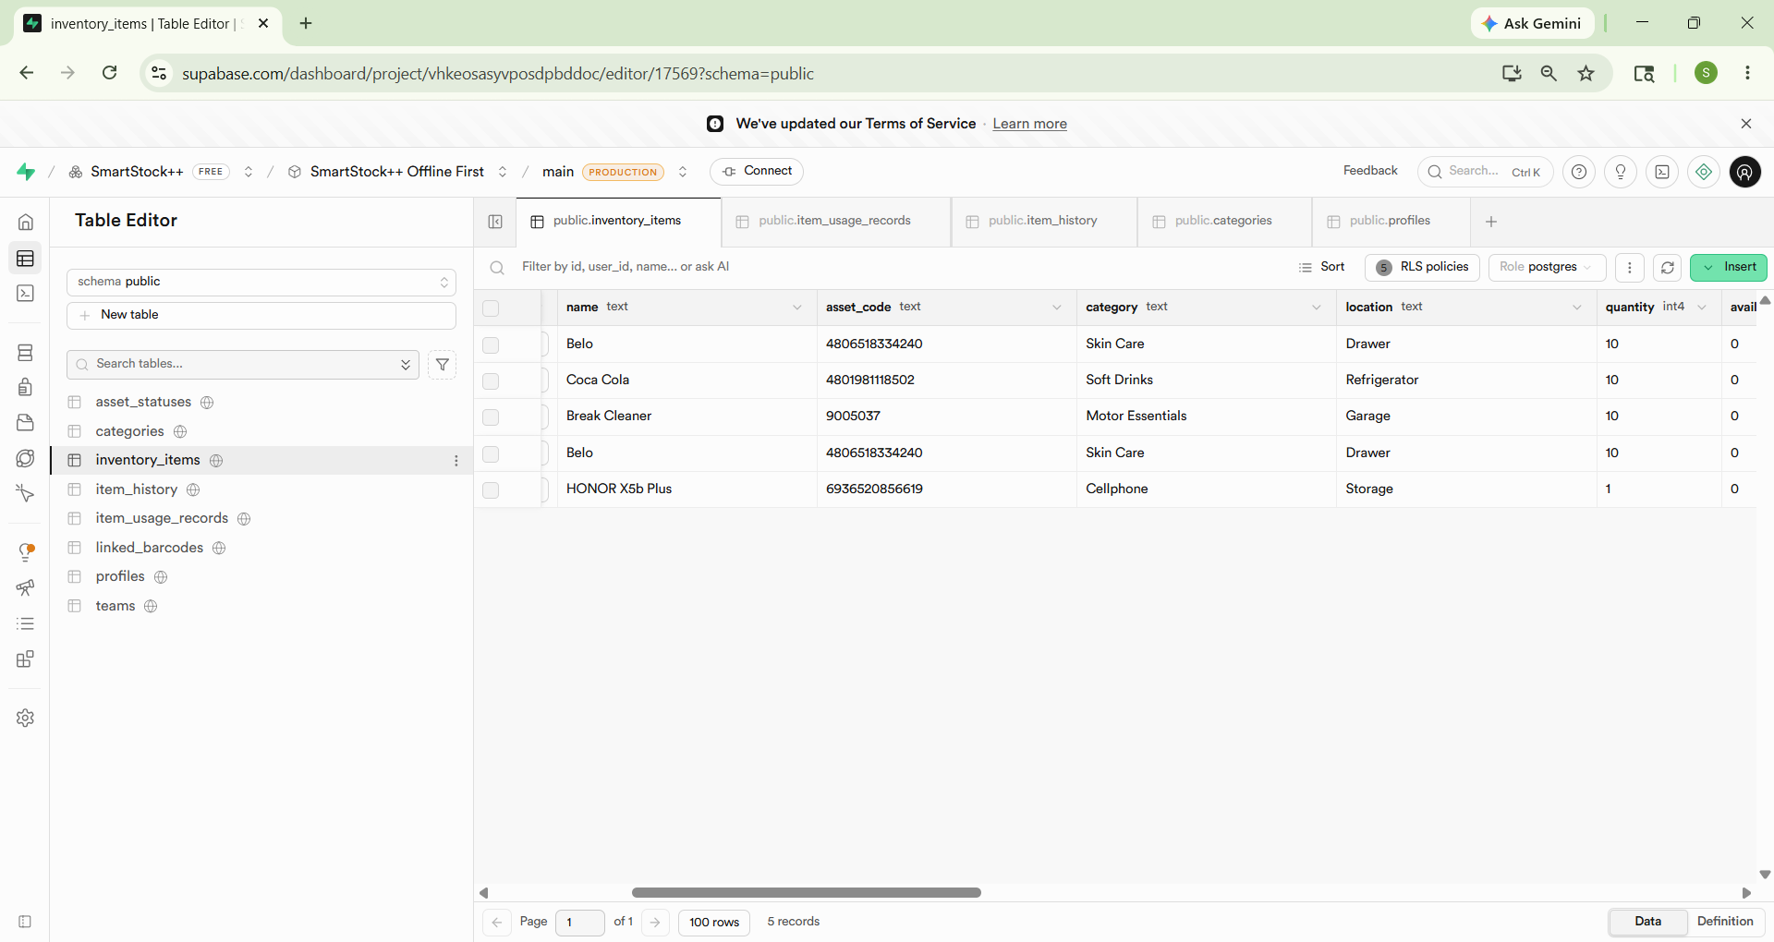
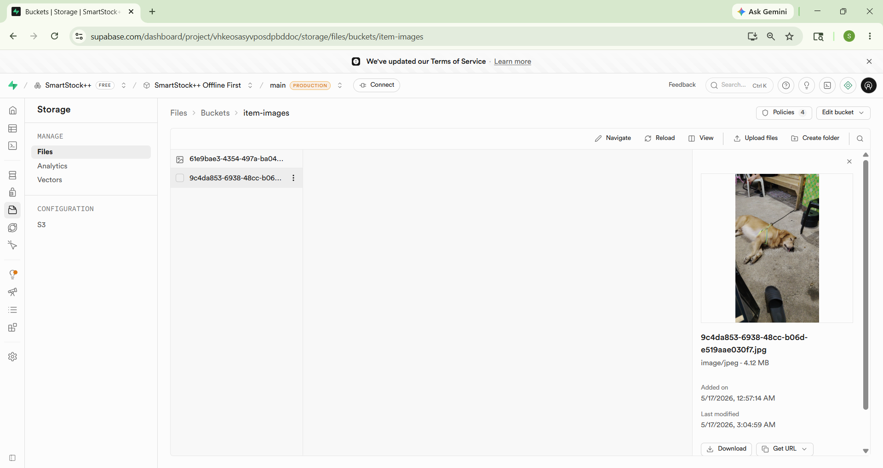
03 · SUPABASE BACKEND
Cloud / API Integration
04 / 09
Supabase (REST API backend)
[ SCREENSHOT ] Supabase table editor (inventory_items rows) + optional Storage bucket / sample JSON
PostgreSQL + PostgREST REST API + GoTrue auth + Storage + Edge Functions, via supabase-kt over Ktor
Auth — email/password, session persistence, password reset, biometric unlock; Admin provisions Staff via an Edge Function
Bidirectional sync — 6 tables, last-write-wins, soft-delete, connectivity-gated; natural-key reconciliation prevents duplicates
Supabase Storage — item photos sync across devices, per-team scoped objects
Multi-tenant isolation — per-team Row-Level Security via a my_team() SECURITY DEFINER function; each account sees only its own team's data
SmartStock+ · Mobile Programming 2 — MCO 2 Final Presentation
Team 2
Notes:
Supabase IS a REST API backend (PostgREST) + managed auth + object storage — it fully satisfies the 'Firebase/REST API' requirement. Show a Supabase table screenshot. Highlight the per-team RLS isolation as the security story.

Slide 5
04 · LIVE WALKTHROUGH
UI Demo
05 / 09
Demo Flow (live on device)
• Registration / Login — redesigned, scrollable, biometric option
• Dashboard — KPIs, low-stock chart, connectivity & sync badge
• CRUD — add an item with photo + barcode, edit, delete with Undo
• Scan — link a barcode, scan-to-checkout a unit
• Cloud sync — row + photo appear in Supabase; pull-to-refresh
• Profile — theme, security settings, CSV export, team management
• Multi-tenant — a fresh account sees an empty, isolated inventory
SmartStock+ · Mobile Programming 2 — MCO 2 Final Presentation
Team 2
Notes:
DEMO SCRIPT (under 4 min):
1. Login -> register a fresh account (proves isolation: empty inventory, only itself in the team list).
2. Add an item with a camera photo + scanned barcode -> save.
3. Supabase dashboard -> refresh inventory_items -> row present with team_id; show the Storage bucket has the photo.
4. Edit quantity below threshold -> low-stock notification.
5. Delete an item -> tap UNDO.
6. Profile -> Export Data (CSV share sheet) + Security Settings.
Keep screenshots open as a fallback.

Slide 6
04 · LIVE WALKTHROUGH
UI Demo — Screenshots (1 of 2)
06 / 09
[ SCREENSHOT ] Login / Registration
[ SCREENSHOT ] Dashboard
[ SCREENSHOT ] Inventory list
SmartStock+ · Mobile Programming 2 — MCO 2 Final Presentation
Team 2
Notes:
Portrait phone captures — paste each over its box and delete the outline. Remove this slide if you demo fully live.

Slide 7
04 · LIVE WALKTHROUGH
UI Demo — Screenshots (2 of 2)
07 / 09
[ SCREENSHOT ] Add / Edit item (CRUD)
[ SCREENSHOT ] Cloud sync / Supabase
[ SCREENSHOT ] Profile & Settings
SmartStock+ · Mobile Programming 2 — MCO 2 Final Presentation
Team 2
Notes:
Portrait phone captures — paste each over its box and delete the outline. Remove this slide if you demo fully live.

Slide 8
05 · WHAT WE LEARNED
Challenges & Learnings
08 / 09
1
Room ↔ REST synchronization
Reconciling epoch-millis vs ISO-8601 and last-write-wins conflict resolution across six tables.
2
Multi-tenant data isolation
An over-broad is_admin() RLS policy + an un-wiped local cache leaked data across accounts — fixed with strict per-team RLS and a cache wipe on account switch.
3
Duplicate-free sync
Client-UUID-only keying duplicated rows on re-install — fixed by reconciling items/categories/statuses by natural key before push.
4
Cross-device images
Local file:// paths are meaningless on other devices — moved photos to per-team Supabase Storage with upload/download in the sync loop.
5
Best practices applied
MVVM · Repository · StateFlow · Hilt DI · lifecycle-aware APIs · WorkManager · RLS-backed security · clean architecture.
SmartStock+ · Mobile Programming 2 — MCO 2 Final Presentation
Team 2
Notes:
The multi-tenant isolation bug is the strongest talking point — found in testing, root-caused to an is_admin() SELECT policy that gave every admin global read, fixed with strict per-team RLS.

Slide 9
06 · WRAP-UP
Conclusion & Future Improvements
09 / 09
Summary
Future Improvements
A complete offline-first inventory system: full CRUD, scanning, reporting, charts, notifications, biometric auth, and secure multi-tenant Supabase sync with cross-device image storage.
Stays fully usable with zero connectivity and reconciles automatically once back online — the core goal achieved.
• Admin web panel for fleet-wide oversight
• Real-time updates via Supabase Realtime
• FCM push notifications (currently device-local)
• Audit log + hardened team-bootstrap handling
Thank you, Mr. Aaron Jude Pael, for your guidance throughout Mobile Programming 2.
SmartStock+ · Mobile Programming 2 — MCO 2 Final Presentation
Team 2
Notes:
Close confidently: every MCO 2 requirement is met and the app is demo-ready. Read the acknowledgment aloud — thank Mr. Pael directly and invite his questions.

