Slide 1
High Cloud Airlines Project Dashboard Insights
16/10/2024

Slide 2
Agenda
Objective
Key Insights
Data Overview
Analytics Approach
Dashboard Walkthrough
Recommendations
Conclusion

Slide 3
Objective
Optimize airline performance
Improve route utilization
Enhance operational decisions
The aim is to provide data-driven insights to improve route utilization, flight occupancy, and passenger satisfaction.

Slide 4
Problem Statement
Identify load factor trends
Analyze top routes and airlines
Improve off-peak and underperforming segments

Slide 5

Data Overview
Data from 2008 to 2013
207 airlines analyzed
1.1 million passengers
Key Metrics: Yearly, quarterly, and monthly load factors, airline performance, route traffic, and passenger preferences are analyzed.

Slide 6
Analytics Approach
The analysis focuses on year-wise, quarter-wise, and month-wise load factor trends to identify peak performance periods.
Looked at top airlines by load factor and passenger preferences, and examine the busiest routes based on the number of flights.
Visualizations used extensively to track performance KPIs and provide actionable insights.

Slide 7
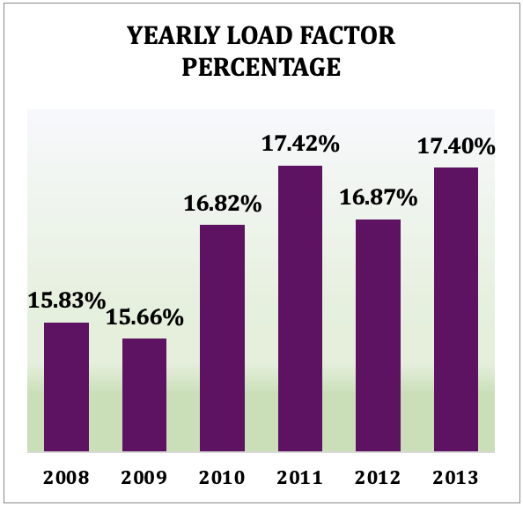
Key Performance Indicators (KPI) featured
Year-wise Load Factor Percentage
Definition: The load factor is the percentage of available seating capacity that has been filled by passengers over a year.
Significance: This KPI helps in identifying the yearly trends in flight occupancy. A rising trend indicates growing demand, whereas a declining trend may signal issues like reduced demand or operational inefficiencies.
Insight: In the data, the load factor generally increases year after year, with a peak in 2011. This suggests the airline has been gradually optimizing operations or increasing passenger demand.

Slide 8
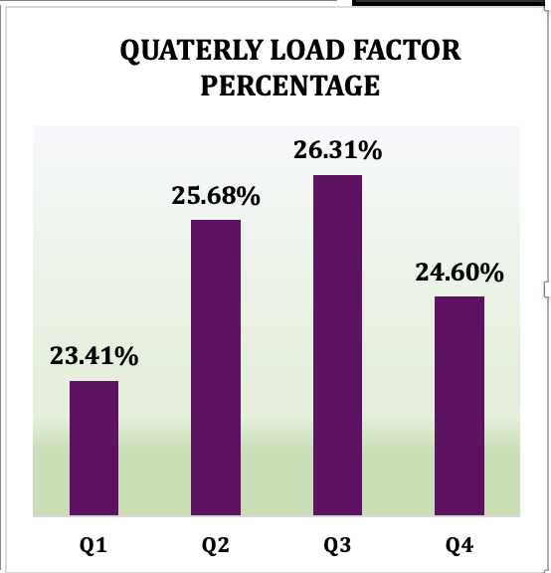
Quarter-wise Load Factor Percentage
Definition: This measures the percentage of occupied seats during different quarters of the year.
Significance: This KPI helps understand seasonal patterns in passenger demand. Certain quarters, like Q3 (July to September), may have higher load factors due to peak travel seasons such as summer holidays.
Insight: In the dashboard, Q3 has the highest load factor (26.31%), indicating a seasonal peak in demand, likely due to summer vacations or holiday travel. Q1 and Q4 show comparatively lower values, suggesting opportunities to boost demand during these periods.

Slide 9
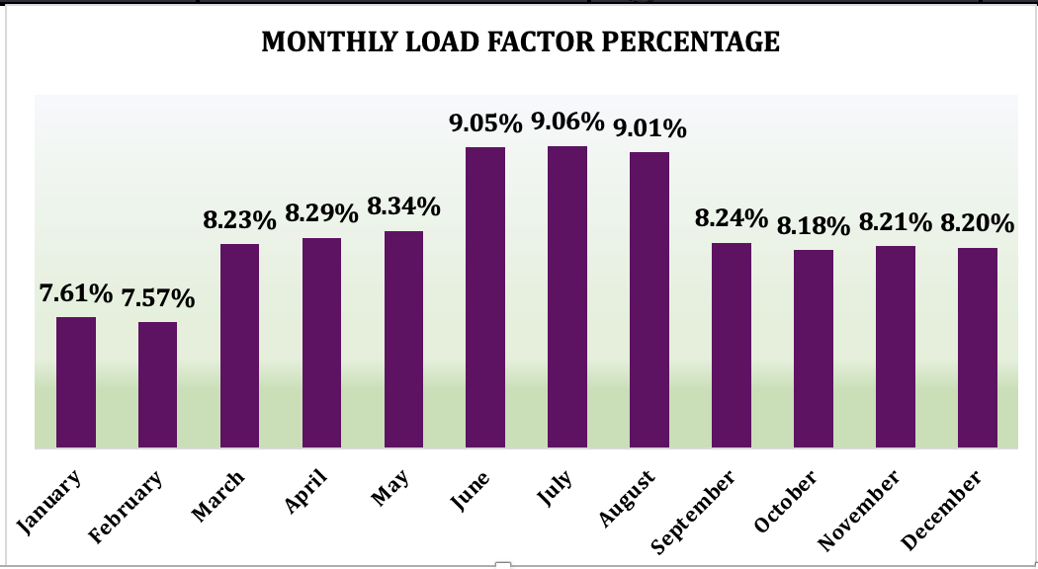
Month-wise Load Factor Percentage
Definition: The load factor broken down by each month of the year, reflecting the percentage of seats filled month over month.
Significance: This KPI highlights monthly variations in passenger traffic and helps airlines adjust capacity or pricing strategies. It can be useful for identifying off-peak months that might benefit from promotions.
Insight: The dashboard reveals that July and August have the highest load factors (9.05% and 9.01%, respectively), indicating peak travel periods. January and February have the lowest load factors, suggesting potential opportunities for marketing campaigns or discounted fares during these months.

Slide 10
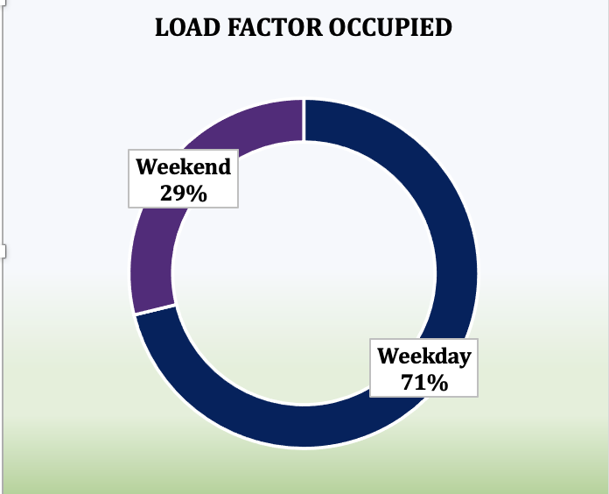
Load Factor Occupied (Weekday vs Weekend)
Definition: This KPI shows the percentage of seats filled on weekdays vs weekends.
Significance: It helps airlines understand travel patterns and adjust services, pricing, or promotions accordingly. For instance, higher weekday occupancy may suggest a strong business traveler base, while weekend occupancy may represent leisure travel.
Insight: In the data, weekdays account for 71.18% of the load factor, indicating that most passengers are flying on weekdays. This could suggest a predominance of business travelers, providing an opportunity for weekday-centric loyalty programs or business travel packages.

Slide 11
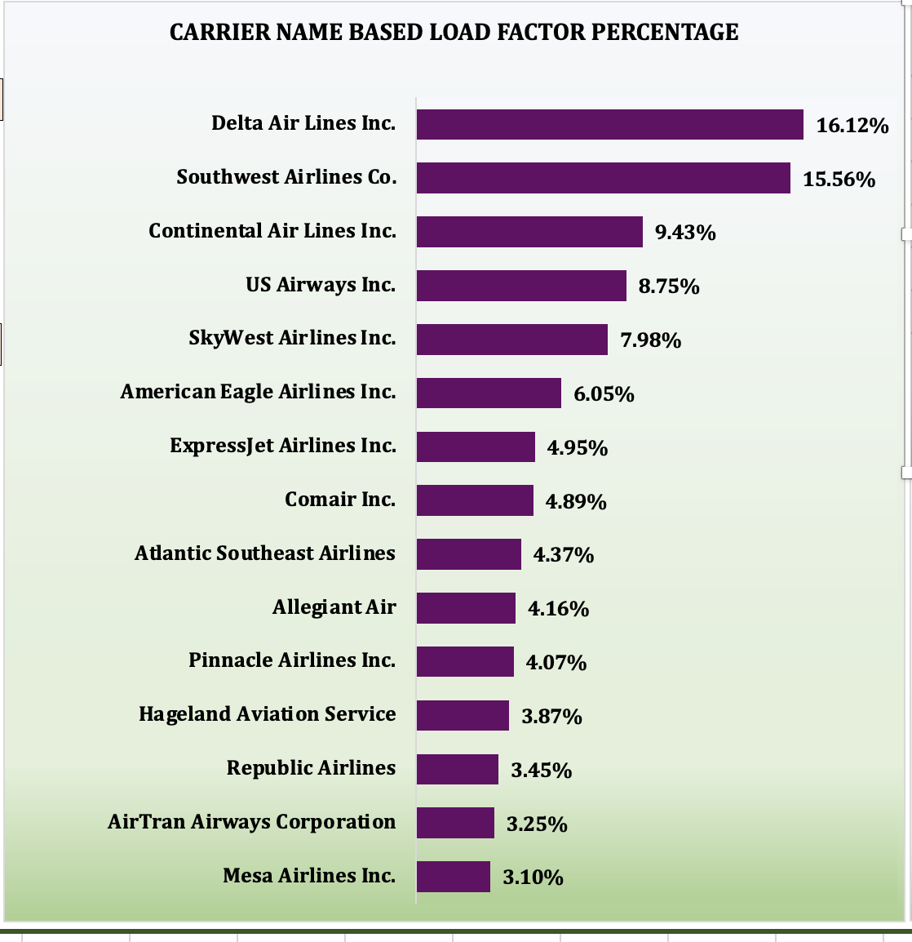
Top 10 Carriers Based on Load Factor
Definition: This KPI ranks airlines based on the percentage of their seats filled by passengers.
Significance: It gives insights into which airlines are most efficient at filling their available capacity. A higher load factor often indicates better financial performance.
Insight: Delta Air Lines Inc. leads with a load factor of 19.60%, followed by Southwest Airlines at 18.92%. Airlines with lower load factors, such as Allegiant Air and Atlantic Southeast Airlines, may need to improve their marketing or operational strategies.

Slide 12
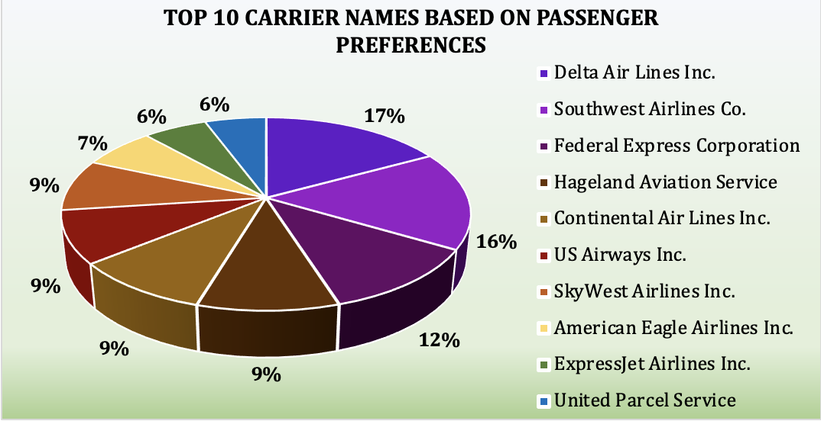
Top 10 Carrier Names Based on Passenger Preference
Definition: This KPI ranks airlines based on the number of passengers who prefer them, which could be influenced by service quality, pricing, or route availability.
Significance: It reflects brand loyalty and customer satisfaction. Carriers with higher passenger preference may have stronger customer relationships and competitive advantages.
Insight: Delta Air Lines Inc. ranks highest with 8,271 passengers, followed by Southwest Airlines Co. with 8,019 passengers. This aligns with their high load factor, suggesting that these airlines are effectively attracting and retaining passengers.

Slide 13
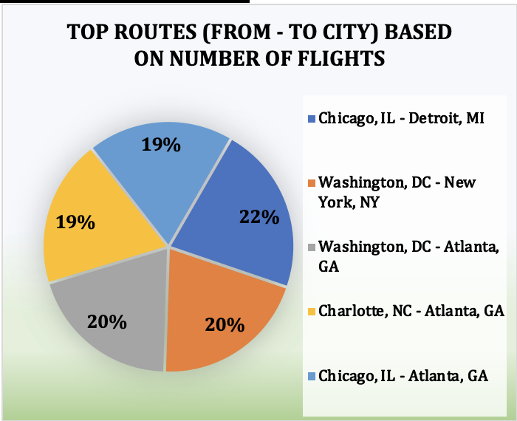
Top Routes Based on Number of Flights
Definition: This KPI lists the most popular routes in terms of the number of flights operated between city pairs.
Significance: Identifying the most frequented routes helps airlines focus resources on optimizing service and pricing for those routes, and it may also highlight potential bottlenecks or capacity issues.
Insight: Chicago, IL – Detroit, MI is the busiest route with 95 flights, followed by Washington, DC – New York, NY with 88 flights. These high-demand routes could benefit from additional flights, larger aircraft, or pricing strategies to maximize profitability.

Slide 14
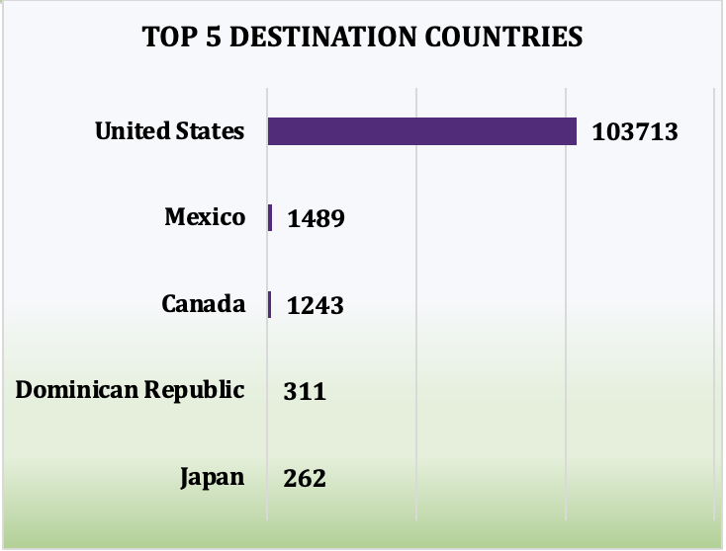
Top 5 Destination Countries
Definition: This KPI ranks the most popular destination countries based on the number of flights.
Significance: It highlights the airline's geographical focus and provides insights into potential expansion or service improvement opportunities in key markets.
Insight: The United States dominates with 103,713 flights, followed by Mexico and Canada with significantly fewer flights. This suggests a strong domestic market focus, with limited international operations.

Slide 15
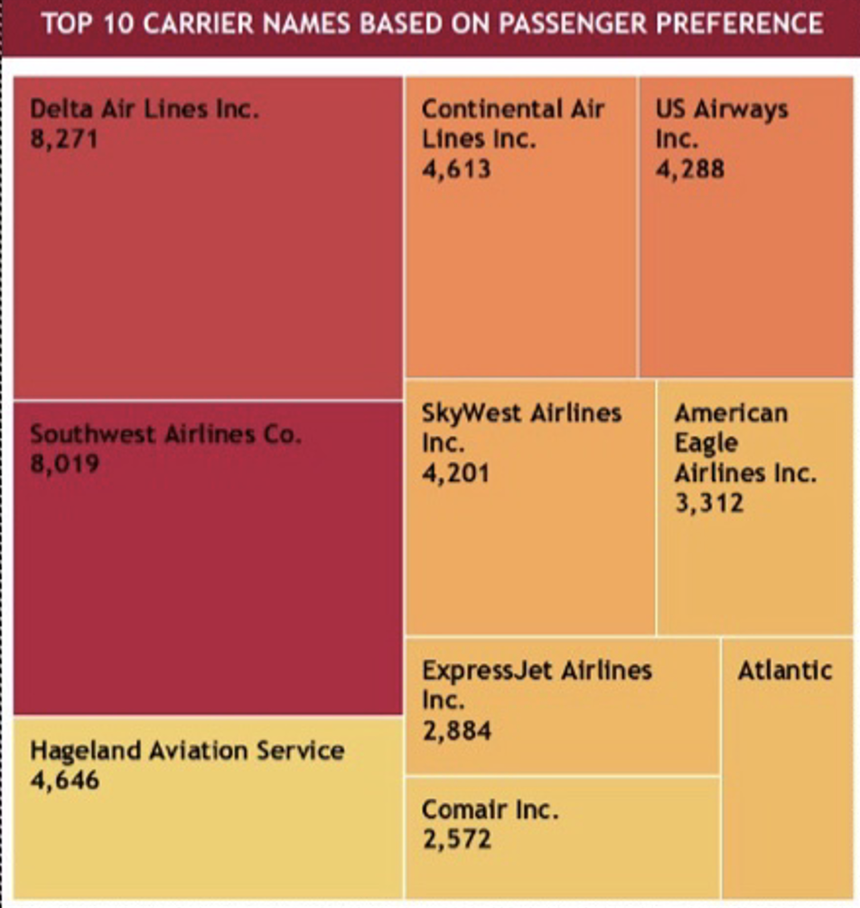
Top 10 Carrier Names Based on Passenger Preferences (Treemap)
Definition: This KPI visually represents the percentage of passengers preferring each airline in a treemap format, giving a proportional sense of the distribution.
Significance: This visualization provides a quick overview of the market share of each carrier, helping airlines benchmark themselves against competitors.
Insight: Delta Air Lines Inc. leads with 17% of the passenger market share, followed by Southwest Airlines Co. at 16%. This reinforces the earlier KPI indicating that these two airlines have high customer preference and operational success.

Slide 16
Key Insights
Yearly & Quarterly Trends:
Load factor percentage shows consistent growth from 2008 to 2013, peaking at 17.42% in 2011.
Quarter 3 consistently has the highest load factor (26.31%), indicating higher demand during this period.
Monthly Load Factor Trends
July and August have the highest load factor percentages (9.05% and 9.01% respectively), implying peak travel periods during summer months.
January and February are the lowest, which could suggest opportunities for boosting demand during these months through promotions or marketing strategies.

Slide 17
Carrier Performance
Delta Air Lines Inc. leads in load factor percentage (19.60%) and passenger preference.
Southwest Airlines Co. and US Airways Inc. are also major players in both load factor and passenger preferences.
Airlines like Allegiant Air and Atlantic Southeast Airlines have relatively lower load factors, indicating potential areas for optimization.
Top Routes and Flights
The busiest route is Chicago, IL – Detroit, MI, followed by Washington, DC – New York, NY, highlighting significant traffic on these city pairs.
Top 16 routes account for a majority of the traffic, with Chicago-Detroit topping the chart at 95 flights.

Slide 18
Passenger Preference and Distance
Delta Air Lines Inc. dominates both in terms of load factor and passenger preference, capturing 17% of the passenger preference market.
Shorter flights (distance group 1) dominate the number of flights, with 58,047 flights being in this group. This is followed by medium-distance flights (group 2) at 28,131 flights.
Weekend vs Weekday Occupancy
Weekdays have a significantly higher occupancy rate at 71% compared to weekends (29%). This suggests that business travel may be contributing heavily to weekday traffic, while weekend travel is more leisure-based.

Slide 19
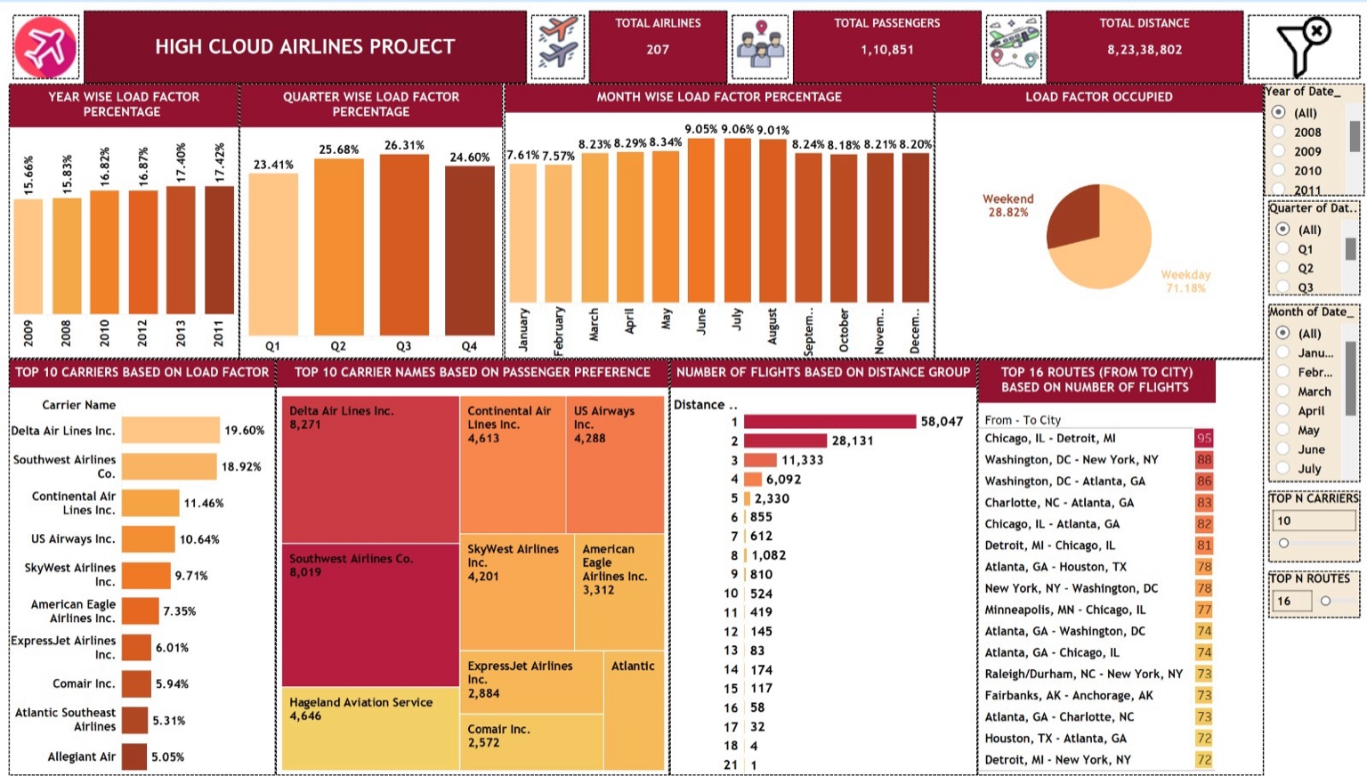
Dashboard Walkthrough - Slide 1

Slide 20
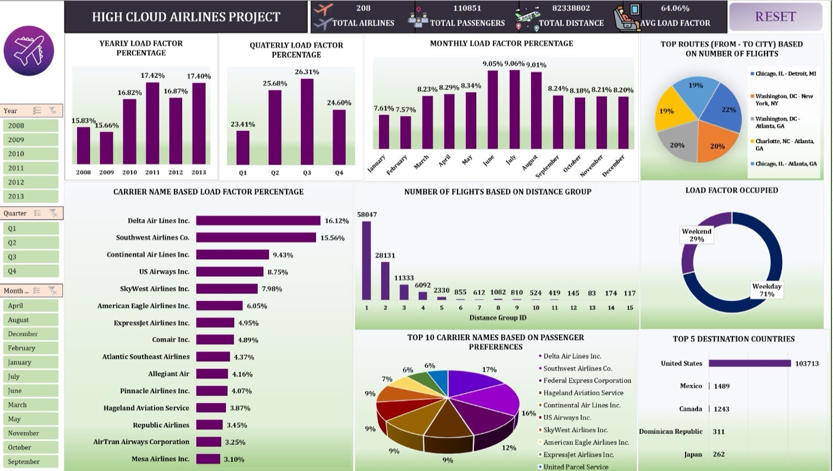
Dashboard Walkthrough - Slide 2

Slide 21
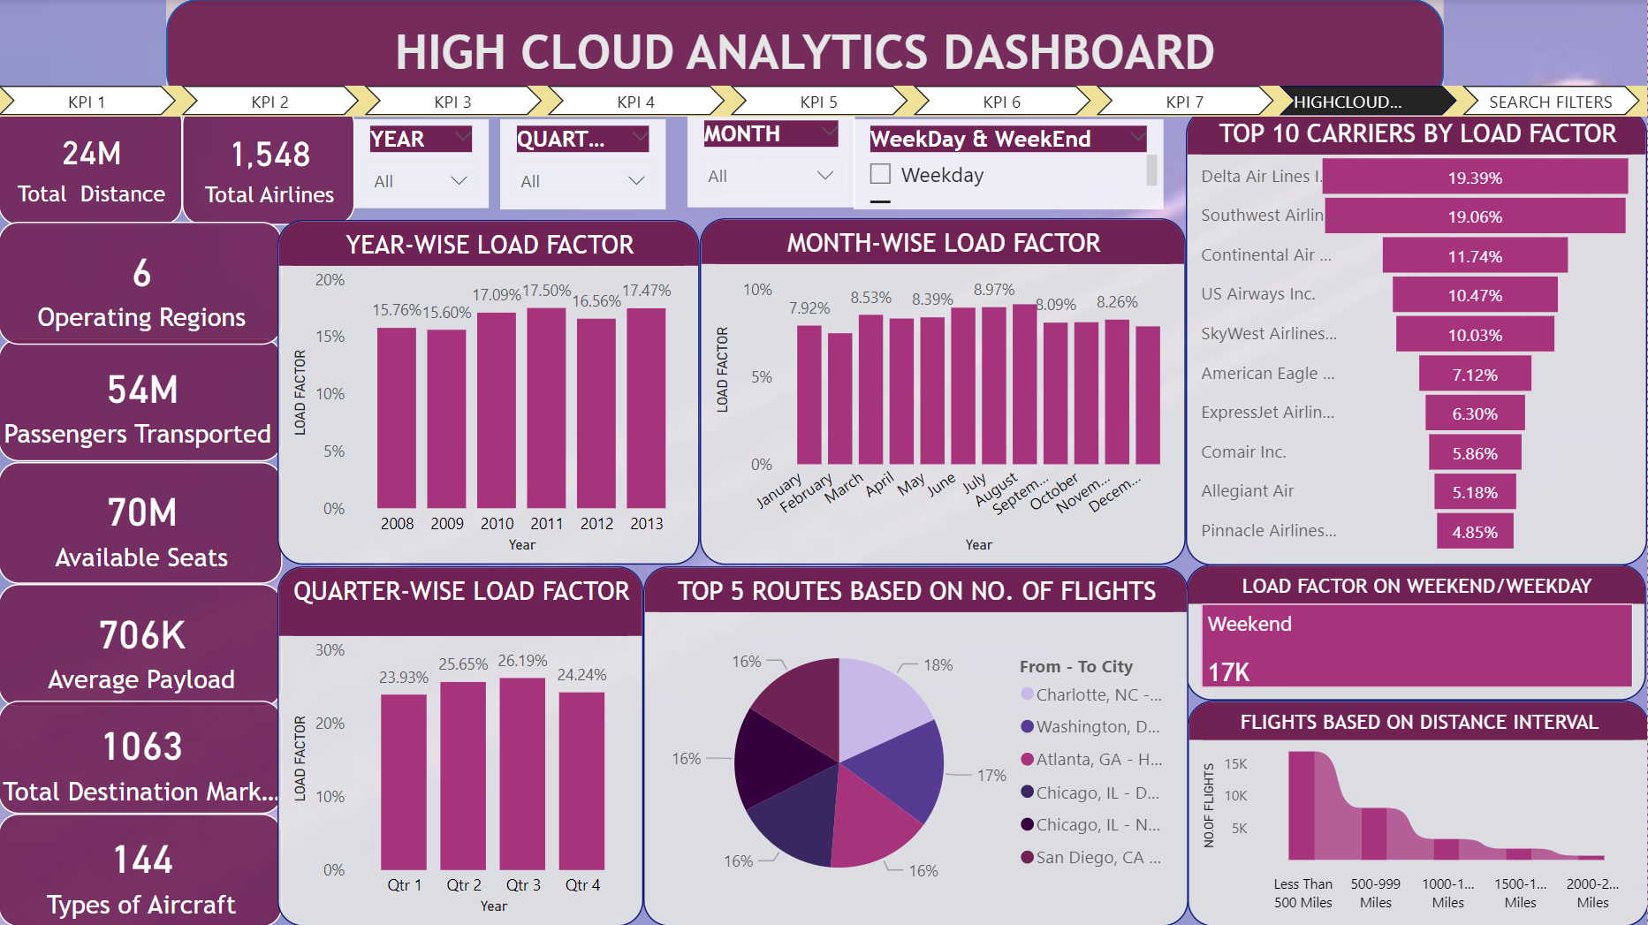
Dashboard Walkthrough - Slide 3

Slide 22
Recommendations
Promotional Strategies: Targeted campaigns and promotions during off-peak months, especially January and February, to boost demand during these periods.
Optimize Short-Haul Operations: Short-haul flights dominate the network; optimizing flight operations and load factor for these routes can yield significant improvements in overall performance.
Improve Underperforming Airlines: Airlines with lower load factors, such as Allegiant Air and Atlantic Southeast Airlines, may need to revise their operational strategies and consider pricing or service adjustments to improve performance.
Focus on Business Travel: With a significantly higher weekday load factor, airlines should explore business travel packages or loyalty programs aimed at weekday passengers.

Slide 23
Conclusion
Summary of Insights: The analysis highlights peak performance periods, top-performing airlines, and key routes. It also identifies opportunities to boost load factors in off-peak months and underperforming airlines.
Increased demand in Q3 and summer months: Highest load factor during Q3, particularly in July and August. Strategies focused on: maintaining this peak performance & exploring campaigns for off-peak.
Top airlines driving performance: Delta Air Lines and Southwest Airlines are consistently performing well in terms of load factors and passenger preference.

Slide 24
Conclusion
Key routes dominate air traffic: Chicago-Detroit and Washington-New York are the busiest routes. Any changes in these routes can significantly impact overall network performance.
Short-haul flights dominate: A large number of flights fall into shorter distance groups, which suggests that a focus on optimizing short-haul operations can yield significant results.
Weekday focus for optimization: With 71% of load factor being on weekdays, airlines should consider targeted offers or improved services for weekday travelers, likely consisting of business passengers.

Slide 25
THANK YOU

