Slide 1
Cancer Rate Regression Estimate and Alert System
A tool for public health officials, governing bodies, local activists

Slide 2

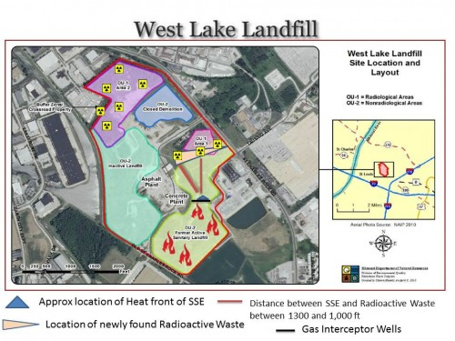
Purpose: Baseline Cancer Estimate & Alert System

Slide 3
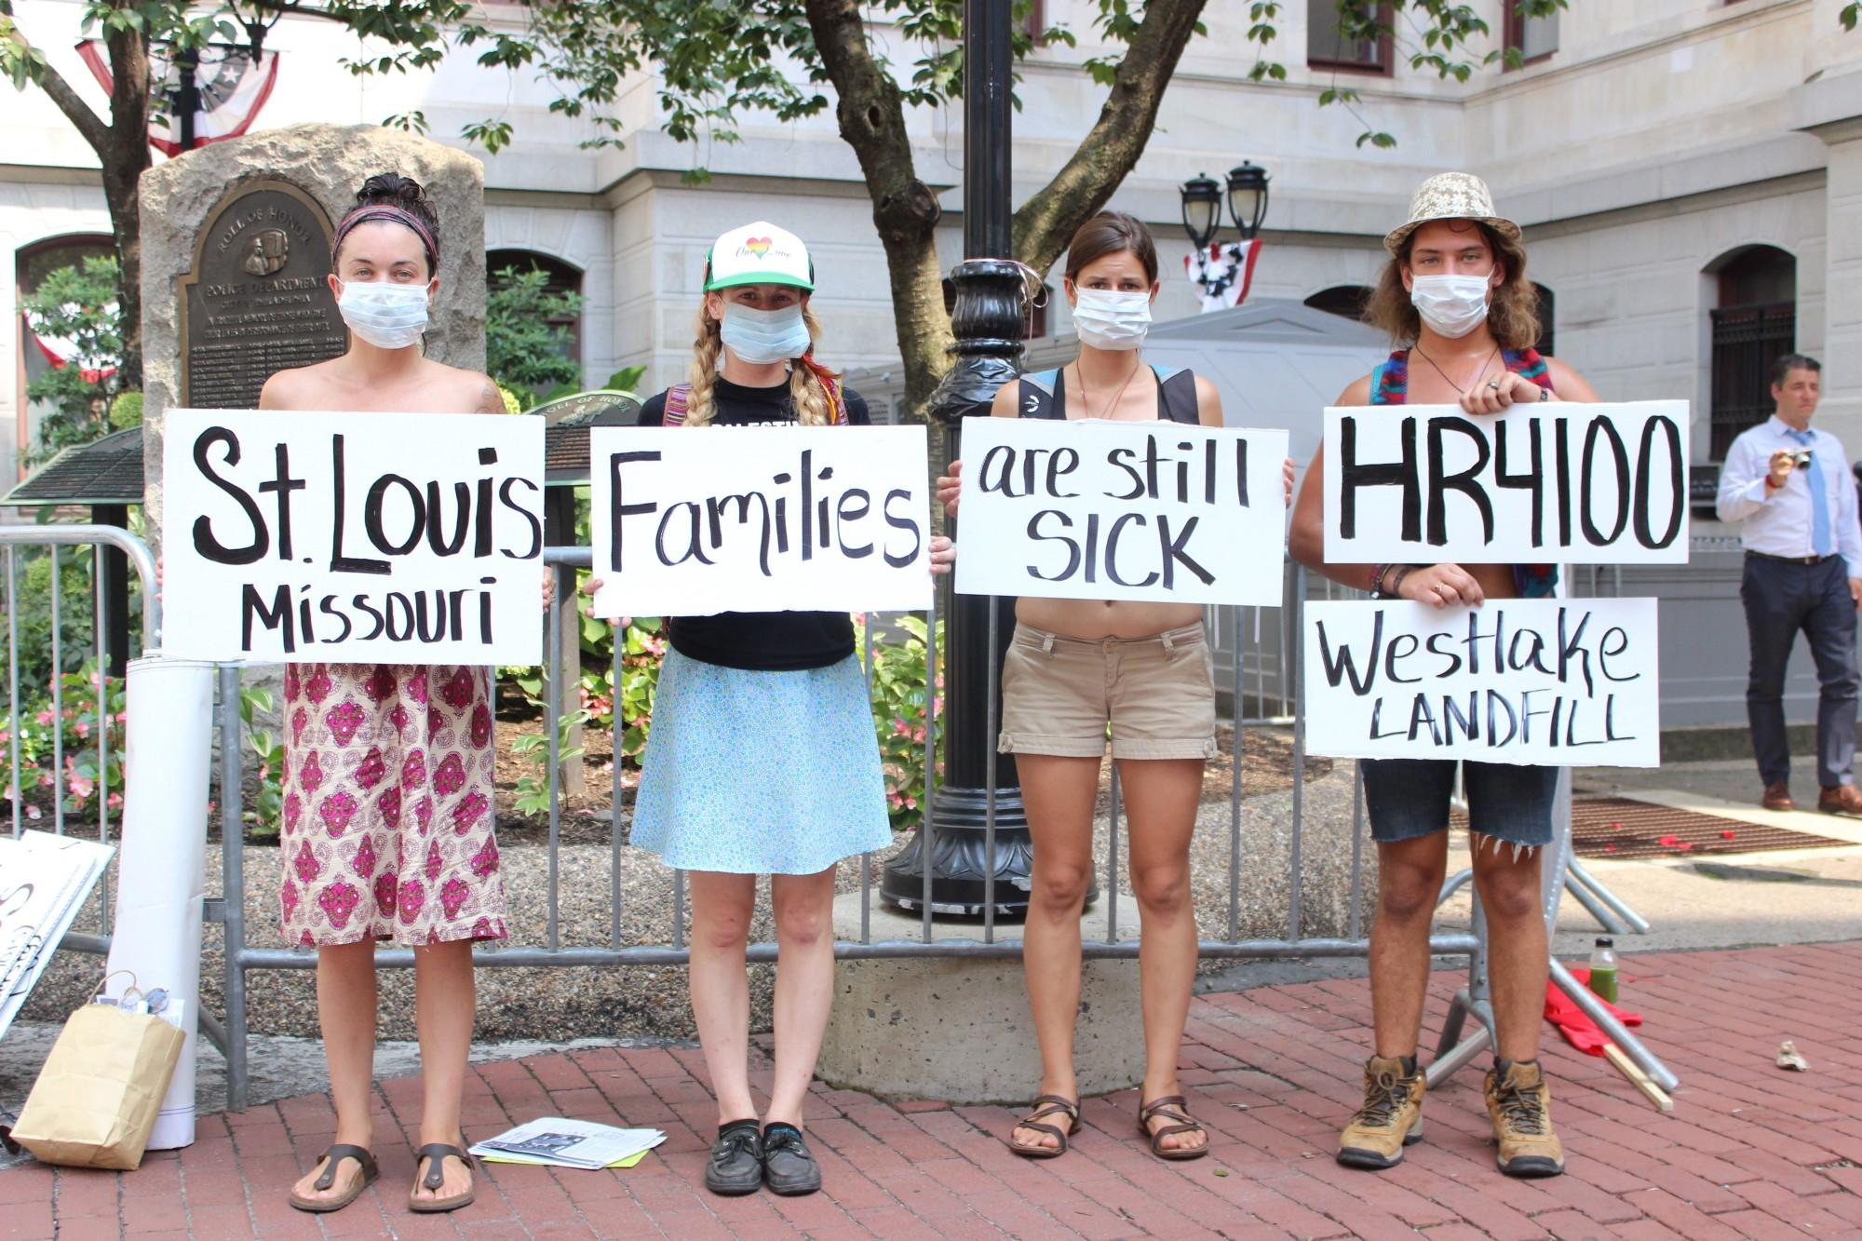


Potential Users:
Public Health Officials
Local Government Officials
Local Activists

Slide 4
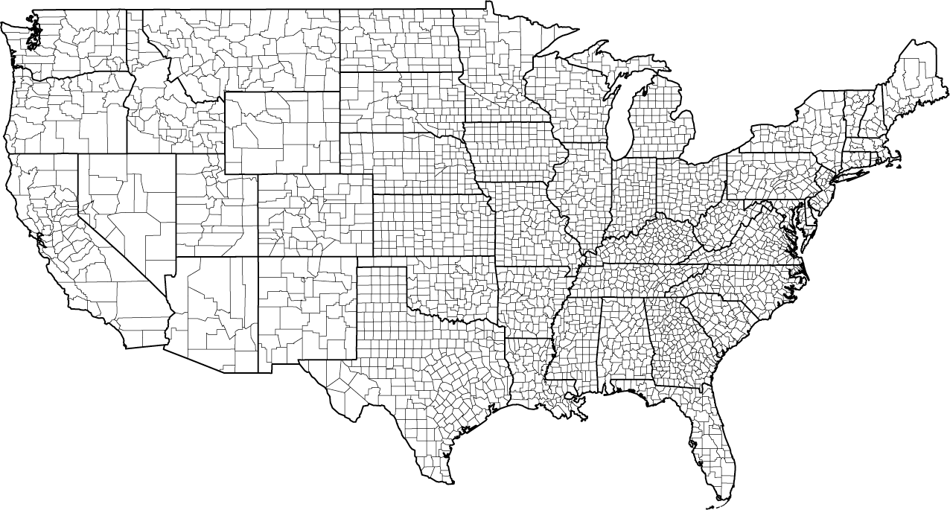
Data Overview:
Cancer data from 3,047 Counties
https://data.world/nrippner/ols-regression-challenge

Slide 5



Education
What’s in the Data?
Health Care
Economic

Slide 6
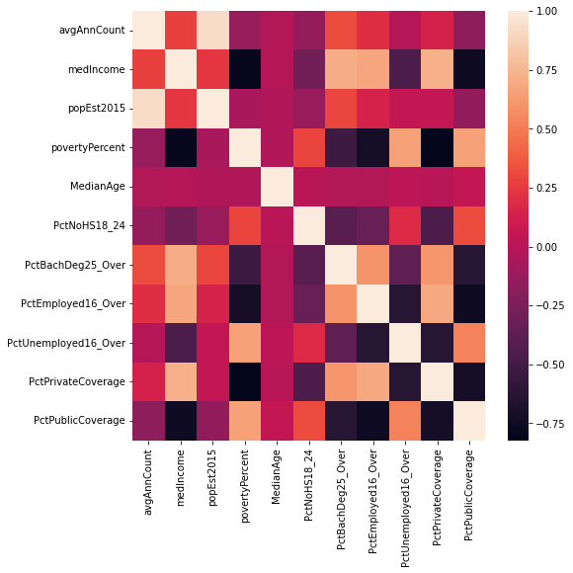
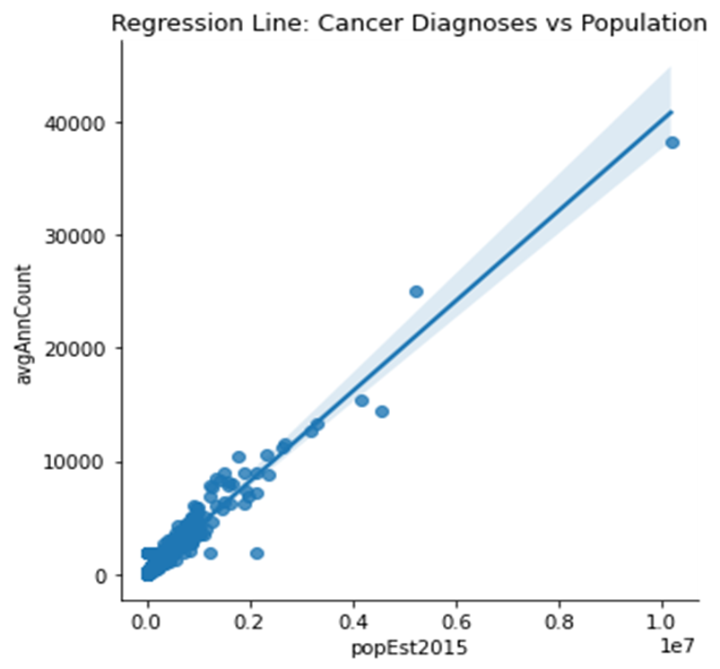
Data Wrangle & Exploratory Data Analysis (EDA)
Steps Performed:
Drop columns- many missing values, data leakage, contains redundant information
Fill missing values
Pairplot- How are variables related to avgAnnCount
Heatmap- How are variables related to each other

Slide 7
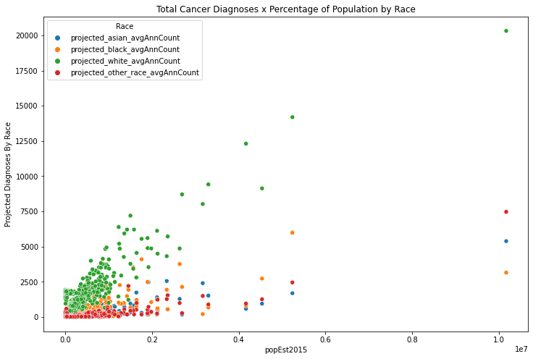
Data Wrangle & EDA Cont.
Check highest and lowest values to ensure there are no issues with data quality
Conceptual Exploration- Other uses for data

Slide 8
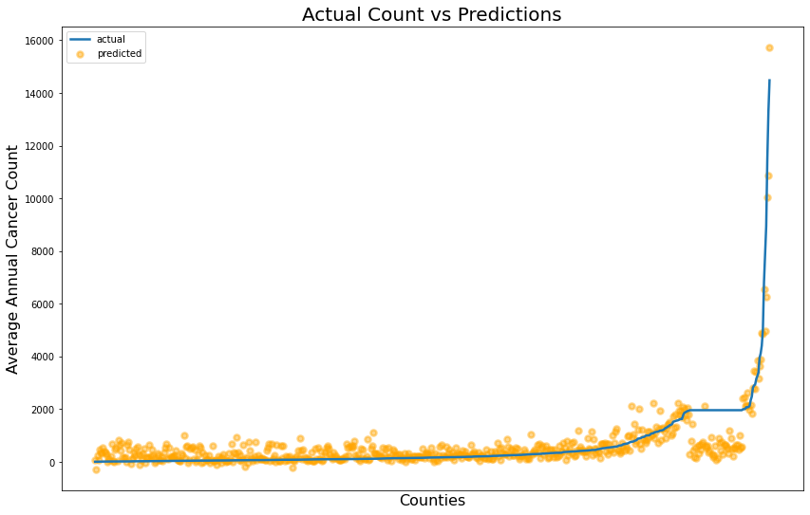
Modeling: Gradient Boosting Regressor
Order test data by increasing cancer count and visualize
Mean Squared Error:
263,909
R Squared:
0.83
Weird. What’s going on with the data around 2,000?

Slide 9
Exploring Model Anomaly
Input: subset['avgAnnCount'].value_counts()
Input: #look into the counties with this value
subset[subset['avgAnnCount'] == 1962.667684]['Geography']
Output:
1962.667684 206
554.000000 7
569.000000 4
564.000000 4
622.000000 3
...
628.000000 1
815.000000 1
1601.000000 1
1625.000000 1
509.000000 1
Name: avgAnnCount, Length: 488, dtype: int64
Output:
111 Churchill County, Nevada
112 Clark County, Nevada
113 Douglas County, Nevada
114 Elko County, Nevada
115 Esmeralda County, Nevada
...
3042 Ellsworth County, Kansas
3043 Finney County, Kansas
3044 Ford County, Kansas
3045 Franklin County, Kansas
3046 Geary County, Kansas
Name: Geography, Length: 206, dtype: object

Slide 10
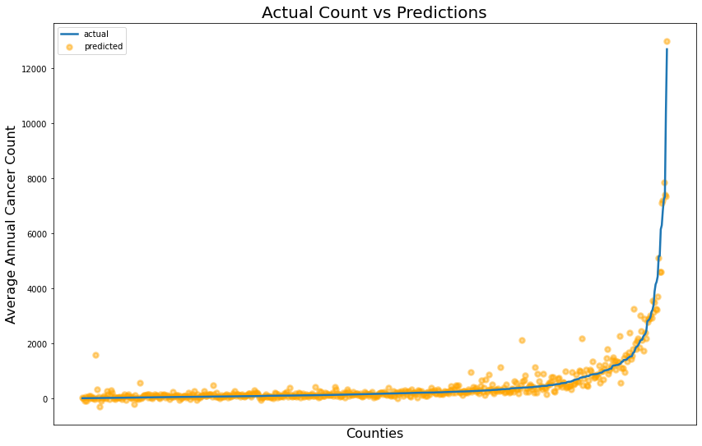
Gradient Boosting Model v2
Mean Squared Error: 71,607
R Squared:
0.94

Slide 11
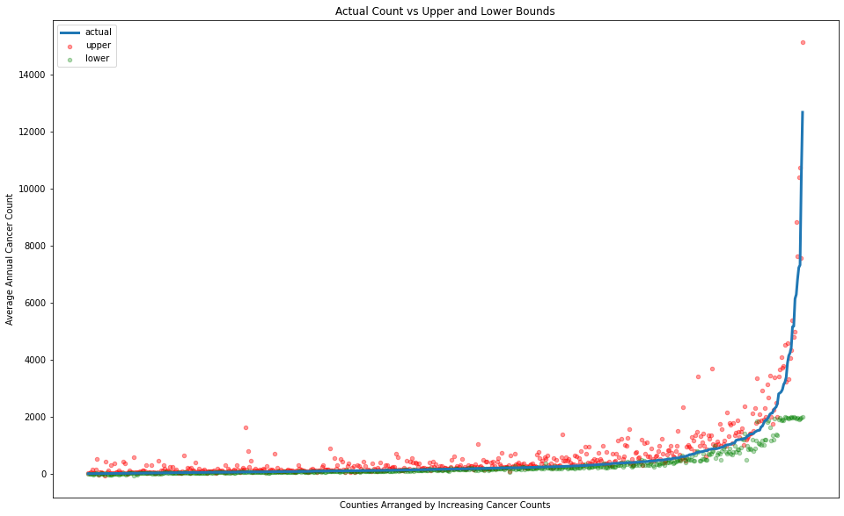
Gradient Boosting Regressor: Upper and Lower Bounds
What’s going on at the far ends?

Slide 12
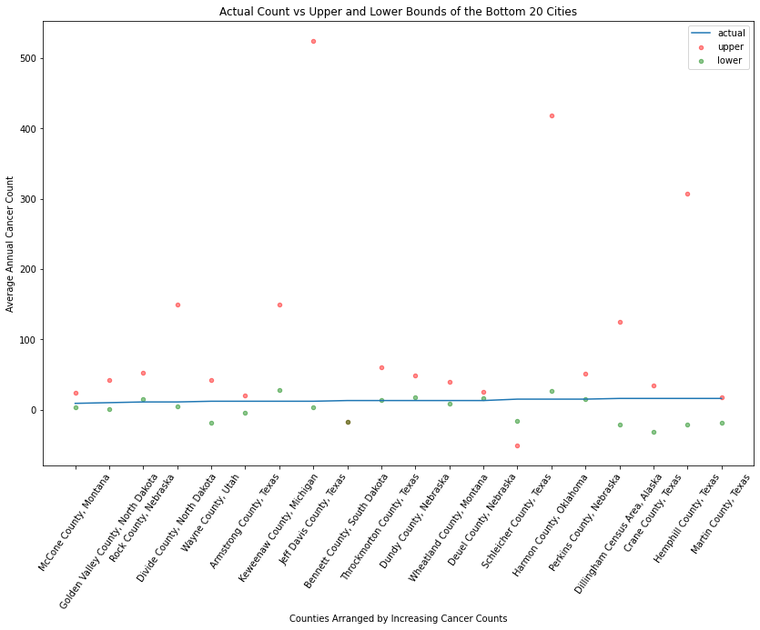
Bottom 20:
Bounds:
About ⅓ of actual values fall outside bounds
6 upper bound estimates above 300
Two upper bound estimates below zero
Takeaway: At very least, some checks will be necessary on the model to make sure its numbers are reasonable

Slide 13
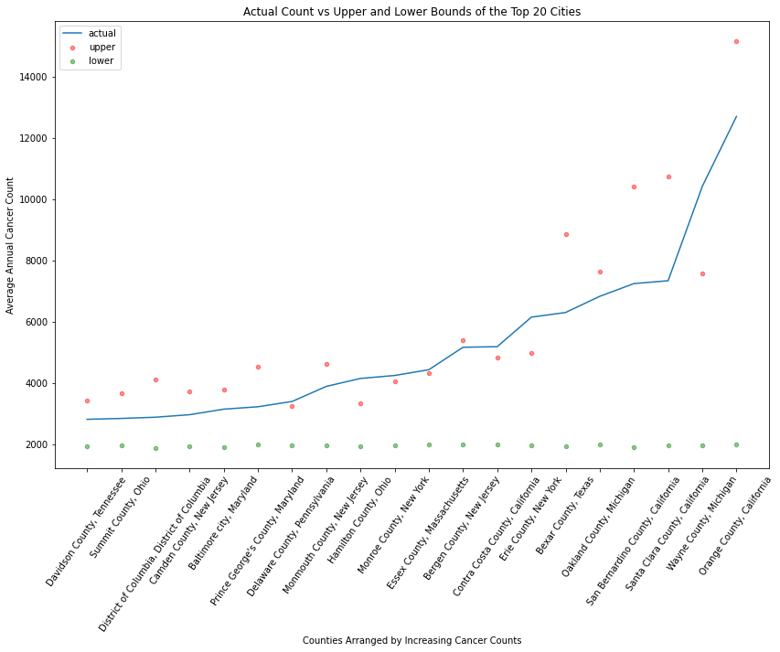
Top 20:
Upper Bound:
7 below actual count
Lower Bound:
No change as values increase

Slide 14

Random Forest Regressor
Results?
Metrics:
Test Data Mean Squared Error: 169,990
R Squared: 0.86
Underwhelming…

Slide 15
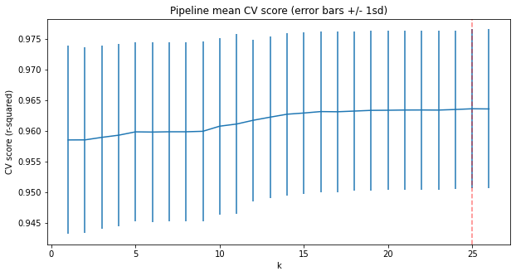
Final Model:
Scikit Learn - Linear Regression
Parameters:
KBest = 25

Slide 16
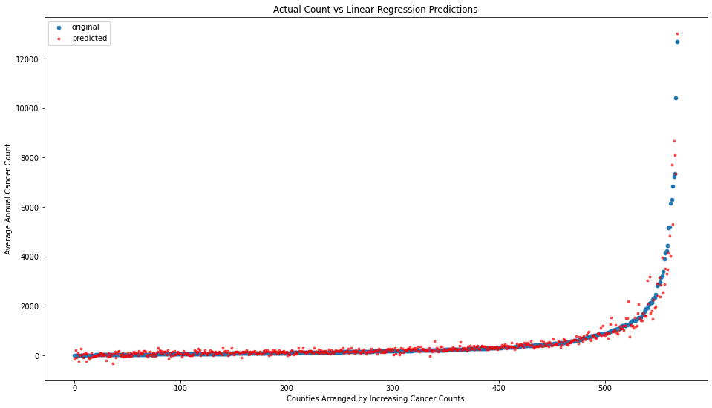
Metrics
Coefficients
povertyPercent -10.468678
MedianAgeMale -6.893624
PctPrivateCoverage -4.299202
PctMarriedHouseholds -4.161871
AvgHouseholdSize -3.982874
PercentMarried -3.698090
PctPublicCoverageAlone -1.635652
PctEmployed16_Over -1.110698
PctOtherRace -0.936090
PctNoHS18_24 -0.823617
PctHS18_24 -0.744546
MedianAge -0.073071
medIncome 0.002595
popEst2015 0.004044
studyPerCap 0.008639
PctBlack 0.253991
PctWhite 0.340307
BirthRate 0.341140
PctHS25_Over 1.425162
PctAsian 1.923341
PctBachDeg25_Over 4.469056
PctBachDeg18_24 6.473242
PctEmpPrivCoverage 6.803297
PctUnemployed16_Over 8.231038
PctPublicCoverage 9.498376
MedianAgeFemale 12.577454
Mean Squared Error:
66,128
R Squared:
0.95

Slide 17
Moving Forward:
Identify communities that the model might work well for.
Gather/identify more data to increase model performance.
Re-train Gradient Boosting models
Use an error metric - scaled to population - to determine a threshold past which an alert is raised
Train models using data subsets to search for disparities - For example in predominantly minority communities.
See if a model using cases per capita yields better results and/or further insight

