Slide 1
Business Segmentation and Forecasting

Slide 2


Purposes
Use unsupervised clustering to identify business segments for added insight
Create a 4-week forecast for the upcoming holiday season

Slide 3


Data Overview
514,000 sales from an online retailer
Sales occur between December, 2010 and December, 2011

Slide 4



What’s in the data?
Timestamps
“Descriptions”
Country

Slide 5

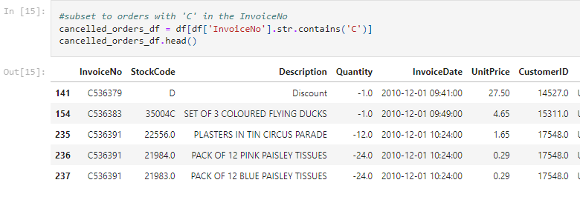
Data Wrangle and EDA
Primary Challenge: Removing cancelled orders
9,288
Cancellations indicated by ‘C’ in InvoiceNo
Original orders that correspond to cancellations are also in the dataset

Slide 6
Create Identifier to pair cancellation and original order
Match on:
UnitPrice
CustomerID
StockCode
Quantity is negative in cancellation and positive in original order

Slide 7
Results
Create array with all identifiers in a data frame of only the cancellations
Check for all instances of those values in remaining data frame
Optimally would retrieve 9,288 values but some adjustments were done manually and other orders could have been made multiple times but only one of them cancelled.
18,239 total → 6,632 unique
Remove these from the data frame

Slide 8
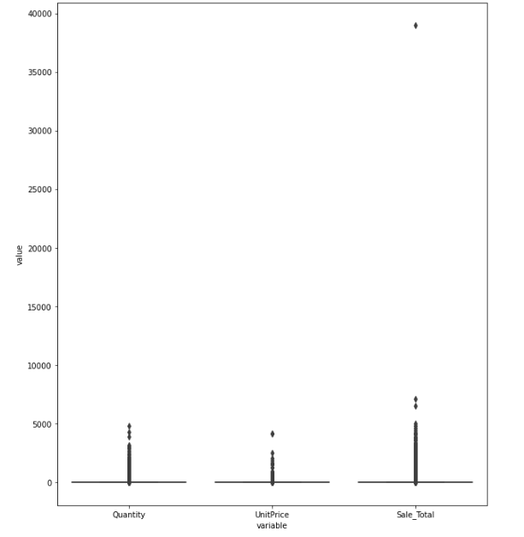
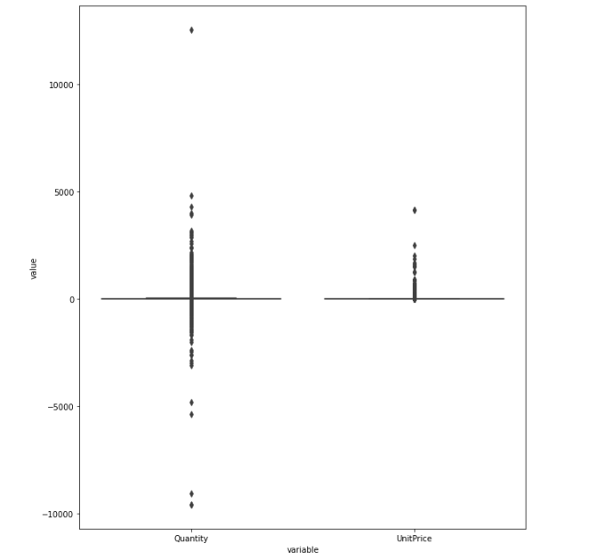
EDA - Box Plots

Slide 9
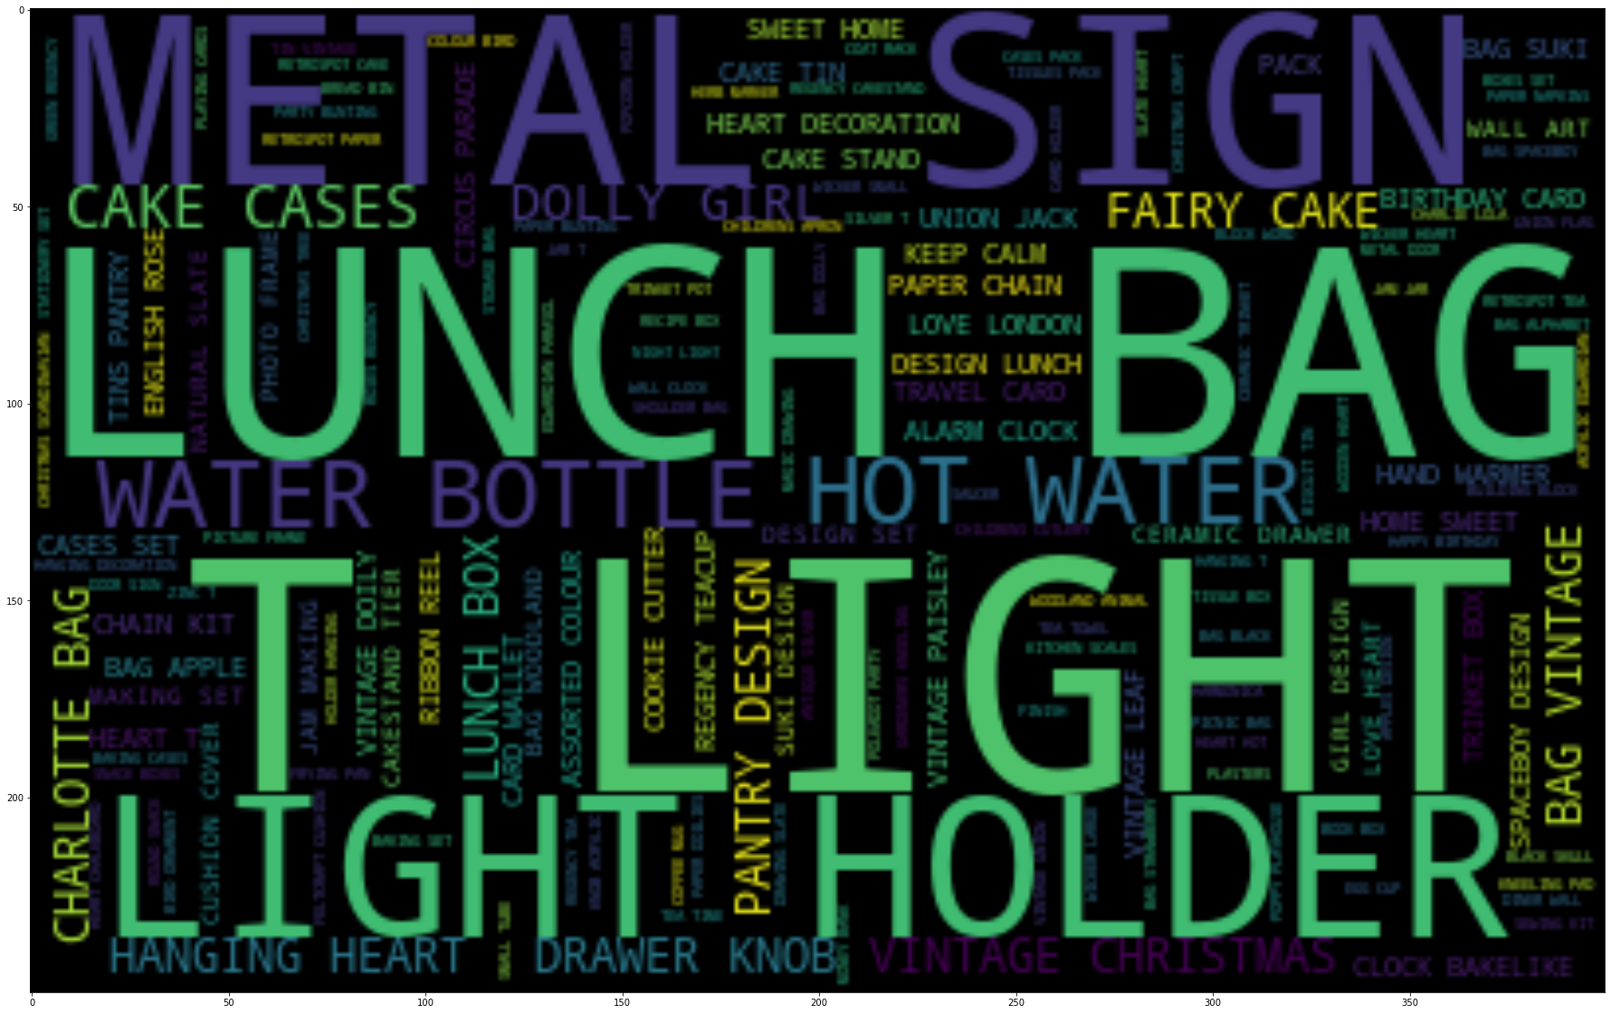
Visualize Description Column
Create Word Cloud

Slide 10
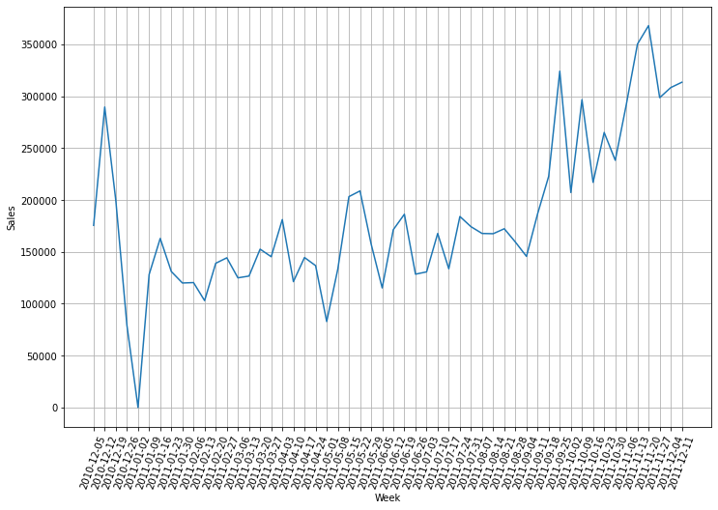
Sales by Week

Slide 11
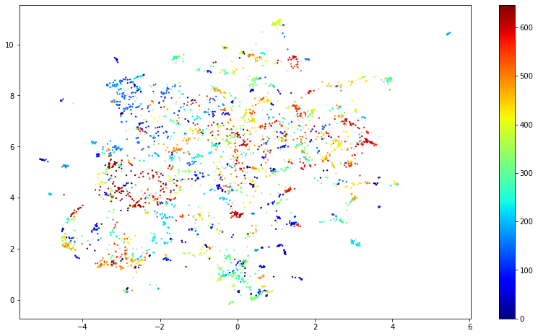
Clustering with UMAP + HDBSCAN
Number of clusters can be unknown with HDBSCAN
Use pre-trained sentence embedding models since descriptions are only a couple words.
UMAP reduces dimensionality.
Visualize results
Too many clusters to be useful

Slide 12
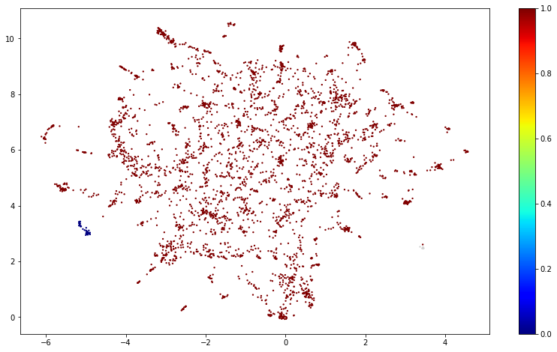
Other Results
Regardless of parameters model either created too many clusters or essentially lumped everything into one cluster
N = 3
But almost all points are in one cluster

Slide 13
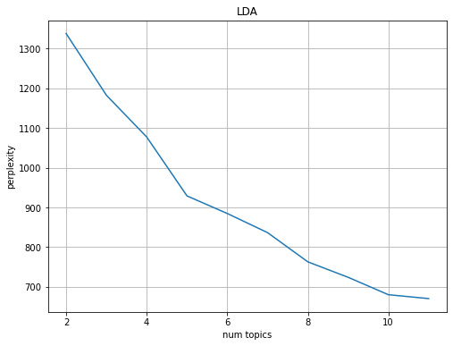
Latent dirichlet allocation (LDA)
Perplexity is high for all values of n.
Elbow at n=5

Slide 14
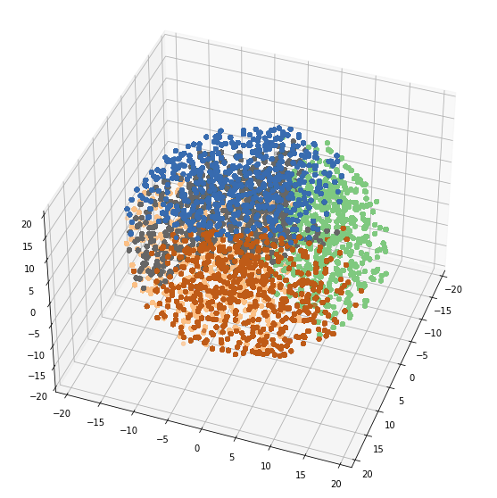
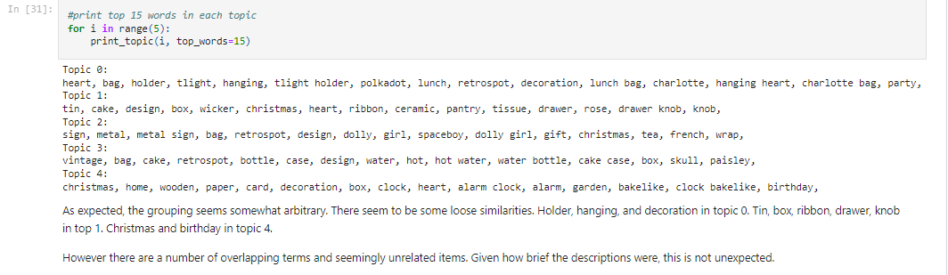
After parameter tuning at n=5
Model doesn’t seem to be performing poorly but picking dividing points seems somewhat arbitrary

Slide 15
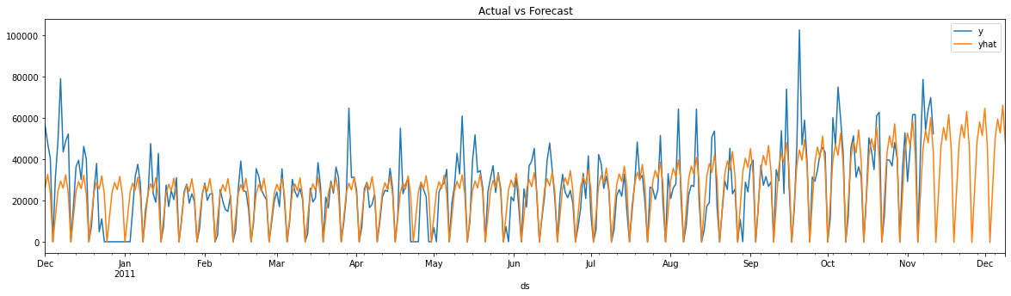
Forecasting
By Region
All Sales
By LDA Segment

Slide 16
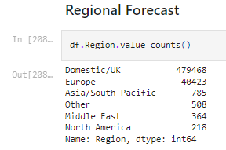
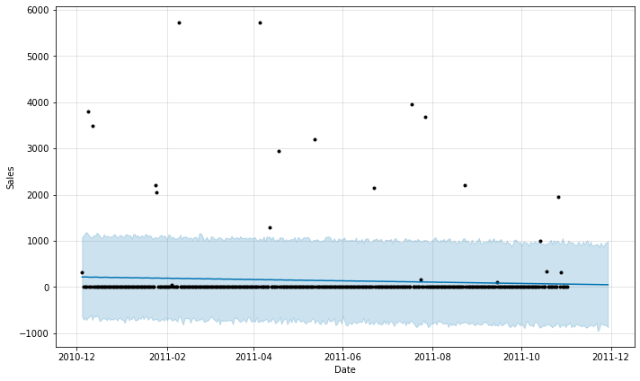
Region
Forecast for Asia/South Pacific
Too few data points for most regions

Slide 17
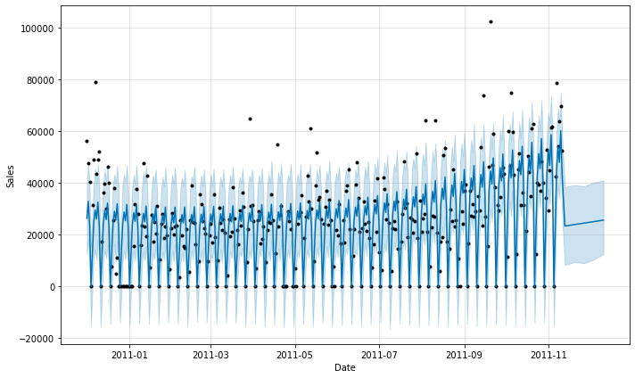
All Sales - 4 Weeks withheld for testing
All Sales Daily Forecast with Weekly mean Predictions
Overall best model
Error Metrics:
Mean Absolute Percentage Error (MAPE) = 11.2%
Root Mean Square Error (RMSE) = 48,891

Slide 18
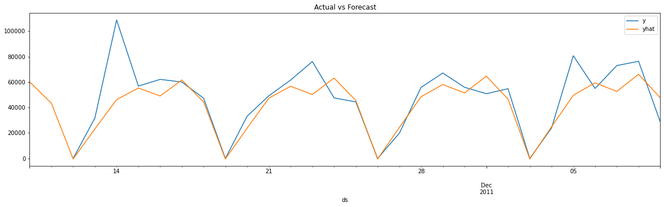
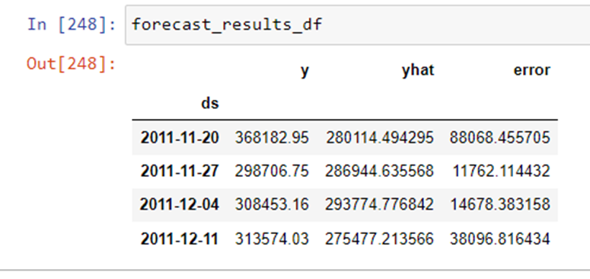
Four week Forecast: Actual vs Predicted
Daily sales and predictions are aggregated by week for forecasting and error purposes
Most error occurs in the first week due to an unusually high sales day

Slide 19
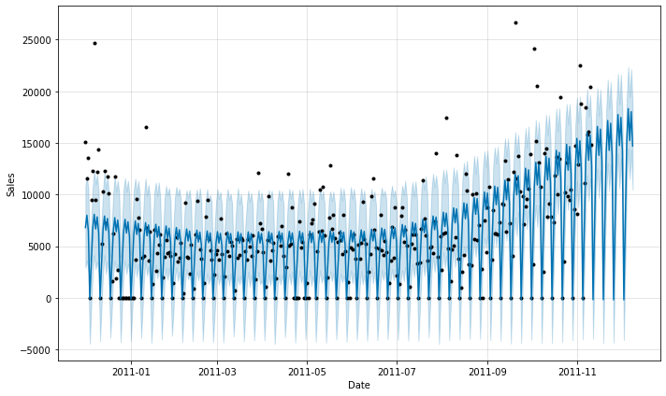
Note on Segment Forecasting
Segment 3 Forecast with MAPE = 9.26%
Two segments performed slightly better than all sales data. Two significantly worse.
Because segments were somewhat arbitrary, these models were abandoned for the all sales model
However…

Slide 20
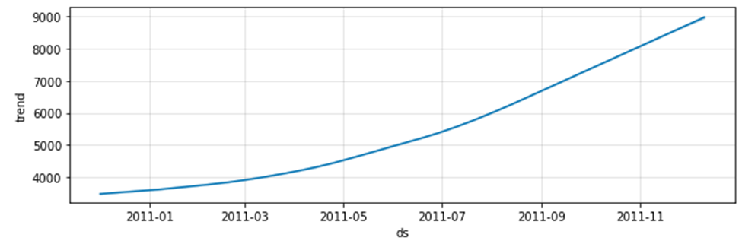
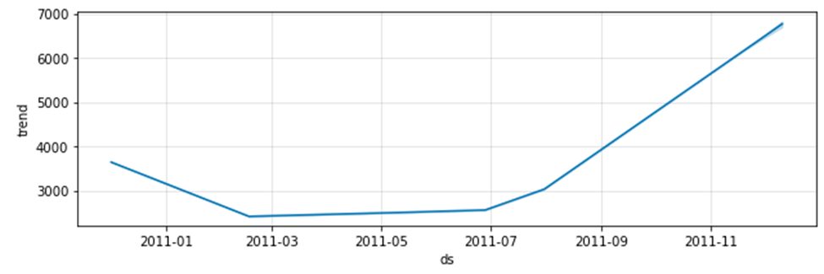
Segment Trends
Segment 0 Trendline
There is a clear difference in segment trends
If a business had segments that were not yet formally distinguished it is easy to see how this exercise could produce powerful insight into the performance of different aspects of the business
Segment 1 Trendline

Slide 21
Conclusion
Next Steps:
Work with business execs to decide whether model is performing well enough to be put to use.
Seek more information that might improve forecast metrics. E.g. could the unusually high sales day have been predicted?

