Slide 1
The Mammalian Cell Cycle as a Boolean GRN
System is stable equilibrium in absence of CycD
In the presence of CycD, all states converge on dynamical cycleFauré, Adrien, et al. "Dynamical analysis of a generic Boolean model for the cDynontrol of the mammalian cell cycle." Bioinformatics 22.14 (2006): e124-e131.
Theresa Mason Fisher
SES 591

Slide 2
The Cell Cycle
Made up of G0, G1, S, G2, and M phase
Tightly regulated
  Promoted and modulated by cyclin and cyclin-dependent kinases (CDKs)
  Inhibited by kip proteins (tumor suppressor genes, e.g. p53)

Slide 3
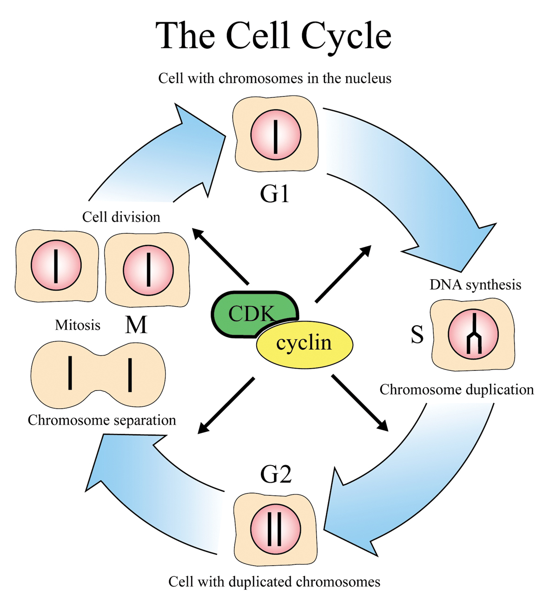

Slide 4
Cast of characters
CycD- Cyclin D- initiates sequence, activated by external growth factors
Rb- retinoblastoma protein, tumor suppressor
P27- tumor suppressor
E2F- transcription factor
CycE- Cyclin E- deactivates suppressors
CycA- Cyclin A- deactivates suppressors and Anaphase Promoting Complex (APC), as well as E2F (negative feedback loop)
Cdh1- part of APC, suppresses CycB and CycA
CycB- Cyclin B- activates Cdc20
Cdc20- initiates anaphase and chromosome separation, suppresses Cdh1
UbcH10- ubiquitinating enzyme, deactivates CycA

Slide 5
Specific sequence
CycD triggered by external growth factors
This inactivates inhibitor Rb
  This in turn releases CycA and promotes CycE transcription via E2F
  CycE also inactivates Rb, as well as p27
  CycA also helps suppress p27 and Rb, and also inactivates Cdh1, switching off APC

Slide 6
Specific sequence
Deactivating APC allows CycB to appear
CycB then activates Cdc20, activator of APC (negative feedback loop)
Cdc20 activates Cdh1
Cdh1, along with UbcH10, then degrade/inactivate Cdc20, CycB, and CycA
  Inactivating the latter releases E2F, restarting the cycle

Slide 7
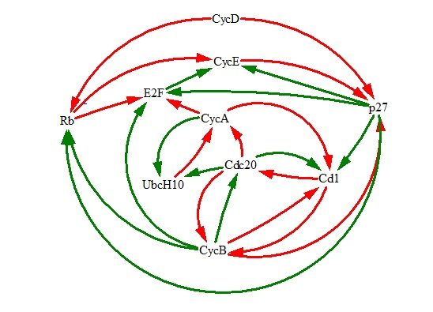
Cell cycle logical regulatory graph

Slide 8
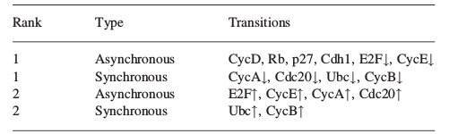
Model construction and results
Built using GINsim
1024 possible states
Mixed updating

Slide 9
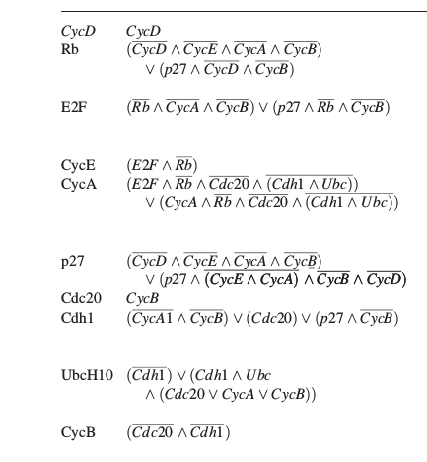
Cell cycle rules

Slide 10
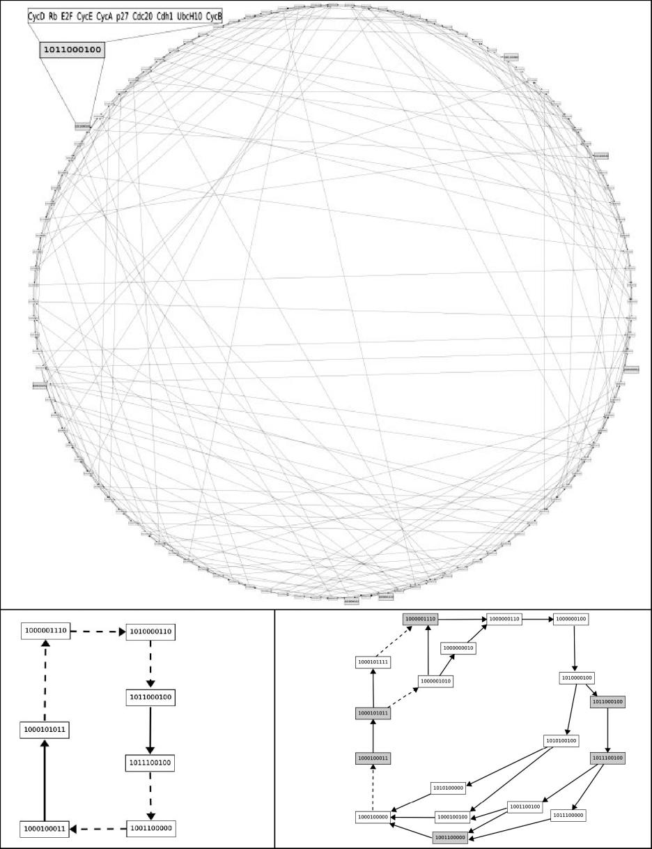
Network graph

Slide 11
Model results
System is stable equilibrium in absence of CycD
In the presence of CycD, all states converge on dynamical cycle
  Attractor made up of 112 states

