Slide 1
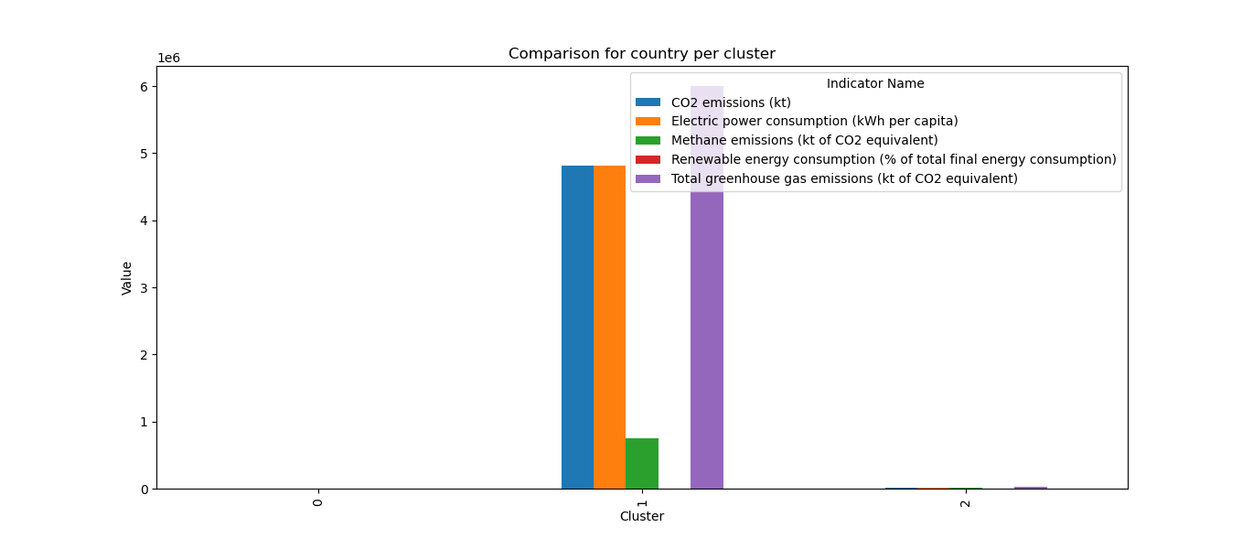
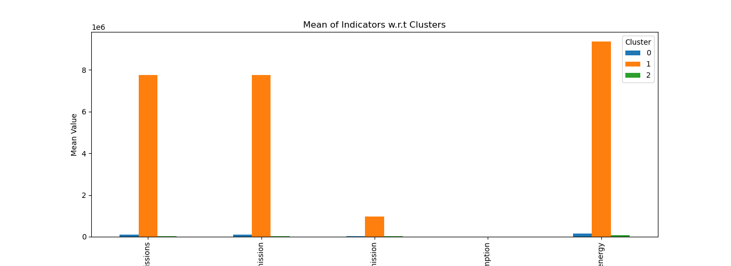
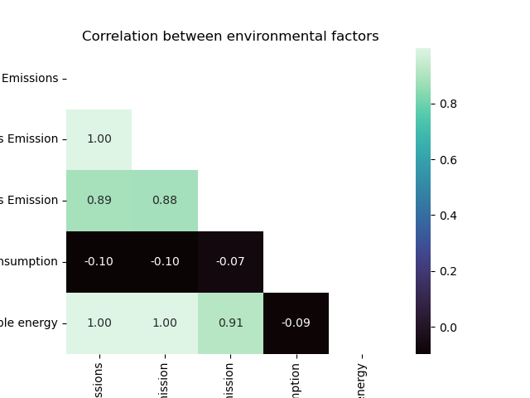
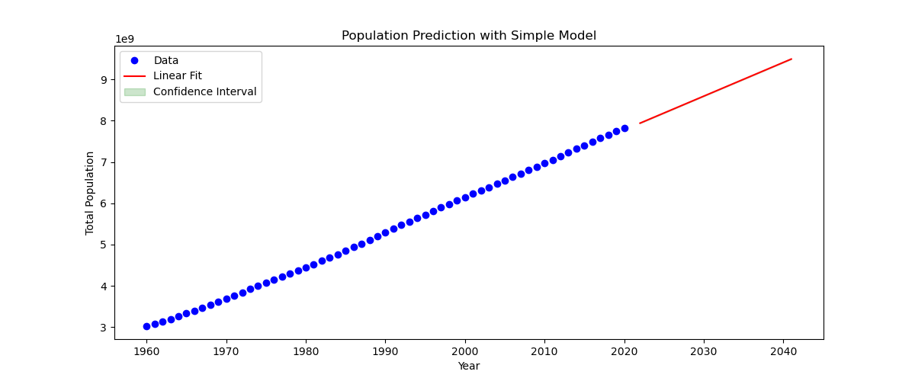
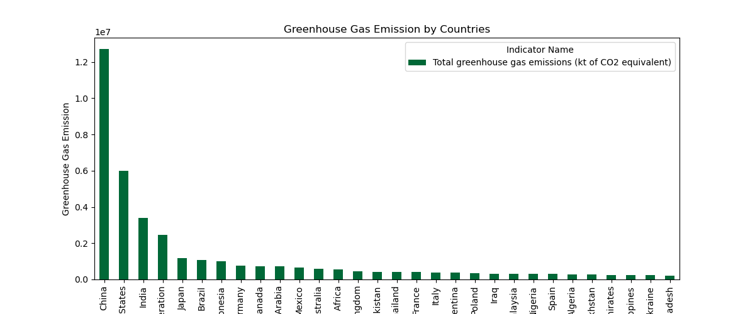
Climate Change Analysis Muhammad Ali id:21069608
→ Introduction
Our planet's health and the well-being of humans and animals are in jeopardy from the problem of climate change. It is brought on by several human activities, including farming, deforestation, and the combustion of fossil fuels, all of which have exacerbated the issue. Based on data gathered from the World Bank, this study intends to investigate several climate change indicators and identify the nations with the largest forested areas.
Background
We used the following climate change indicators from the World Bank…
Then I performed in-depth analysis on selected data.
Analysis
Cluster 0
Cluster 1
Cluster 2
No Significant percentage for metrics.
49.84% of CO2 emissions.
60.84 Kilo tons of Greenhouse gas emission.
No Significant percentage for metrics.
CO2 Emissions
Greenhouse Gas Emissions
Methane Gas Emission
Electricity Power Consumption
Renewable energy
It was found that clusters 0 and 2 had the lowest amounts of CO2 and methane emissions, whereas cluster 1 had the greatest emission levels, according to the clustering study.
According to the Pearson correlation analysis, there was a negative correlation between Electricity Power Consumption and Methane Gas Emission, as well as other indicators.
We estimated the world population up to 2040 using a curve_fit model that was trained on data collected between 1960 and 2021. According to our projections, there will be 9.495 billion people on the planet in 2040, up from 7.942 billion in 2021.
Conclusion
In conclusion, our work emphasises the urgent requirement to reduce greenhouse gas emissions, especially CO2 and methane, in order to combat climate change. Countries that need to take immediate action to minimise their carbon footprint have been identified by the clustering analysis. The nations with significant forest cover can also provide information on conservation and sustainable land use methods. Our estimate of global population growth emphasises how urgent it is to address climate change right away in order to ensure a sustainable future for future generations. It is imperative to move quickly to cut greenhouse gas emissions and advance sustainable practises at the local, state, and federal levels in order to lessen the adverse effects of climate change.
The top 20 countries with the highest to lowest Green House Emissions are…
Our KMeans clustering analysis selected one country from each cluster, with the following average indicator values…
GitHub https://github.com/SESWAMODELSCHOOL/ADSClusteringAndFittings

