Slide 1
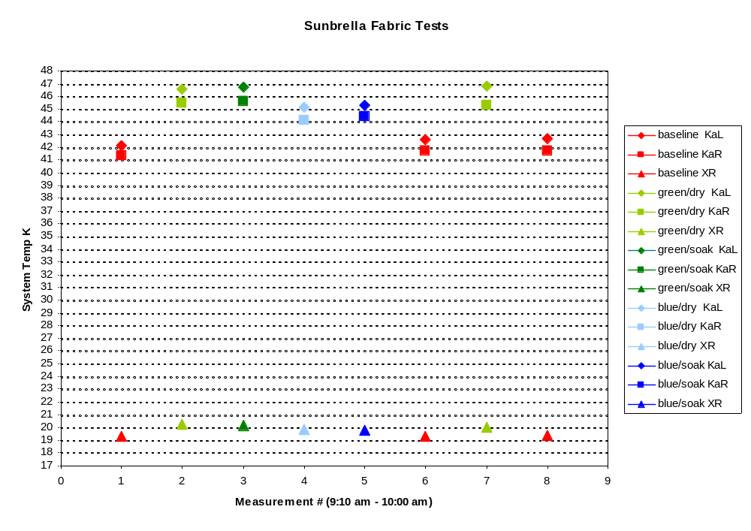
Blue = Sunbrella
Green = Marine Sunbrella
Ka-band
X-band

