Slide 1
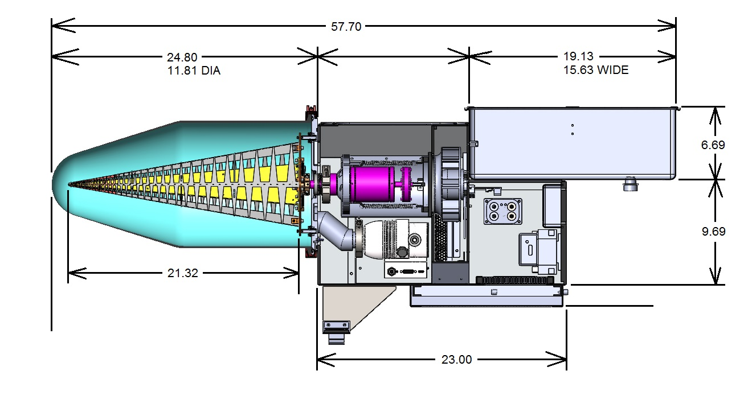
Cryocooler connection to the feed base
4 Titanium standoffs to thermally isolate the 85K feed with the base plate

