Slide 1
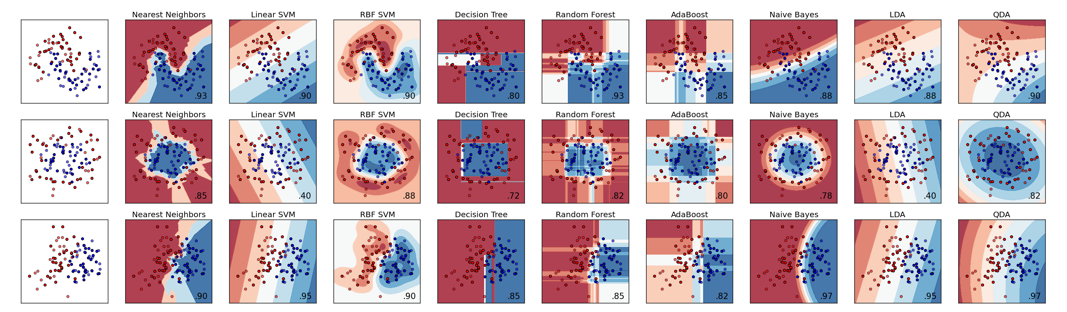

Machine Learning, Data Analytics & Archiving
Brian Bue, Gary Doran, Umaa Rebbapragada, Rishi Verma and Kiri Wagstaff
Jet Propulsion Laboratory
California Institute of Technology
Research described in this presentation was carried out at the Jet Propulsion Laboratory, under contract with the National Aeronautics and Space Administration. Copyright 2016 California Institute of Technology. All Rights Reserved. US Government Support Acknowledged.

Slide 2
Astronomy/ML Experience
Deployed Systems
V-FASTR for FRB detection
Optical transient vetting for PTF (3 systems)
Collaborations
Optical: PTF
Radio: VLBA, VLA, ASKAP, Parkes, DSN
Remote sensing, imaging systems, spectrometer data

Slide 3
Simplified Data Chain
Sampling
and
Represen-tation
Training
Data
supervised
Data
Statistical Model
unsupervised
outcome

Slide 4
Simplified Data Chain
feature selection
Sampling
and
Represen-tation
Training
Data
supervised
Data
Statistical Model
classification, regression, clustering, anomaly detection
unsupervised
outcome

Slide 5
Uncertainty in Data Chain
Am I using enough data?
Is my data sample biased?
Are my features relevant and expressive?
feature selection
Sampling
and
Represen-tation
Training
Data
Is there contamination in my training data?
supervised
Data
Statistical Model
classification, regression, clustering, anomaly detection
unsupervised
outcome
Which data architectures best support these queries?
How can my system perform better?
Why did I miss this specific detection?
Do software upgrades, survey changes affect my data characteristics?
Diagnostics & Monitoring

Slide 6
Need ML in Entire Data Chain
Am I using enough data?
Is my data sample biased?
Are my features relevant and expressive?
active learning
feature selection
Sampling
and
Represen-tation
Training
Data
Is there contamination in my training data?
supervised
anomaly detection
Data
Statistical Model
classification, regression, clustering, anomaly detection
unsupervised
outcome
Which data architectures best support these queries?
clustering
How can my system perform better?
Why did I miss this specific detection?
Do software upgrades, survey changes affect my data characteristics?
Diagnostics & Monitoring
dimensionality reduction
domain adaptation

Slide 7
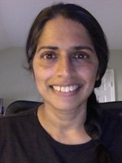

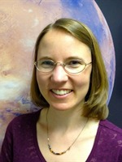
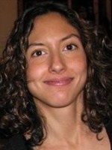

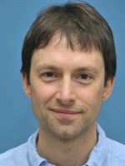
JPL Team
Umaa
PTF, VLA, ASKAP simulations
optical & radio transient vetting, light curve classification
anomaly detection, time series modeling, active learning, data cleaning
Kiri
VLBA (V-FASTR), ASKAP simulations
FRB detection, RFI classification
active learning, anomaly detection, transparent decision-making
Brian
PTF, imaging spectroscopy
optical transient vetting, image and light curve classification
deep learning, domain adaptation, computer vision
Gary
PTF, Parkes, GBT
RFI classification, optical transient vetting, clustering of artifacts
outlier detection, active learning, Bayesian modeling
Rishi
NASA’s Deep Space Network (DSN)
data-intensive architectures, algorithm workflow systems, real-time complex event processing, cluster computing frameworks
Melissa
wide band receivers, radio science & astronomy, antenna arrays (DSN, LWA-1, NAA), tracking weak spacecraft signals
Joe
radio astronomer, chief scientist interplanetary network directorate

Slide 8
Upcoming Talks
Systems Overview
V-FASTR [Kiri]
PTF [Umaa]
Techniques
Training Data Generation / Cleaning [Umaa]
Data Analysis via Clustering [Gary]
Anomaly Detection [Kiri]
Deep Learning [Brian]
Domain Adaptation [Brian]
Supporting Data Architectures [Rishi]

