Slide 1








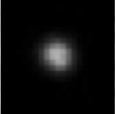
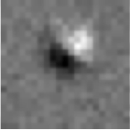
Supervised Learning for Data Triage
Training Data (expert labeled)
Test Data (unlabeled)
Trained Classifier
Test Predictions
Follow-up
Real
Bogus

Slide 2














Asteroid Detection from Sky Survey Imagery
Goal: automatically distinguish real vs. bogus asteroids from Palomar Transient Factory (PTF) imagery
Current dataset: 240 confirmed asteroids, 1441 synthetically-generated asteroids, 20072 bogus
Confirmed Asteroids
Bogus Detections
(cosmic rays, processing artifacts)
Notes:
How many people can tell me which of these are real vs. bogus?
Colors=connected components in image

Slide 3
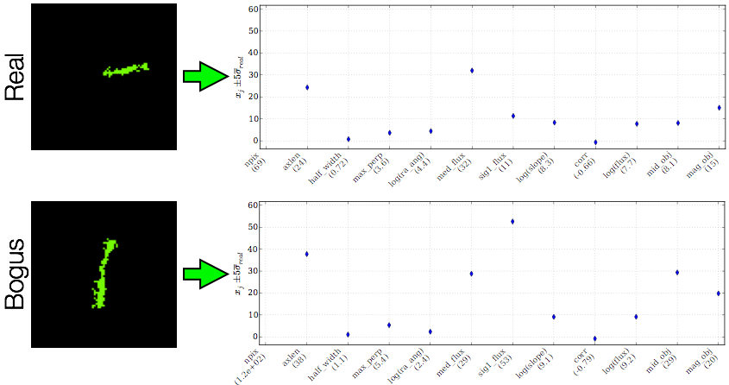
Initial Machine Learning Approach
Extract intensity + shape features from masked images
Train/classify feature vectors using a Random Forest classifier
Accurate (0.8% test error)...but required expert knowledge to design/extract/validate features

Slide 4
Deep Learning Approach: Deep Belief Network
Approach: use a DBN to detect asteroids using the (raw) asteroid mask image pixels
Consider downsampled images... 30x30, 45x45, 50x50 ...with RBM layer dims... [1000,1000], [1600,1600], [1600], [2500]
Experimental setup:
Pylearn2 DBN implementation
2.8Ghz Intel Core i7, 16GB RAM
CPU only (no GPU optimization)
Asteroid Mask Images
Input Layer
RBM Layer1
DBN
RBM Layer2
Output Layer
Real/Bogus

Slide 5
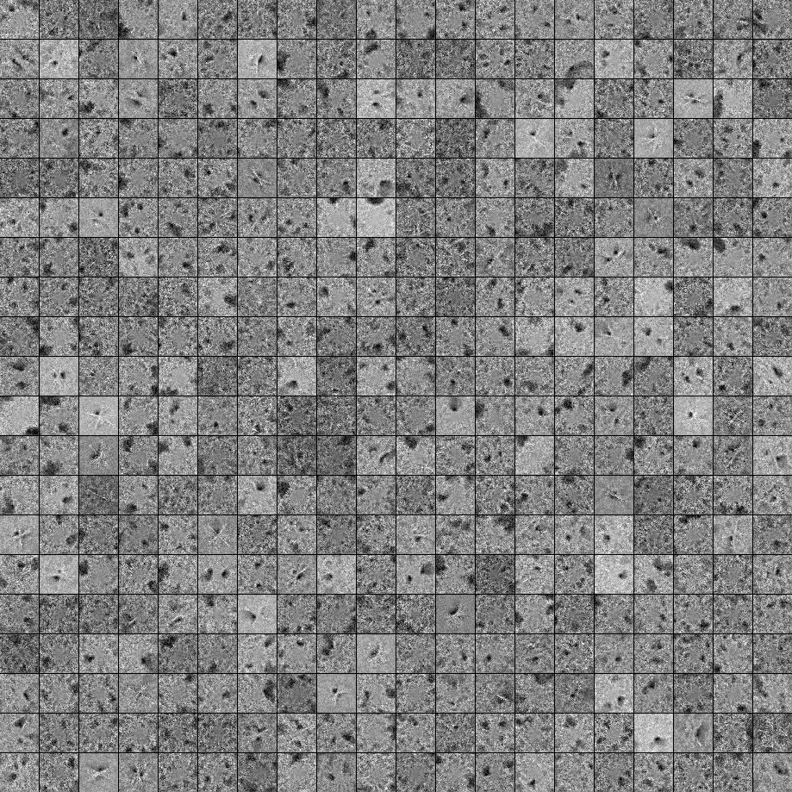
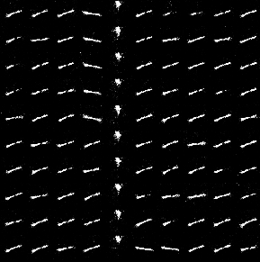
RBM Weights, Samples for Asteroids DBN
Image Dims | RBM Dims | Test Error | Pretraining time (minutes) | Finetune time (minutes)
30x30 | [900,900] | 5.07% | 86 | 900
45x45 | [1600] | 1.47% | 74 | 358
45x45 | [1600,1600] | 1.21% | 403 | 1042
50x50 | [2500] | 1.15% | 416 | ?
Weights (1st Layer)
Generated Samples
Bogus Seeds
Real Seeds
Selected RBM Weights and Samples for [1600,1600] DBN with 45x45 images

Slide 6
Domain Adaptation
Domain adaptation adapts data/classifiers from earlier applications with similar science goals (and labeled data)
Given: labeled source (training) samples target (test) samples Compute: mapping between source and target feature spaces
Source Domain
Feature Space
Target Domain
Feature Space
Unlabeled Sample
Common
Feature Space
Labeled Sample
Notes:
small amount = not enough to train a classifier robustly
desirable to get labeled out-of-domain data
related to: however, as we see later, mtl/man align have issues...

Slide 7
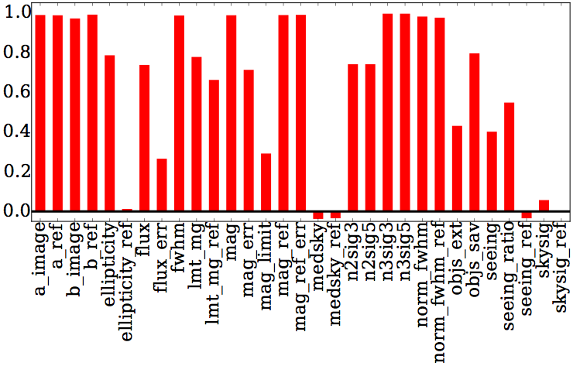
PTF vs. iPTF Feature Drift
Correlation
Correlation between PTF and iPTF features for
real (spectroscopically-verified) transient sources

Slide 8
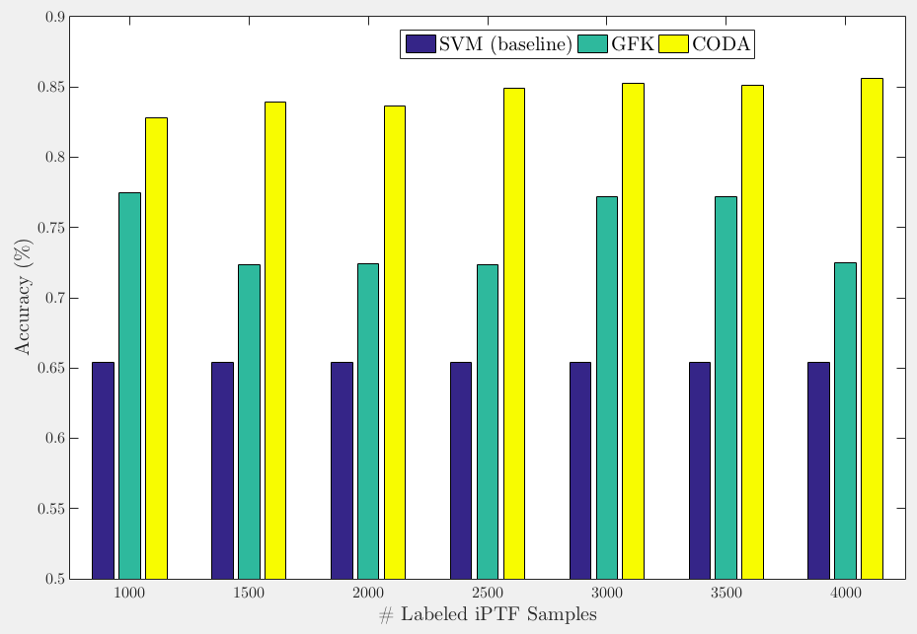
PTF → iPTF Prediction Accuracy

Slide 10
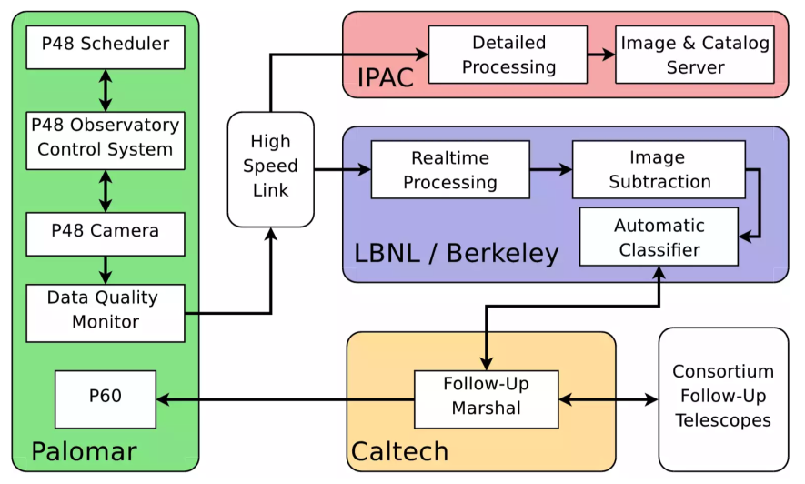
Palomar Data Flow
(Law et al., 2009)

