Slide 1

Energy-Efficient UAV Flight Planning for a General PoI-Visiting Problem with a Practical Energy Model
Jianping Huang, Feng Shan, Runqun Xiong,
Yuchao Shao, Junzhou Luo
Southeast University, Nanjing, China
July 19, 2021

Slide 2
Outline
Background
Problem Modeling
Solution
Simulation
Conclusion

Slide 3
Outline
Background
Problem Modeling
Solution
Simulation
Conclusion

Slide 4





















UAV application scenarios
Edge cloud
Data collection
Surveillance & Monitor
Edge computing

Slide 5


Energy consumption problem of UAVs
Limited energy supply on board
Flight power 1000 times communication power
Related flight energy consumption models
Trajectory
distance-related energy model
Too simple to be accurate
Time
duration-related energy model

Slide 6
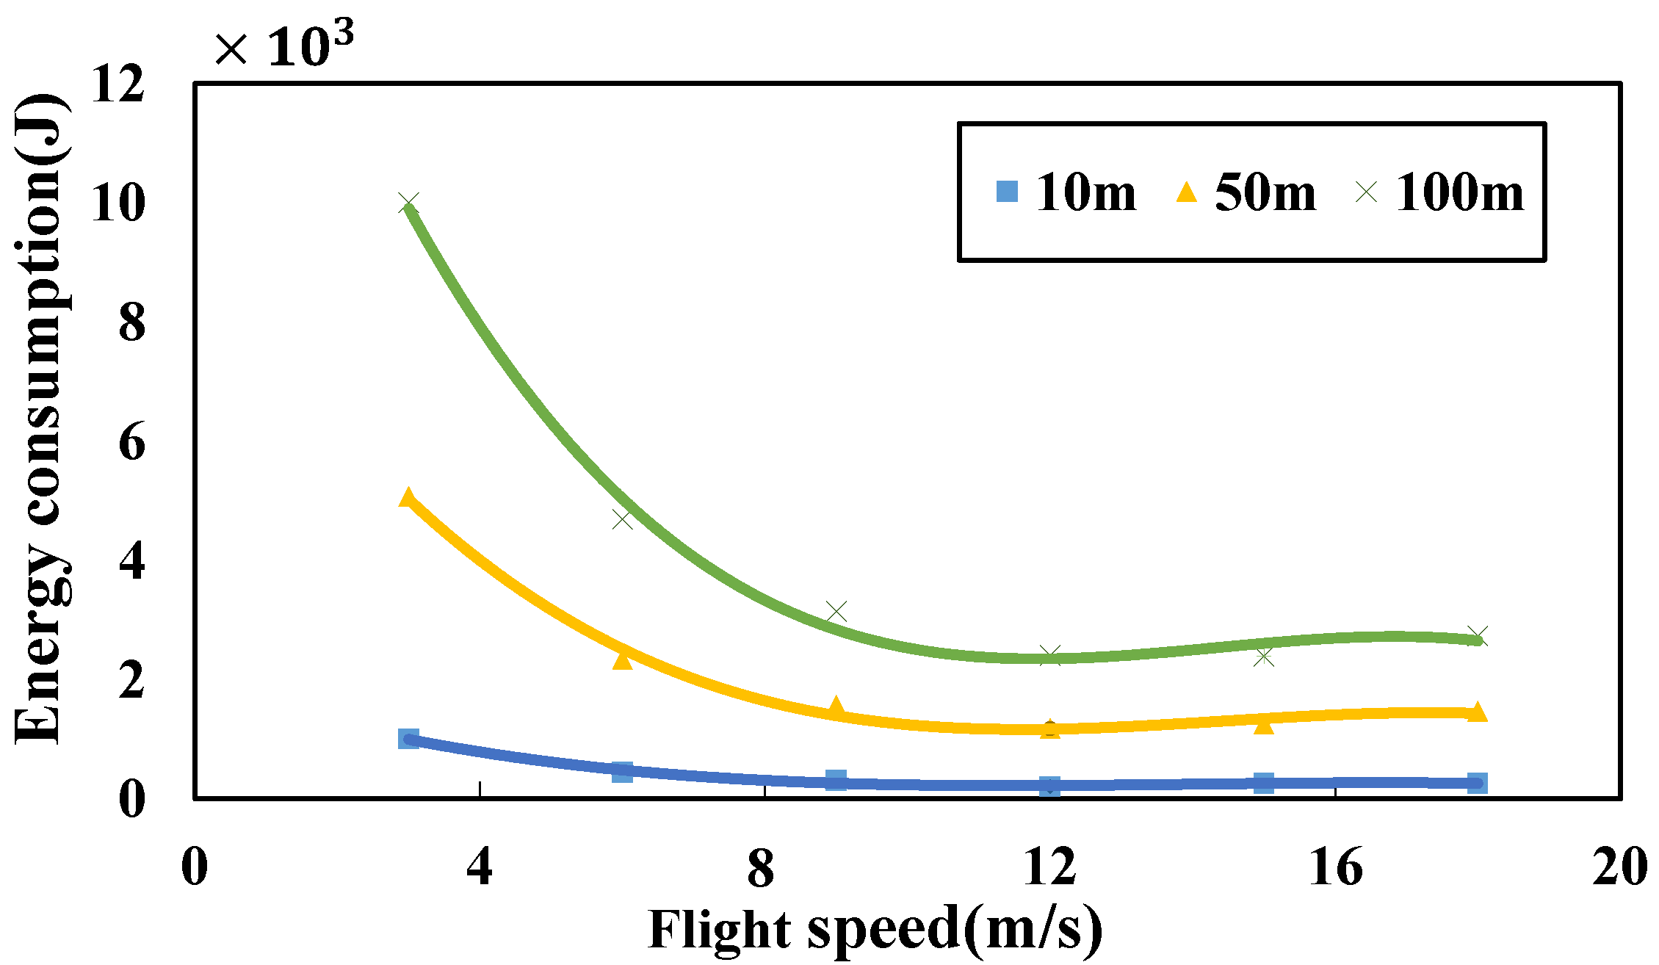
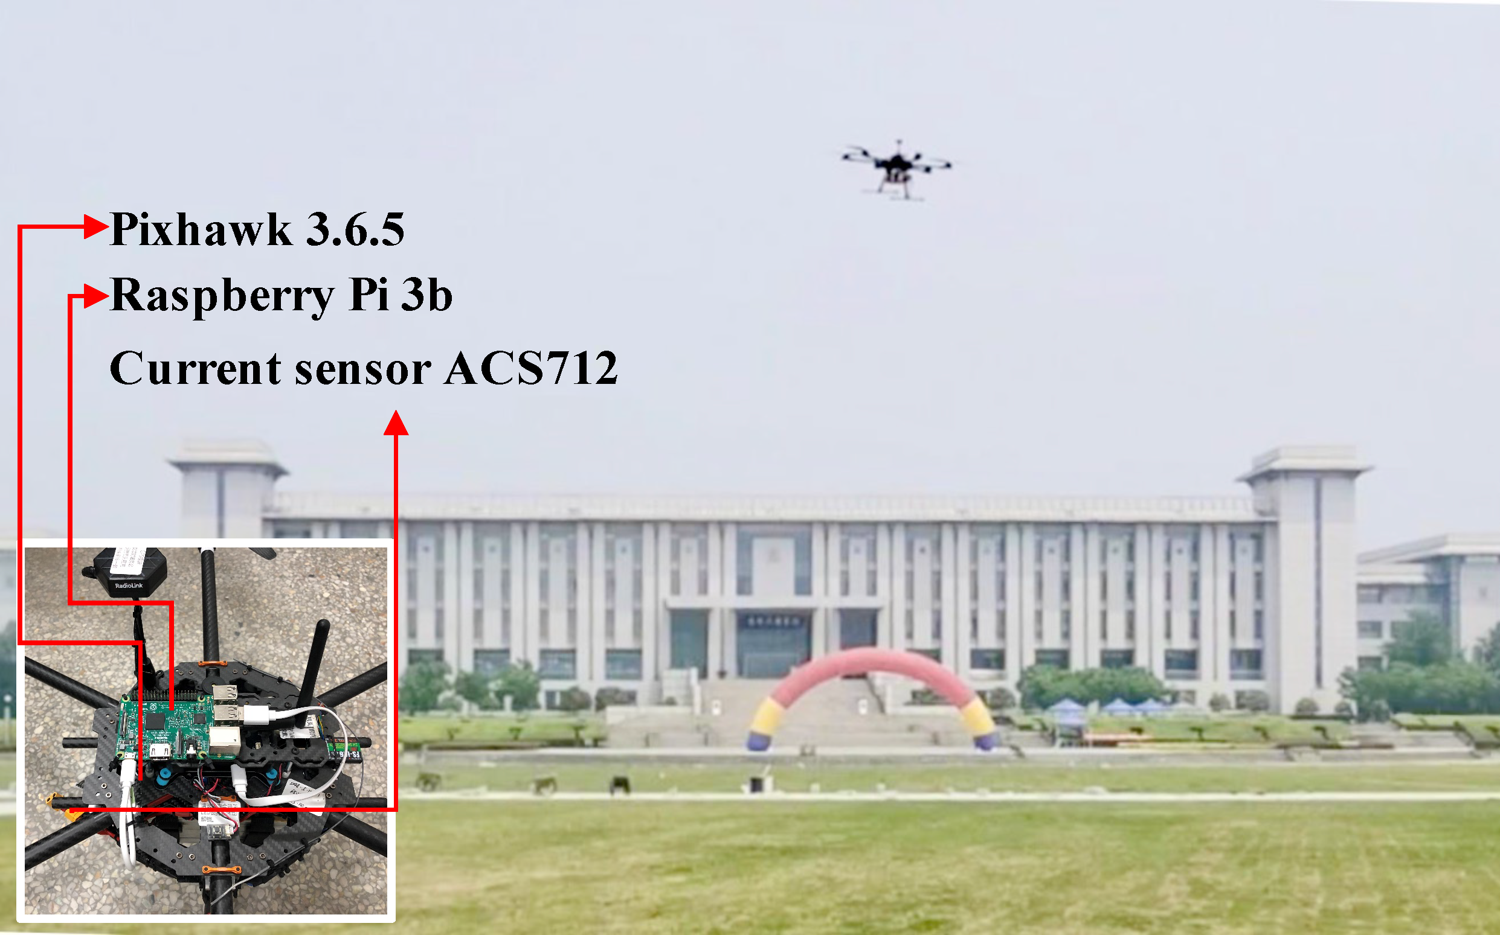
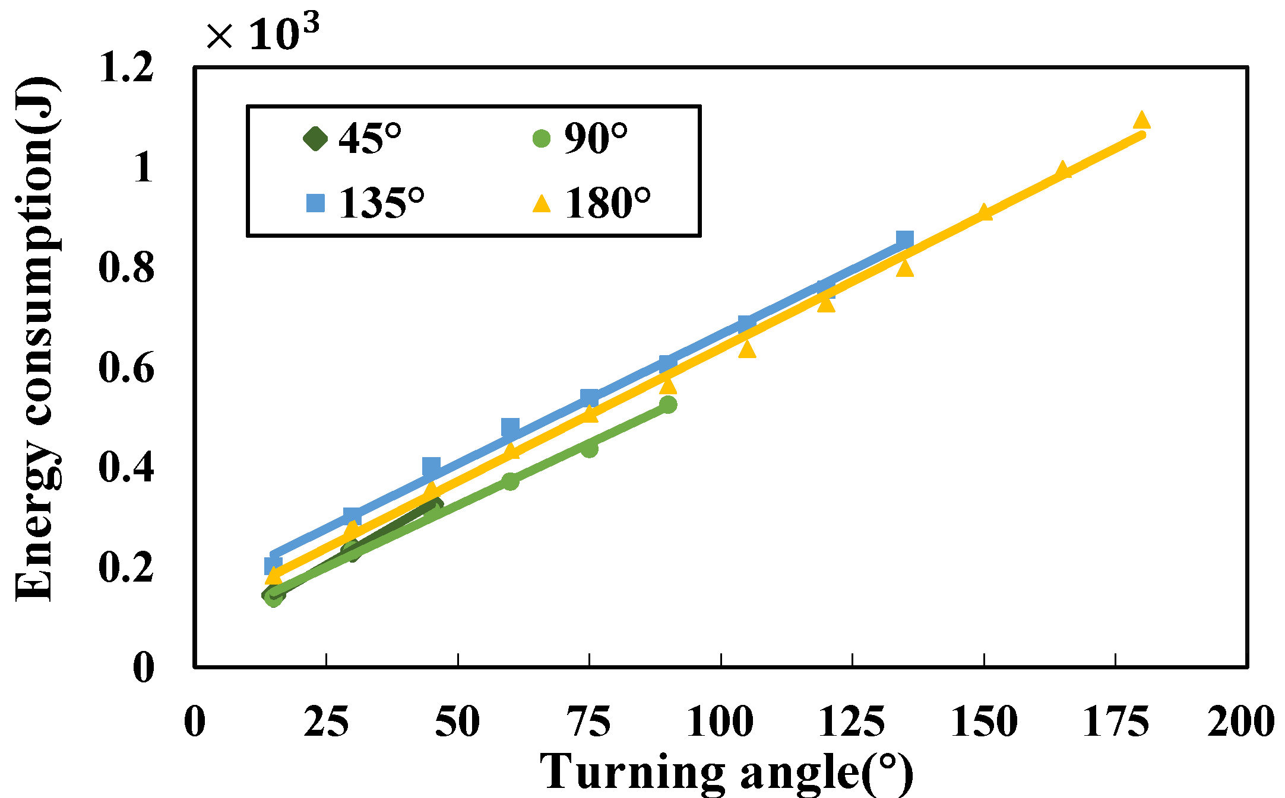
Our practical flight energy model
Our flight tests

Slide 7




Challenges to our problem
Point of interest
Path1
$$θ_{1}$$
Overlapping waypoint
Path2
Non-overlapping waypoint
$$θ_{2}$$
Straight flight
$$θ$$
Turning angle
A two-fold tradeoff:
waypoints and straight flight distance
waypoints and turning angle and the number of switching

Slide 8
Outline
Background
Problem Modeling
Solution
Simulation
Conclusion

Slide 9

System model
N PoIs are randomly located in a rectangle region.
Each PoI has a circle range.
The UAV files at a fixed height.
PoI 1
PoI 3
R
PoI 2
PoI 4
region
Original system model

Slide 10
System model
Rasterize the region at a certain granularity.
Take grid centers that fall within each PoI range as its candidate waypoints.
Waypoints may overlap.
PoI 1
PoI 3
R
PoI 2
PoI 4
region
Rasterize region

Slide 11




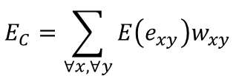

Energy consumption model
Straight flight energy consumption:
$$e_{xy}$$
$$y$$
$$E\left(e_{xy}\right)=c_{1}\left|e_{xy}\right|+C_{1}$$
$$x$$
$$E_{C}=\sum_{∀x,∀y}{E\left(e_{xy}\right)w_{xy}}$$
$$z$$
region

Slide 12


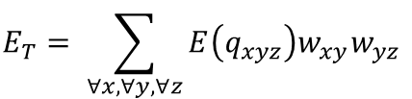


Energy consumption model
Turning energy consumption:
$$e_{xy}$$
$$y$$
$$E\left(q_{xyz}\right)=c_{2}q_{xyz}+C_{2}$$
$$x$$
$$q_{xyz}$$
$$E_{T}= \sum_{∀x,∀y,∀z}{E\left(q_{xyz}\right)w_{xy}w_{yz}}$$
$$z$$
region

Slide 13





Energy consumption model
Switching energy consumption:
$$e_{xy}$$
$$y$$
$$E\left(D_{x}\right)=c_{3}(\left|D_{x}\right|−1)$$
$$x$$
$$q_{xyz}$$
$$D_{x}$$
$$E_{S}= \sum_{∀x}{E(D_{x})}$$
$$z$$
region

Slide 14
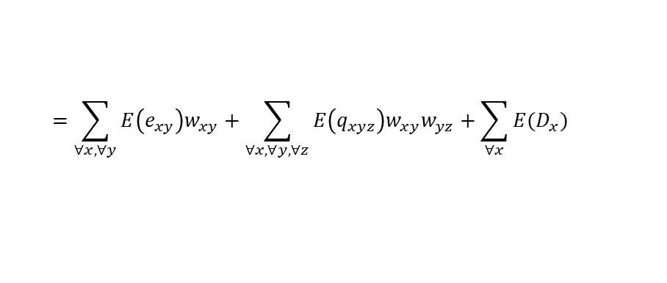

Energy consumption model
Total UAV energy consumption:
$$E_{ALL}=E_{C}+E_{T}+E_{S}$$
$$e_{xy}$$
$$y$$
$$x$$
$$q_{xyz}$$
$$=\sum_{∀x,∀y}{E\left(e_{xy}\right)w_{xy}}+\sum_{∀x,∀y,∀z}{E\left(q_{xyz}\right)w_{xy}w_{yz}}+\sum_{∀x}{E(D_{x})}$$
$$D_{x}$$
$$z$$
region

Slide 15
System model
Visiting constraint
PoI 1
Visit each PoI at least once.
R
PoI 3
PoI 2
Range constraint
PoI 4
Visit each PoI within its range.
region

Slide 16

Waypoint-based PoI-visiting problem
Waypoint-based PoI-visiting problem : find a route to
minimize UAV energy consumption $E_{ALL}$
satisfy visiting constraint
satisfy range constraint

Slide 17
Outline
Background
Problem Modeling
Solution
Simulation
Conclusion

Slide 18
Problem Transformation
Waypoint-based PoI-visiting problem
Turning energy consumption
Switching energy consumption
?
Generalized traveling salesman problem

Slide 19


















Modeling energy cost of making turns
How to embed the energy cost of making turns into a graph?
$$x$$
$$y_{6}$$
$$y_{7}$$
$$y$$
$$y_{5}$$
$$y_{8}$$
$$O_{y}$$
$$y$$
$$y_{4}$$
$${135}^{°}$$
$$y_{1}$$
$${135}^{°}$$
$$z$$
$$y_{3}$$
$$y_{2}$$
$$p$$
waypoint
Regular octagon
Turning energy cost :
$E\left(q_{xyp}\right)=E(135°)$
${E(q_{xyp}\text{) =} E(e}_{y_{1}y_{2}})$ + $E(e_{y_{2}y_{3}})$ + ${E(e}_{y_{3}y_{4}})$

Slide 20



































Modeling energy cost of making turns
How to embed the energy cost of making turns into a graph?
$$x_{6}$$
$$x_{7}$$
$$x$$
$$x_{5}$$
$$O_{x}$$
$$x_{8}$$
$$y$$
$$e_{x_{1}y_{1}}$$
$$y_{6}$$
$$y_{7}$$
$$x_{4}$$
$$x_{1}$$
$$z$$
$$x_{3}$$
$$x_{2}$$
$$y_{5}$$
$$O_{y}$$
$$y_{8}$$
$$y_{4}$$
$$y_{1}$$
$$e_{y_{1}z_{1}}$$
$$z_{6}$$
$$z_{7}$$
$$p$$
$$p_{6}$$
$$p_{7}$$
$$y_{3}$$
$$y_{2}$$
$$z_{5}$$
$$z_{8}$$
$$p_{5}$$
$$p_{8}$$
$$O_{z}$$
$$O_{p}$$
$$z_{4}$$
$$z_{1}$$
$$p_{4}$$
$$p_{1}$$
$$z_{3}$$
$$z_{2}$$
$$p_{3}$$
$$p_{2}$$
No turning energy cost

Slide 21












Modeling energy cost of making turns
How to embed the energy cost of making turns into a graph?
$$x_{6}$$
$$x_{7}$$
$$x$$
$$x_{5}$$
$$O_{x}$$
$$x_{8}$$
$$y$$
$$e_{x_{1}y_{1}}$$
$$y_{6}$$
$$y_{7}$$
$$x_{4}$$
$$x_{1}$$
$$z$$
$$x_{3}$$
$$x_{2}$$
$$y_{5}$$
$$O_{y}$$
$$y_{8}$$
$${135}^{°}$$
$$e_{y_{4}p_{4}}$$
$$y_{4}$$
$$y_{1}$$
$$z_{6}$$
$$z_{7}$$
$$p$$
$$p_{6}$$
$$p_{7}$$
$$y_{3}$$
$$y_{2}$$
$$z_{5}$$
$$z_{8}$$
$$p_{5}$$
$$p_{8}$$
$$O_{z}$$
$$O_{p}$$
$$z_{4}$$
$$z_{1}$$
$$p_{4}$$
$$p_{1}$$
$$z_{3}$$
$$z_{2}$$
$$p_{3}$$
$$p_{2}$$
135$°$turning energy cost

Slide 22








Modeling energy cost of PoI-switching
How to embed the energy cost of PoI-switching into a graph?
PoI 1
PoI 1
$$x_{1}^{1}$$
Virtual vertices:
$x_{1}^{1}$,
$$x_{1}^{2}$$
$$x_{1}$$
$$e_{x_{1}^{2}x_{1}^{1}}$$
PoI 2
$$x_{1}^{2}$$
PoI 2
Switching energy cost :
$E\left({D_{x}}_{1}\right)=E(1)$
$$E\left({D_{x}}_{1}\right)=E(e_{x_{1}^{2}x_{1}^{1}})$$

Slide 23




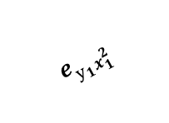


Modeling energy cost of PoI-switching
How to embed the energy cost of PoI-switching into a graph?
$$y_{1}$$
PoI 1
$$e_{y_{1}x_{1}^{1}}$$
$$y_{1}$$
PoI 1
$$e_{y_{1}x_{1}}$$
$$x_{1}^{1}$$
$$e_{y_{1}x_{1}^{2}}$$
$$x_{1}$$
$$x_{1}^{2}$$
PoI 2
PoI 2

Slide 24
Redefinition of the problem
Given a directed weighted graph D = (S,E,W), to find a cycle to visit each subset at least once with the minimum sum of weights of all visiting-edges.

Slide 25
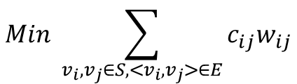
Redefinition of the problem
Objective function:
Waypoint-based PoI-visiting problem
$$Min \sum_{v_{i},v_{j}∈S,<v_{i},v_{j}>∈E}{c_{ij}w_{ij}}$$
redefinite
Constraints:
Subset coverage
Tour continuity
Subloop avoidance
Generalized traveling salesman problem

Slide 26
Outline
Background
Problem Modeling
Solution
Simulation
Conclusion

Slide 27
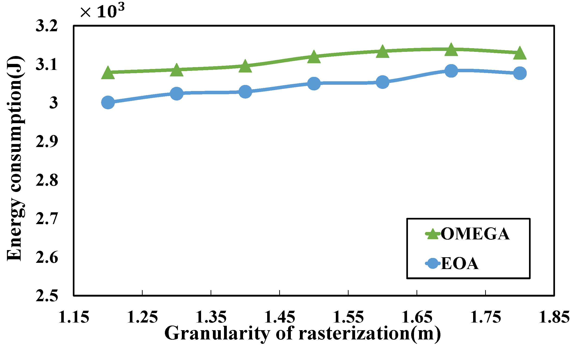
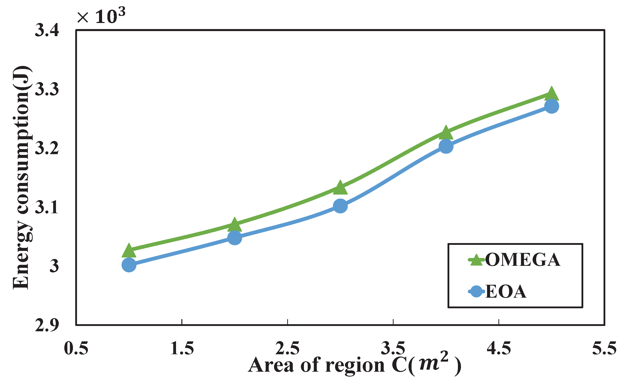
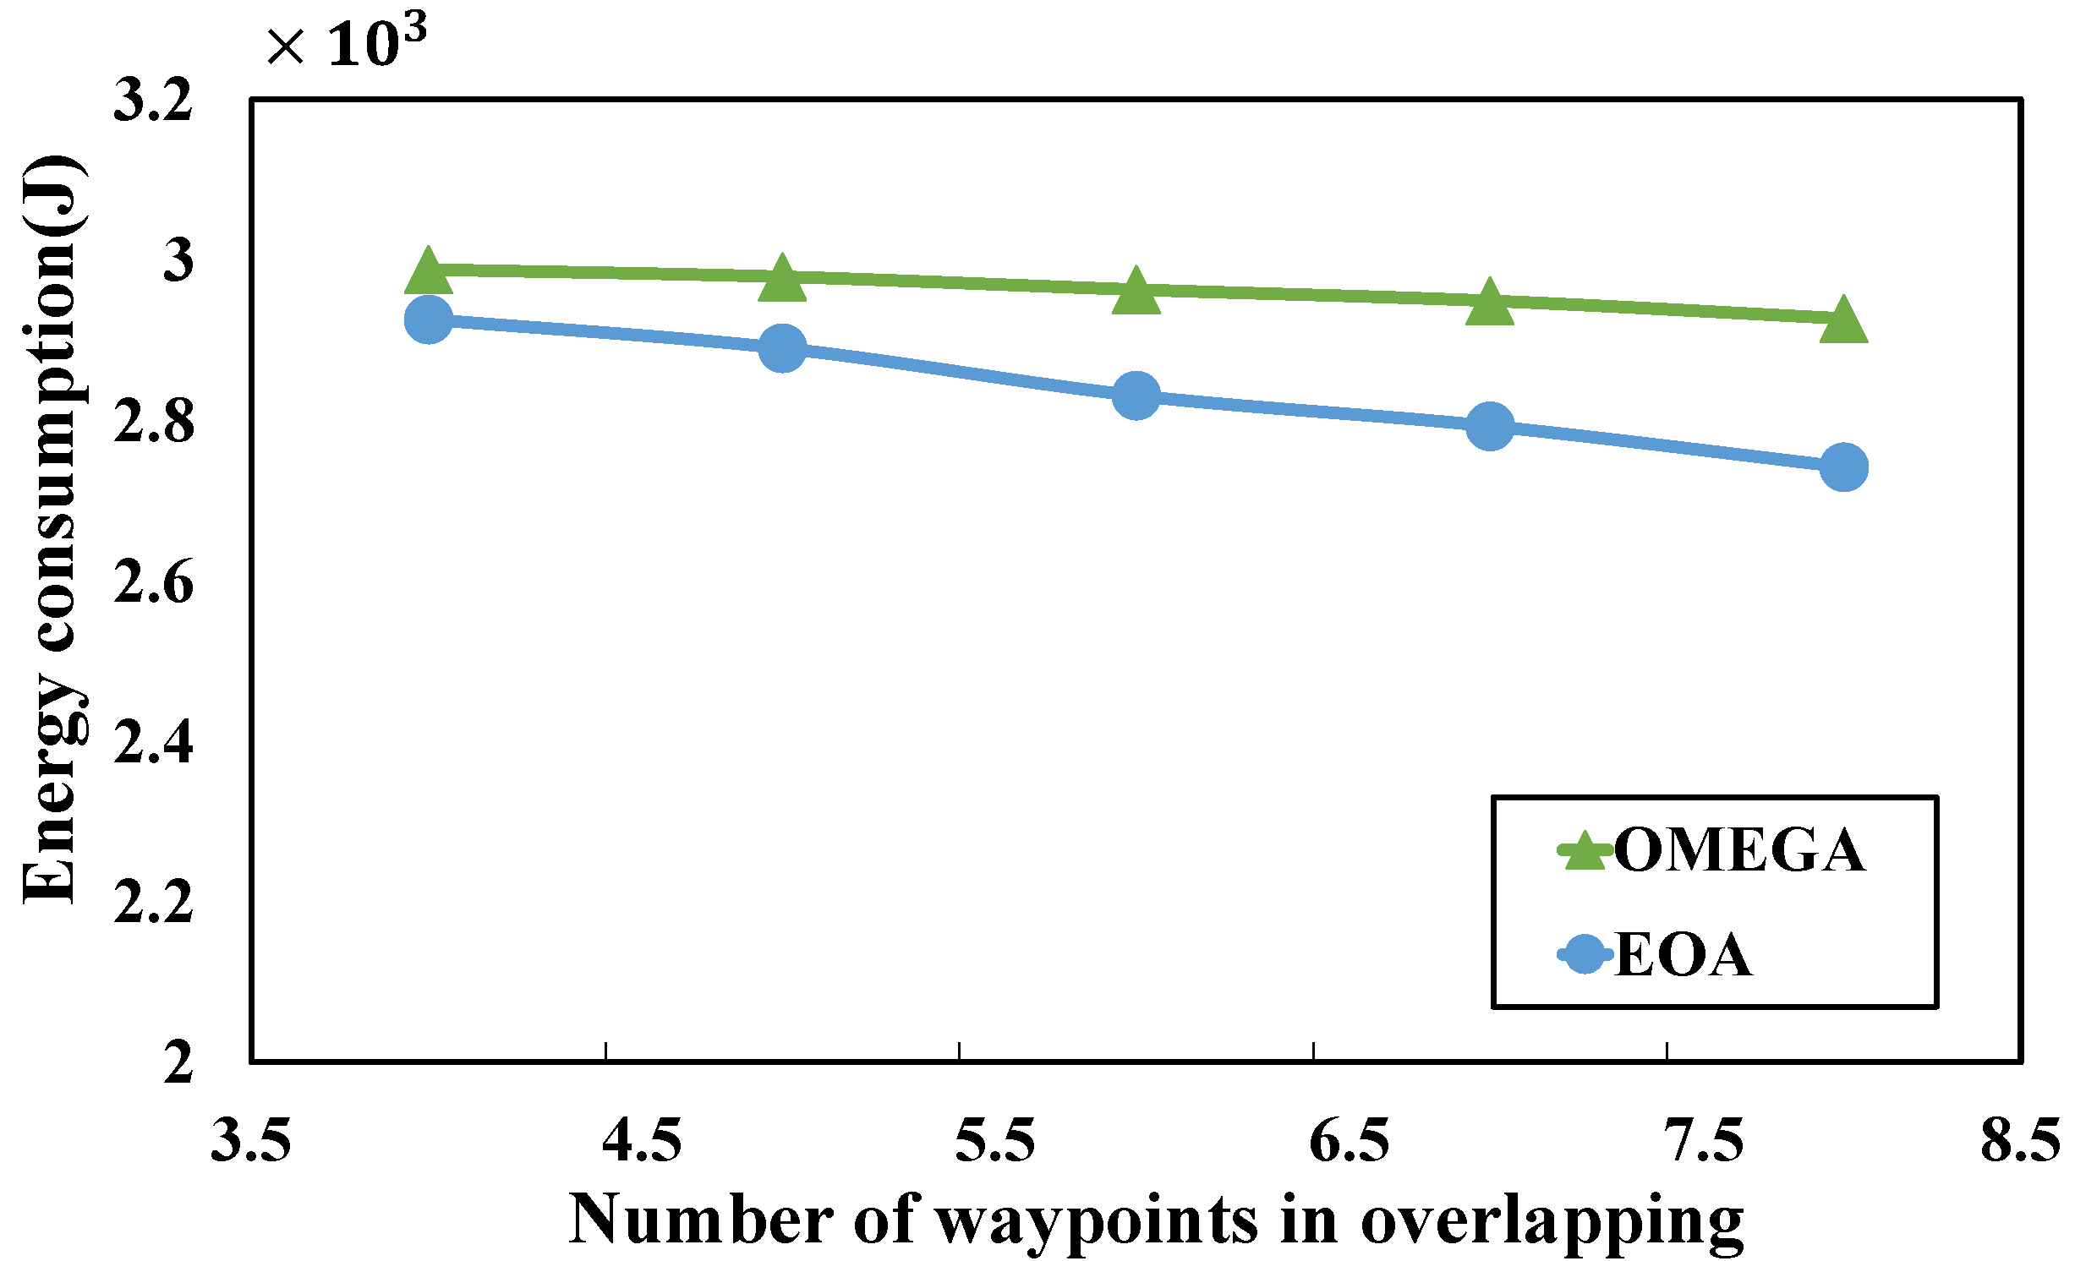
Simulation
Small scale problem
OMEGA spends < 107% of the energy of EOA.

Slide 28
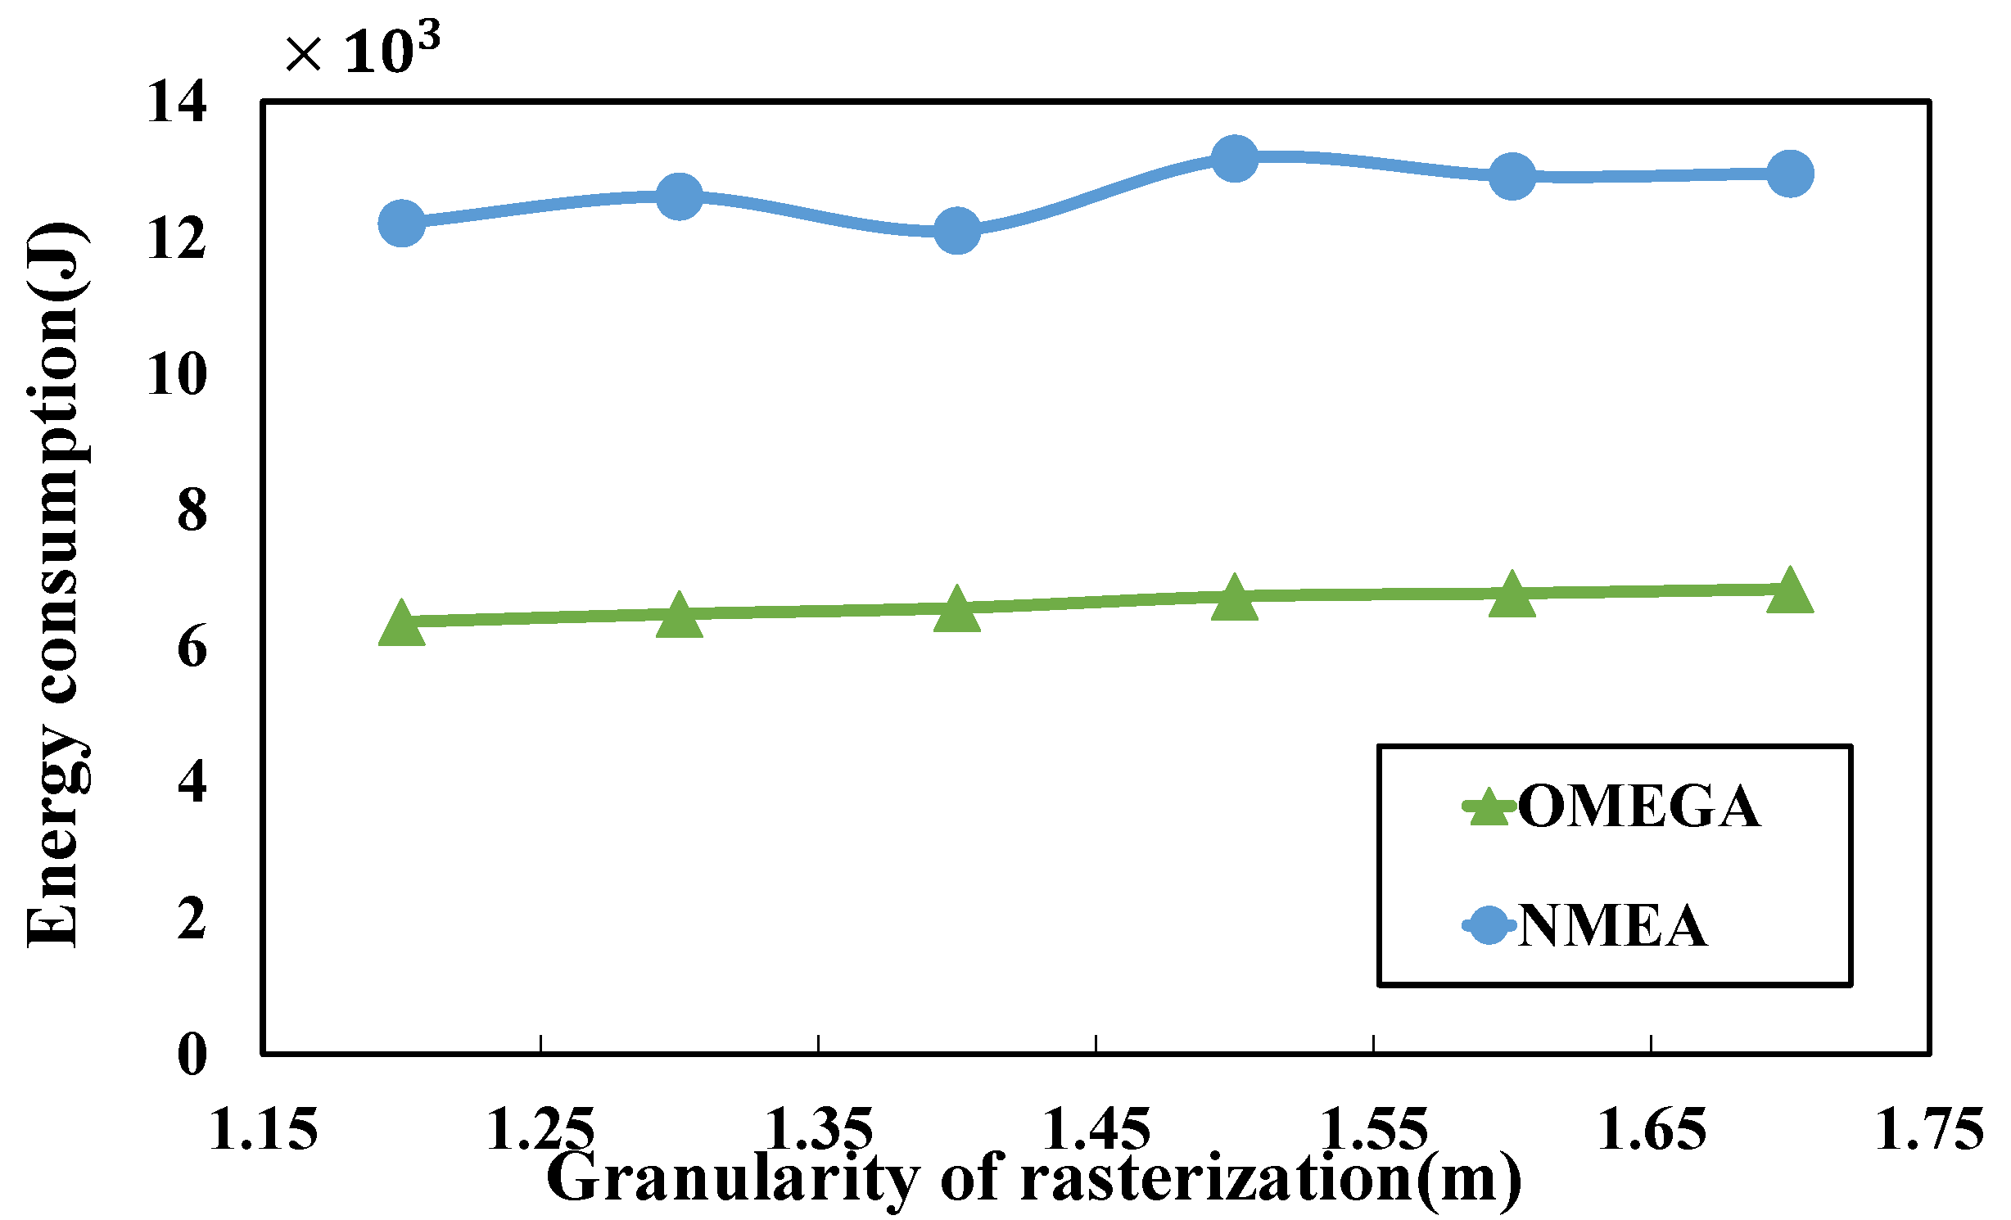
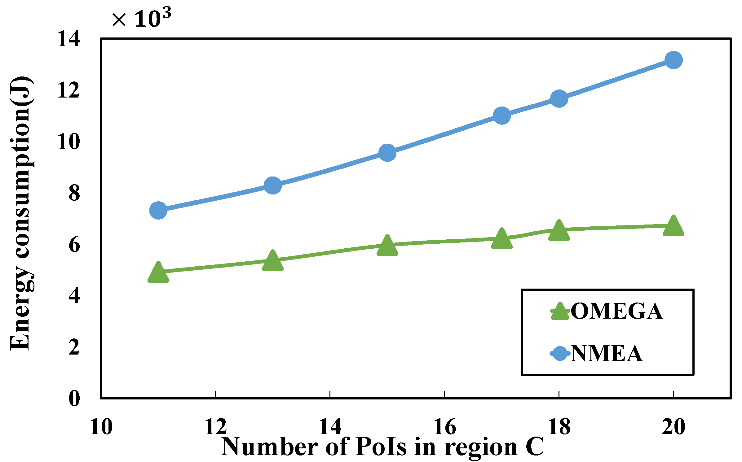
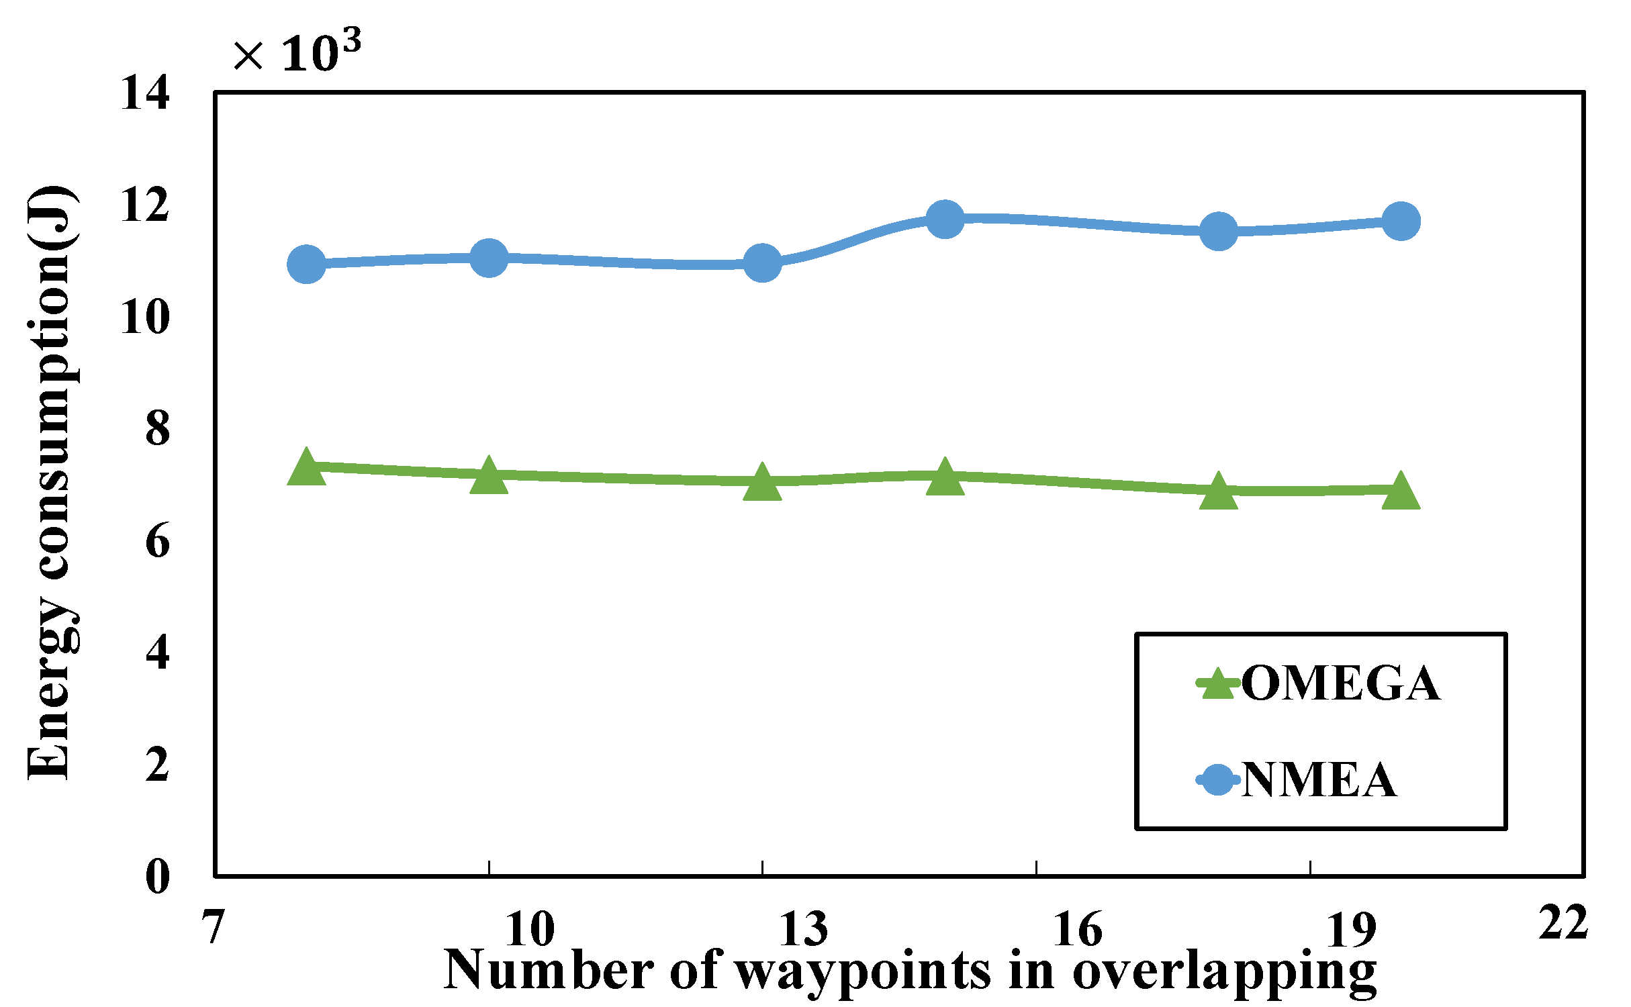
Simulation
Large scale problem
OMEGA saves ~50% more energy than NMEA.

Slide 29
Outline
Background
Problem Modeling
Solution
Simulation
Conclusion

Slide 30
Conclusion
Real-world flight tests: a more practical energy model.
Investigate the general waypoint-based PoI-visiting problem to find a tour with the minimum UAV energy cost.
Propose a graph-based algorithm to transfer the problem into a classic graph problem.
Conduct simulations to evaluate the performance of our proposed algorithm.

Slide 31
Thank You!
Jianping Huang(huangjp1997@seu.edu.cn) Southeast University, China

