Slide 1

Where Should Action Generation Begin?
A Learnable Source Prior for Generative Robot Policies
Meipo Dai¹* Qiyuan Zhuang¹* He-Yang Xu¹* Ying-Jie Shuai¹
Yijun Wang¹ Qi Dou² Xiu-Shen Wei¹†
¹ Southeast University
² The Chinese University of Hong Kong
* Equal contribution. † Corresponding author.
10th Conference on Robot Learning (CoRL 2026)
Notes:
Thank you. Today I'll ask a question that sits underneath nearly every modern generative robot policy: where should action generation actually begin? [15s]

Slide 2
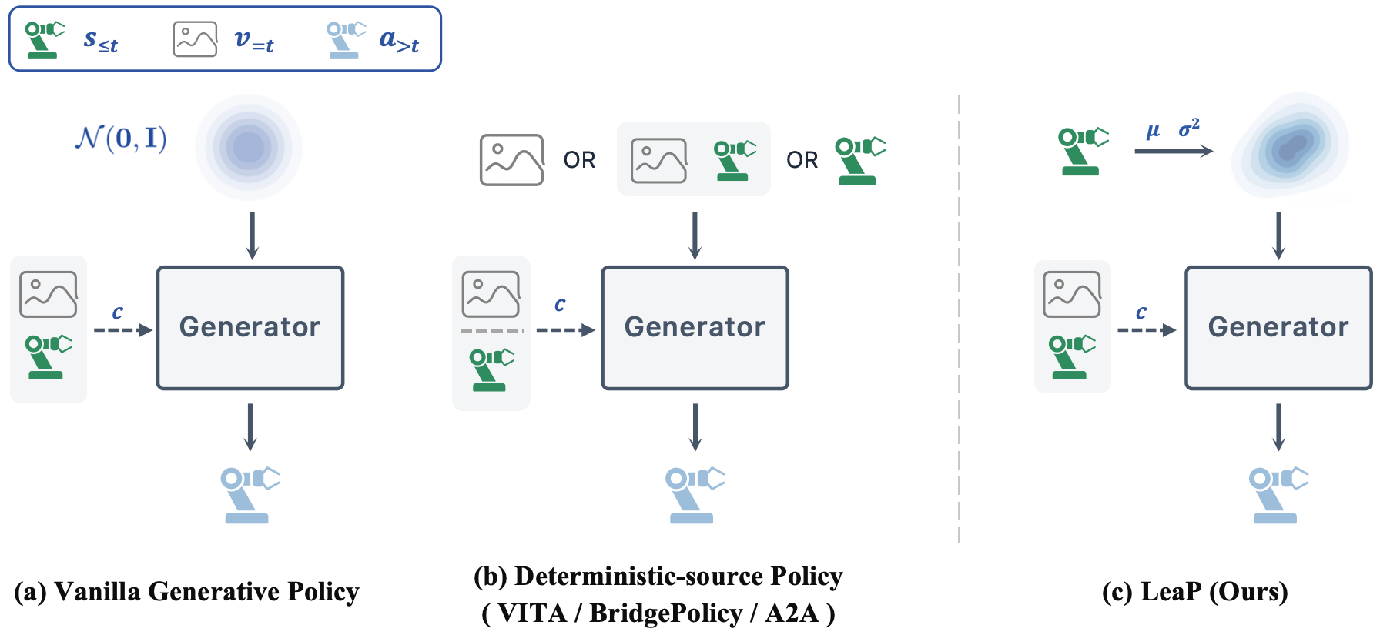
Where should action generation begin?
— Generative policies (diffusion, flow-matching) model rich, multimodal actions from demonstrations
— Yet nearly all begin from an observation-independent N(0, I) — no information about observation or task
— Recent work (A2A, VITA, BridgePolicy) derives the source from observations, but as a fixed point — ignoring its uncertainty
(a) vanilla N(0, I) (b) deterministic, observation-derived (c) LeaP — learnable, stochastic
LeaP · CoRL 2026
2 / 11
Notes:
Visuomotor policies are powerful — diffusion and flow models capture rich action distributions from demos — but they almost all begin from an observation-independent standard Gaussian, N(0,I), panel (a): a source with no information about the current state or task. A recent line — A2A, VITA, BridgePolicy — derives the source from observations, panel (b), but treats it as a fixed point, leaving its uncertainty unmodeled. So the question of this talk: where should generation begin? Our answer is panel (c) — make the source learnable and stochastic. [60s]

Slide 3
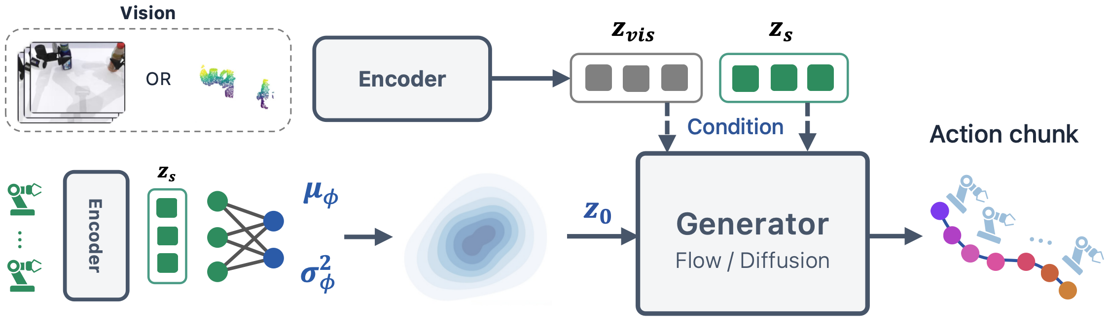
METHOD
LeaP: a learnable source prior
Replace N(0, I) with a proprioception-conditioned, learnable diagonal Gaussian — learn the mean μ and a state-adaptive variance σ². Plug-and-play: the generator and solver are unchanged.
Trained end-to-end: L = L_flow + β · L_NLL + α · L_align
flow regression (backprops into the prior) · source density (NLL) · CLIP-style source ↔ action alignment
LeaP · CoRL 2026
3 / 11
Notes:
Here is the whole method on one slide. The observation is encoded into a visual feature z_vis and a proprioceptive feature z_s. A lightweight MLP prior g_phi reads the proprioceptive state ALONE and predicts a diagonal Gaussian — mean and state-adaptive variance. We draw the source z0 from it by reparameterization, then the unchanged flow generator transports z0 to the action chunk under the full vision-plus-state conditioning. This creates a division of labor: the prior places the source in a proprioceptively plausible region, the generator refines toward the expert action. Training is joint, three terms: L_flow (its gradient also flows into the prior), L_NLL on the source density, and L_align, a CLIP-style source-to-action contrastive loss. [2 min]

Slide 4
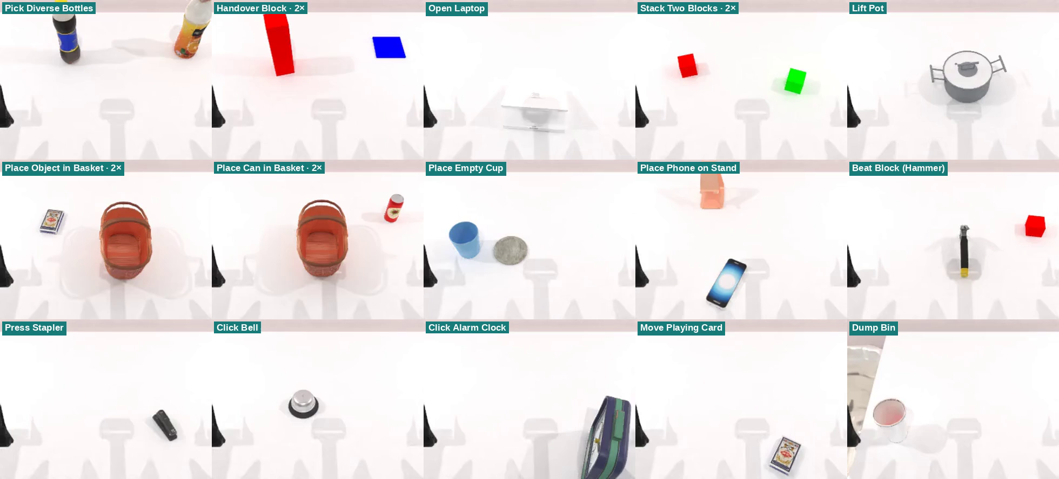
RESULTS
Simulation — 15 RoboTwin tasks
LeaP
81.6 ±0.4
VITA
75.1 ±0.9
A2A
73.8 ±2.2
BridgePolicy
60.8 ±1.4
NoPrior
56.1 ±2.5
mean ± std over 3 seeds
+6.5 to +25.5 pp over four baselines
+25.5 vs NoPrior — same pipeline, only the source differs · also the lowest variance (±0.4)
LeaP · CoRL 2026
4 / 11
Notes:
On the 15 RoboTwin tasks, LeaP ranks first and beats all four baselines by 6.5 to 25.5 points. I'll let you read the relative ordering off the bars; the most telling gap is the 25.5 points over NoPrior — that baseline shares our exact encoder, generator, and flow pipeline, differing ONLY in using N(0,I). So the gain is the learnable source itself. The montage on the right auto-plays all 15 tasks. [90s]

Slide 5
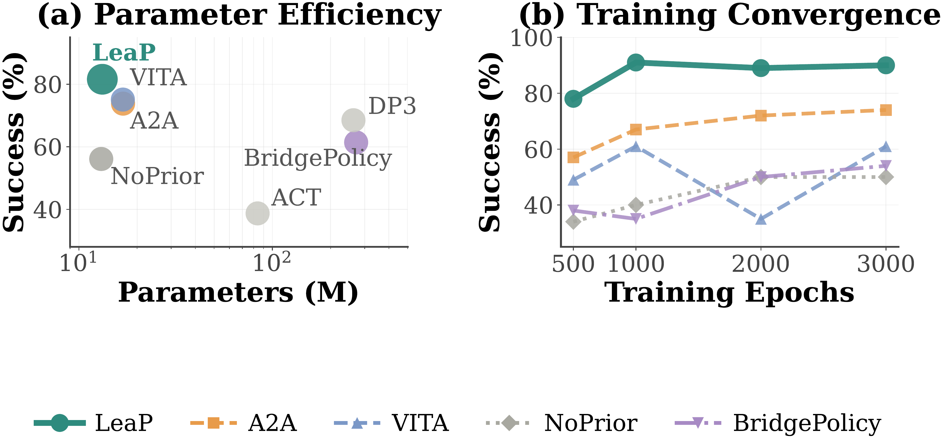
RESULTS
Efficient: small, fast, stable
(a) Fewer parameters, higher success — 13.2M total; the prior head adds just 0.21M (+1.6%)
(b) Faster, more stable convergence — 91% within 1000 epochs and holds near 90%, beating baselines' final 3000-epoch scores
LeaP · CoRL 2026
5 / 11
Notes:
A dedicated efficiency slide, matching the paper. Panel (a) plots parameters against 15-task success — LeaP sits top-left, the smallest model with the highest success; the prior head adds only 0.21M parameters, about 1.6% overhead, while A2A and VITA use 28% more and the Transformer/UNet baselines 6 to 20 times more. Panel (b) is convergence on open_laptop — LeaP reaches 91% within 1000 epochs, already above the baselines' final 3000-epoch numbers, and stays stable near 90%, while VITA and BridgePolicy fluctuate. So the source distribution is a low-overhead lever that also trains faster and more stably. [60s]

Slide 6
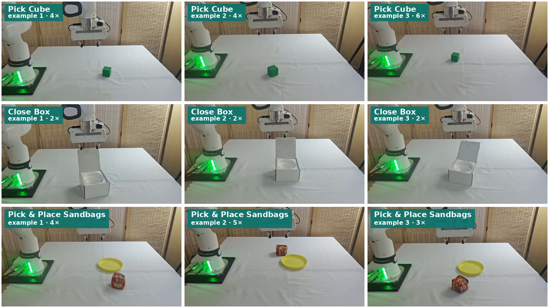
RESULTS
Real robot — Franka Research 3
LeaP
80.0
A2A
68.3
VITA
56.7
NoPrior
46.7
+11.7 / +23.3 / +33.3 pp
over A2A / VITA / NoPrior
LeaP · CoRL 2026
6 / 11
Notes:
It carries to hardware. The three Franka Research 3 tasks are Pick Cube, Close Box, and Pick & Place Sandbags — picking, articulated manipulation, and a deformable object. Read the ordering off the bars: LeaP leads by 11.7, 23.3, and 33.3 points, and the architecture-matched NoPrior stays last, as in sim. The evaluation itself is 20 rollouts per task, three seeds, with randomized object positions; the grid just shows three example rollouts per task, picked to illustrate, auto-playing on a loop. [90s]

Slide 7
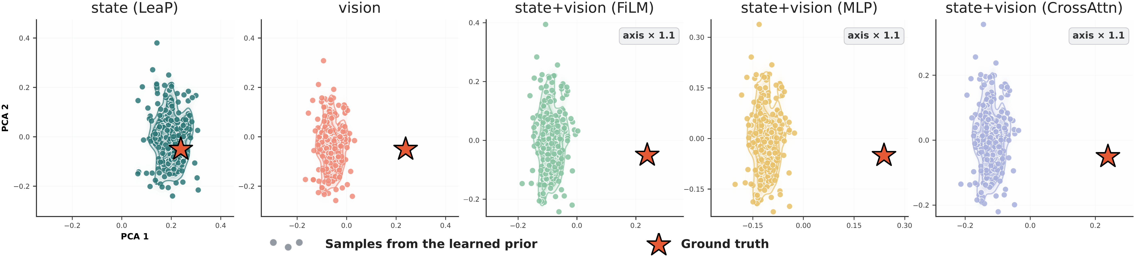
ANALYSIS · CORE
All numbers = mean success over 3 tasks · open_laptop · pick_diverse_bottles · handover_block (n = 3)
Ablation 1 — prior input: state alone wins
state (LeaP)
85.3
Conditioning the prior on proprioceptive state alone is best — 85.3%.
Routing vision into the prior hurts by 15–26 pp; vision is left to the generator's full conditioning. The PCA below shows why: only the state column lands its samples on the target, while vision variants drift away.
v+s (FiLM)
70.3
v+s (MLP)
69.3
vision
66.0
v+s (X-attn)
59.3
Source samples (•) vs. one target action (★), K=200 per variant — state-only clusters on the target; vision variants drift away
LeaP · CoRL 2026
7 / 11
Notes:
Now the core. First ablation: what should parameterize the prior? Conditioning on proprioceptive STATE alone gives 85.3%, and every variant that feeds vision into the prior — FiLM, MLP, cross-attention fusion, or vision only — is 15 to 26 points worse. The PCA banner across the bottom explains why: for a single target action (the star), the state-only prior places its 200 source samples right on the target with a tight spread, while the vision-based variants shift that mass away. So vision belongs in the generator's conditioning, not in the source. [90s]

Slide 8
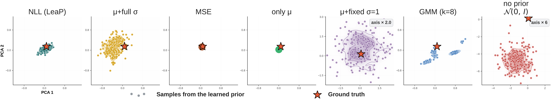
ANALYSIS · CORE
All numbers = mean success over 3 tasks · open_laptop · pick_diverse_bottles · handover_block (n = 3)
Ablation 2 — parameterization: learn the variance
μ + σ² (LeaP)
85.3
μ + fixed σ falls 15.3 pp below only-μ.
The lever is state-adaptive uncertainty — not raw expressivity (full Σ, GMM don't help) and not stochasticity alone. The PCA below: LeaP stays tight on the target, others spread or shift away.
μ + full Σ
79.7
GMM (k=8)
78.7
only μ
78.0
MSE
74.7
μ + fixed σ
62.7
no prior
47.7
Source samples (•) vs. target action (★) per parameterization — LeaP (NLL) is centered & compact; fixed-variance / higher-capacity variants spread or shift away
LeaP · CoRL 2026
8 / 11
Notes:
Second ablation: how should the prior be parameterized? Among seven choices the NLL-trained diagonal Gaussian wins at 85.3%. Two lessons. More expressive priors — a full covariance, a Gaussian mixture — do NOT help. And removing the learned variance hurts: mu-plus-fixed-sigma falls 15.3 points below only-mu. So the lever is specifically a variance that adapts to the current state, not capacity or mere stochasticity. The PCA banner matches: LeaP sits on the target with a calibrated spread, while fixed-variance or over-parameterized variants either spread too broadly or shift mass off-target. [90s]

Slide 9
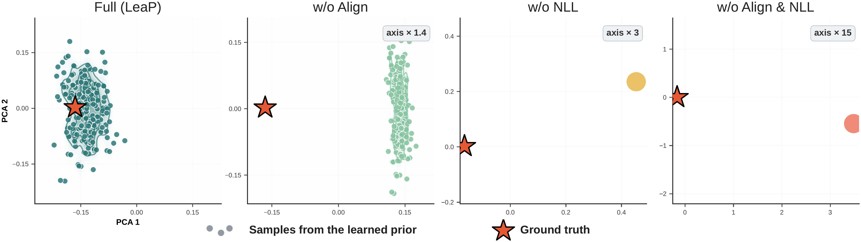
ANALYSIS · CORE
All numbers = mean success over 3 tasks · open_laptop · pick_diverse_bottles · handover_block (n = 3)
Ablation 3 & 4 — supervision and generality
Same prior, other generators
Full (LeaP)
85.3
FM + LeaP
85.3
w/o L_align
74.7
FM (no prior)
47.7
w/o L_NLL
74.3
w/o both
59.7
Bridge + LeaP
76.7
exec μ directly
0.0
Bridge (μ)
68.7
Each loss matters: −~11 pp each · execute μ directly → 0% (the prior seeds, never acts).
+37.6 pp on flow matching · +8.0 pp on a diffusion bridge (already mean-aligned ⇒ isolates the learned variance).
Source geometry per supervision variant: Full (LeaP) tight on the target ★; w/o L_align broadens; w/o L_NLL collapses to a point far away
LeaP · CoRL 2026
9 / 11
Notes:
Two ablations on one slide. Supervision, left: each loss is necessary — removing L_align or L_NLL each costs about 11 points, removing both drops to 59.7, and executing the prior's mean directly gives 0%. The PCA banner shows the roles: L_NLL sets WHERE the source sits — drop it and it collapses to a point far away; L_align sets how TIGHTLY it concentrates — drop it and the cloud broadens; L_flow does the transport. Generality, right (the fourth ablation): attach the same prior to a different generator and you still gain — plus 37.6 on flow matching, plus 8 on a diffusion bridge. The bridge is already mean-aligned, so that plus-8 isolates the variance contribution specifically. [2 min]

Slide 10
Conclusion
— LeaP turns the start of action generation into a learnable, proprioception-conditioned distribution — generator & solver unchanged
— Helps in both simulation and the real world; transfers across generator families
— Where action generation begins is a reusable design axis — complementary to generative dynamics
LeaP · CoRL 2026
10 / 11
Notes:
To conclude — and this is the paper's conclusion almost verbatim. We presented LeaP, a learnable source-prior module: it models the starting point of action generation as a learnable distribution, a proprioception-conditioned diagonal Gaussian over the action chunk, giving a calibrated, stochastic source before generative refinement, while leaving the generator architecture and inference solver unchanged. Across simulation and real-world manipulation, LeaP improves over prior methods and transfers across both flow-matching and diffusion-bridge generators — so source-distribution design complements generator dynamics rather than replacing them. WHERE action generation begins is a reusable design axis: a lightweight learnable source is an effective lever without redesigning the generator. Limitations: the diagonal Gaussian doesn't model cross-dimension correlations — a full covariance gave no gain — and we only tested tabletop manipulation; VLA and world-action models and dexterous hands remain untested. [45s]

Slide 11
Thank you
Questions?
Where Should Action Generation Begin? · LeaP · CoRL 2026
Notes:
To wrap up — the source distribution is an independent, reusable lever for generative robot policies. Happy to take questions. [15s]

