Slide 1


A Low Complexity Expectation Propagation
Algorithm for Active User Detection for Massive Connectivity
Rui Ma, Yuanli Ma, Jikun Zhu, Zheng Wang, Yuekai Cai
Southeast University
Beijing University of Posts and Telecommunications

Slide 2
01.
Content
Background & Motivation
02.
System model & Methodology
03.
Complexity Reduction
04.
Order-based threshold activity detector

Slide 3
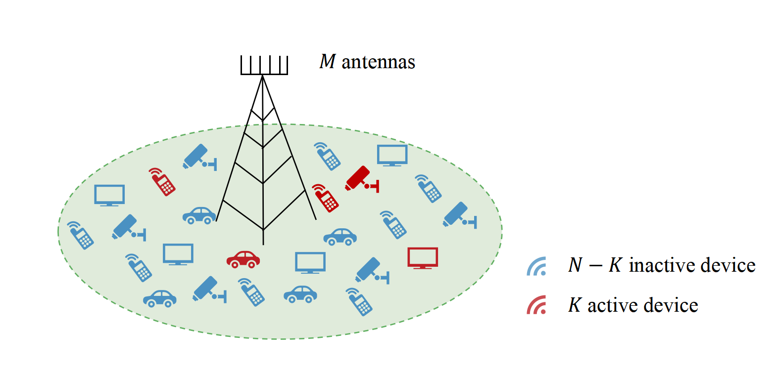
Background
IoT-based wireless networks future Internet of Everything (IoE) networks
connect up to a million devices
require massive machine-type communication (mMTC)
massive access
Sporadic traffic property
base station (BS)
BS: identify red active devices
Compressed sensing (CS) framework for sparse signal recovery
Figure 1: Illustration of massive connectivity scenario

Slide 4
Motivation
Existing problems:
Relatively poor performance in current CS algorithms because a priori distribution of the sparse vector is not exploited
Proposed method：
Consider EP to incorporate a priori distribution
Better performance !
High complexity of EP due to lost favorable propagation in massive connectivity scenario
Find a numerical property of Gram matrix to reduce complexity
Lower complexity !
Performance loss due to the inefficient LLR test
Develop a order-based threshold activity detector to perform better decision
Better tradeoff !

Slide 5
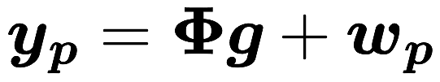
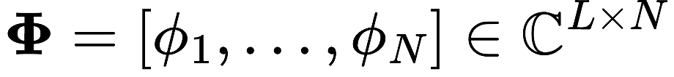
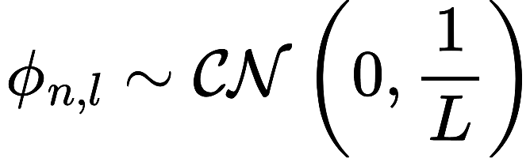
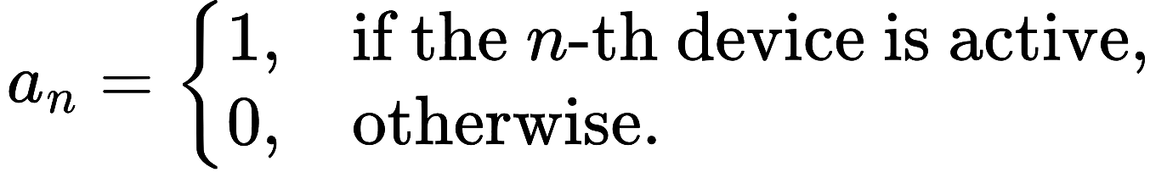
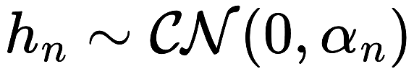
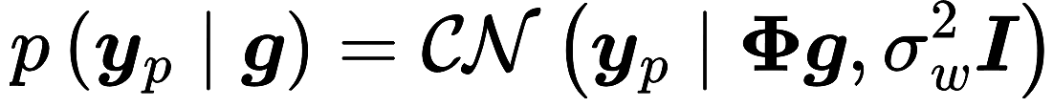
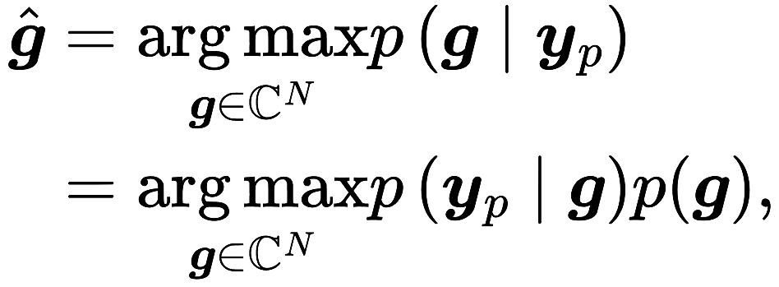
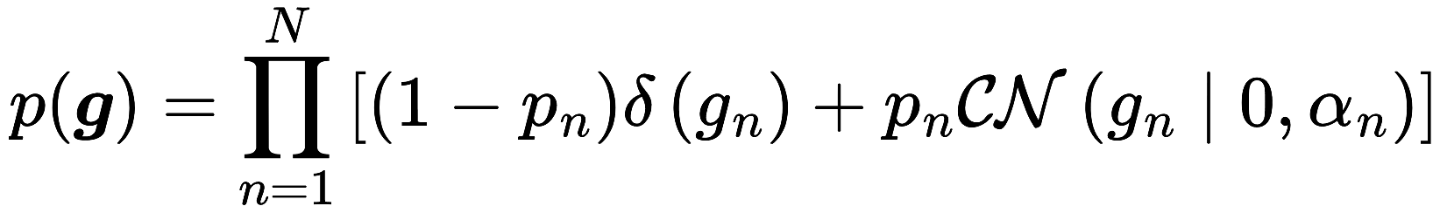
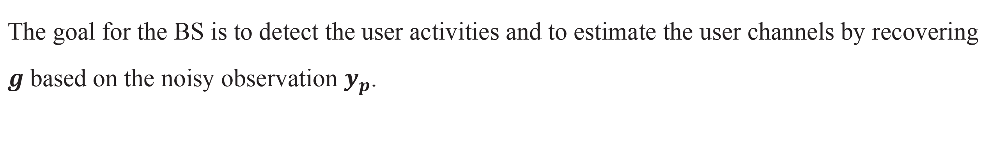

Develop a threshold-based approach to sparsify the Gram matrix
System model
Each user $n$ transmits its pilot sequence to the BS and the received signal at the BS:
pilot matrix
joint user activity and channel information
The goal for the BS is to detect the user activities and to estimate the user channels by recovering $g$based on the noisy observation $y_{p}$.
MAP estimator:
likelihood function
prior distribution
The optimization problem is computationally intractable due to the discrete nature of the binary activity vector $a$.

Slide 6
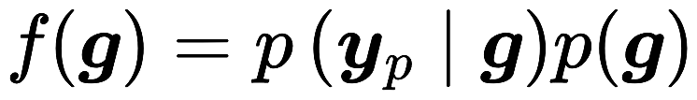
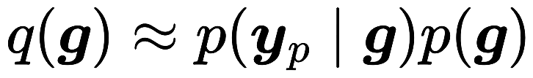
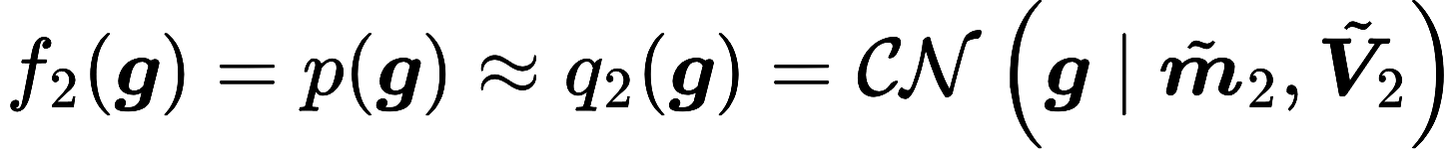
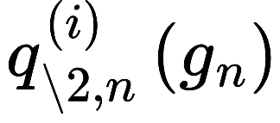
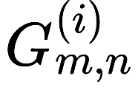
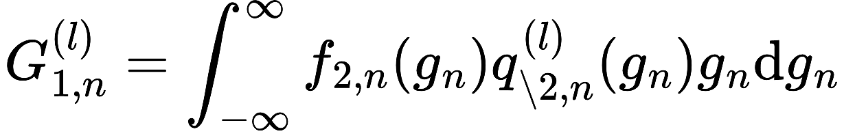
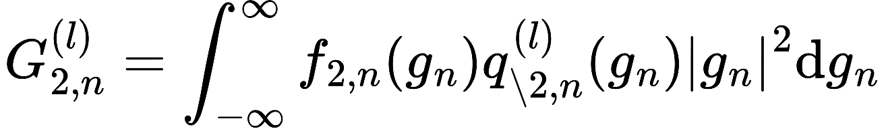
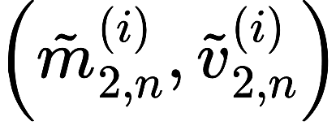
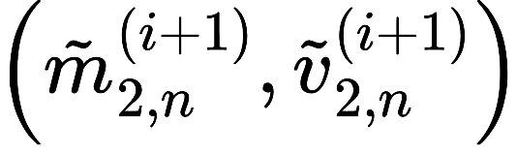
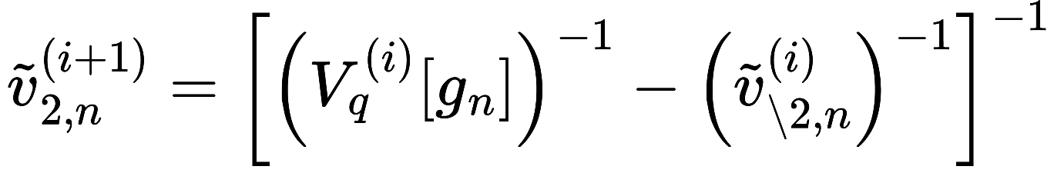
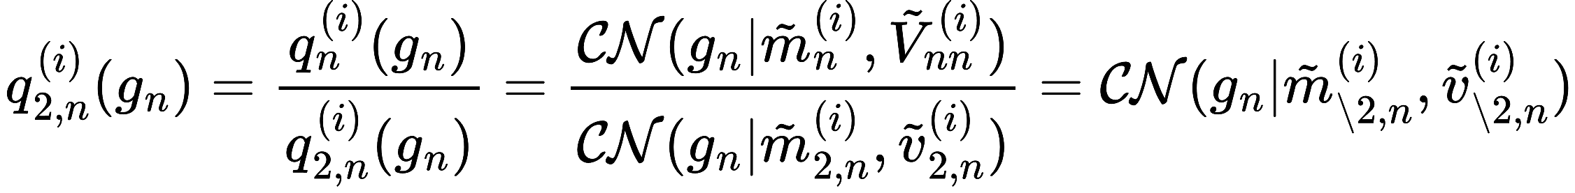
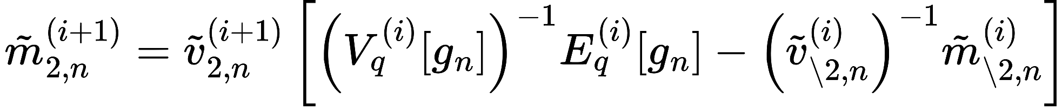


Methodology
Construct a tractable approximation of the target posterior distribution:
The main idea of EP is to match the mean and variance of the original distribution with those of the approximate distribution.
Iterative EP update rules:
moment computation:
compute ratio distribution
moment computation
moment matching
$$y_{p}$$
$$\hat{g},\hat{V}$$
moment matching
compute ratio distribution:

Slide 7
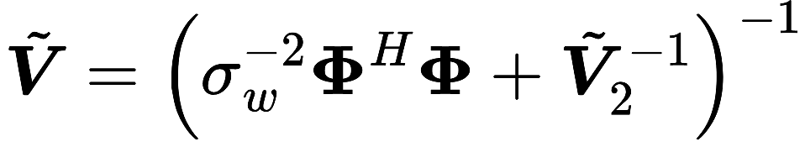
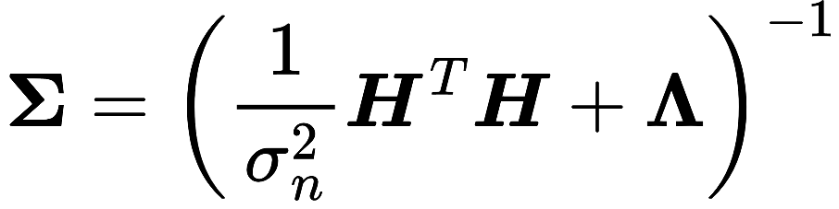
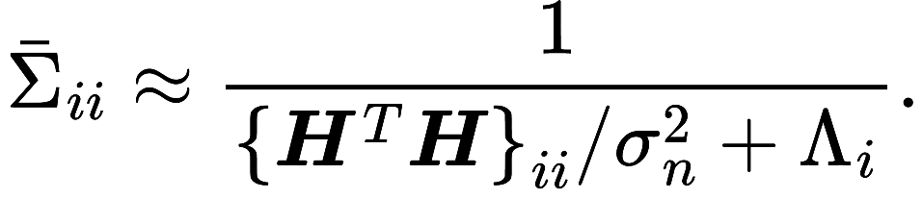

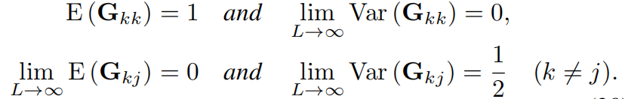
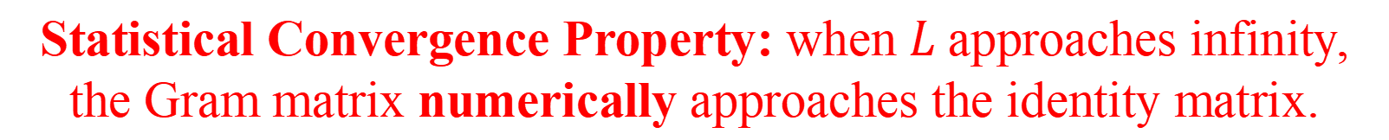
Complexity Reduction
The complexity of the EP algorithm is dominated by the computation of the covariance matrix $\tilde{V}$
Conventional massive MIMO system
Massive connectivity scenario
Dimension of $H$: $n_{R}×n_{T} {(n}_{R}>n_{T})$
Dimension of $Φ$: $L×N (N,L→∞,N>L)$
Leveraging channel hardening to reduce complexity:
Statistical Convergence Property: when $L$ approaches infinity, the Gram matrix numerically approaches the identity matrix.
Theorem 1. Define . As the number of rows tends to infinity,
converges numerically to the identity matrix. Specifically, we have

Slide 8

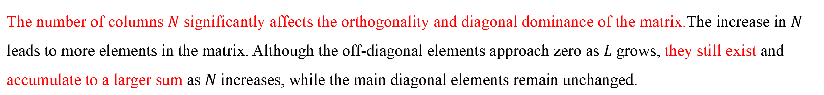
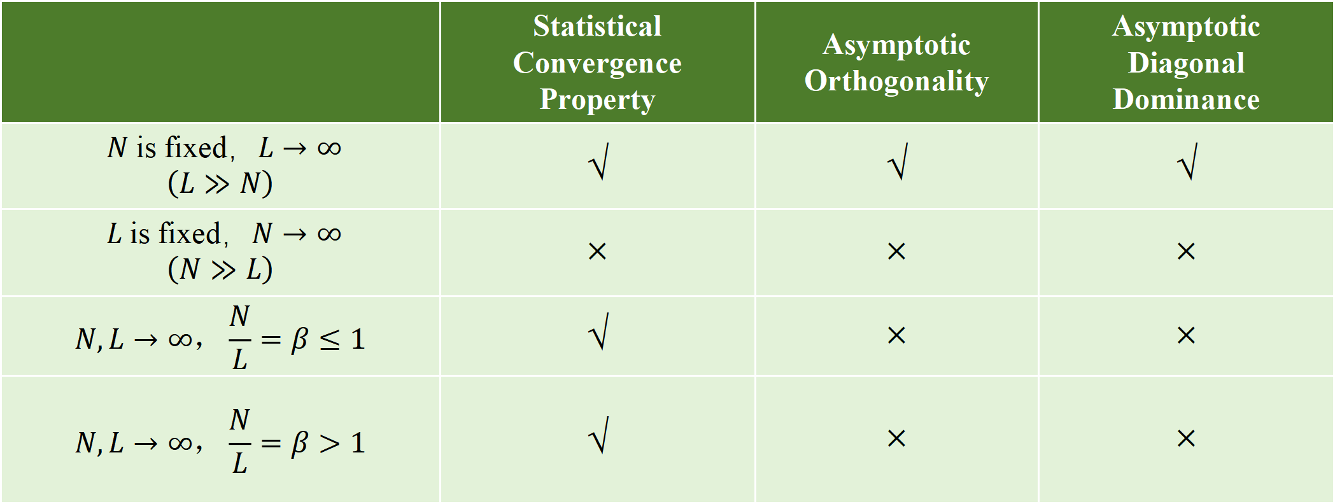
Complexity Reduction
Summary of the properties of the Gram Matrix $Φ^{H}Φ$
$$N×N$$
 | Statistical Convergence Property | Asymptotic Orthogonality | Asymptotic Diagonal Dominance
$N$ is fixed，$L→∞$ $$\left(L≫N\right)$$ | √ | √ | √
$L$ is fixed，$N→∞$ $$\left(N≫L\right)$$ | × | × | ×
$$N,L→∞，\frac{N}{L}=β≤1$$ | √ | × | ×
$$N,L→∞，\frac{N}{L}=β>1$$ | √ | × | ×
The number of columns $N$ significantly affects the orthogonality and diagonal dominance of the matrix.The increase in $N$ leads to more elements in the matrix. Although the off-diagonal elements approach zero as $L$ grows, they still exist and accumulate to a larger sum as $N$ increases, while the main diagonal elements remain unchanged.

Slide 9
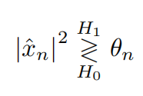


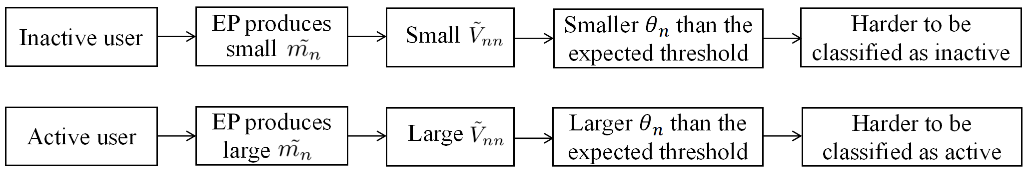


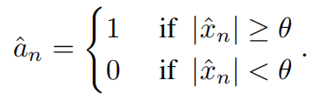
ORDER BASED THRESHOLD ACTIVITY DETECTOR
LLR-based threshold in EP fails to well suit in signal recovery:
The proposed method involves first calculating the absolute estimated values for all users and sorting them in descending order:
Next, the K-th largest value, , is selected as the threshold, where K is the number of active users. As a result, the threshold is defined as

Slide 10
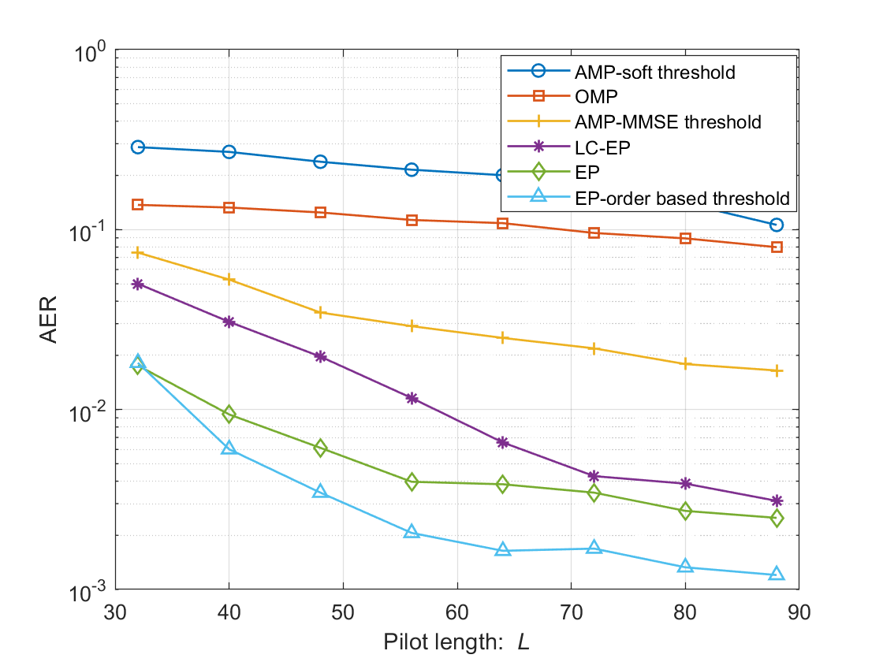
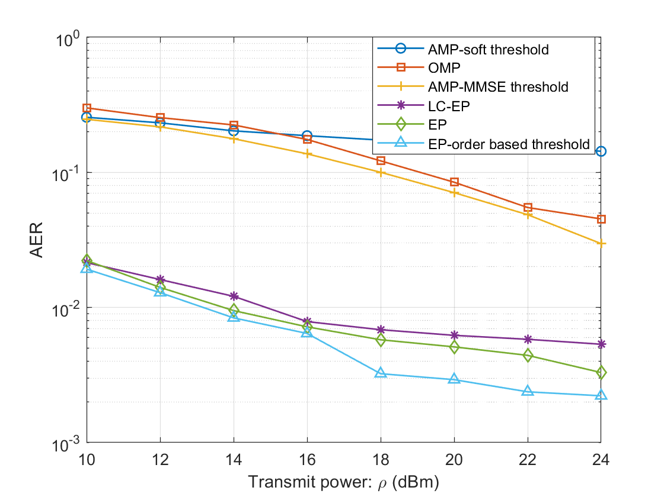
Simulation
From Figure 1,as the pilot length L increases, the performance of LC-EP approaches that of EP. This is because, in this case, the Gram matrix becomes numerically closer to the identity matrix, which is consistent with the theoretical results outlinedin Theorem 1.
From Figure 2, LC-EP achieves complexity reduction while maintaining a relatively small performance loss.

Slide 11
Thanks for your listening !
Notes:
Thank you for your attention. I’d be happy to take any questions.

