Slide 1



Recursive Joint Channel Estimation and Signal Detection for Massive MIMO Systems
Yiqun Gao, He Zhu, Zheng Wang, Zhen Gao
Southeast University, Beijing Institute of Technology
2025.5.19
Notes:
Good morning, everyone. I'm Yiqun Gao, and today I'm going to present our research on "Recursive Joint Channel Estimation and Signal Detection for Massive MIMO Systems."

Slide 2

Contents
01
Background
02
Traditional Framework for Joint Channel Estimation and Signal Detection
03
Algorithm Description
04
Simulations
Notes:
Let's start with an overview of the presentation. First, we'll introduce the background of joint channel estimation and signal detection in MIMO systems. Then, we'll discuss the traditional framework for this joint method. After that, I'll describe our proposed algorithm in detail. Finally, we'll look at the simulation results to evaluate the performance of our method.

Slide 3

1 Background
Joint Channel Estimation and signal detection of MIMO
High computational cost with the growing number of antennas
Role: An alternative to the traditional pilot-based channel estimation
Target: Improve the performance of estimation and detection
Challenge upon the Joint Channel Estimation and Signal Detection
Traditional framework for joint method
Advantage:
Exchange information between channel estimator and signal detector
Disadvantage:
Still with high computational complexity; Require full dataset
Notes:
In the background section, joint channel estimation and signal detection in MIMO systems play a crucial role. It serves as an alternative to the traditional pilot - based channel estimation, aiming to improve the performance of both estimation and detection.
Despite its merits, the traditional framework for joint channel estimation and signal detection in MIMO systems faces several challenges. On one hand, it offers the advantage of facilitating information exchange between the channel estimator and the signal detector, which is crucial for enhancing the overall performance of the system. On the other hand, it suffers from significant drawbacks. Specifically, it is burdened with high computational complexity and necessitates the availability of the full dataset, which can be impractical in many real - world scenarios. Moreover, as the number of MIMO antennas continues to increase, its computational complexity also significantly rises, which brings challenges for joint methods.

Slide 4
1 Background
Recursive framework for joint estimation and detection
Combine the adaptive filters algorithms with the feedback of the detected signals
Advantages
Disadvantages
Without full dataset
Low iteration numbers
Update estimated channel promptly
Complexity introduced when signal detection
Error propagation
Jointly design channel estimation and signal detection scheme
Notes:
To address the limitations of the traditional framework, a recursive framework for joint channel estimation and signal detection scheme is proposed. This type of method combined adaptive filter algorithms with the feedback of detected signals, creating a recursive framework for joint estimation and detection. This recursive framework has several advantages. It doesn't require the full dataset, has a low number of iterations, and can update the estimated channel promptly. However, it also has some drawbacks. Signal detection introduces complexity, and there is a problem of error propagation.

Slide 5
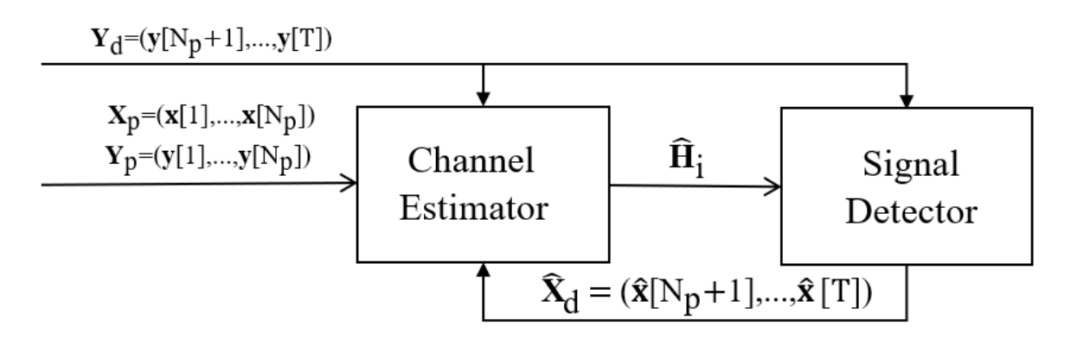

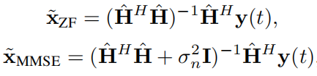
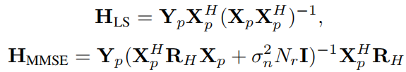

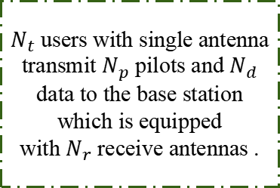
2 Traditional Framework for Joint Method
System Model
$N_{t}$ users with single antenna transmit $N_{p}$ pilots and $N_{d}$ data to the base station which is equipped
with $N_{r}$ receive antennas .
Channel estimator
Linear signal detector
Notes:
Now, let's move on to the traditional framework for the joint method. Consider a TDD protocol scenario, the base station is equipped with N_r antennas, and receives transmissions from N_t single-antenna users. Each user sends T=N_p+N_d symbols during the uplink transmission, with N_p known pilot symbols followed by N_d data symbols. As shown in Fig. above, after receiving T symbol vectors, the traditional joint channel estimation and detection method begins to work by exchanging information iteratively. Specifically, given the MIMO channel matrix H, the received signals can be expressed by Y=HX+N. An initial estimated channel is normally obtained based on the pilot signals via least squares (LS) or minimum mean square error (MMSE) estimation. And the classic linear detectors like zero forcing (ZF) and MMSE are normally applied for detection. After signal detection, the detected signal matrix is fed back to channel estimator, which uses pilots and detected data to update the channel estimates.

Slide 6
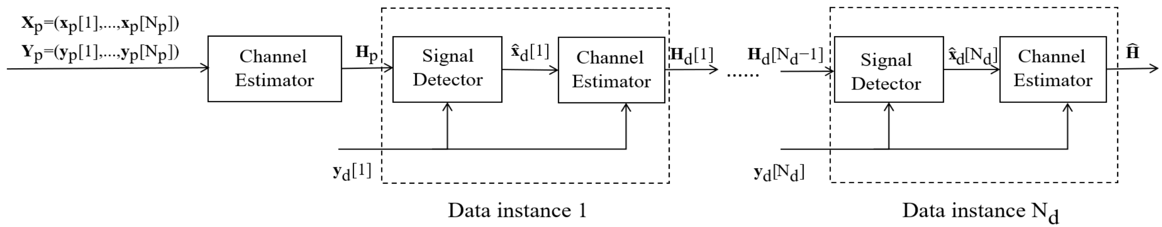
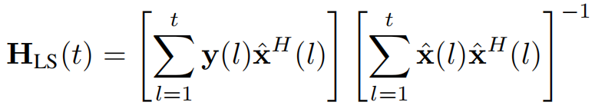


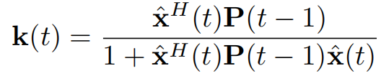

3 Algorithm Description
Recursive framework
Recursive joint channel estimation and signal detection
Cumulative LS
Matrix inverse lemma
RLS
Bypass the matrix inversion
Notes:
Our proposed algorithm is based on a recursive framework for joint channel estimation and signal detection. As shown in Fig above, different from the traditional joint channel estimation and signal detection, RLS joint method
updates the channel estimation at every time instance.
Specifically, consider the cumulative form of LS at each time instance and employ matrix inverse lemma to bypass the matrix inversion behind. RLS estimation serves as a recursive version of LS by H(t)=H(t-1)+e(t)k(t). Here e(t)
represents the prior error vector at time t, the Kalman gain vector k(t) is given by k(t)=......

Slide 7



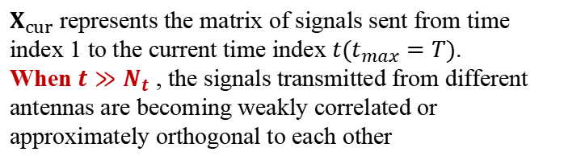
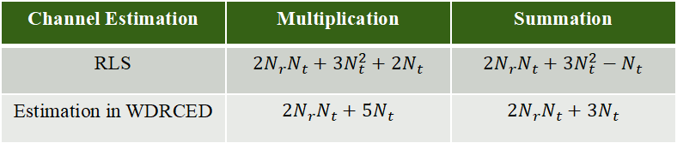
3 Algorithm Description
Criterion: reduce high-dimensional multiplication
A. Complexity Reduction in Channel Estimation by Diagonalizing the Information Matrix
Information matrix P
Complexity Analysis
Main complexity source
$X_{cur}$ represents the matrix of signals sent from time index 1 to the current time index $t(t_{max}=T)$.
When $t≫N_{t}$ , the signals transmitted from different antennas are becoming weakly correlated or approximately orthogonal to each other
Calculate
Calculate
diagonalized
Channel Estimation | Multiplication | Summation
RLS | $$2N_{r}N_{t}+3N_{t}^{2}+2N_{t}$$ | $$2N_{r}N_{t}+3N_{t}^{2}−N_{t}$$
Estimation in WDRCED | $$2N_{r}N_{t}+5N_{t}$$ | $$2N_{r}N_{t}+3N_{t}$$
Notes:
To better utilize the information from joint channel estimation and detection, we propose a joint weighted diagonalized recursive channel estimation and detection (WDRCED) method.
A. One of the key aspects of our algorithm is the complexity reduction in channel estimation by diagonalizing the information matrix. In the RLS channel estimation algorithm, updating the information matrix P involves matrix-vector and vector-vector multiplications, which contribute to its computational complexity. The matrix P, on the other hand, represents the approximation of the inverse of X_curX_cur^H where X_cur represents the matrix of signals sent from time index 1 to the current time index t (tmax = T). As time index t increases, matrix P exhibits a dominantly diagonal characteristic when t is much greater than Nt . This situation arises because the signals transmitted from different antennas are becoming weakly correlated or approximately orthogonal to each other. Motivated by this, we update only the diagonal elements of the matrix P P(t)=diag(P(t-1)-P(t-1)x(t)k(t)).
The main complexity source comes from calculating k(t),P and P(t-1)x(t) .By doing this, we can significantly reduce the computational complexity of vector-matrix multiplications. In RLS, the multiplication complexity is reduced from 2N_rN_t + 3N_t^2+ 2N_t to 2N_rN_t + 5N_t, and the summation complexity is also reduced.

Slide 8


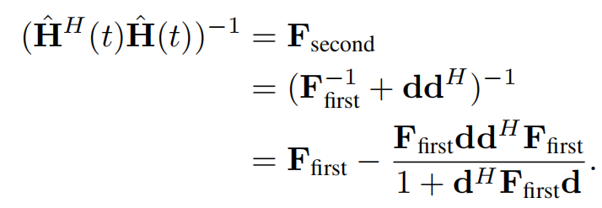

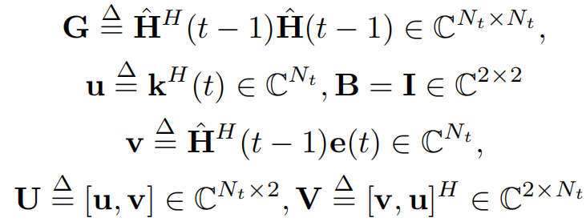
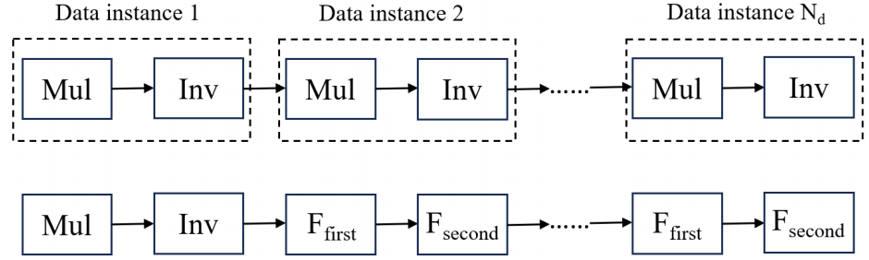
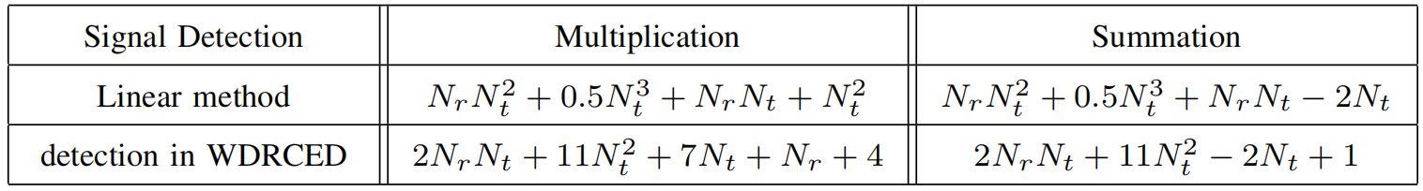
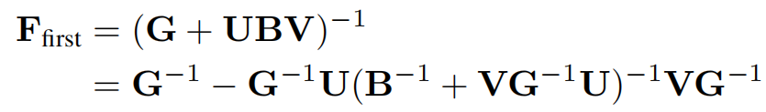
3 Algorithm Description
B. Complexity Reduction in Signal Detection by Two-stage Sherman Formula
Criterion: reduce high-dimensional multiplication and inversion of Gram
High computation cost
Notes:
B. Another important part is the complexity reduction in signal detection by the two - stage Sherman formula. Our goal here is to reduce high - dimensional multiplications and inversions of the Gram matrix H^HH, which are computationally expensive operations in traditional signal detection methods. At the first stage, considering the first three terms of the Gram matrix update calculation and we then introduce Sherman-Woodbury formula to compute the first stage filter matrix F_first. Next, at the second stage, we add the last term ∆ H^H(t)∆ H(t) to the results of the first stage. By leveraging Sherman Morrison-Woodbury formula, the target matrix inversion (Hˆ H(t)Hˆ (t))−1 can be computed by the two stage sherman formula. The calculation of the matrix inversion can be calculated directedly based on the results of last time instance without the traditional matrix multiplication and inversion. By doing this, the matrix multiplication and inversion are only required at the first time instance. To be precise, the calculation flow chart is shown below, where ‘Mul’ and ‘Inv’ represent multiplication and inversion respectively. Specifically, at each time instance, the traditional computational complexity of directly calculating (Hˆ H(t)Hˆ (t))−1 is NrNt^2 + 0.5Nt^3. Note that at the first stage, the matrix inversion involved has a dimension of only 2. At the second stage, all computations only involve matrix-vector or vector-vector multiplications, thus reducing the complexity.

Slide 9

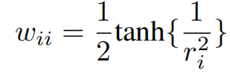
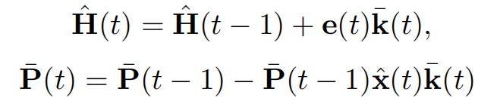

3 Algorithm Description
Improve Kalman gain
C. Performance Improvement by weighted RLS
Design
A weight matrix W
Modified Kalman gain
Positive impact upon the performance
W is a diagonal matrix, where its i-th diagonal element reflects the reliability of transmit antenna i. This reliability is assessed based on how accurately the signal from this antenna is detected at the receiver.
weighted RLS
The update rule is a heuristic approach designed to provide a smooth and bounded adjustment for the weight coefficient.
Notes:
C. To further improve the performance, we use weighted RLS. We introduce a weight matrix W to modify the Kalman gain. The weight matrix W is a diagonal matrix, and its i - th diagonal element reflects the reliability of transmit antenna i. This reliability is assessed based on how accurately the signal from this antenna is detected at the receiver. Here, J_linear is the equalization matrix for linear detection, which maps the received signals back to the transmitted signal space through a linear transformation and x_nearest is the nearest constellation point. The update rule for the weight coefficient is a heuristic approach designed to provide a smooth and bounded adjustment. By using weighted RLS, we can achieve better performance in both channel estimation and signal detection.

Slide 10
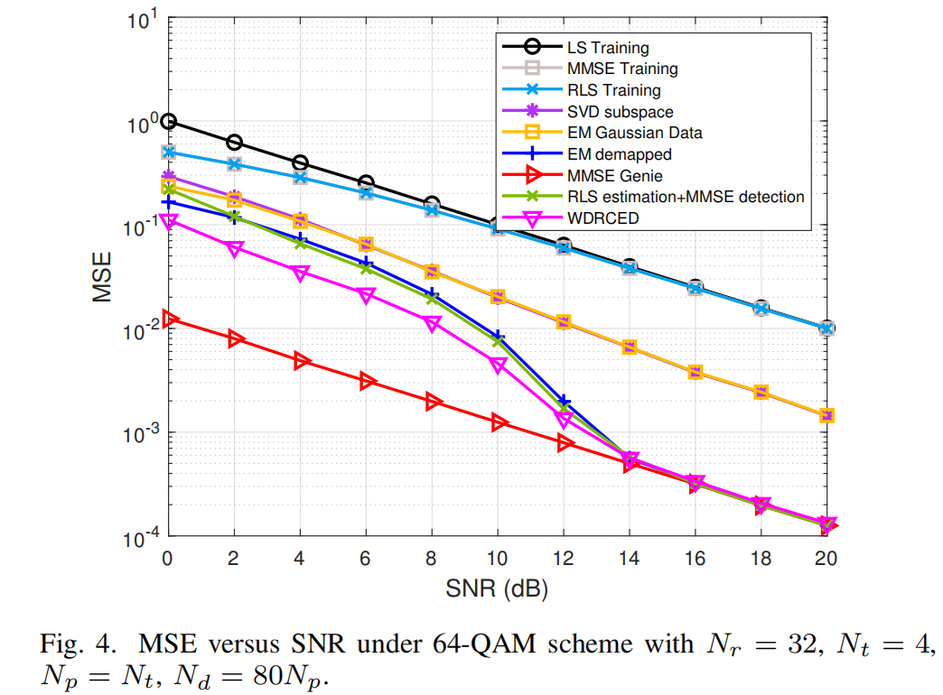
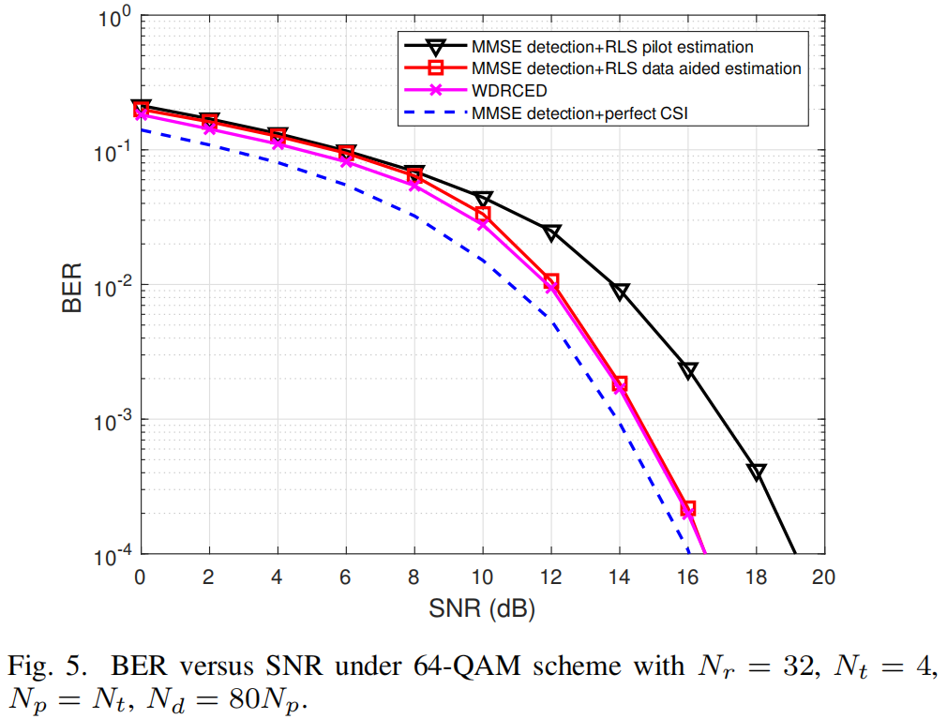
4 Simulations
Estimation Performance
Detection Performance
The proposed WDRCED method outperforms other methods and operates as an online method without requiring a full dataset.
The proposed WDRCED method outperforms other methods.
Data-aided methods are superior to pilot-based methods
Notes:
Now, let's look at the simulation results. Our proposed WDRCED method outperforms other methods. In terms of estimation performance, it shows better results compared to other methods. Data - aided methods are generally superior to pilot - based methods. Moreover, the proposed WDRCED operates as an online method without requiring a full dataset. For detection performance, the same trend is observed, with our method achieving better results.

Slide 11
Conclusion
Propose an efficient recursive joint channel estimation and signal detection method named as WDRCED for massive MIMO systems.
In the recursive framework, the computational complexity of the RLS channel estimation is reduced by approximating the information matrix as diagonal.
A two-stage detection strategy is introduced to avoid repeated high-dimensional matrix computations and inversions during signal detection, significantly reducing computational overhead.
Adaptive weighting coefficients are applied to different transmit antennas to optimize the channel estimation and signal detection results.
Notes:
In conclusion, we have proposed an efficient recursive joint channel estimation and signal detection method named WDRCED for massive MIMO systems. In the recursive framework, we reduce the computational complexity of the RLS channel estimation by approximating the information matrix as diagonal. We introduce a two - stage detection strategy to avoid repeated high - dimensional matrix computations and inversions during signal detection, which significantly reduces the computational overhead. We also apply adaptive weighting coefficients to different transmit antennas to optimize the channel estimation and signal detection results.

Slide 12
Thank you for your watching
Yiqun Gao, He Zhu, Zheng Wang, Zhen Gao
Southeast University , Beijing Institute of Technology
2025.5.19
Notes:
Thank you all for your attention. If you have any questions, I'd be more than happy to answer them.

