Slide 1




The 21st International Wireless Communications & Mobile Computing Conference
12–16 May 2025 // Abu Dhabi, UAE
Cluster-Based Low-Complexity Codebook Design for Hierarchical Beam Training in XL-MIMO
Jikun Zhu, Xiaochen Ma, Wang Zheng, and Yongming Huang
Southeast University
16 May, 2025

Slide 2
Outline
01
Background
04
Simulation Results
02
System Model
05
Conclusion
03
Proposed Codebook Design Scheme

Slide 3
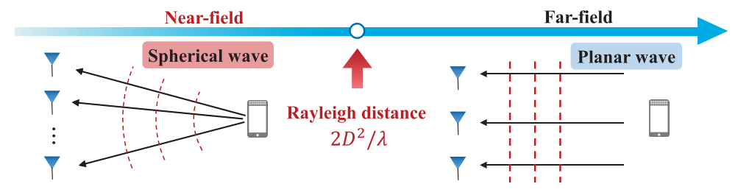
01
Extremely Large-Scale MIMO
XL-MIMO has emerged as a critical technology for future 6G due to its high spatial multiplexing and spectral efficiency ^{[1]} .
^{[2]}
The transition in electromagnetic propagation characteristics from far-field planar waves to near-field spherical waves also renders traditional beamforming approaches unsuitable^{[2]} .
[1] C.-X. Wang et al., “On the Road to 6G: Visions, Requirements, Key Technologies, and Testbeds,” IEEE Communications Surveys & Tutorials, vol. 25, no. 2, pp. 905-974, Secondquarter 2023.
[2] M. Cui and L. Dai, “Channel Estimation for Extremely Large-Scale MIMO: Far-Field or Near-Field?” IEEE Transactions on Communications, vol. 70, no. 4, pp. 2663-2677, April 2022.
Jikun Zhu, Xiaochen Ma, Wang Zheng, and Yongming Huang: Cluster-Based Low-Complexity Codebook Design for Hierarchical Beam Training in XL-MIMO

Slide 4
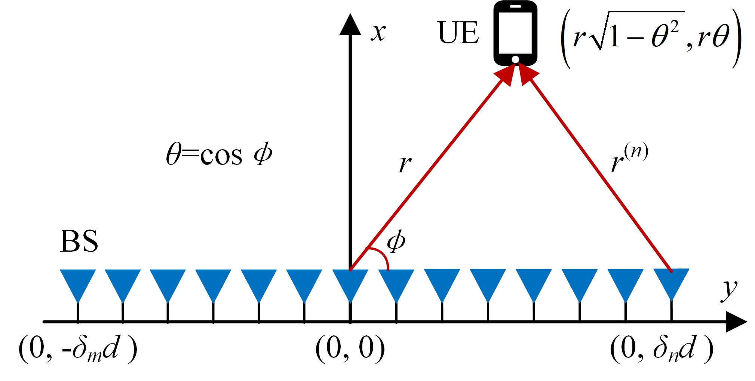
02
A Narrow-Band XL-MIMO Communication System
Consider a downlink beam training XL-MIMO communication system, the base station with 𝑁antennas communicates with a single-antenna user.
spherical-wave model
received signal at UE：
Distance：
Jikun Zhu, Xiaochen Ma, Wang Zheng, and Yongming Huang: Cluster-Based Low-Complexity Codebook Design for Hierarchical Beam Training in XL-MIMO

Slide 5

02
Existing Beam Training Schemes
Exhaustive Search Based On Polar-Domain Codebook
If given perfect CSI information $\left(θ, r\right)$, the optimal beamforming vector in XL-MIMO can be obtained as $v^{∗}=b\left(θ,r\right)$.
Polar-Domain Codebook^{[1]}
Codeword
Optimal beamforming vectors from different sampling points
Exhaustive Search: find the optimal codeword to serve as the beamforming vector $v$ in the polar-domain codebook that maximizes the received signal power.
Codebook size: $N×S_{N}$
Unaffordable Beam training Overhead!
[1] M. Cui and L. Dai, “Channel Estimation for Extremely Large-Scale MIMO: Far-Field or Near-Field?” IEEE Transactions on Communications, vol. 70, no. 4, pp. 2663-2677, April 2022.
Jikun Zhu, Xiaochen Ma, Wang Zheng, and Yongming Huang: Cluster-Based Low-Complexity Codebook Design for Hierarchical Beam Training in XL-MIMO

Slide 6
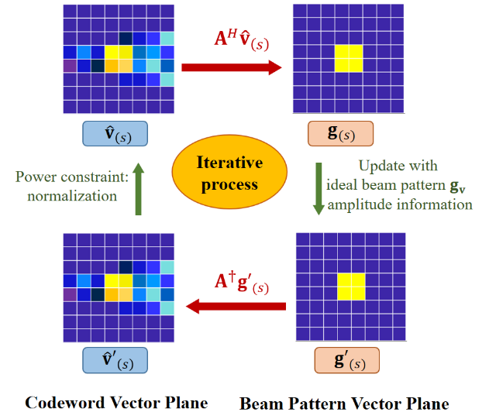


02
Existing Beam Training Schemes
GS-Based Codeword Design For Near-Field 2D Hierarchical Beam Training
^{[1]}
Minimize the discrepancy between the ideal beam pattern and the beam pattern obtained by $w$
Iteratively update two variables ^{[1]}
The computational cost of calculating the pseudoinverse of matrix $M$ during the iteration is rather expensive
High computational complexity!
[1] Y. Lu, Z. Zhang and L. Dai, “Hierarchical Beam Training for Extremely Large-Scale MIMO: From Far-Field to Near-Field,” IEEE Transactions on Communications, vol. 72, no. 4, pp. 2247-2259, April 2024.
Jikun Zhu, Xiaochen Ma, Wang Zheng, and Yongming Huang: Cluster-Based Low-Complexity Codebook Design for Hierarchical Beam Training in XL-MIMO

Slide 7
03
Cluster-Based Hierarchical Near-Field Codebook
The proposed CHB scheme seeks to maximize the achievable rate by minimizing the discrepancy between the designed codebook $W$ and the polar-domain codebook $M$.
Angle and Distance Clustering
Angle
Sort both the angular and distance cluster centers are in an ascending order
Minimize these cost functions
Jikun Zhu, Xiaochen Ma, Wang Zheng, and Yongming Huang: Cluster-Based Low-Complexity Codebook Design for Hierarchical Beam Training in XL-MIMO

Slide 8
03
Cluster-Based Hierarchical Near-Field Codebook
To construct a multi-resolution hierarchical codebook, angular and distance cluster centers are initially paired to form all possible combinations $(μ_{m}^{θ},μ_{n}^{r})$.
Calculation of Beam Codeword Coverage
A single angle-distance point
A coverage region in the polar domain
Sort
Angle
Coverage
Codeword
Jikun Zhu, Xiaochen Ma, Wang Zheng, and Yongming Huang: Cluster-Based Low-Complexity Codebook Design for Hierarchical Beam Training in XL-MIMO

Slide 9
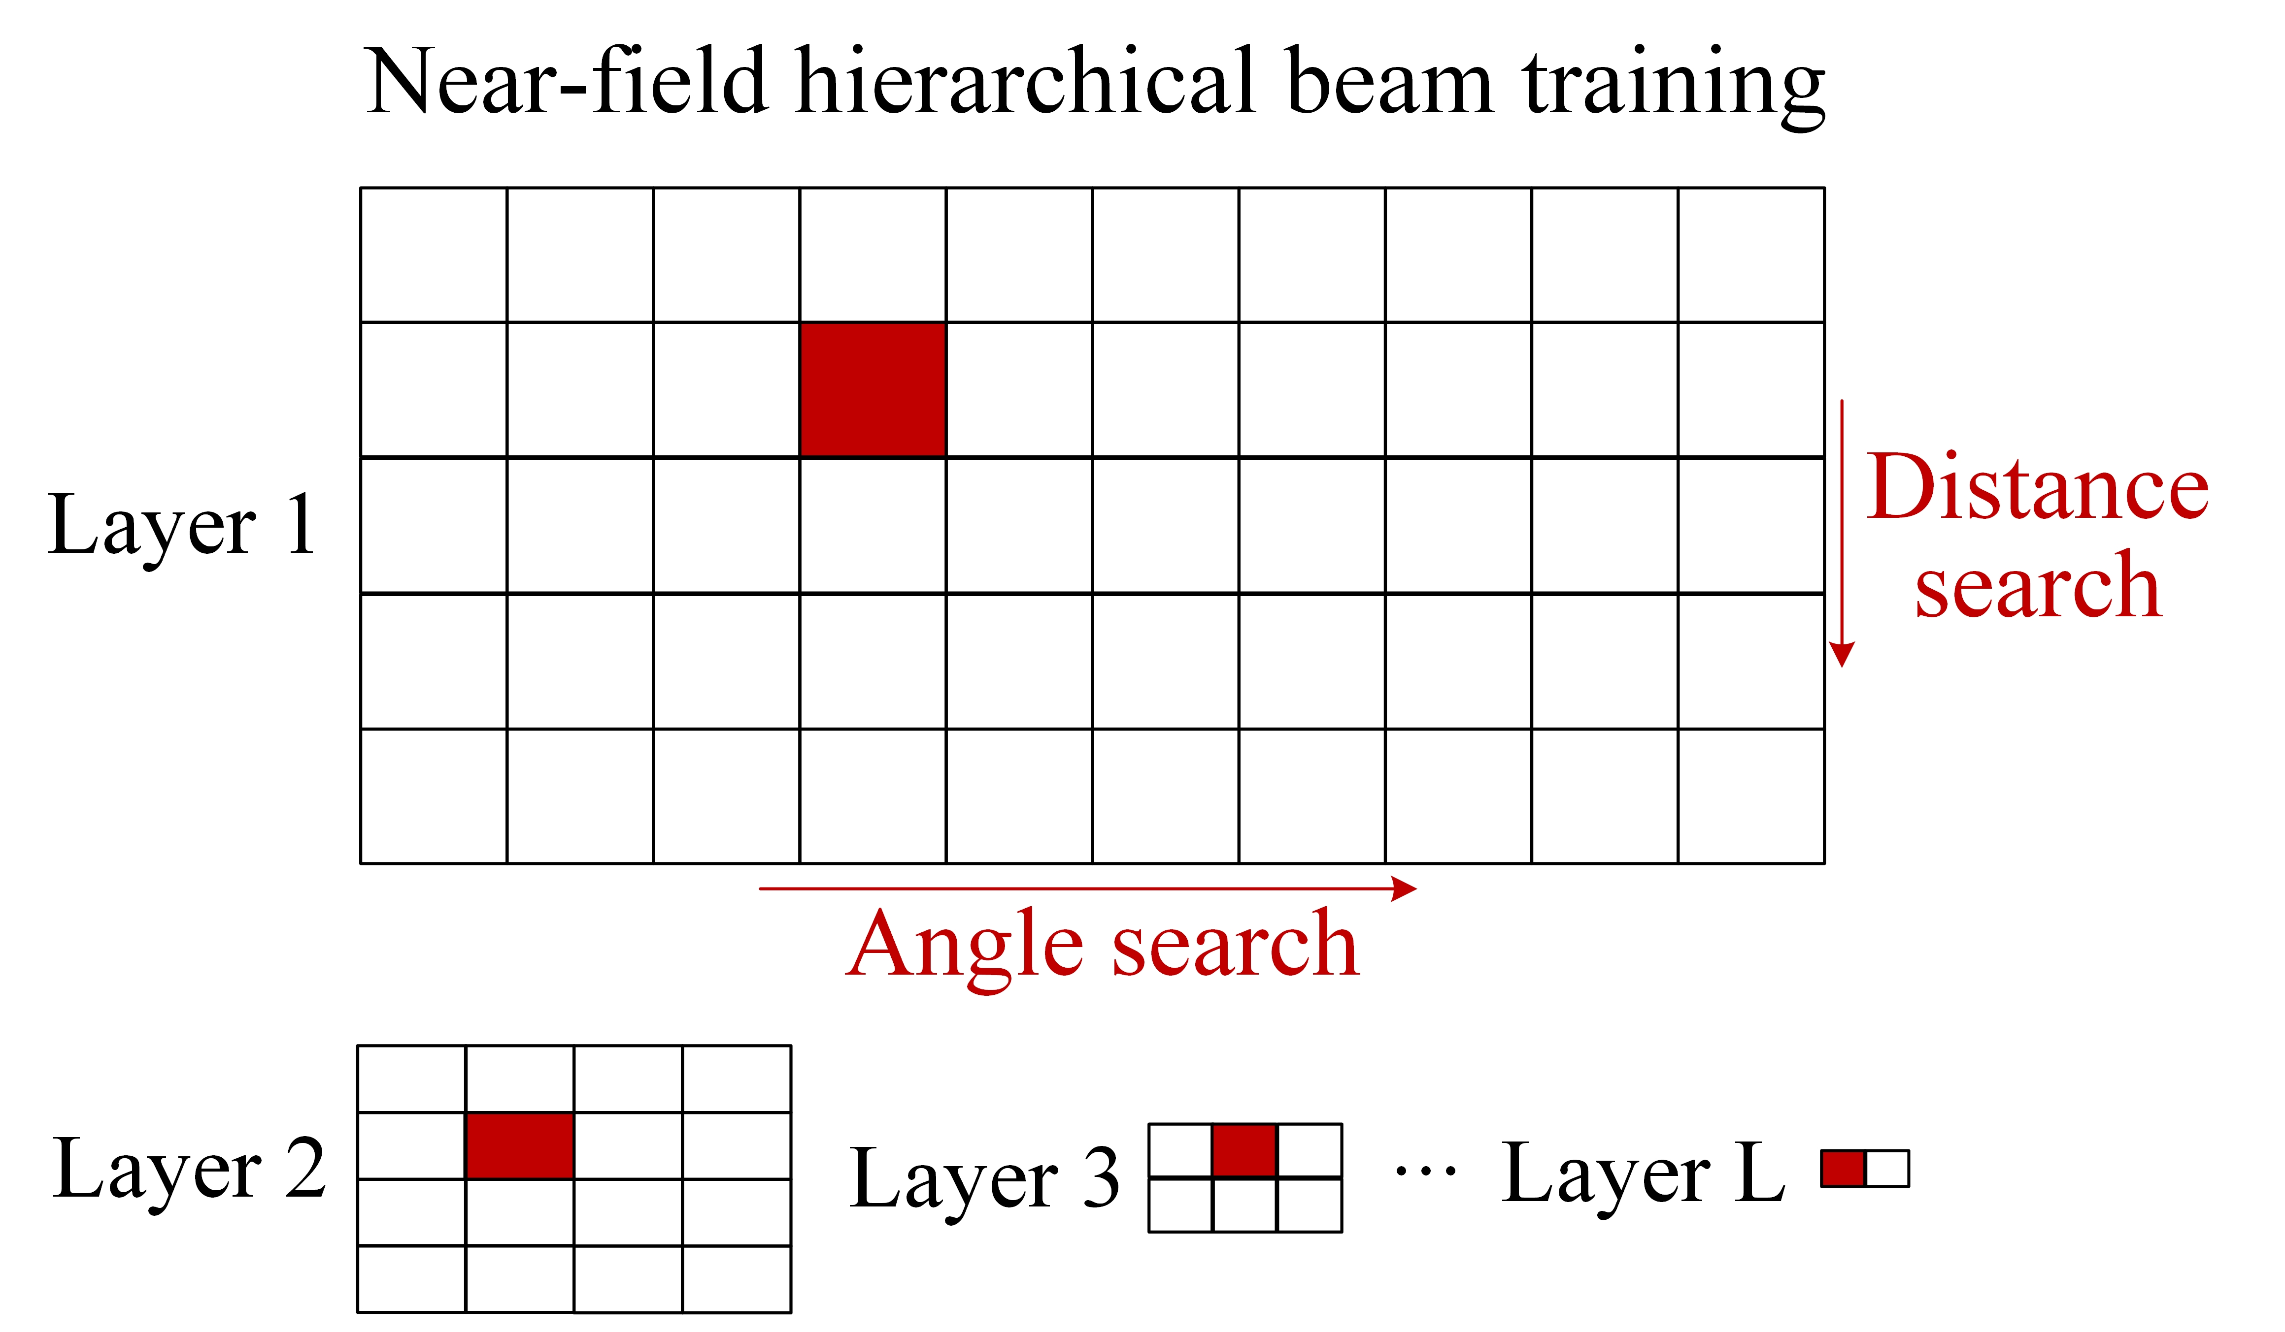

03
Cluster-Based Hierarchical Near-Field Codebook
Hierarchical Near-Field Beam Training
Coverage
Step Size
In$l$–th layer
Step size is determined by the number of cluster centers:
Dynamically adjust the size of each layer's codebook
Significantly reduce beam training overhead
L layers of sub-codebooks
Jikun Zhu, Xiaochen Ma, Wang Zheng, and Yongming Huang: Cluster-Based Low-Complexity Codebook Design for Hierarchical Beam Training in XL-MIMO

Slide 10

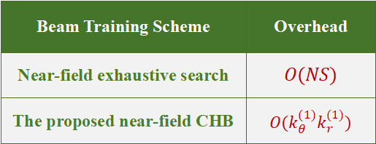
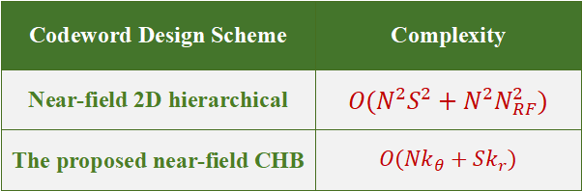
03
Cluster-Based Hierarchical Near-Field Codebook
Overhead and Complexity Comparison
$$k_{θ}^{(1)}k_{r}^{(1)}$$
The first layer codebook size
Codeword Design Scheme | Complexity
Near-field 2D hierarchical | $$O(N^{2}S^{2}+N^{2}N_{RF}^{2})$$
The proposed near-field CHB | $$O(Nk_{θ}+Sk_{r})$$
Beam Training Scheme | Overhead
Near-field exhaustive search | $$O(NS)$$
The proposed near-field CHB | $$O(k_{θ}^{(1)}k_{r}^{(1)})$$
The proposed CHB scheme achieves approximately two orders of magnitude in codeword design complexity lower than the Near-field 2D hierarchical scheme.
The proposed CHB scheme significantly reduces training overhead compared with exhaustive search.
Jikun Zhu, Xiaochen Ma, Wang Zheng, and Yongming Huang: Cluster-Based Low-Complexity Codebook Design for Hierarchical Beam Training in XL-MIMO

Slide 11
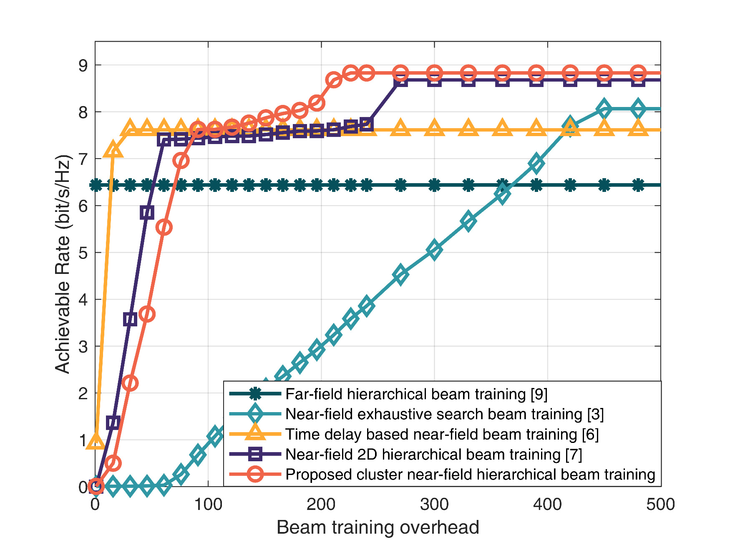
04
Simulation Results: Achievable Rate vs Overhead
The proposed CHB scheme achieves a balance between performance and overhead
Parameters | Value
Carrier | 50GHz
Number of antennas | 512
Number of distance girds | 16
15% reduction in overhead than 2D hierarchical
Narrow-band
97% reduction in overhead than exhaustive search
Beam Training Scheme | Overhead
Near-field exhaustive search | 8192
Near-field 2D hierarchical | 268
The proposed near-field CHB | 227
Jikun Zhu, Xiaochen Ma, Wang Zheng, and Yongming Huang: Cluster-Based Low-Complexity Codebook Design for Hierarchical Beam Training in XL-MIMO

Slide 12
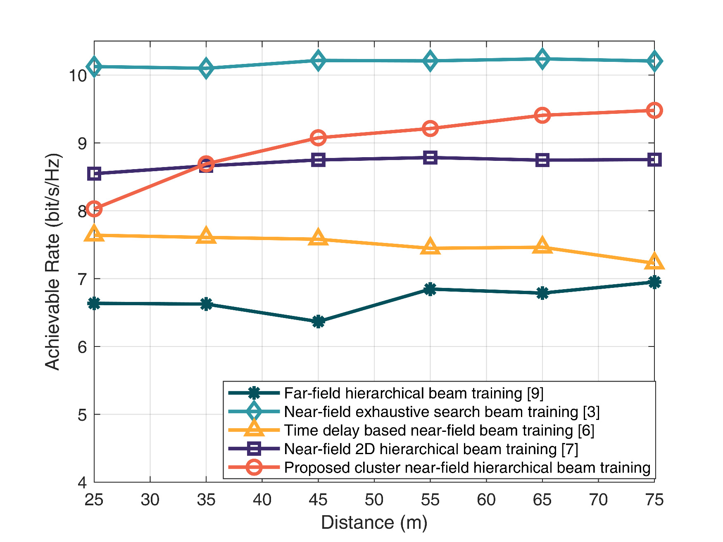
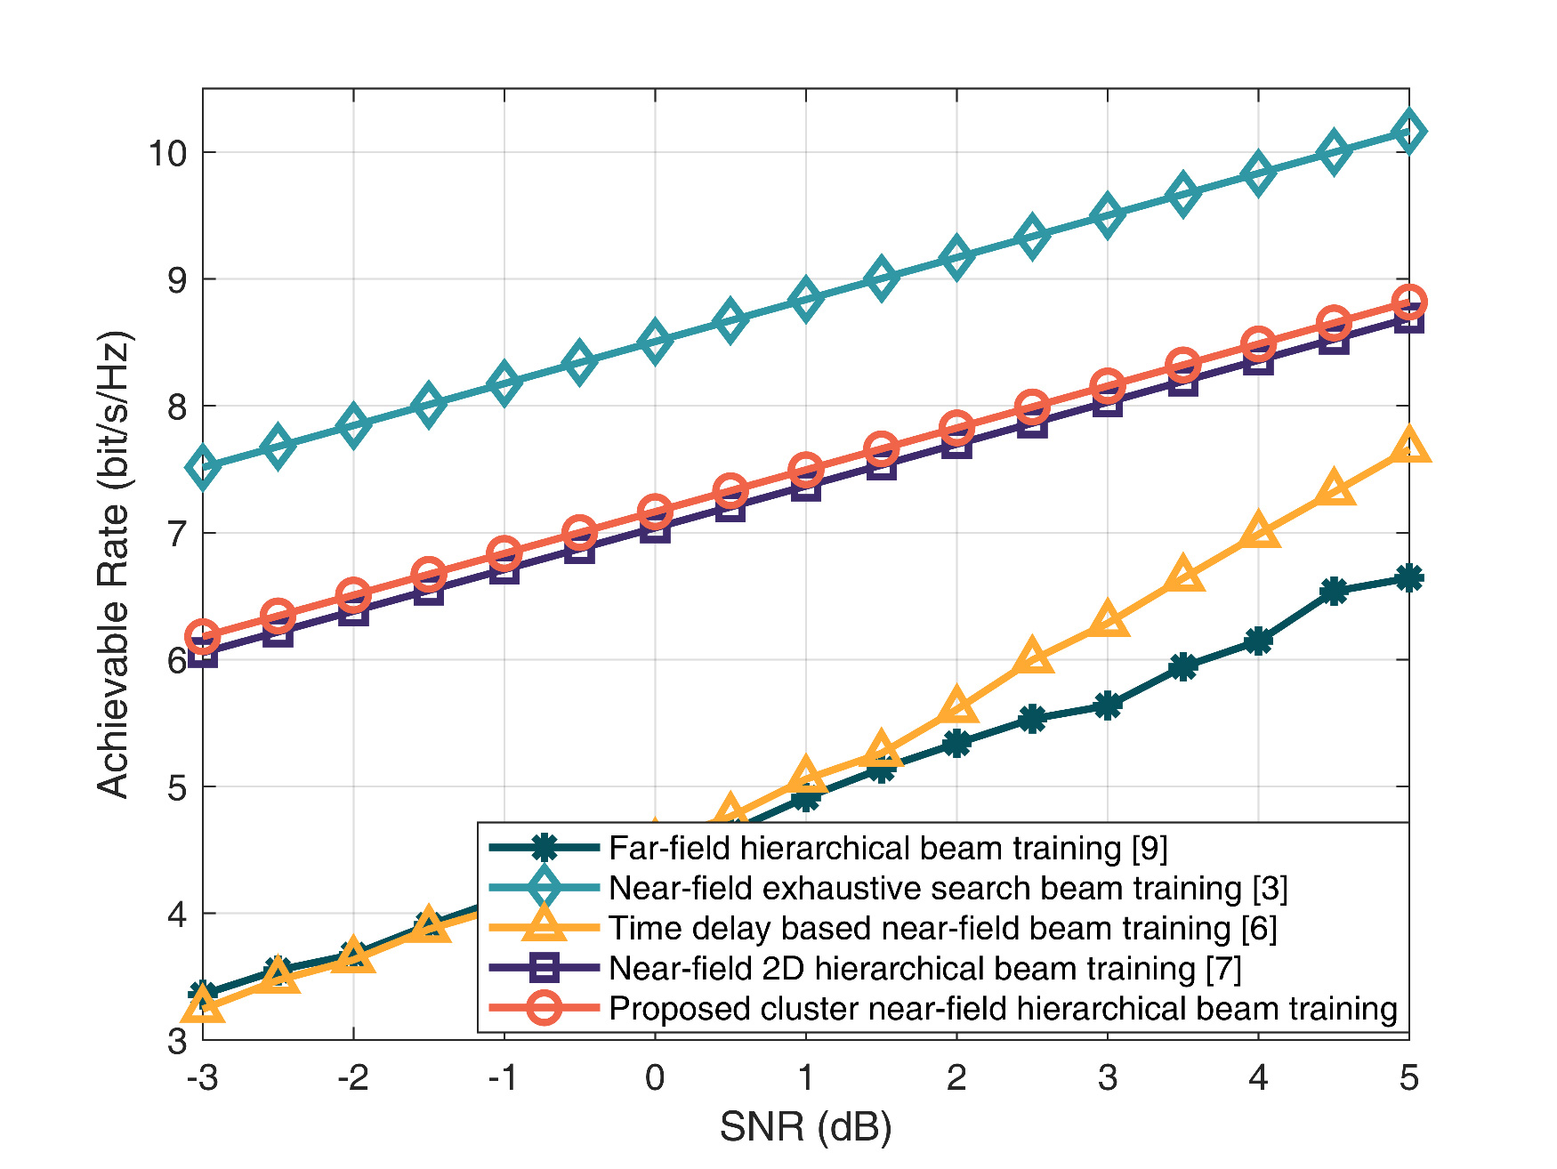
04
Achievable Rate vs Distance and SNR
The proposed CHB scheme achieves suboptimal performance in most cases
Average performance improvement of 10% than 2D hierarchical
Closer to optimal performance
Jikun Zhu, Xiaochen Ma, Wang Zheng, and Yongming Huang: Cluster-Based Low-Complexity Codebook Design for Hierarchical Beam Training in XL-MIMO

Slide 13
05
Conclusion
Proposed CHB
A cluster-based hierarchical beam-training scheme that applies clustering to polar-domain sampling points, yielding multi-resolution codebooks with minimal design complexity.
Twofold benefits
Codebook design complexity ↓10²× — eliminates expensive matrix pseudo-inverses.
Beam training overhead ↓ 97 % — shrinks the search beams from 8192 to 227 while maintaining near-optimal achievable rate.
Future directions:
Extend CHB to wide-band systems; Develop clustering criteria tailored to distributed cell-free XL-MIMO deployments.
Jikun Zhu, Xiaochen Ma, Wang Zheng, and Yongming Huang: Cluster-Based Low-Complexity Codebook Design for Hierarchical Beam Training in XL-MIMO

Slide 14
The 21st International Wireless Communications & Mobile Computing Conference
12–16 May 2025 // Abu Dhabi, UAE
THANKS！
Jikun Zhu, Xiaochen Ma, Wang Zheng, and Yongming Huang
Southeast University
16 May, 2025

