Slide 1


Dynamic Metasurface Antennas-Based
Beamforming for Holographic MIMO Systems
Yuanli Ma, Bin Yan, Zheng Wang, Yongming Huang
Southeast University
2025.10.16
Notes:
Good afternoon everyone, it’s my great honor to present the paper “Dynamic Metasurface Antennas-Based Beamforming for Holographic MIMO Systems”.

Slide 2

Contents
01
Background
02
System model
03
DMA weights matrix and precoding matrix alternating optimization strategy
04
DMA weights matrix and precoding matrix decoupling optimization strategy
05
Simulations
Notes:
This presentation consists of the following five parts.

Slide 3
1 Background
DMA-based beamforming for HMIMO
MIMO with nearly spatially continuous aperture
Role: An alternative to traditional antenna
Target: Improve the sum-rate
Challenge upon DMA-based beamforming
The Lorentzian constraint for DMA element is non-convex constraint.
The baseband precoding matrix needs to be optimized.
The algorithm take inter-user interference into consideration.
The algorithm needs to improve sum-rate with low computational complexity.
Notes:
First of all, I introduce the background of Holographic MIMO (or HMIMO) beamforming. It allows nearly spatially continuous aperture, such that the transceiver can accommodate huge number of elements delopyed in a practically viable way.
As one of the typical HMIMO surfaces, dynamic metasurface antenna (or DMA) is tunable with reduced cost and power consumption compared to conventional arrays. Specifically, the transceiver equipped with DMA requires less radio frequency chains than the conventional one, which greatly facilitates the practical implementation.
However, there exists challenges upon the design of dynamic metasurface antenna-based HMIMO beamforming, as follows.
Typically, the Lorentzian constraint for DMA element is non-convex constraint.
The inter-user interference need proper handling.

Slide 4
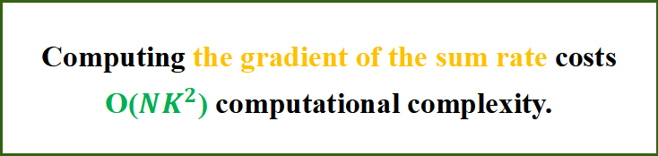
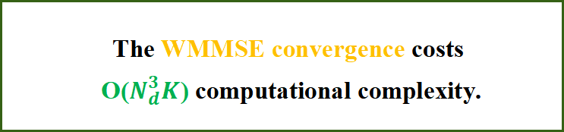
1 Background
High Complexity Burden!
in the DMA weights matrix design
in multiple times of WMMSE convergence
Computing the gradient of the sum rate costs O(${NK}^{2}$) computational complexity.
The WMMSE convergence costs
O($N_{d}^{3}K$) computational complexity.
AO/DO for DMA weights matrix and precoding matrix design.
Notes:
Specifically, there exists high complexity burden in the DMA weights matrix design and in multiple times of WMMSE convergence.
Therefore, we investigate the designs of DMA weights matrix and precoding matrix based on strategies of alternating optimization (or AO) and decoupling optimization (or DO) to achieve array gains with reduced complexity.

Slide 5
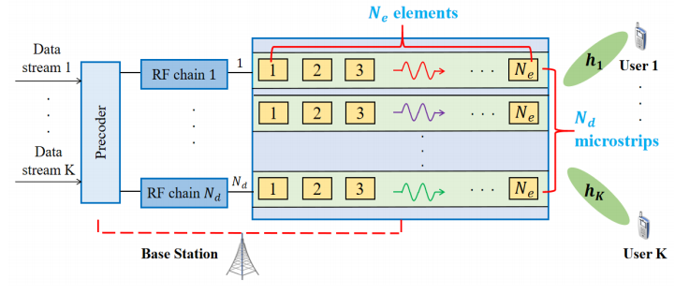


2 System model
A multi-user HMIMO downlink system
System
The BS is equipped with N DMA elements to serve K single-antenna users
Constraint
Notes:
We consider a multi-user HMIMO downlink system. The base station, or BS is equipped N DMA elements with Nd microstrips to serve K single-antenna users. Specifically, the data stream is first precoded by a baseband precoder, and then processed by the DMA before transmitted to the users.
In addition, the block-diagonal matrix of DMA elements follow the Lorentzian constraint as shown, which consists of two parts, the complex constant term and the exponential term containing the tunable and optimizable phase. This constraint is non-convex.

Slide 6


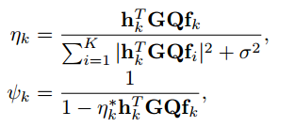


2 System model
The sum-rate is given by:
WMMSE algorithm for precoding matrix in AO
The cost function of DMA weights matrix in AO
Notes:
1 order?
The goal of HMIMO beamforming is to maximizee the sum rate. And the received SINR of the k-th user is given by this formula, where \omega_k \leq 1 indicates the priority of user k
Based on it, the sum rate is given.
In particular, the DMA weights matrix Q and precoding matrix F are alternatingly optimized.
On one hand with the fixed weights matrix Q, we adopt the classsical weighted minimum mean-square error, or WMMSE, algorithm for precoding matrix.
On the other hand, with the fixed precoding matrix F, the optimization problem of DMA weights matrix Q is shown here, with the cost function as optimization objective.
This leads to the alternating optimization, or AO, strategy.
However, computing the gradient of the cost function costs O(NK^2) computational complexity,
which results in high complexity burden.

Slide 7





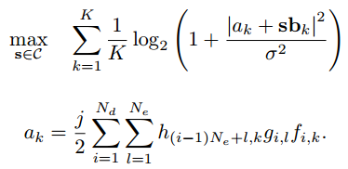




3 DMA weights matrix and precoding matrix AO strategy
For lower complexity cost
For better DMA weights matrix
Get rid of the inter-user interference in DMA weights matrix design
Based on the equal gain transmission (EGT) method,
${|a_{k}+sb_{k}|}^{2}$can be maximized when each term of
keeps the same phase with $a_{k}$:
How to seek for better Q with lower complexity cost?
By dividing the Lorentzian constraint of Q
into the unit-modulus constraint
To be more specific, $sb_{k}$ aims to be
The DMA weights matrix design can be formulated as
To minimize the difference between $sb_{k}$ and $t_{k}$ for all k, we put forward:
Notes:
For our proposed AO strategy, with fixed precoding matrix F, we aim to seek for better Q with lower complexity cost.
In this stage, we focus on maximizing the array gain. Firstly, we get rid of the inter-user interference and left it to be eliminated by WMMSE when optimizing F, and assume that each user has equal priority.
Then by dividing the Lorentzian constraint of Q into the unit-modulus constraint, the DMA weights matrix design can be formulated as this, the original optimization problem for Q is equivalent to optimizing an auxiliary vector s with unit-modulus constraint, and bk is another auxiliary vector containing channel information. This simplity complicated matrix multiplications to simple vector inner-product. Which help reduce the complexity.
For better DMA weights matrix design, based on the equal gain transmission method, we put forward the goal shown as this.
According to cauchy-schwarz inequality, the nominator is maximized if and only if each term of the following summation keeps the same phase as a_k.
However, since s is common for all k, only few items of (13) can be fulfilled at the same time.
Therefore, we we approximate the problem by the minimizing the difference between sb_k and the iedal t_k for all k, we put forward the novel formula shown as this.

Slide 8
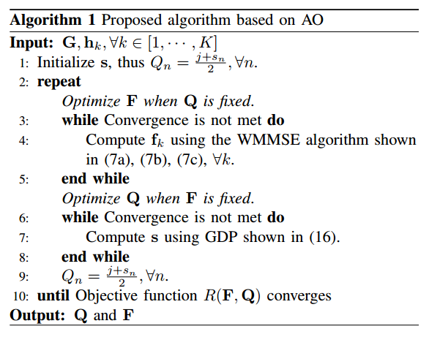
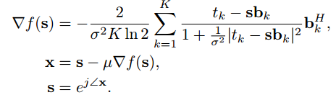
3 DMA weights matrix and precoding matrix AO strategy
GDP method for DMA weights matrix
Proposed algorithm based on AO strategy
The computationally efficient GDP can be applied
How to solve the novel formula?
Because the cost function has Lipschitz continuous gradient, the convergence can be guaranteed.
To speed up convergence, a better initial value is presented.
Notes:
Then we consider how to solve the novel formula. The computationally efficient gradient descend projection (or GDP) can be applied here with the following process.
Because the cost function has Lipschitz continuous gradient, the convergence can be guaranteed.
And a better initial value is presented to speed up the convergence instead of using random initialization.
After designing the weights matrix Q, we fix it, and precoding matrix F can be updated by WMMSE as shown earlier until convergence. Then the DMA weights matrix Q and the precoding matrix F are alternatingly optimized until the objective function of sum-rate converges.
Finally, the proposed algorithm based on AO strategy is summarized on the right side.

Slide 9
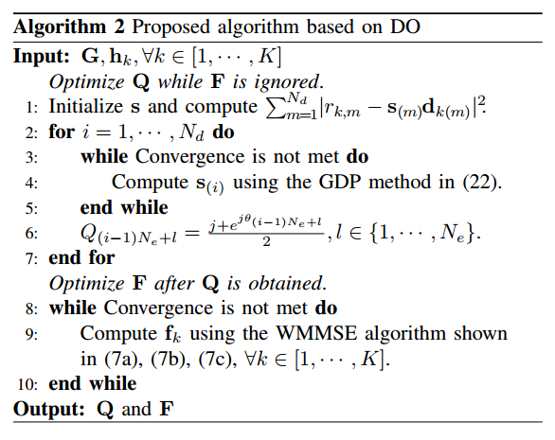



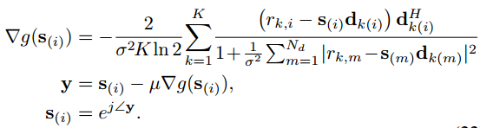
4 DMA weights matrix and precoding matrix DO strategy
DMA weights matrix design in DO
Proposed algorithm based on DO strategy
To avoid multiple times of convergence, DO strategy can be adopted. The design of DMA weights matrix is
How to reduce further complexity?
To harvest array gain, the cost function is given by
The GDP method is given by
Notes:
However, we notice that the outer loop of AO incurs high complexity, so we explore how to reduce complexity. To avoid multiple times of convergence, decoupling optimization, or DO strategy can be adopted. We modified the cost function so that it harvest array gains independent from the precoding matrix. With similar transformation, GDP method can also be employed to solve the weights matrix.
When Q is fixed, the precoding matrix is designed through the WMMSE method.
Finally, the proposed algorithm based on DO strategy is summarized here.

Slide 10
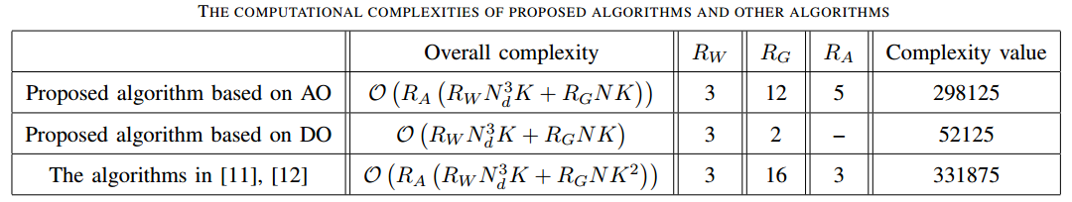




4 Complexity analysis
Complexity cost in AO algorithms
Proposed algorithm based on DO strategy
To optimize precoding matrix, the AO algorithms all adopt WMMSE with complexity of O($R_{W}N_{d}^{3}K$).
To optimize precoding matrix, the DO algorithm adopt WMMSE with complexity of O($R_{W}N_{d}^{3}K$).
How to judge complexity cost reduction?
To optimize DMA weights matrix, the complexity
of GDP is given by O($R_{G}NK$), while other schemes have O($R_{G}NK^{2}$) complexity cost.
To optimize DMA weights matrix, GDP is adopted for $N_{d}$times to get each $s_{(i)}$, and its complexity is O($R_{G}NK$).
Notes:
Now, we analyze the computational complexities. To optimize precoding matrix, the DO algorithm and AO algorithms all adopt WMMSE with complexity of O(R_WN_d^3K).
To optimize DMA weights matrix, the complexities of GDP in AO and DO are both given by O(R_G N K), while other schemes in AO have O(R_G N K^2) complexity cost, this is the main reason for the complexity reduction achieved in our work. When considering various HMIMO system, the computational complexities are shown here.

Slide 11
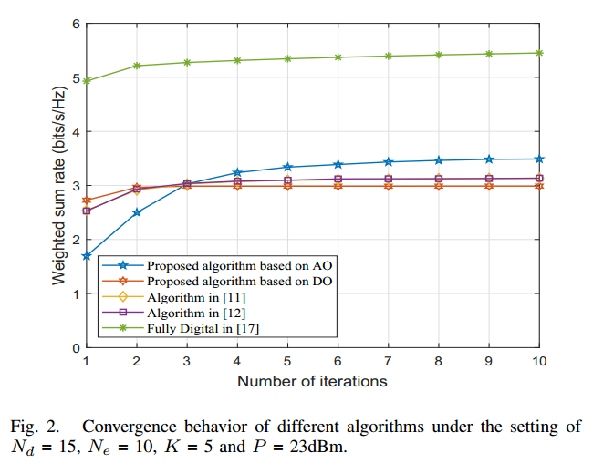
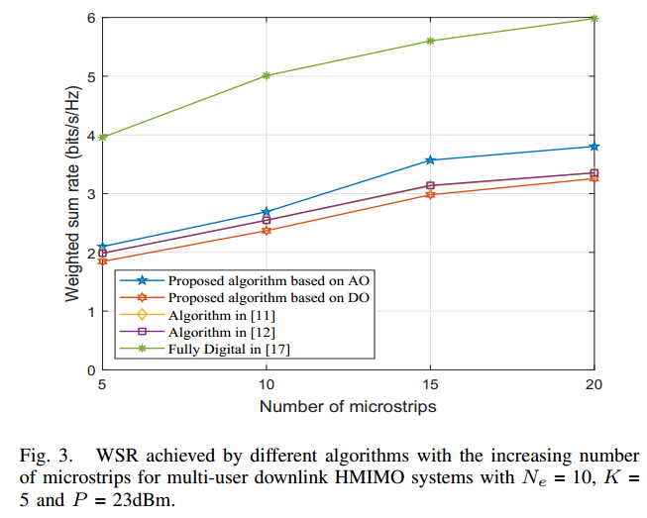
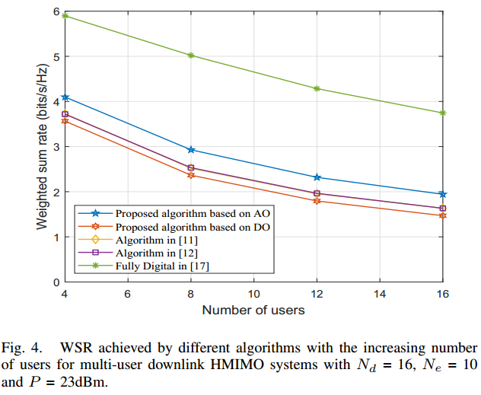
5 Simulations
The proposed algorithm based on AO always achieves higher sum rate with lower complexity.
With larger DMA array size, the advantage is more obvious.
Even under high inter-user interference situation, it still remains more excellent.
The proposed algorithm based on DO achieves trade-off between performance and complexity.
The FD architecture can attain the highest sum rate, but it suffers expensive RF chain hardware cost.
Notes:
Finally, we compare the sum rate achieved by the proposed algorithms with other
algorithms.
We observe that the proposed algorithm based on AO always achieves higher sum rate with lower complexity. And the advantage is more obvious with larger DMA array size, characterized by the increasing number of microstrips. Even under high inter-user interference, the AO scheme still achieves better performance.
Besides, the proposed algorithm based on DO achieves trade-off between performance and complexity.

Slide 12
Thank you for your watching
Yuanli Ma, Bin Yan, Zheng Wang, Yongming Huang
Southeast University
2025.10.16
Notes:
In this paper we focus on DMA weights matrix design and precoding matrix design in AO and DO strategy to maximize sum rate in the downlink multi-user HMIMO system. Specifically, these two matrices can be alternatively designed in AO.
Based on it, we propose novel problem formulation of the DMA weights matrix design to harvest array gain, which can be solved with reduced complexity.
To achieve performance and complexity trade-off, an algorithm based on DO is also proposed, in which the DMA weights matrix is optimized independently from the precoding matrix. Finally, simulation results confirm the advantages of the proposed algorithms on
That’s all for this presentation, thanks for your kind attention.

