Slide 1

The WMMSE Algorithm Based on BFGS Quasi-Newton Method in Massive MIMO Systems
Yuhuan Zhao¹ , Bin Yan¹ , Zheng Wang¹ , Yongming Huang¹ and Qingjiang Shi²
¹School of Information Science and Engineering, Southeast University, Nanjing, China
²School of Software Engineering, Tongji University, Shanghai, China
Presented by: Bin Yan (bin yan @seu.edu.cn)
Notes:
Good morning everyone. Thank you for attending my presentation.
Today, I will present our work entitled “The WMMSE Algorithm Based on BFGS Quasi-Newton Method in Massive MIMO Systems.”
约 20 秒

Slide 2

Contents
01
Introduction
02
System model
03
The WMMSE-BFGS algorithm
04
Complexity reduction of the WMMSE-BFGS algorithm
05
Complexity analysis & Simulations
Notes:
Here is the outline of my presentation, which consists of five parts.
约 10秒

Slide 3
1. Introduction
The sum rate of the downlink massive MIMO systems
The celebrated WMMSE algorithm tries to solve the constrained weighted sum rate (WSR) maximization problem via block coordinate descent (BCD) method.
By making use of the full power property, the constrained WSR maximization problem can be transformed into an equivalent unconstrained problem.
The main problem of WMMSE
The computational complexity of WMMSE grows cubically, which becomes unaffordable with the rapid increment of the number of the transmit antennas.
Notes:
First, let me introduce the motivation.
Weighted sum-rate maximization is an important problem in downlink massive MIMO systems.
The classical WMMSE algorithm solves the constrained WSR maximization problem by using BCD method.
By using the full power property, the constrained WSR problem can be transformed into an equivalent unconstrained problem.
However, the main bottleneck is computational complexity.
In WMMSE, the precoder update involves matrix inversion, and the complexity grows cubically with the number of transmit antennas.
Therefore, when the number of antennas becomes large, the complexity becomes unaffordable.
This motivates us to design a lower-complexity WMMSE algorithm for massive MIMO systems.
约70秒

Slide 4
1. Introduction
The proposed WMMSE-BFGS algorithm
Works for massive MIMO and guarantees convergence
Low complexity
The generalized Broyden-Fletcher-Goldfarb-Shanno (BFGS) quasi-Newton method is adopted into the WMMSE algorithm
Complexity of the proposed WMMSE-BFGS algorithm scales linearly with respect to the number of transmit antennas
Notes:
To address this problem, we propose the WMMSE-BFGS algorithm, which has two main advantages.
First, it works for massive MIMO systems and guarantees convergence.
Second, the complexity of WMMSE-BFGS scales linearly with the number of transmit antennas, which makes it more practical for large-scale antenna systems.
约 35秒

Slide 5
2. System model
A downlink massive MIMO system
The equivalent MSE minimization problem
The WSR maximization problem
The MSE matrix of user k is
Notes:
Now, let me introduce the system model and problem formulation.
We consider a downlink massive MIMO system.
Based on this model, we formulate the WSR maximization problem.
The objective is to maximize the system WSR under the total transmit power constraint.
However, this problem is non-convex and difficult to solve directly.
Therefore, it is transformed into an equivalent MSE minimization problem.
This equivalent problem is unconstrained and is convex with respect to each variable Uk, Wk and Vk when the other variables are fixed.
约 1分10秒

Slide 6
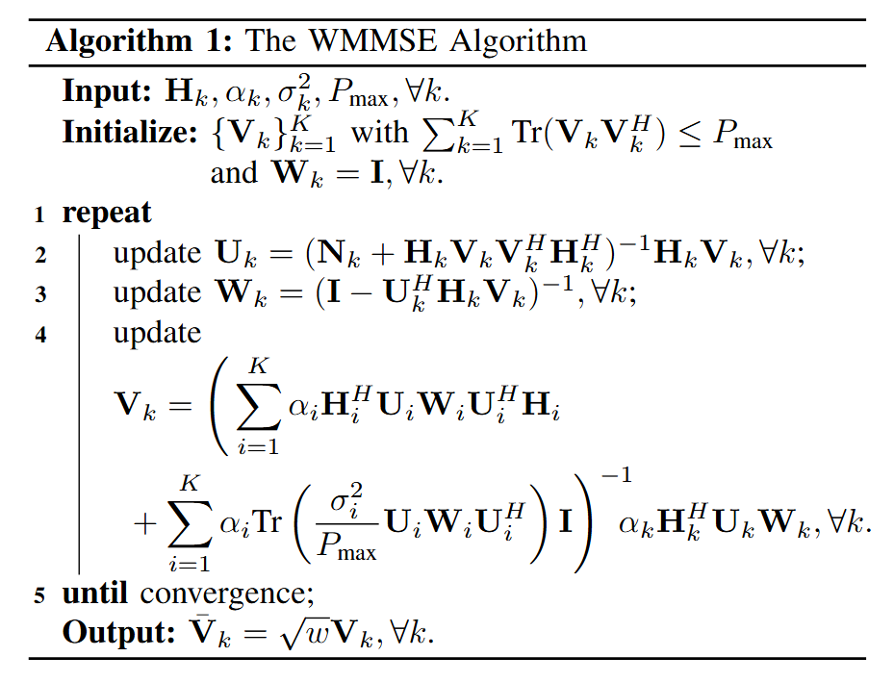
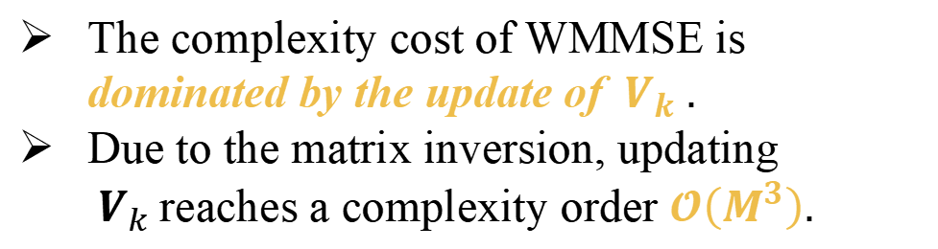
2. System model
The WMMSE Algorithm
The complexity cost of WMMSE is dominated by the update of ${ V}_{k} .$
Due to the matrix inversion, updating ${ V}_{k}$reaches a complexity order $𝓞\left(M^{3}\right).$
Notes:
The classic WMMSE can be applied to address it, which employs the BCD method to sequentially update variables Uk, Wk and Vk by fixing the other two variables.
However, the complexity of WMMSE is dominated by the update of Vk.
This is because the closed-form solution of Vk contains a matrix inversion, which leads to cubic complexity in M.
Therefore, the main problem of WMMSE lies in the precoder update.
约 55秒

Slide 7
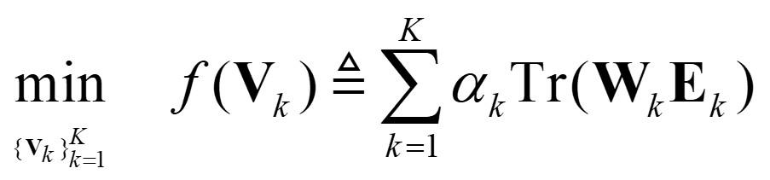
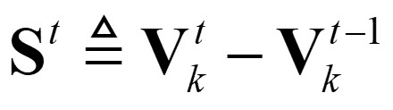
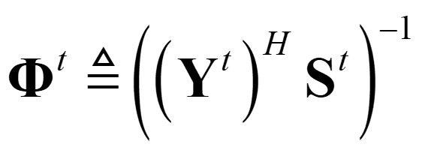
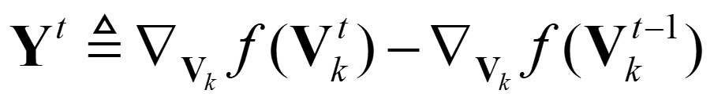
3. The WMMSE-BFGS algorithm
In WMMSE, by fixing variables $U_{k}$and $W_{k}$, the optimization problem with respect to $V_{k}$ turns out to be
Goal: Solve the subproblem with lower complexity
The traditional Newton method for seeking works iteratively by
The generalized BFGS quasi-Newton method to solve this subproblem by
：the gradient
： the positive definite Hessian matrix
To bypass the costly computation of and its inverse
Notes:
Our method still follows the WMMSE framework, but solves this subproblem with lower complexity.
A traditional Newton method is introduced.
It updates Vk using the gradient and the inverse Hessian.
However, the Hessian and its inverse are still expensive to compute for massive MIMO systems.
To bypass the costly computation, we introduce the generalized BFGS quasi-Newton method, which constructs an inverse approximation matrix G^t directly.
约 1分10秒

Slide 8
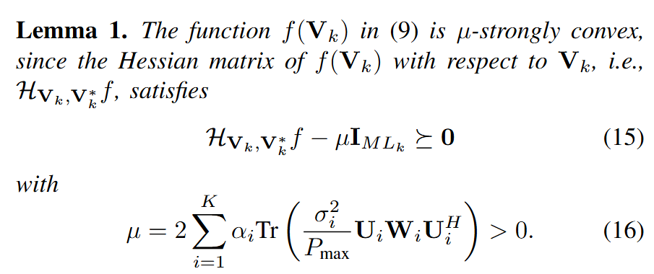
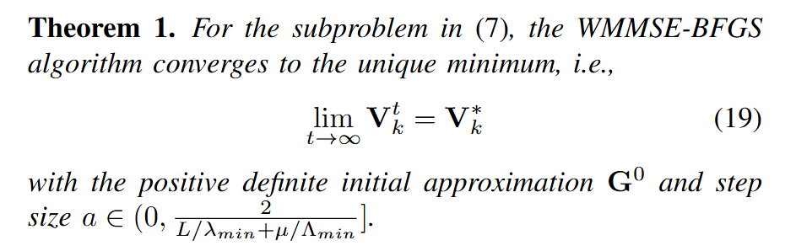
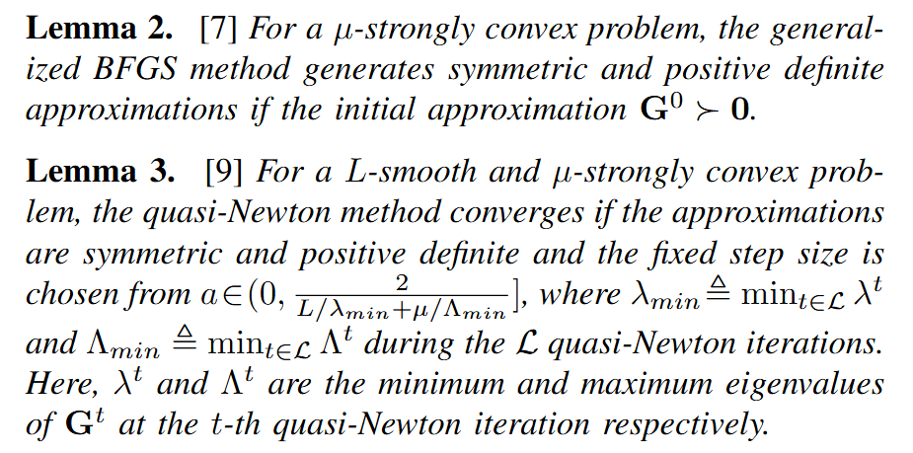
3. The WMMSE-BFGS algorithm
Convergent or not?
Notes:
Next, we analyze the convergence.
First, the objective function with respect to Vk is strongly convex.
Second, for a strongly convex problem, the generalized BFGS method can keep the approximation matrix Gt symmetric and positive definite, as long as the initial matrix is positive definite.
Based on these lemmas, with a properly selected step size, the WMMSE-BFGS update can converge to the unique minimum of the precoder subproblem.
约 55秒

Slide 9
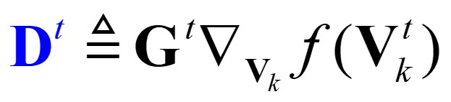

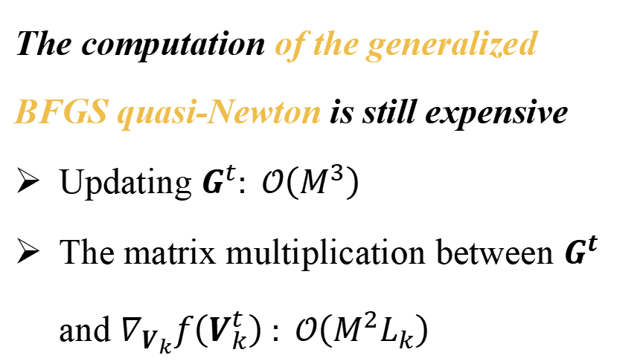
4. Complexity reduction of the WMMSE-BFGS algorithm
Key:
Only need the quasi-Newton direction:
The computation of the generalized BFGS quasi-Newton is still expensive
Updating $G^{t}: 𝒪\left(M^{3}\right)$
The matrix multiplication between $G^{t}$ and $∇_{V_{k}}f\left(V_{k}^{t}\right) : 𝒪\left(M^{2}L_{k}\right)$
Compute${ D}^{t}$ directly instead of explicitly forming${ G}^{t}$
Notes:
Although generalized BFGS avoids computing the Hessian inverse, it is still expensive.
Specifically, explicitly updating the approximation matrix G^t requires cubic complexity in M, and the multiplication between G^t and the gradient also brings additional computational cost.
However, we do not actually need the full matrix G^t.
What we really need is only the quasi-Newton direction.
Therefore, the key idea is to compute D^t directly instead of explicitly forming G^t.
约 1分钟

Slide 10
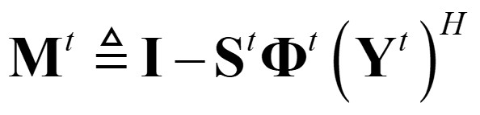
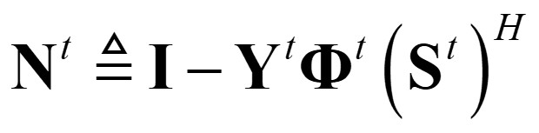
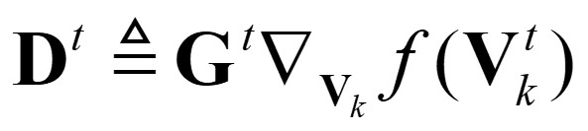

4. Complexity reduction of the WMMSE-BFGS algorithm
Define
The complexity order of computing $D^{t}$ is reduced to$𝒪\left(M^{2}L_{k}\right).$
Notes:
Starting from the generalized BFGS update, we first rewrite Gt using two auxiliary matrices, M^t and N^t.
Then, by recursively substituting the expression of G^t, the direction D^t can be expanded into the product form.
By using this reformulation, the complexity order of computing D^t can be reduced to big O of M squared times L k
约 55秒

Slide 11
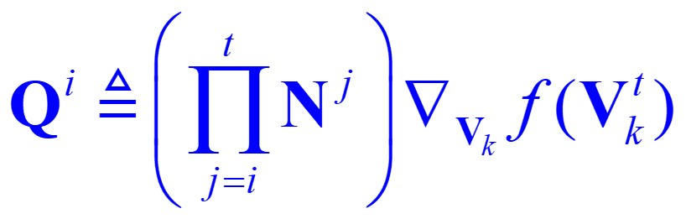
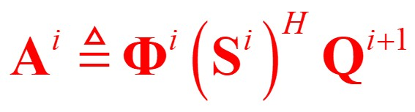
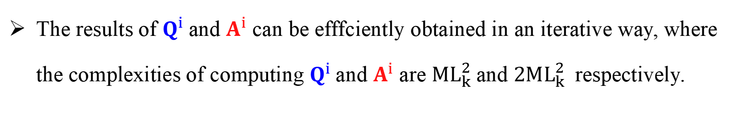

4. Complexity reduction of the WMMSE-BFGS algorithm
Step 1: $Q^{i}$and $A^{i}$
Define
Recursion
The results of $Q^{i}$and $A^{i}$ can be efffciently obtained in an iterative way, where the complexities of computing $Q^{i}$and $A^{i}$ are $ML_{k}^{2}$and $2ML_{k}^{2}$respectively.
Notes:
To further reduce the complexity, we observe that the expression of (D^t) contains repeated product terms involving N^j.
To avoid this repeated computation, we introduce two auxiliary variables, Q^i and A^i.
With these definitions, Qi can be updated recursively from Q^{i+1} and A^i .
In other words, the results of Q^i and A^i can be efficiently obtained in an iterative way,
where the complexities of computing Q^i and A^i are ML_k^2 (M times L sub k squared) and 2ML_k^2 (M times L sub k squared) respectively.
约 55秒

Slide 12
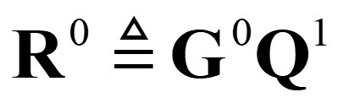
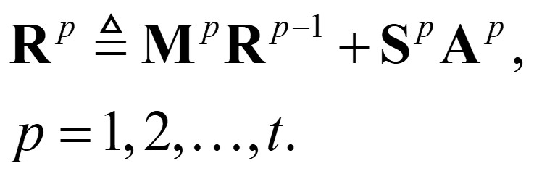


4. Complexity reduction of the WMMSE-BFGS algorithm
Interestingly, $D^{t}$ can be directly obtained by the computation of $R^{t}$ , which can be iteratively calculated with a more efficient formulation as
Step 2: $R^{p}$
Define
Notes:
After obtaining Qi and Ai , we still need to handle the remaining product terms involving M^j.
For this purpose, we introduce another auxiliary variable, R^p.
It starts from the initial value R^0, and then updates recursively by using the previous value R^{p−1} and the term S^pA^p.
The key result is that the quasi-Newton direction D^t can be directly obtained by the computation of $R^{t}$, which can be iteratively calculated with a more efficient formulation.
约 50秒

Slide 13
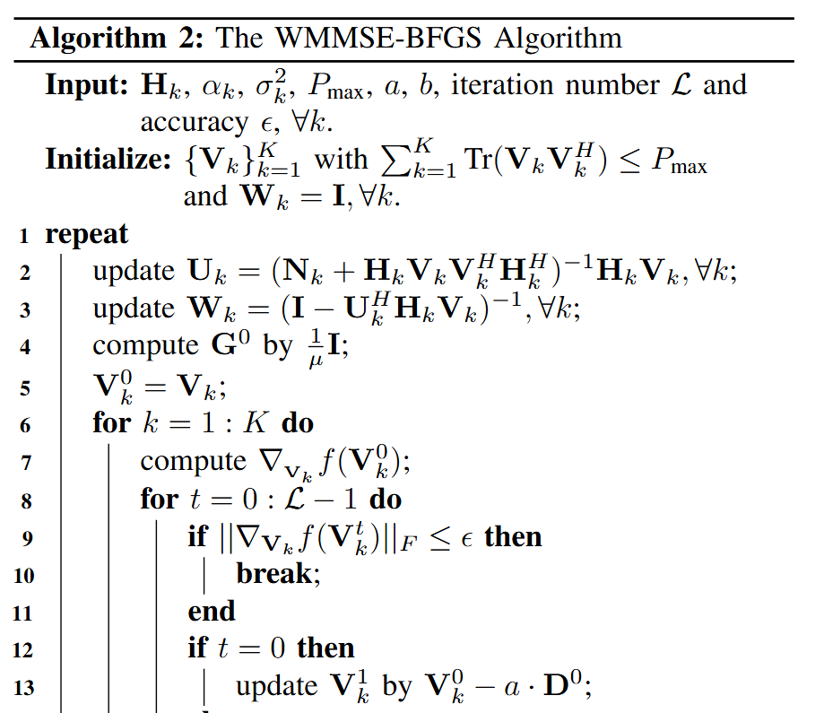
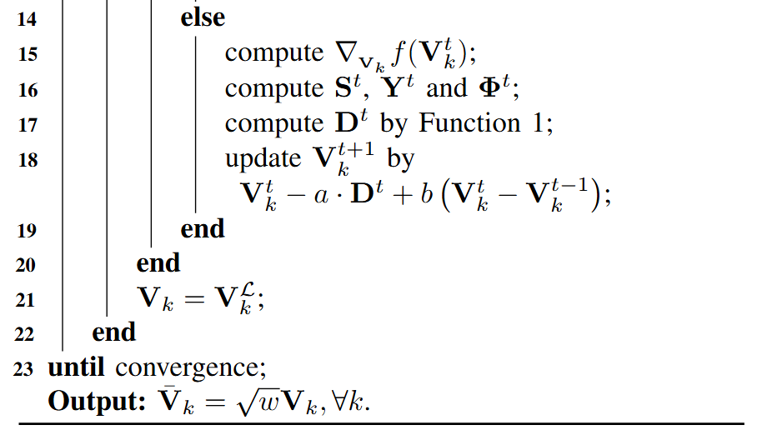
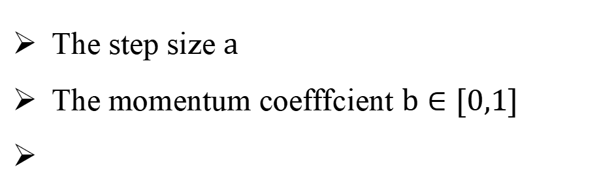
4. Complexity reduction of the WMMSE-BFGS algorithm
A more accurate initial approximation
A momentum variant
The step size $a$
The momentum coefffcient $b∈[0,1]$
Notes:
This slide summarizes the proposed WMMSE-BFGS algorithm.
To further improve the performance of WMMSE-BFGS and accelerate its convergence,
we introduce two additional improvements: a more accurate initial approximation matrix and a momentum variant for the precoder update.
约 45秒

Slide 14
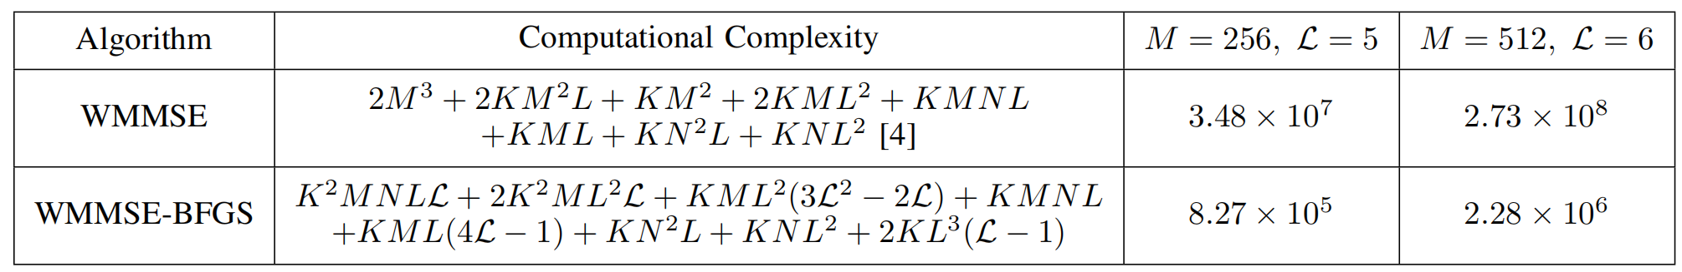
5. Complexity analysis & Simulations
The computational complexity of WMMSE-BFGS and WMMSE in a BCD iteration.
For simplicity, we assume and .
The overall computation of in Function1 needs multiplications.
Moreover, the computation of requires multiplications.
The complexities of updating in and in are multiplications.
Besides, the computation of in requires multiplications, while in requires aaaaaaaaaaaaa multiplications.
Notes:
Now, we analyze the computational complexity of the proposed WMMSE-BFGS algorithm.
For simplicity, we assume that all users have the same number of data streams and receive antennas, that is, Lk=L and Nk=N.
The detailed complexity expressions are listed in the table.
For WMMSE-BFGS, the complexity scales only linearly with M.
As shown in the table, this reduces the overall complexity by roughly two orders of magnitude compared with WMMSE.
约 1分10秒

Slide 15
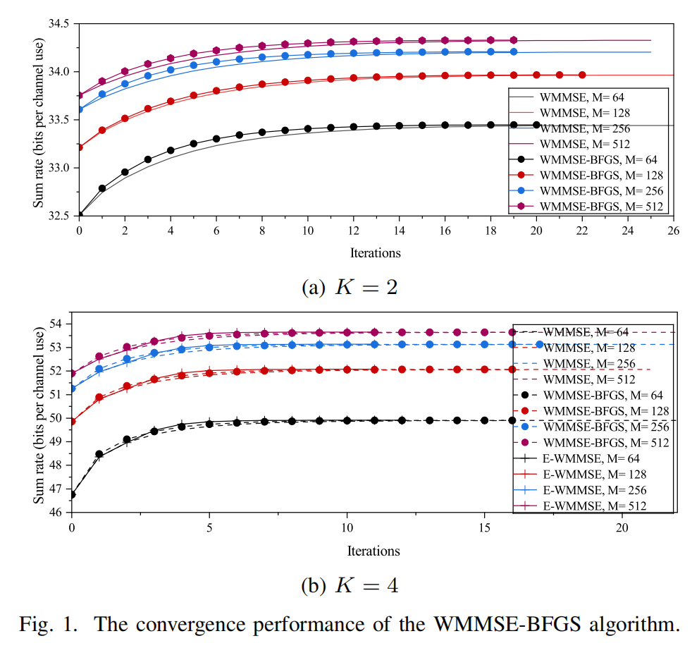
5. Complexity analysis & Simulations
From Fig.1, WMMSE-BFGS requires fewer iterations when reaches the same WSR.
Based on the comparison of numerical complexity in Table I, WMMSE-BFGS achieves a reduction in complexity relative to WMMSE.
Notes:
Finally, we evaluate the convergence performance.
This figure compares WMMSE-BFGS with WMMSE under different numbers of transmit antennas.
Specifically, the upper subfigure shows the case with K=2 users, and the lower subfigure shows the case with K=4 users.
From the curves, we can see that WMMSE-BFGS achieves competitive performance compared to the classic WMMSE.
More importantly, it reaches the same WSR with fewer iterations.
Together with the complexity comparison, these results show that WMMSE-BFGS achieves a reduction in complexity while maintaining competitive performance.
约 70s

Slide 16
THANK YOU
Yuhuan Zhao¹ , Bin Yan¹ , Zheng Wang¹ , Yongming Huang¹ and Qingjiang Shi²
¹School of Information Science and Engineering, Southeast University, Nanjing, China
²School of Software Engineering, Tongji University, Shanghai, China
Presented by: Bin Yan (bin yan @seu.edu.cn)
Notes:
In summary, we proposed a low-complexity WMMSE-BFGS algorithm for downlink massive MIMO systems.
Thank you very much for your attention.
I would be happy to take any questions.
约 25秒

