Slide 1



Smooth Penalty Detection Methods for Quantized and Distributed Massive MIMO Systems
Qiqiang Chen¹, Zheng Wang¹, Yongming Huang¹, and Tony Q. S. Quek²
¹Southeast University, Nanjing, China
²Singapore University of Technology and Design, , Singapore
2026-06-10
Notes:
20 seconds. Good afternoon, everyone. It is my great honor to present our work entitled "Smooth Penalty Detection Methods for Quantized and Distributed Massive MIMO Systems."
This work was completed by Qiqiang Chen, Zheng Wang, Yongming Huang, and Tony Q. S. Quek.
In this talk, I will focus on how smooth penalty modeling can be used to design efficient detectors for low-resolution and distributed massive MIMO systems.

Slide 2
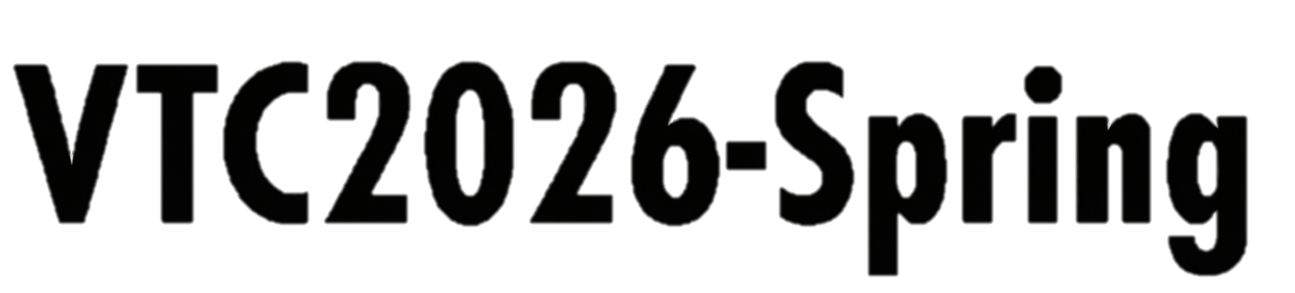

Contents
01
Background & System Model
02
Distributed Homotopy Penalty Detection (HPD)
03
Distributed Fusion Penalty Detection Network (FPD-Net)
04
Numerical Results
Notes:
25 seconds. The presentation is organized into four parts.
First, I will introduce the background and the system model, including low-resolution quantization and distributed baseband processing.
Second, I will present the distributed homotopy penalty detection algorithm, or HPD.
Third, I will introduce the distributed fusion penalty detection network, or FPD-Net.
Finally, I will show the numerical results and conclude the presentation.

Slide 3
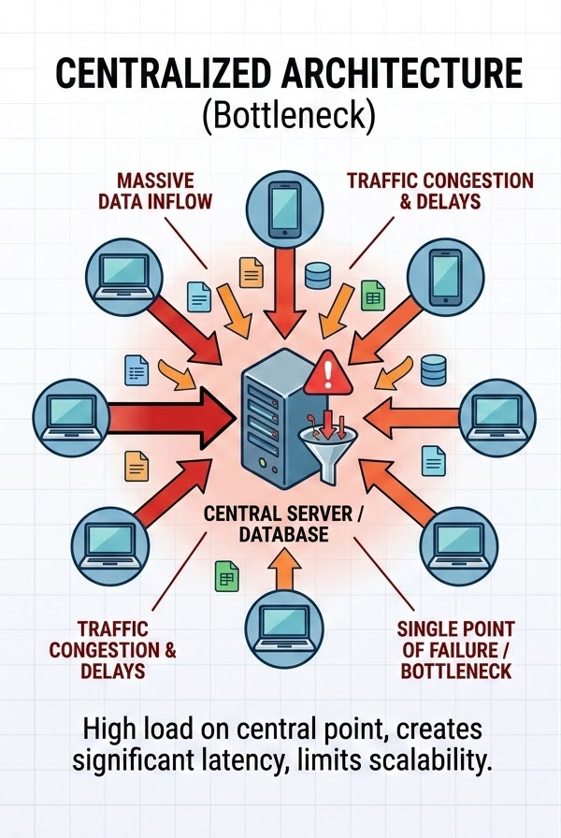
1 Background & System Model
Development of MIMO Technology
With the evolution toward B5G and 6G wireless communication systems:
Base stations (BSs) are equipped with increasingly many antennas, even more than 256.
This significantly enhances capacity and spectral efficiency.
Challenges towards MIMO evolution
Increased power consumption: The power consumption of ADCs grows exponentially with the number of quantization bits.
Unaffordable interconnection bandwidth: The large volume of raw data may exceed existing hardware capabilities.
Notes:
60 seconds. Let me start with the background.
Massive MIMO is an important technology for B5G and 6G systems because deploying more antennas at the base station can significantly improve capacity and spectral efficiency.
However, as the number of antennas grows to hundreds, the receiver also faces two practical challenges.
The first one is power consumption. In particular, the power consumption of high-resolution ADCs increases rapidly with the number of quantization bits.
The second one is the interconnection bottleneck. If all raw baseband data are transferred to a centralized processing unit, the required bandwidth and processing load may become unaffordable.
Therefore, low-resolution quantization and distributed processing are natural solutions for scalable massive MIMO receivers.

Slide 4
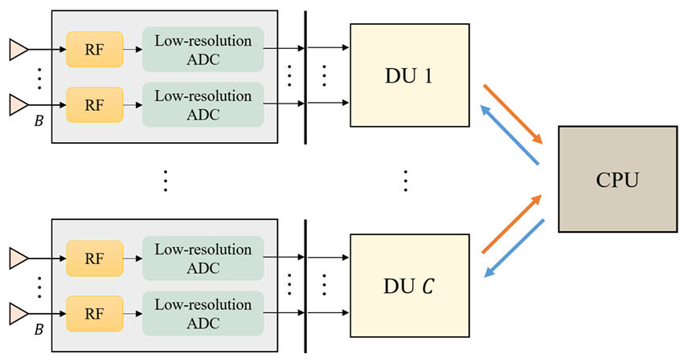
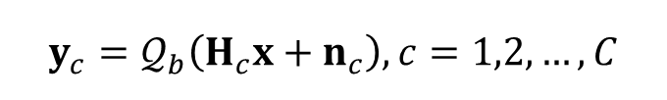
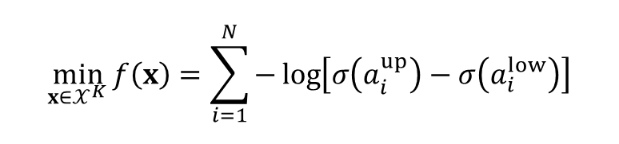
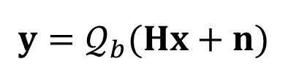
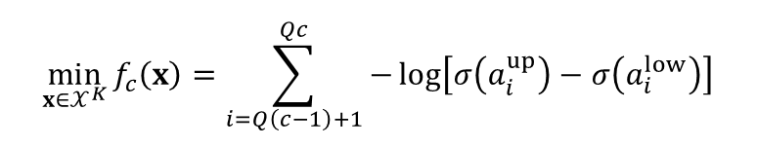
1 Background & System Model
Quantized and Distributed Architecture
Low-resolution ADC: 1-3 bits ADCs significantly reduce hardware cost and power consumption.
Distributed baseband processing (DBP): The DBP architecture can distribute the computational load and reduce the interconnection bandwidth.
Real-Valued MIMO System and ML Detection
Fig. 1. Quantized and distributed MIMO architecture
$$y=𝒬_{b}(Hx+n)$$
Distributed Processing
$$y_{c}=𝒬_{b}\left(H_{c}x+n_{c}\right), c=1,2,…,C$$
$$\min_{x∈𝒳^{K}}{f\left(x\right)=\sum_{i=1}^{N}{−\log\left[σ\left(a_{i}^{up}\right)−σ\left(a_{i}^{low}\right)\right]}}$$
$$\min_{x∈𝒳^{K}}{f_{c}\left(x\right)=\sum_{i=Q\left(c−1\right)+1}^{Qc}{−\log\left[σ\left(a_{i}^{up}\right)−σ\left(a_{i}^{low}\right)\right]}}$$
Notes:
75 seconds. This slide shows the considered quantized and distributed massive MIMO architecture.
On the hardware side, low-resolution ADCs, typically with one to three bits, are used to reduce power consumption and hardware cost.
On the processing side, decentralized baseband processing partitions the base station antennas into several distributed units, or DUs. Each DU processes its own local received signal and exchanges only low-dimensional information with the CPU.
Mathematically, after converting the complex-valued model into a real-valued representation, the received vector is written as a quantized version of Hx plus noise. The maximum-likelihood detector is then formulated using the quantization thresholds and the sigmoid function.
In the distributed setting, the global likelihood can be decomposed into several local likelihood functions, each corresponding to one DU.
Our objective is to recover the transmitted finite-alphabet vector from quantized observations while keeping both computation and interconnection cost low.

Slide 5
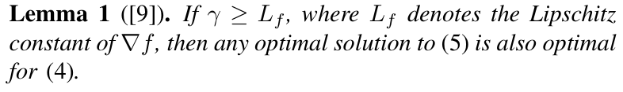
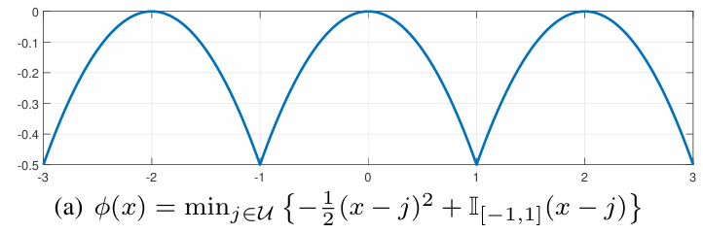

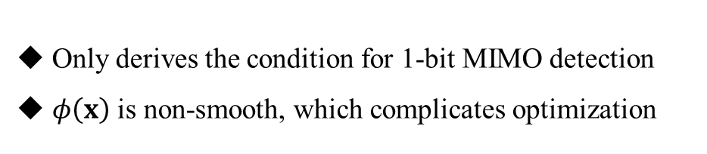

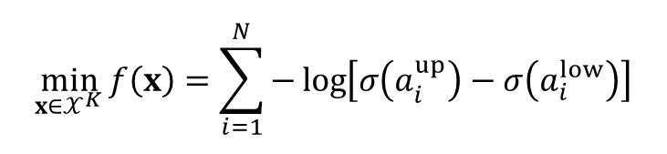
1 Background & System Model
Low-Complexity Requirements
The ML detection problem is NP-hard, and the complexity of brute-force search grows exponentially with K. To avoid exhaustive search, an exact penalty model was proposed in [9] to relax the ML problem into a continuous form.
The ML Problem
$$\min_{x∈𝒳^{K}}{f\left(x\right)=\sum_{i=1}^{N}{−\log\left[σ\left(a_{i}^{up}\right)−σ\left(a_{i}^{low}\right)\right]}}$$
Equivalent Continuous Form (Exact Penalty Model)
$$\min_{x∈{\overline{𝒳}}^{K}}{f\left(x\right)+γφ(x)}$$
Limitations
Only derives the condition for 1-bit MIMO detection
$φ\left(x\right)$ is non-smooth, which complicates optimization
Notes:
Estimated time: 70 seconds. The fundamental benchmark is the ML detection problem shown on the left. It directly searches over the discrete constellation set and is therefore NP-hard. A brute-force search has a complexity that grows exponentially with the number of transmitted symbols. To avoid this exhaustive search, an exact penalty model was previously introduced to transform the discrete ML problem into a continuous penalized form. When the penalty parameter is sufficiently large, the continuous problem is equivalent to the original ML problem. However, there are two limitations. First, the existing exact threshold was derived only for the one-bit MIMO detection case. Second, the exact penalty function is non-smooth, so its gradient is not well-defined everywhere. This makes the resulting problem difficult to optimize and also inconvenient for learning-based implementations. These two issues motivate the proposed smooth penalty detection methods.

Slide 6
1 Background & System Model
Our work: Two efficient detectors for Q&D-MIMO systems
General Exact Penalty Model
General Multi-Term Smoothing Framework
Make the exact penalty model applicable to general multi-bit quantization scenarios
Approximate the non-smooth penalty by multiple smooth terms with asymptotic convergence
Propose homotopy penalty detection (HPD) and fusion penalty detection network (FPD-Net)
Notes:
Estimated time: 45 seconds. Based on the above motivation, our work develops two efficient detectors for quantized and distributed massive MIMO systems. The first contribution is a general exact-penalty model for multi-bit quantization, which extends the equivalence condition beyond the one-bit case. Then, by replacing the non-smooth penalty with a smooth surrogate, we obtain the distributed HPD algorithm for efficient optimization. The second contribution is a general multi-term smoothing framework. It approximates the non-smooth penalty using multiple smooth terms, and the approximation quality is theoretically guaranteed to improve as the number of terms increases. Based on this framework, we further develop FPD-Net, which learns the penalty-related parameters through a deep unfolding structure.

Slide 7
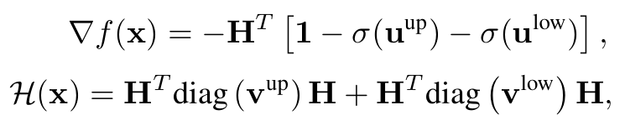
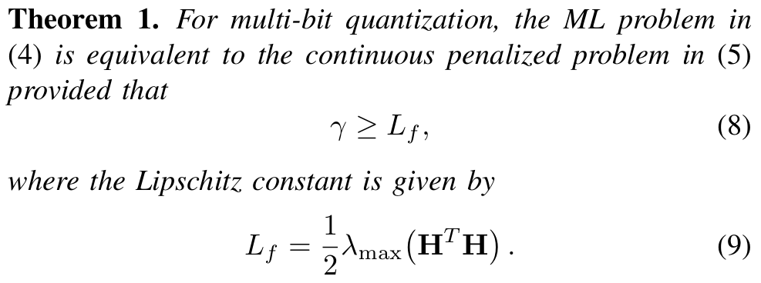
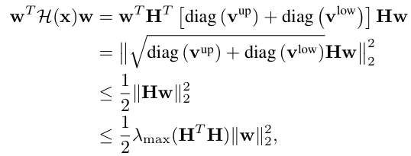
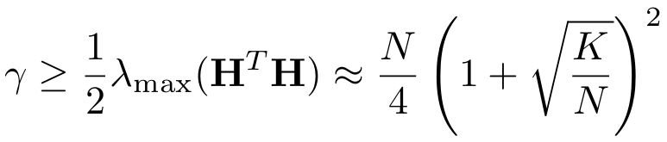
2 The Proposed Distributed HPD Algorithm
General Exact Penalty Model for Multi-bit Quantization
Favorable Properties
Low-Complexity Choice
Breaks the limitation of the 1-bit case
Enables general multi-bit quantization scenarios
Allows different quantizers, including uniform and non-uniform schemes
To avoid costly eigenvalue decomposition, we exploit the channel hardening property and simplify:
Notes:
Estimated time: 70 seconds. I first introduce the general exact-penalty model for multi-bit quantization. The key result is Theorem 1. It states that, for the multi-bit quantized ML problem, the original discrete problem is equivalent to the continuous penalized problem when the penalty parameter is no smaller than the Lipschitz constant of the likelihood gradient. In our analysis, this constant is given by one half of the largest eigenvalue of H transpose H. This result breaks the limitation of the one-bit case and makes the exact-penalty model applicable to general multi-bit quantization scenarios, including both uniform and non-uniform quantizers. Since computing the largest eigenvalue exactly is still costly for large systems, we further exploit the channel hardening property and use a low-complexity approximation for the penalty threshold. This gives a practical way to select the penalty parameter without expensive eigenvalue decomposition.

Slide 8
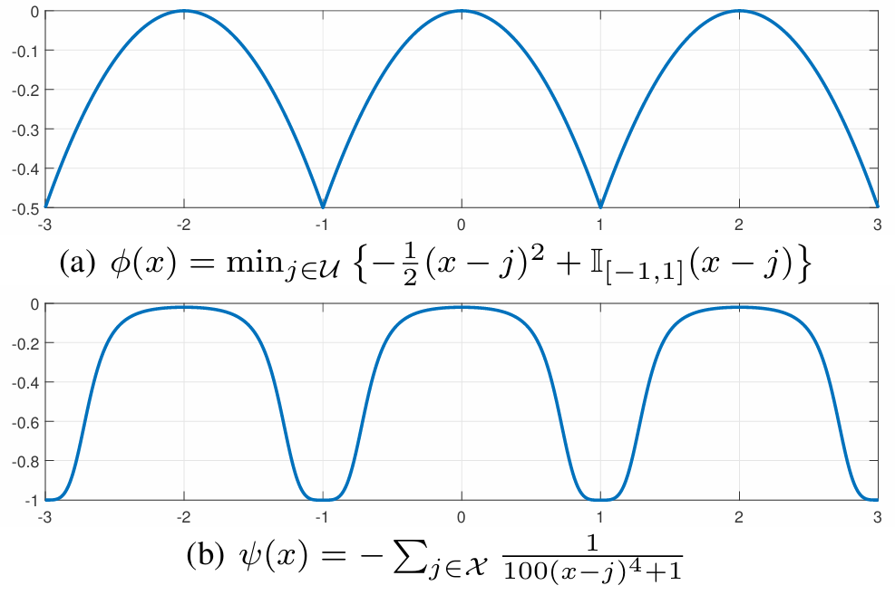
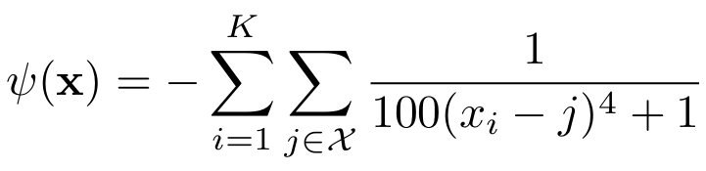
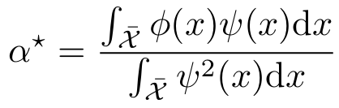
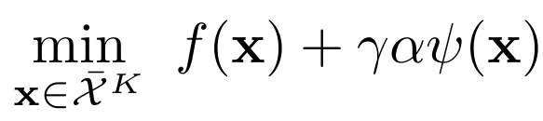
2 The Proposed Distributed HPD Algorithm
Smooth Approximation Of 𝜙(𝐱) For Efficient Optimization
The Exact Penalty
The Smooth Surrogate
with the scaling factor determined by minimizing the approximation mismatch:
Smooth Penalized Detection Problem
Continuous
Smooth
Box-Constrained
Notes:
Estimated time: 70 seconds. Although the exact-penalty model gives an equivalent continuous formulation, the penalty function itself is still non-smooth. To improve computational efficiency, we approximate it by a smooth surrogate. The two curves on the right illustrate the exact penalty and the smooth penalty for a one-dimensional component. Both functions have local minima at the constellation points, so both can encourage the estimate to approach the discrete constellation. The difference is that the smooth surrogate is differentiable, which enables stable gradient-based optimization. The scaling factor alpha is selected by minimizing the approximation mismatch between the exact penalty and the smooth surrogate. As a result, the original discrete ML detection problem is reformulated into a continuous, smooth, and box-constrained detection problem, which can be solved efficiently by the proposed HPD algorithm.

Slide 9
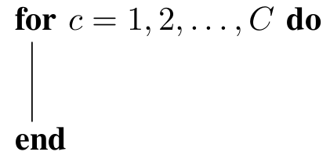
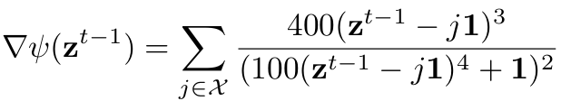

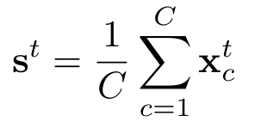
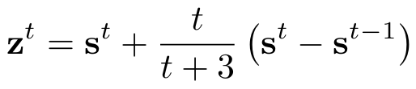


2 The Proposed Distributed HPD Algorithm
Local Update
Parallel Local Updates
Global Update
Upload local estimates to form the global estimate
The equivalent threshold in Theorem 1
Convergence Judgment
Iterations terminate once
Mitigate poor local minima
Otherwise, continue to the next iteration
Notes:
Estimated time: 65 seconds. The HPD algorithm solves the smooth penalized problem in a distributed manner. Because the penalty term makes the problem non-convex, we adopt a homotopy strategy. Instead of using a large penalty parameter from the beginning, the algorithm starts from a small value and gradually increases it along the iterations. This helps trace a better solution path and reduces the risk of poor local minima. In each iteration, every DU computes the local gradient of its likelihood term and the gradient of the smooth penalty, and then updates its local estimate in parallel. These local estimates are uploaded to the CPU and averaged to obtain a global estimate. After that, a momentum step is applied and the new consensus vector is broadcast back to all DUs. The iterations terminate when the penalty parameter reaches the equivalence threshold from Theorem 1 or when the maximum number of iterations is reached.

Slide 10
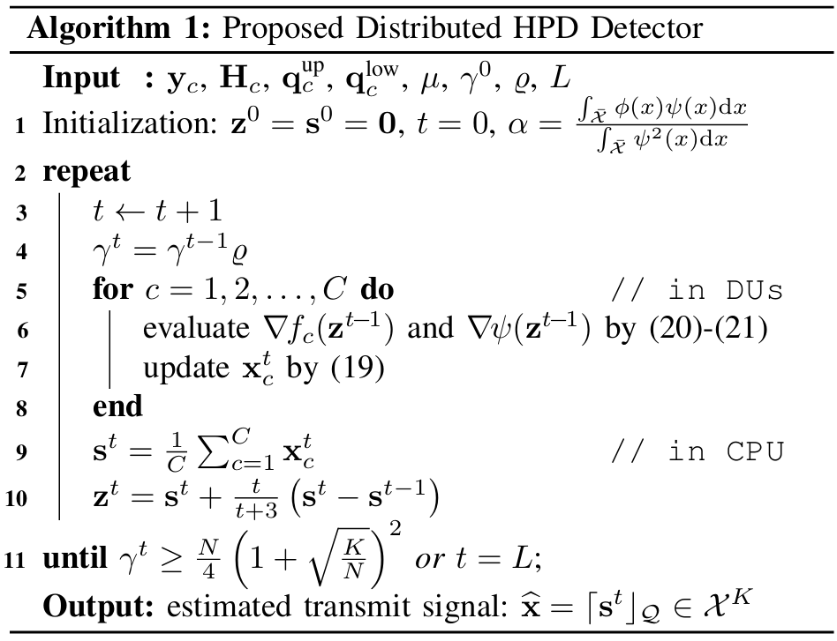



2 The Proposed Distributed HPD Algorithm
Overall Procedure
Computational Complexity Reduction
BMMSE: O($N^{3}$).
HPD: O($NK$).
Low Interconnection Bandwidth
HPD: O($K$).
Notes:
Estimated time: 45 seconds. The overall distributed HPD procedure is summarized in this algorithm. The main advantage is that the algorithm avoids matrix inversion and eigenvalue decomposition during online detection. As shown on the right, the computational complexity of BMMSE is cubic in the system dimension, while the proposed HPD algorithm has linear complexity with respect to N times K. In addition, the interconnection bandwidth is low because each DU only needs to upload a K-dimensional local estimate to the CPU. Therefore, HPD is suitable for distributed baseband processing in large-scale quantized MIMO systems.

Slide 11
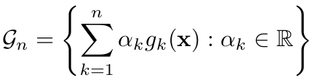
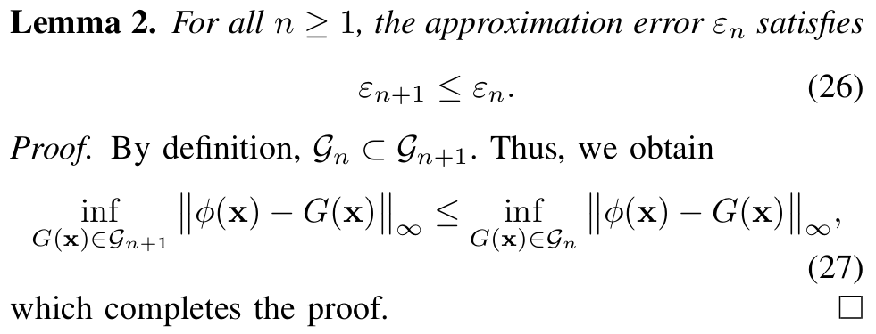


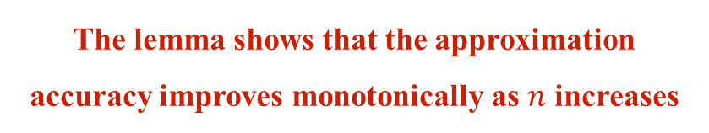
3 The Proposed Distributed FPD-Net Detector
General Multi-Term Smoothing Framework of $φ(x)$
A single smooth penalty may still be too limited to describe the whole constellation landscape. This naturally motivates multi-term smooth modeling to improve the approximation quality of the non-smooth penalty $φ(x)$.
The number of smoothing terms
Linear Combination of a Family of Smooth Functions
Worst-Case Approximation Error
The lemma shows that the approximation accuracy improves monotonically as $n$ increases
Notes:
Estimated time: 60 seconds. Next, I introduce the proposed FPD-Net detector. The motivation is that a single smooth penalty may still be too limited to describe the whole constellation landscape. Therefore, we construct a general multi-term smoothing framework. We use a linear combination of a family of smooth functions to approximate the non-smooth exact penalty. The approximation quality is measured by the worst-case error under the uniform norm. Lemma 2 shows that this approximation error is non-increasing as the number of smoothing terms grows. The reason is intuitive: when more smooth functions are included, the feasible approximation space becomes larger, so the best achievable approximation cannot become worse. This provides the theoretical basis for using multiple smooth penalties.

Slide 12
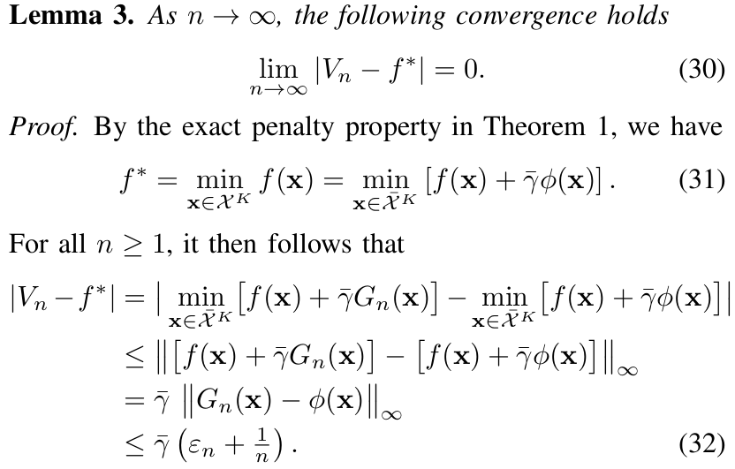
3 The Proposed Distributed FPD-Net Detector
Optimal Value of the Penalized Problem
Can It Converge to ML?
Optimal ML Objective Value
The lemma shows that the ML performance can be asymptotically achieved.
How can we utilize these properties?
Notes:
Estimated time: 45 seconds. Lemma 3 further connects the approximation property with ML detection performance. Here, V_n denotes the optimal value of the smooth penalized problem with n smoothing terms, and f star denotes the optimal objective value of the original ML problem. The lemma shows that, as the number of smoothing terms tends to infinity, the difference between these two values converges to zero. In other words, with a sufficiently rich smooth approximation, the smooth penalized detector can asymptotically achieve the ML objective value. This result motivates us to use a practical finite-term fusion penalty model.

Slide 13
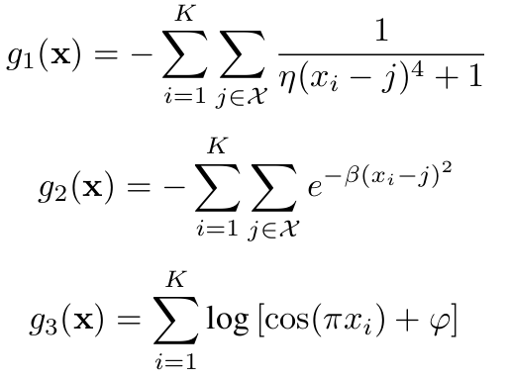
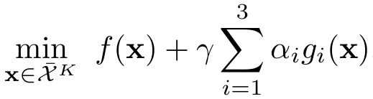
3 The Proposed Distributed FPD-Net Detector
Multi-Term Smoothing Framework for Reduced Approximation Error
The Exact Penalty
Multiple Smooth Penalties
The Smooth Surrogate
Fusion Penalty Detection Problem
Continuous
Smooth
Box-Constrained
Accurate Representation of ML Detection
Requires learnable penalty weights
Notes:
Estimated time: 55 seconds. In practice, we instantiate the multi-term framework by combining three smooth penalties. The first term is a rational quartic penalty, the second is a Gaussian-type penalty, and the third is a log-cosine penalty. These terms have different shapes, but they share the same purpose: their local minima are located at the constellation points. By fusing them, the detector obtains a more accurate representation of the ML-related constellation constraint than a single smooth penalty. However, finding the jointly optimal weights and shape parameters analytically is difficult. Therefore, instead of fixing them manually, we learn these parameters through the subsequent FPD-Net structure.

Slide 14
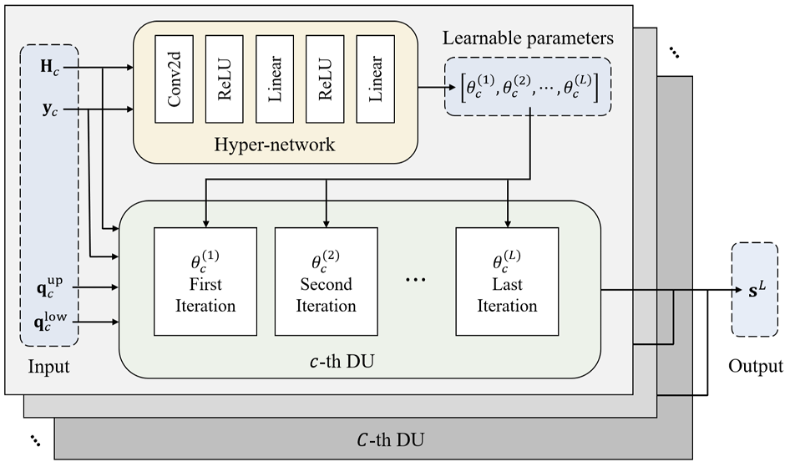
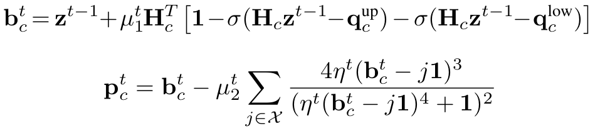

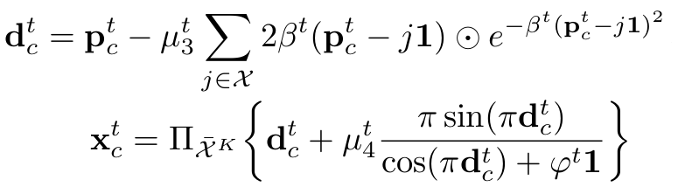

3 The Proposed Distributed FPD-Net Detector
Fusion Penalty Detection Problem
The fusion penalty detection network (FPD-Net) modifies the updates into a sequential form for faster convergence
Training Objective
Notes:
Estimated time: 75 seconds. This slide shows the structure of the proposed distributed FPD-Net detector. Compared with HPD, FPD-Net modifies the update rule into a sequential form. More specifically, each DU first performs a data-likelihood update, and then applies the three penalty-related updates successively. This sequential design makes better use of intermediate variables and can improve convergence. To further enhance adaptability, a hyper-network is introduced. It takes the local channel matrix and received signal as inputs, extracts features through convolutional and fully connected layers, and outputs layer-dependent learnable parameters, including the step sizes and the shape parameters of the penalty functions. The network is trained offline by minimizing the MSE between the final output and the true transmitted vector. During online detection, the trained parameters are used directly, so FPD-Net combines model-based structure with data-driven parameter learning.

Slide 15
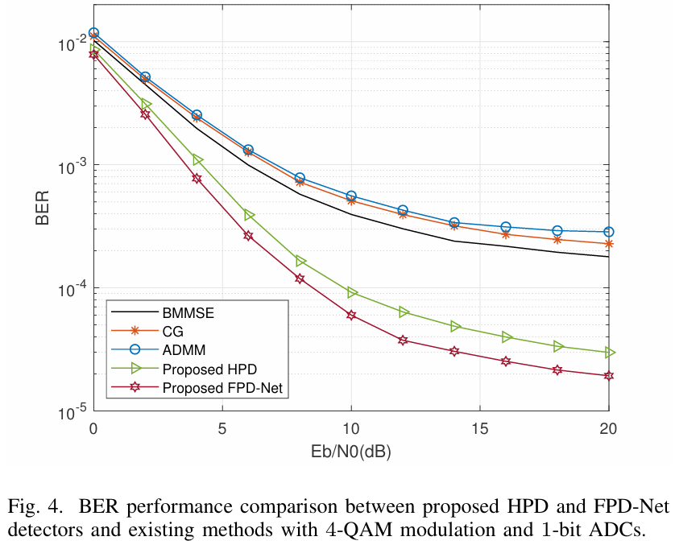
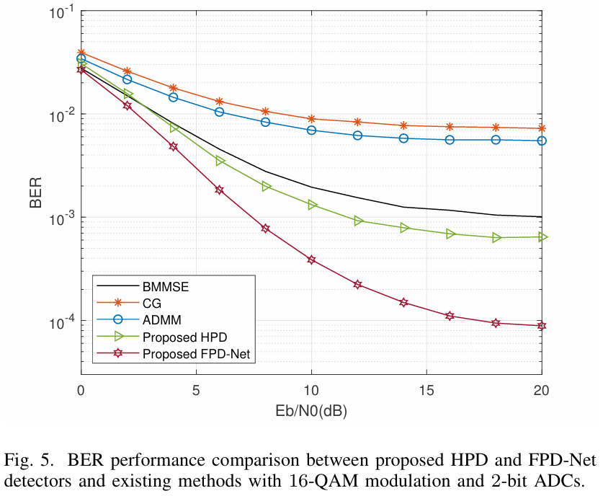
4 Numerical Results
In different modulation and quantization scenarios:
The proposed HPD detector outperforms conventional detectors by achieving lower BER
FPD-Net provides an additional performance gain over HPD and achieves the best detection accuracy
Notes:
Estimated time: 80 seconds. Finally, let us examine the numerical results. In the simulations, the system has 64 receive antennas, 8 transmit antennas, and 4 distributed units. Non-uniform quantizers are adopted, and the maximum number of iterations is set to five for all iterative algorithms. The baselines include centralized BMMSE and decentralized CG and ADMM. The left figure corresponds to 4-QAM modulation with one-bit ADCs. Under this severe quantization condition, CG and ADMM suffer from clear error floors because they are quantization-unaware. The proposed HPD detector achieves lower BER than BMMSE, and FPD-Net further improves the performance. The right figure shows the case with 16-QAM modulation and two-bit ADCs. Although the quantization resolution is higher, the same trend can still be observed. Both HPD and FPD-Net outperform conventional detectors, and FPD-Net achieves the best detection accuracy. These results demonstrate that smooth penalty-based designs can improve detection reliability while maintaining low complexity and low fronthaul bandwidth.

Slide 16
Thank You for Your Attention
Qiqiang Chen¹, Zheng Wang¹, Yongming Huang¹, and Tony Q. S. Quek²
¹Southeast University, Nanjing, China
²Singapore University of Technology and Design, , Singapore
2026-06-10
Notes:
Estimated time: 25 seconds. To conclude, we proposed two efficient detectors for quantized and distributed massive MIMO systems: HPD and FPD-Net. HPD uses a smooth penalty to solve the continuous penalized detection problem with low complexity, while FPD-Net further improves detection performance by learning multi-term penalty parameters through a deep unfolding structure. The numerical results verify the advantages of the proposed methods over conventional detectors. Thank you very much for your attention. I will be happy to take your questions.

