Slide 1



Soft Information Aided Diagonal Kalman Filter for Joint Channel Estimation and Detection in Massive MIMO Systems
Xuanxiang Hu, Zheng Wang, Yongming Huang, Zhen Gao
Southeast University
2026.4.14
Notes:
Good afternoon everyone. It is my great honor to present our work titled “Soft Information Aided Diagonal Kalman Filter for Joint Channel Estimation and Detection in Massive MIMO Systems.”
This work was completed by these authors from Southeast University.
In this talk, I will introduce the motivation behind this work, explain the main idea of the proposed method, and then show the simulation results that demonstrate its effectiveness.
”.

Slide 2

Contents
01
Background & System model
02
Traditional Kalman Filter (KF) based for JCESD
03
Soft information aided diagonal KF (SIA-KF) based for JCESD
04
Simulations
Notes:
My presentation is organized into four parts.
First, I will briefly introduce the background and system model. Second, I will review the traditional Kalman filter based method for joint channel estimation and signal detection. Third, I will present our proposed soft information aided diagonal Kalman filter, or SIA-DKF. Finally, I will show the simulation results and summarize the main conclusions.

Slide 3

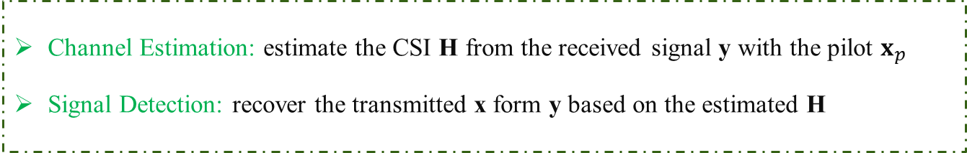
1 Background & System
Two fundamental tasks in MIMO systems: $y_{t}=H_{t}x_{t}+w_{t}$
Detection performance depends heavily on channel accuracy !
Channel Estimation: estimate the CSI H from the received signal y with the pilot $x_{p}$
Signal Detection: recover the transmitted x form y based on the estimated H
Joint Channel Estimation and Signal Detection (JCESD)
Conventional separate design
Joint design with data interaction
y
x
y
Channel estimation
Signal
detection
x
Channel estimation
Signal
detection
The detected symbols $x$are fed back to the channel estimation module to further improve channel estimation performance.
Notes:
Let me begin with the background.
In MIMO systems, there are two fundamental tasks at the receiver side: channel estimation and signal detection.
Channel estimation aims to estimate the channel state information, or CSI, from the received signal and pilot symbols. Signal detection aims to recover the transmitted symbols based on the received signal and the estimated channel.
Traditionally, these two tasks are designed separately. In that case, the receiver first estimates the channel and then performs detection. However, this separate design has a clear limitation: the detection performance strongly depends on the channel estimation accuracy.
To overcome this issue, researchers have proposed joint channel estimation and signal detection, or JCESD. The key idea is to allow data interaction between these two modules. In other words, the detected symbols can be fed back to the channel estimation module, so that the channel estimate can be further refined.
This joint design is especially attractive in time-varying channels, where continuously improving the channel estimate is very important for reliable detection.

Slide 4




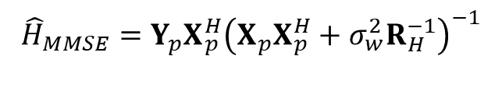
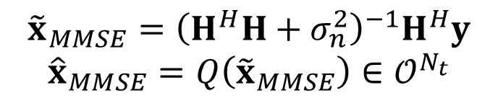


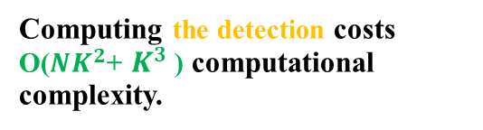

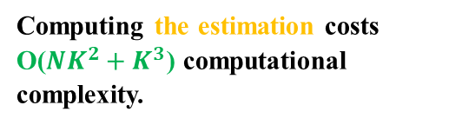
1 Background & System
Slot 0
Slot 1
$$Y_{ }$$
$$H_{0}$$
$$x_{0}$$
$$H_{1}$$
Turbo framework of JCESD
…
Estimation
Detection
Estimation
Detection
$$X_{p}$$
Estimation (Outer layer)
Estimation: LMMSE
Detection: LMMSE
Detection (Inner layer)
$${\tilde{x}}_{MMSE}={\left(H^{H}H+σ_{n}^{2}\right)}^{−1}H^{H}y$$
$${\hat{x}}_{MMSE}=Q\left({\tilde{x}}_{MMSE}\right)∈{\text{𝒪}}^{N_{t}}$$
$${\hat{H}}_{MMSE}={Y_{p}X_{p}^{H}\left(X_{p}X_{p}^{H}+σ_{w}^{2}R_{H}^{−1}\right)}^{−1}$$
Every slot:
Higher accuracy!
Computing the estimation costs O(${NK}^{2}+K^{3}$) computational complexity.
Computing the detection costs O(${NK}^{2}$+ $K^{3}$ ) computational complexity.
Higher Complexity Burden!
Time-varying channel
Notes:
One representative solution for JCESD is the turbo framework.
In this framework, channel estimation and signal detection are performed iteratively, both within each slot and across different time slots. For example, estimation and detection can exchange information multiple times to progressively improve performance.
This iterative design usually provides higher accuracy, because the detector can benefit from improved channel estimates, and the estimator can also exploit the detected data.
However, this performance gain comes at the cost of high computational complexity. In every slot, we need repeated estimation and detection steps, and the complexity can become very high, especially in massive MIMO systems with a large number of antennas.
Therefore, there is a clear trade-off here:
on one hand, iterative joint processing improves performance;
on the other hand, it introduces a heavy complexity burden.
This motivates us to look for a more efficient solution that can still track time-varying channels well.

Slide 5





2 Traditional Kalman Filter based method for JECSD
Slot: $y_{t}=H_{t}x_{t}+w_{t}=\left(I_{N_{r}}⊗x_{t}^{T}\right)h_{t}+w_{t}$
Prediction
Symbol detection
Channel update
$${\hat{h}}_{t|t−1}=F{\hat{h}}_{t−1|t−1}$$
$$P_{t|t−1}=FP_{t−1|t−1}F^{H}+Q$$
$$\tilde{x}={\left({\hat{H}}_{t|t−1}^{H}{\hat{H}}_{t|t−1}+\frac{σ_{w}^{2}}{σ_{x}^{2}}\right)}^{−1}{\hat{H}}_{t|t−1}y_{t}$$
$$\hat{x}=Q(\tilde{x})$$
$$A_{t}=I_{N_{r}}⊗{\hat{x}}_{t}$$
$$K_{t}=P_{t|t−1}A_{t}^{H}S_{t}^{−1}$$
$$u_{t}=y_{t}−A_{t}{\hat{h}}_{t|t−1}$$
$$S_{t}=A_{t}P_{t|t−1}A_{t}^{H}+σ_{w}^{2}I_{N_{r}}$$
$${\hat{h}}_{t|t}={\hat{h}}_{t|t−1}+K_{t}u_{t}$$
$$P_{t|t}=\left(I−K_{t}A_{t}\right)P_{t|t−1}$$
Highlight
Weakness
Make better use of the channel information in the time slot
Make better tracking of time varying channel
Error propagation caused by hard decisions
High computational complexity caused by $K_{t}$
Notes:
Now let us move to the traditional Kalman filter based method for JCESD.
The Kalman filter is a natural choice for time-varying channel tracking, because it explicitly models the channel evolution across slots. In each slot, the receiver typically performs three steps:
First, channel prediction, where the channel of the current slot is predicted based on the previous slot. Second, symbol detection, where transmitted symbols are detected using the predicted channel. Third, channel update, where the detected symbols are used to refine the channel estimate.
This approach has two major advantages.
The first advantage is that it makes better use of the temporal correlation of the channel across slots. The second is that it can provide better tracking performance in time-varying channels than methods that treat each slot independently.
However, this traditional KF-based method also has two important weaknesses.
The first weakness is error propagation caused by hard decisions. In conventional designs, the detected symbols are usually treated as if they were perfectly correct. But in practice, detection errors are unavoidable. Once wrong hard decisions are fed back into channel updating, these errors can propagate and degrade performance further.
The second weakness is high computational complexity. In massive MIMO systems, matrix operations in Kalman filtering can be very expensive, especially when the antenna dimension is large.
So the key challenge is: How can we keep the tracking capability of the Kalman filter while reducing both error propagation and computational complexity?
That is exactly the question addressed in this work.

Slide 6

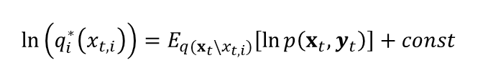
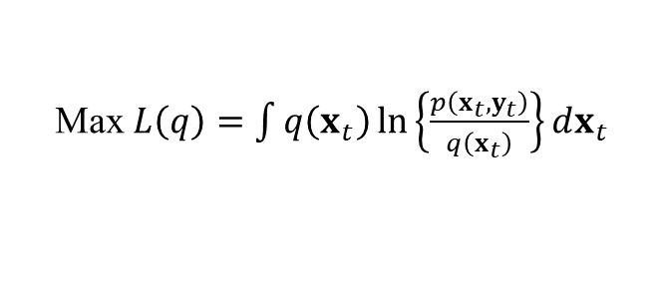

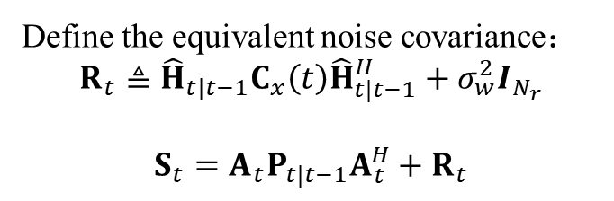
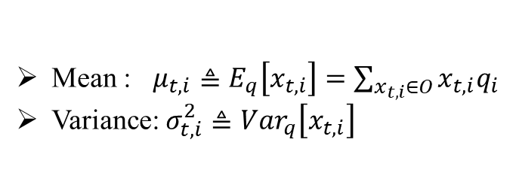
3 Soft information aided diagonal KF (SIA-DKF) based for JCESD
A bayes detection named variation inference
Soft information
Maximum a posteriori (MAP) detection
$${\hat{x}}_{t}=\arg{\max_{x_{t}∈{\text{𝒪}}^{N_{t}}}{p(x_{t}|y_{t})}}$$
$p\left(x_{t} | y_{t}\right)$ is intractable to compute.
we adopt VI to approximate the true posterior $p(x_{t}|y_{t})$ with $q(x_{t})$ !
Solve the maximum by CAVI:
The $i−th$ detection output can be obtained by：
$${\hat{x}}_{t,i}=\arg{\max{q_{i}^{∗}(x_{t,i})}}$$
Given the $q_{i}^{∗}(x_{t},i)$, we can compute the:
Mean : $μ_{t,i}≜E_{q}\left[x_{t,i}\right]=\sum_{x_{t,i}∈O}{x_{t,i}q_{i}}$
Variance: $σ_{t,i}^{2}≜Var_{q}\left[x_{t,i}\right]$
How to address the error propagation problem caused by hard decisions ?
Max $L\left(q\right)=\int{q\left(x_{t}\right)\ln\left\{\frac{p\left(x_{t},y_{t}\right)}{q\left(x_{t}\right)}\right\}dx_{t}}$
Additional information！
Define the equivalent noise covariance：
$$R_{t}≜{\hat{H}}_{t|t−1}C_{x}\left(t\right){\hat{H}}_{t|t−1}^{H}+σ_{w}^{2}I_{N_{r}}$$
$$S_{t}=A_{t}P_{t|t−1}A_{t}^{H}+R_{t}$$
$$ln\left(q_{i}^{∗}\left(x_{t,i}\right)\right)=E_{q(x_{t}\backslash x_{t,i})}\left[\ln{p\left(x_{t},y_{t}\right)}\right]+const$$
Consider detection noise in the updates
Notes:
To address the first problem, namely error propagation caused by hard decisions, we introduce soft information into the detection and channel update process.
Instead of using only hard decisions, we consider a Bayesian detection framework. Ideally, the optimal solution would be maximum a posteriori, or MAP detection. However, MAP detection is generally intractable for massive MIMO systems because of its very high complexity.
Therefore, in this work, we adopt variational inference, or VI, to approximate the true posterior distribution.
The key benefit of variational inference is that it allows us to obtain not only a symbol estimate, but also its soft information, such as the mean and variance of the detected symbols.
This extra information is very useful. Why? Because it tells us how reliable each detected symbol is.
Then, instead of blindly using the detected symbols in the channel update step, we explicitly incorporate the detection uncertainty into the update process through an equivalent noise covariance.
In this way, the channel estimator becomes aware of detection noise and can avoid over-trusting unreliable decisions.
So compared with hard-decision-based Kalman filtering, the proposed idea is more robust and can effectively reduce error propagation.

Slide 7









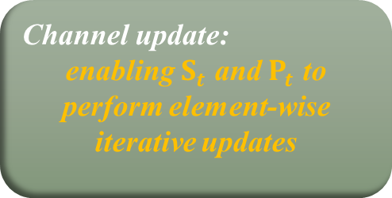

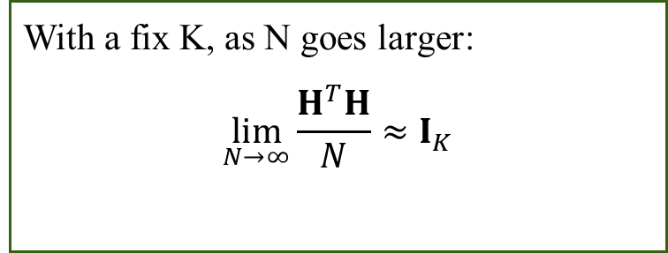




3 Soft information aided diagonal KF (SIA-DKF) based for JCESD
Diagram of soft information aided KF
Slot $T_{P}+1$
Slot $T_{P}+2$
$$H_{T_{p}}$$
$$μ_{x}(N_{p}+1)$$
$$H_{T_{p}+1}$$
$$μ_{x}(N_{p}+2)$$
$$H_{T_{p}+2}$$
$$X_{p}$$
Pilot
Estimator
Channel
Predict
Signal
Detector
Channel
Update
Channel
Predict
Signal
Detector
Channel
Update
$$Y_{p}$$
$$y_{d}\left[1\right]$$
$$σ_{x}^{2}(N_{p}+1)$$
$$y_{d}\left[2\right]$$
$$σ_{x}^{2}(N_{p}+2)$$
$$……$$
Detection:
enabling CAVI to perform element-wise iterative updates
How to address the high complexity problem in every slot?
Favorable propagation characteristic
With a fix K, as N goes larger:
$$\lim_{N→∞}{\frac{H^{T}H}{N}≈I_{K}}$$
Channel update:
enabling $S_{t}$ and $P_{t}$ to perform element-wise iterative updates
Notes:
Next, I will explain the overall framework of the proposed Soft Information Aided Diagonal Kalman Filter, or SIA-DKF.
The receiver still follows the general prediction–detection–update structure across time slots.
For each slot, we first perform channel prediction. Then we carry out signal detection, but now with soft information output instead of only hard decisions. After that, we perform channel update, where the soft information is incorporated into the update step.
At this point, we still face another key challenge: how to reduce the computational complexity in each slot, especially in massive MIMO scenarios.
Here, we exploit a very important property of massive MIMO channels, namely favorable propagation.
When the number of antennas becomes large while the number of users remains fixed, the channel vectors of different users tend to become nearly orthogonal. This property makes many matrices approximately diagonal, or at least diagonally dominant.
This observation is crucial, because it allows us to simplify both:
the detection stage, and
the channel update stage.
As a result, instead of handling full matrix operations, we can perform more efficient element-wise iterative updates, which significantly reduces computational complexity.

Slide 8

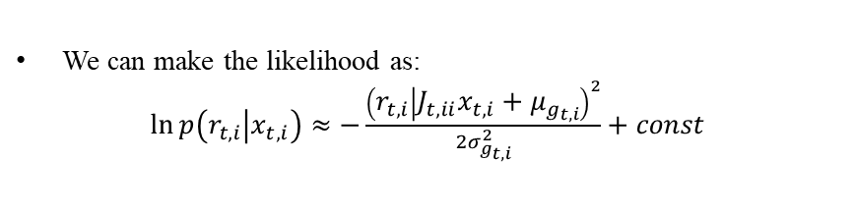
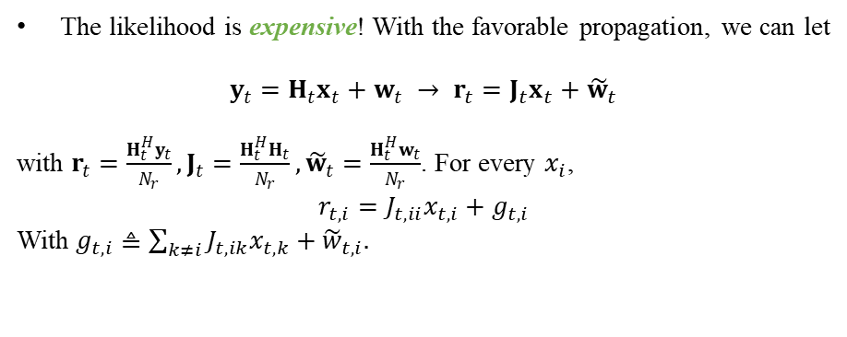
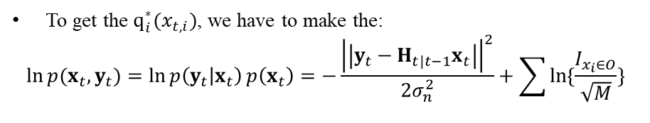

3 Soft information aided diagonal KF (SIA-DKF) based for JCESD
Favorable-Propagation-Exploited Variational Inference
To get the $q_{i}^{∗}(x_{t,i})$, we have to make the:
$$\ln{p(x_{t},y_{t})}=\ln{p\left(y_{t} | x_{t}\right)}p\left(x_{t}\right)=−\frac{{\left|\left|y_{t}−H_{t|t−1}x_{t}\right|\right|}^{2}}{2σ_{n}^{2}}+\sum{\ln{\{\frac{I_{x_{i}∈O}}{\sqrt{M}}\}}}$$
The likelihood is expensive! With the favorable propagation, we can let
$$y_{t}=H_{t}x_{t}+w_{t} → r_{t}=J_{t}x_{t}+{\tilde{w}}_{t}$$
with $r_{t}=\frac{H_{t}^{H}y_{t}}{N_{r}}, J_{t}=\frac{H_{t}^{H}H_{t}}{N_{r}}, {\tilde{w}}_{t}=\frac{H_{t}^{H}w_{t}}{N_{r}}$. For every $x_{i}$,
$$r_{t,i}=J_{t,ii}x_{t,i}+g_{t,i}$$
With $g_{t,i}≜\sum_{k≠i}{J_{t,ik}x_{t,k}}+{\tilde{w}}_{t,i}.$
Complexity reduction in one CAVI iteration
How to make detection complexity reduction?
VI: O($NK^{2}$).
We can make the likelihood as:
$\ln{p\left(r_{t,i} | x_{t,i}\right)≈−\frac{{\left(r_{t,i} | J_{t,ii}x_{t,i}+μ_{g_{t,i}}\right)}^{2}}{2σ_{g_{t,i}}^{2}}+const}$
FPE-VI: O($K^{2}$).
enabling CAVI to perform element-wise iterative updates
Notes:
Let us first look at complexity reduction in the detection stage.
In the variational inference framework, we need to compute the likelihood function and iteratively update the posterior approximation. In its original form, this process is still computationally expensive because it involves large matrix operations.
To solve this issue, we exploit the favorable propagation property of massive MIMO.
Under favorable propagation, the cross-correlation among users becomes weak, which allows us to simplify the likelihood expression. As a result, the coordinate ascent variational inference, or CAVI, updates can be carried out in an element-wise manner.
This leads to what we call Favorable-Propagation-Exploited Variational Inference, or FPE-VI.
The main advantage is complexity reduction. Compared with conventional VI, the proposed FPE-VI significantly lowers the complexity of one CAVI iteration.
In other words, by exploiting a physical property of massive MIMO channels, we can make soft detection much more computationally efficient without sacrificing much performance.
This is an important step, because soft detection is one of the core components of our whole framework. Let us first look at complexity reduction in the detection stage.
In the variational inference framework, we need to compute the likelihood function and iteratively update the posterior approximation. In its original form, this process is still computationally expensive because it involves large matrix operations.
To solve this issue, we exploit the favorable propagation property of massive MIMO.
Under favorable propagation, the cross-correlation among users becomes weak, which allows us to simplify the likelihood expression. As a result, the coordinate ascent variational inference, or CAVI, updates can be carried out in an element-wise manner.
This leads to what we call Favorable-Propagation-Exploited Variational Inference, or FPE-VI.
The main advantage is complexity reduction. Compared with conventional VI, the proposed FPE-VI significantly lowers the complexity of one CAVI iteration.
In other words, by exploiting a physical property of massive MIMO channels, we can make soft detection much more computationally efficient without sacrificing much performance.
This is an important step, because soft detection is one of the core components of our whole framework.

Slide 9
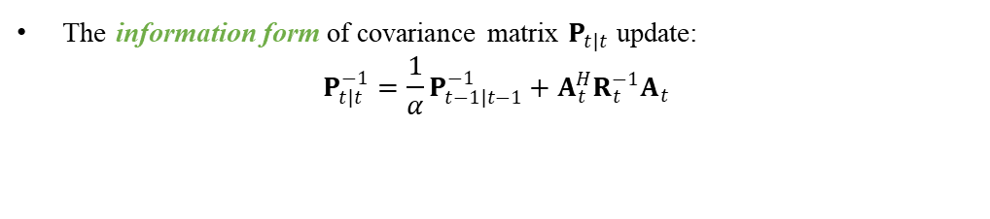
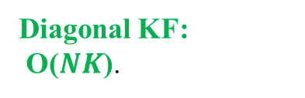
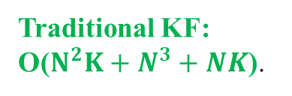

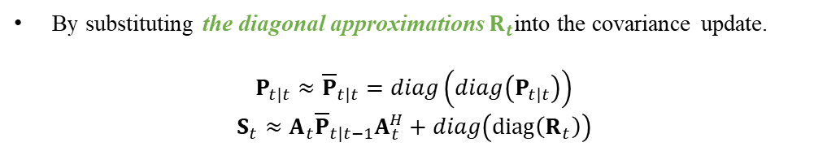
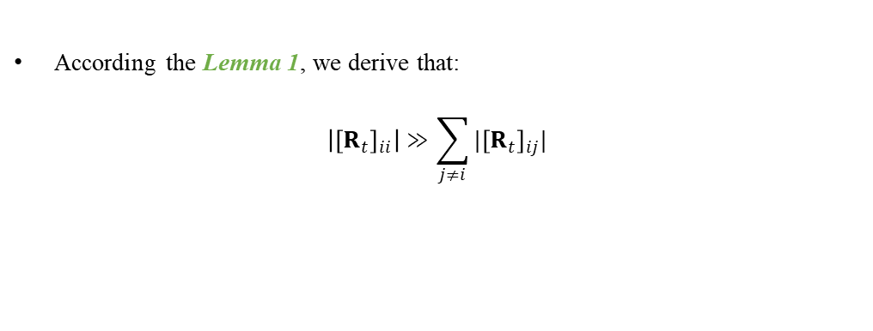
3 Soft information aided diagonal KF (SIA-DKF) based for JCESD
Low-Complexity Channel Update via Diagonal Approximation
The information form of covariance matrix $P_{t|t}$ update:
$$P_{t|t}^{−1}=\frac{1}{α}P_{t−1|t−1}^{−1}+A_{t}^{H}R_{t}^{−1}A_{t}$$
According the Lemma 1, we derive that:
$$\left|{\left[R_{t}\right]}_{ii}\right|≫\sum_{j≠i}{|{\left[R_{t}\right]}_{ij}|}$$
Complexity reduction in every slot
channel update
How to make channel update complexity reduction?
By substituting the diagonal approximations $R_{t}$into the covariance update.
$$P_{t|t}≈{\overline{P}}_{t|t}=diag\left(diag\left(P_{t|t}\right)\right)$$
$$S_{t}≈A_{t}{\overline{P}}_{t|t−1}A_{t}^{H}+diag\left(diag\left(R_{t}\right)\right)$$
Traditional KF:
O($N^{2}K+N^{3}+NK$).
Diagonal KF:
O($NK$).
enabling $S_{t}$ and $P_{t}$ to perform element-wise iterative updates
Notes:
Now let us move to the second source of complexity, namely the channel update step.
In a traditional Kalman filter, updating the channel covariance matrix involves high-dimensional matrix inversion and multiplication. These operations become very expensive in massive MIMO systems.
Again, we exploit the favorable propagation property and apply a diagonal approximation.
The basic idea is the following: if the covariance-related matrices are approximately diagonal, then we can replace the full matrix update by a diagonal Kalman filter update.
This brings two major benefits.
First, it enables element-wise updates for both the channel estimate and the covariance terms. Second, it reduces the computational complexity significantly compared with the traditional Kalman filter.
So instead of dealing with the full covariance matrix, we only need to track the diagonal entries, which is much cheaper.
In this way, the proposed SIA-DKF achieves a good balance:
it still preserves the dynamic tracking capability of Kalman filtering,
but it greatly lowers the computational burden.
This diagonal approximation is one of the key reasons why our method is suitable for massive MIMO systems.

Slide 10
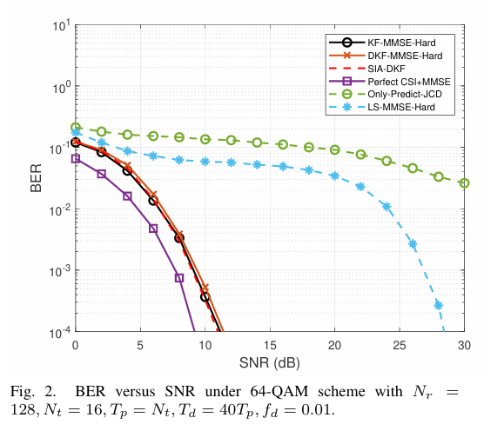
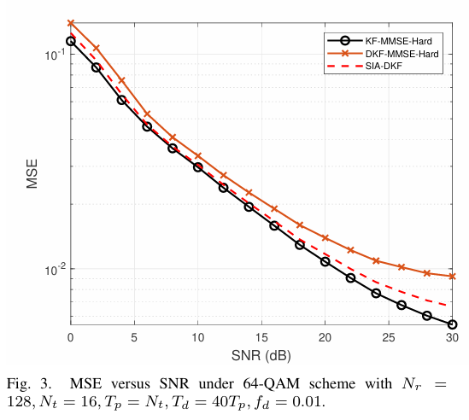
4 Simulations
The proposed algorithm based on KF can achieve higher BER than traditional method like Turbo framework under time-varying channels.
The proposed algorithm can achieve the same BER and MSE performance as traditional KF with lower computational complexity.
Notes:
Next, I will present the simulation results.
The first important observation is that the proposed algorithm based on Kalman filtering can achieve better BER performance than traditional methods such as the turbo framework under time-varying channels.
This shows that exploiting temporal channel evolution through Kalman filtering is very effective for dynamic scenarios.
The second observation is that the proposed algorithm can achieve almost the same BER and MSE performance as the traditional Kalman filter, but with much lower computational complexity.
This is a very important result. It means that our proposed approximations, including the soft-information-aided design and the diagonal approximation, do not cause a significant performance loss, while they provide a substantial complexity reduction.
Therefore, the proposed method is attractive not only in theory, but also for practical implementation in large-scale systems.

Slide 11
Thank you for your watching
Xuanxiang Hu, Zheng Wang, Yongming Huang, Zhen Gao
Southeast University
2026.4.14
Notes:
Finally, let me conclude this presentation.
In this work, we studied joint channel estimation and signal detection for massive MIMO systems with time-varying channels.
To address the error propagation problem caused by hard decisions, we introduced soft information through variational inference, so that the channel update step can explicitly take detection uncertainty into account.
To address the high computational complexity problem, we exploited the favorable propagation property of massive MIMO and proposed a diagonal Kalman filter framework with efficient element-wise updates.
Simulation results show that the proposed method:
outperforms conventional iterative methods in time-varying channels, and
achieves performance close to the traditional Kalman filter with much lower complexity.
So overall, the proposed soft information aided diagonal Kalman filter provides an effective and low-complexity solution for joint channel estimation and detection in massive MIMO systems.
That’s all for my presentation. Thank you very much for your attention.

