Slide 1

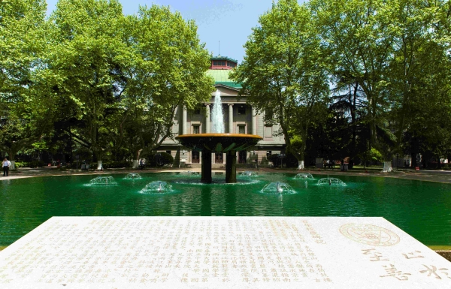
Matrix-Inversion-Free Expectation Propagation for Massive Connectivity
Rui Ma, Zheng Wang, Yongming Huang
Southeast University, Nanjing, China
Zhen Gao
Beijing Institute of Technology, Beijing, China

Slide 2
01.
Content
Background & Motivation
02.
System Model & EP Algorithm
03.
Proposed Matrix-Inversion-Free EP Method
04.
Simulation

Slide 3
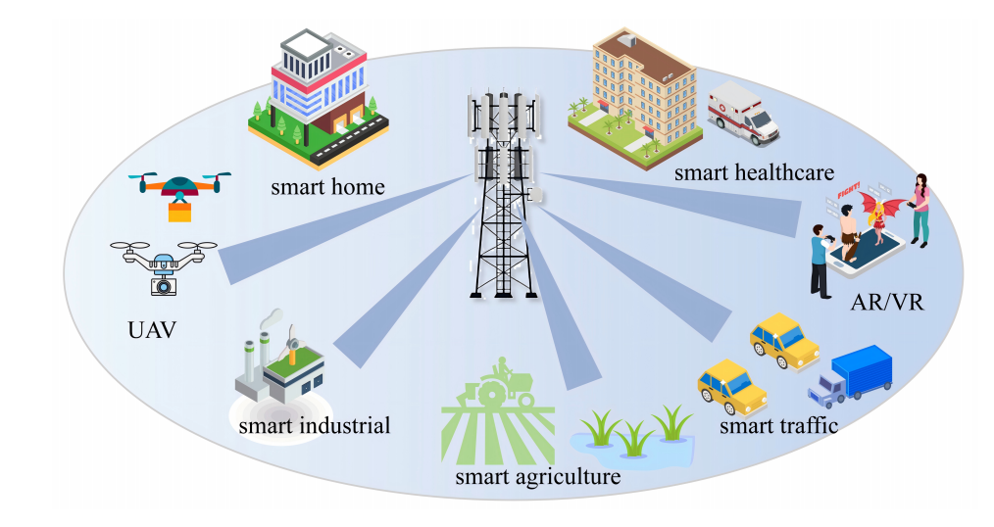
Background
IoT-based wireless networks future Internet of Everything (IoE) networks
connect up to a million devices
require massive machine-type communication (mMTC)
massive access
Sporadic traffic property
BS: identify active devices
Compressed sensing (CS) framework for sparse signal recovery
Figure 1: Illustration of massive connectivity scenario

Slide 4

Motivation
Existing problems:
Relatively poor performance in current CS algorithms because a priori distribution of the sparse vector is not exploited
Proposed method：
Consider EP to incorporate a priori distribution
Better performance !
Propose a matrix-inversion-free EP-CG framework that uses preconditioned conjugate gradient (CG) and a Hutchinson diagonal estimator
High computational complexity of conventional EP due to repeated inversions of large covariance matrices $O(N^{3})$
Lower complexity !
Theoretically specify the lower bound of probe vectors R in Hutchinson diagonal estimator required to guarantee a desired level of estimation accuracy
Performance loss due to the use of the Hutchinson diagonal estimator
Estimation accuracy guarantee !

Slide 5

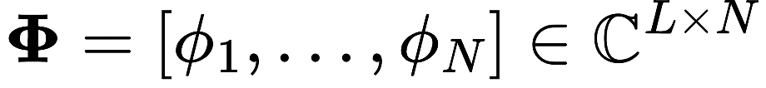
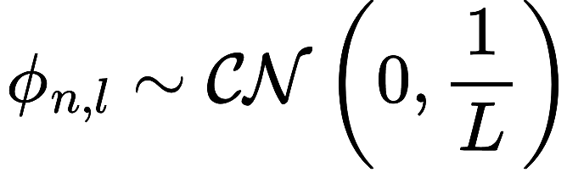
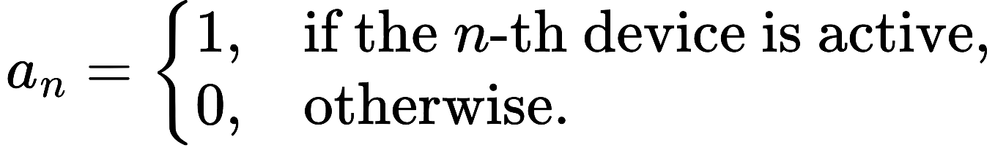
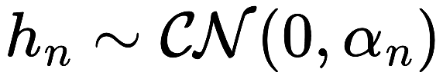


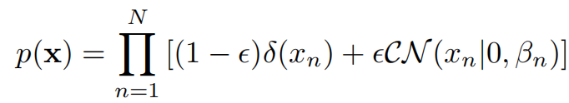
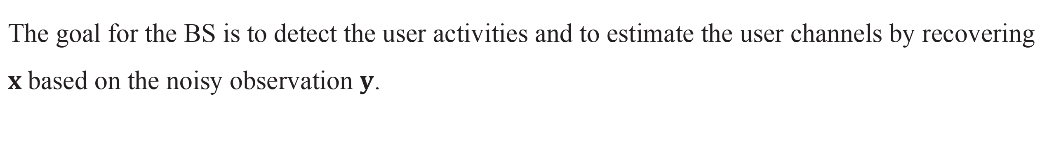

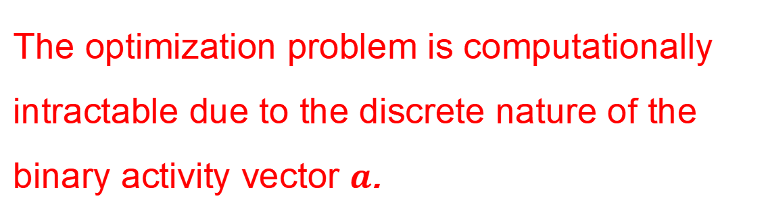
Develop a threshold-based approach to sparsify the Gram matrix
System model
Each user $n$ transmits its pilot sequence to the BS and the received signal at the BS:
pilot matrix
joint user activity and channel information
$$x=a⨀h={[a_{1}h_{1},a_{1}h_{1},⋯a_{1}h_{1}]}^{T}$$
The goal for the BS is to detect the user activities and to estimate the user channels by recovering $x$based on the noisy observation $y$.
MAP estimator:
likelihood function
The optimization problem is computationally intractable due to the discrete nature of the binary activity vector $a$.
prior distribution

Slide 6
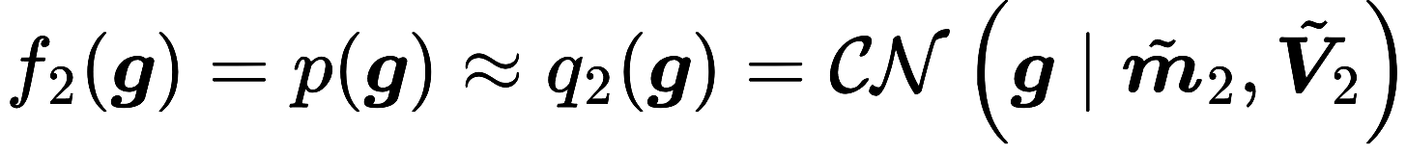


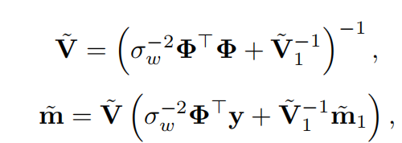
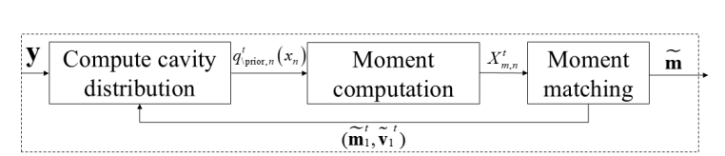
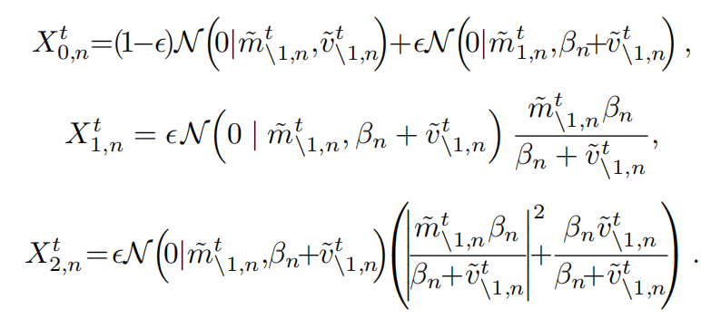
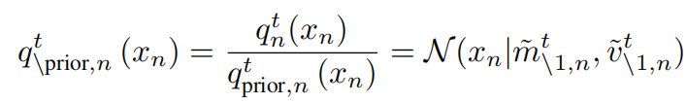
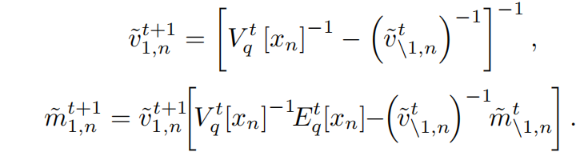
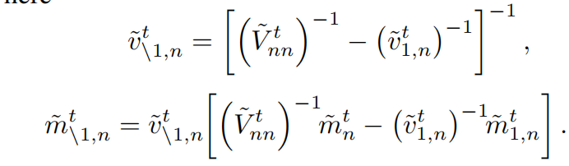



EP Algorithm
Construct a tractable approximation of the target posterior distribution:
$$f(x)=p\left(y | x\right)p(x)$$
$$q(x)=p\left(y | x\right)q_{prior}(x)$$
$$p(x)=q_{prior}(x)=$$
Iterative EP update rules:
moment computation:
compute cavity distribution:
moment matching

Slide 7


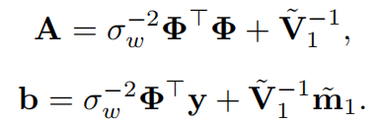


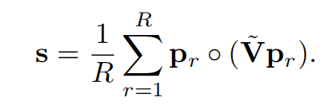



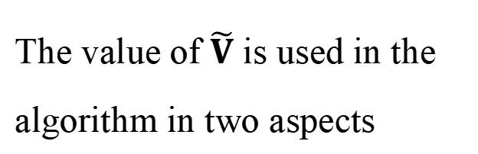
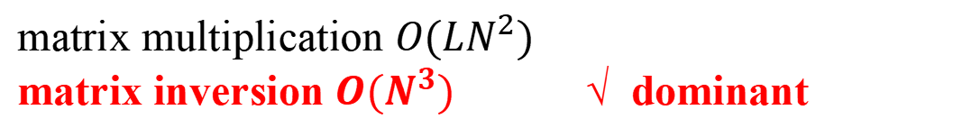

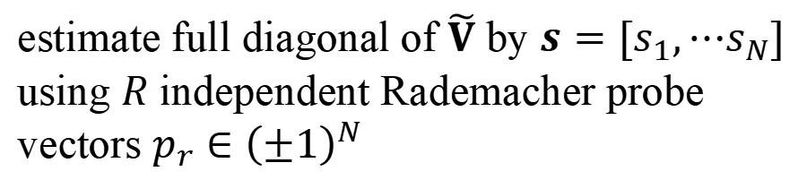

EP-CG Algorithm
The complexity of the EP algorithm is dominated by the computation of the covariance matrix $\tilde{V}$
matrix multiplication $O(LN^{2})$
matrix inversion $O(N^{3})$ √ dominant
matrix multiplication $O(LN^{2})$
matrix inversion $O(N^{3})$ √ dominant
We propose EP-CG that avoids the direct calculation of $\tilde{V}$
We propose EP-CG that avoids the direct calculation of $\tilde{V}$
the multiplication of $\tilde{V}$ to a vector
obtain $\tilde{m}$ by solving linear system using CG
the multiplication of $\tilde{V}$ to a vector
The value of $\tilde{V}$ is used in the algorithm in two aspects
reformulate this operation
The value of $\tilde{V}$ is used in the algorithm in two aspects
use parallel CG to obtain $Z$
the diagonal entries of $\tilde{V}$
estimate full diagonal of $\tilde{V}$ by $s=[s_{1},⋯s_{N}]$ using $R$ independent Rademacher probe vectors $p_{r}∈{\left(±1\right)}^{N}$
Hutchinson estimator

Slide 8


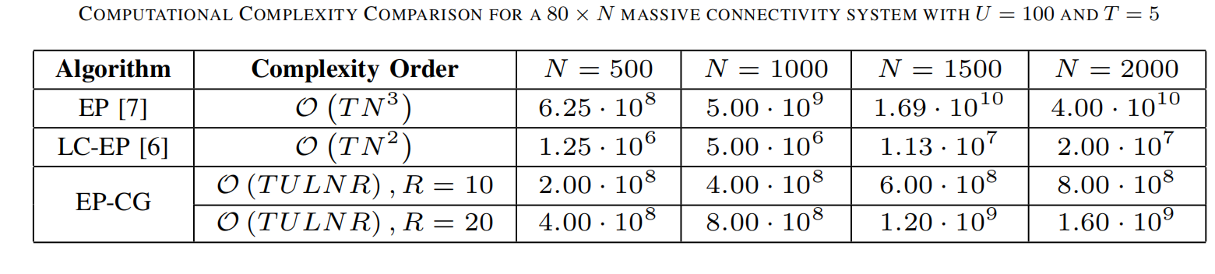


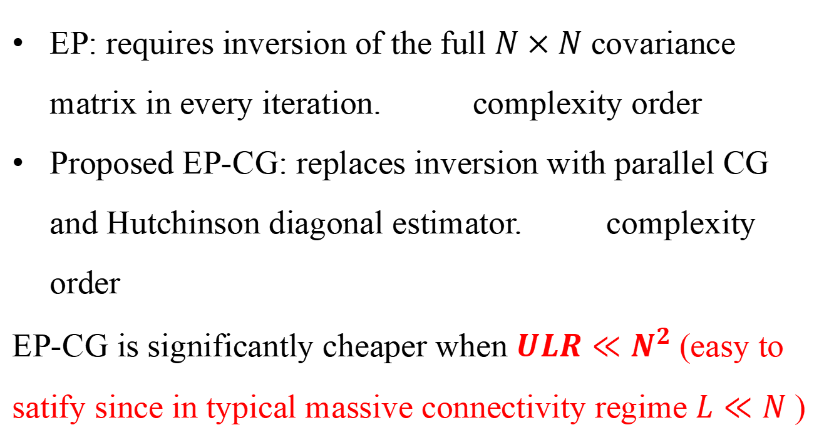
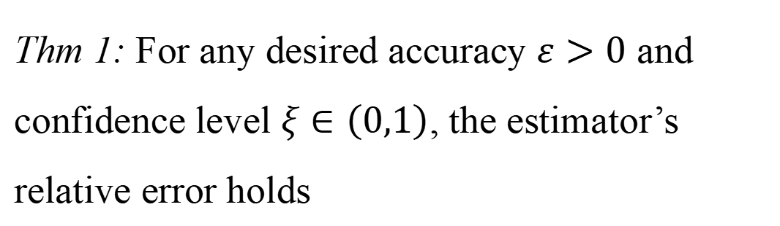

EP-CG Algorithm
Complexity Comparison
Theoretical accuracy guarantees of the Hutchinson estimator
EP: requires inversion of the full $N×N$ covariance matrix in every iteration. complexity order
Proposed EP-CG: replaces inversion with parallel CG and Hutchinson diagonal estimator. complexity order
EP-CG is significantly cheaper when $ULR≪N^{2}$(easy to satify since in typical massive connectivity regime $L≪N$ )
Thm 1: For any desired accuracy $ε>0$ and confidence level $ξ∈\left(0,1\right)$, the estimator’s relative error holds
$$O(N^{3})$$
$$O(ULNR)$$
if the number of probe vectors $R^{t}$ satisfies
where

Slide 9
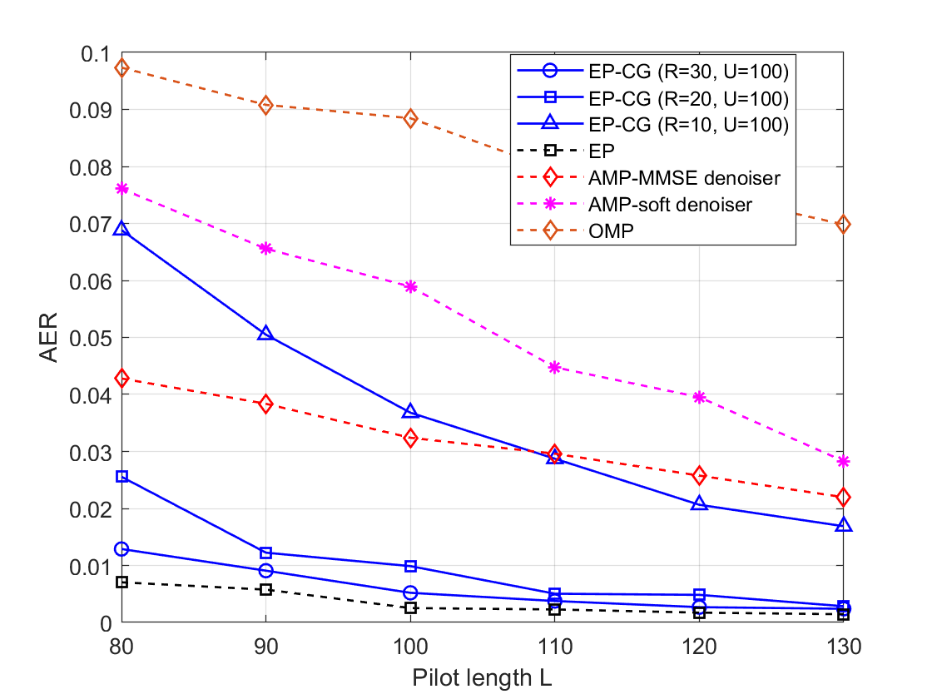
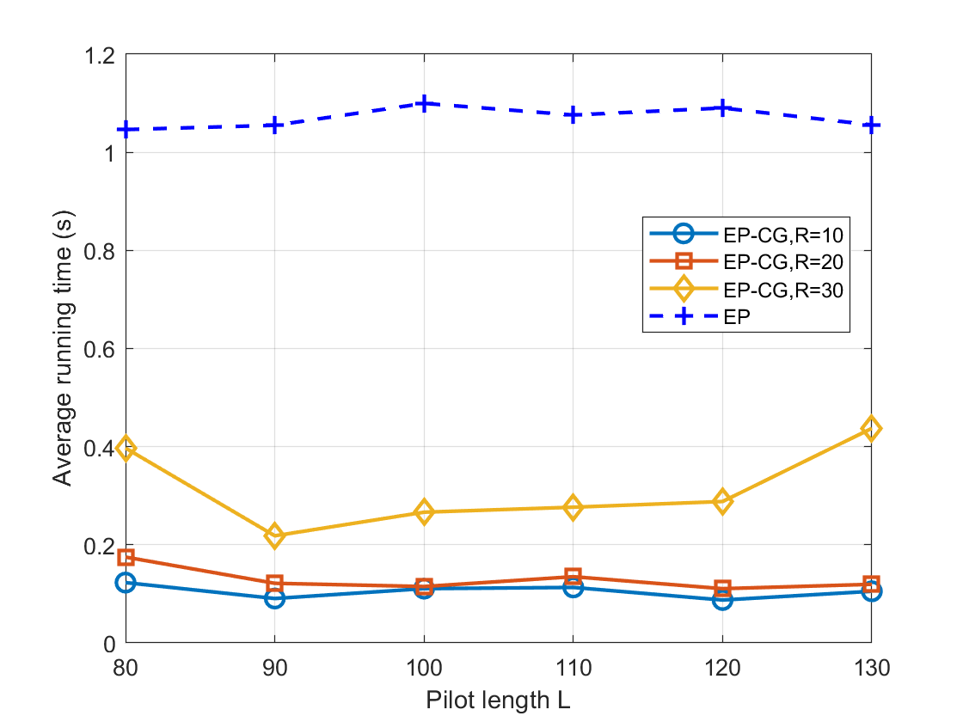
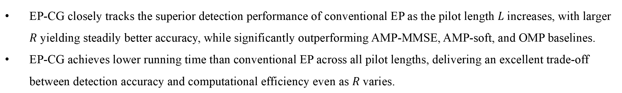
Simulation
EP-CG closely tracks the superior detection performance of conventional EP as the pilot length $L$ increases, with larger $R$ yielding steadily better accuracy, while significantly outperforming AMP-MMSE, AMP-soft, and OMP baselines.
EP-CG achieves lower running time than conventional EP across all pilot lengths, delivering an excellent trade-off between detection accuracy and computational efficiency even as $R$ varies.

Slide 10
Thanks for your listening !
Notes:
Thank you for your attention. I’d be happy to take any questions.

