Slide 1
An Efficient NS-ADMM Detection for Uplink
MIMO-ISAC Systems
Jian Wang, Qiqiang Chen, Zheng Wang and Wenbing Fan
School of Information Science and Engineering,
Southeast University, Nanjing, China
IEEE WCNC 2025, Milan, Italy
24–27 March 2025

Slide 2
Contents
01
Introduction
02
The Uplink Signal Detection For MIMO-ISAC
03
The Proposed NS-ADMM Algorithm
04
Simulation Results

Slide 3
Introduction
Motivation
Existing signal processing methods for MIMO-ISAC systems mainly focus on the transmitter side, i.e., beamforming and waveform design.
Existing uplink signal detection work
The sensing signals are assumed to be received earlier than the uplink communication signals.
Only concerns single user and single-target scenarios.
Can we design?
Simultaneous processing of sensing and communication signals
Multi-user and multi-target scenarios
Significant performance advantages with low complexity

Slide 4
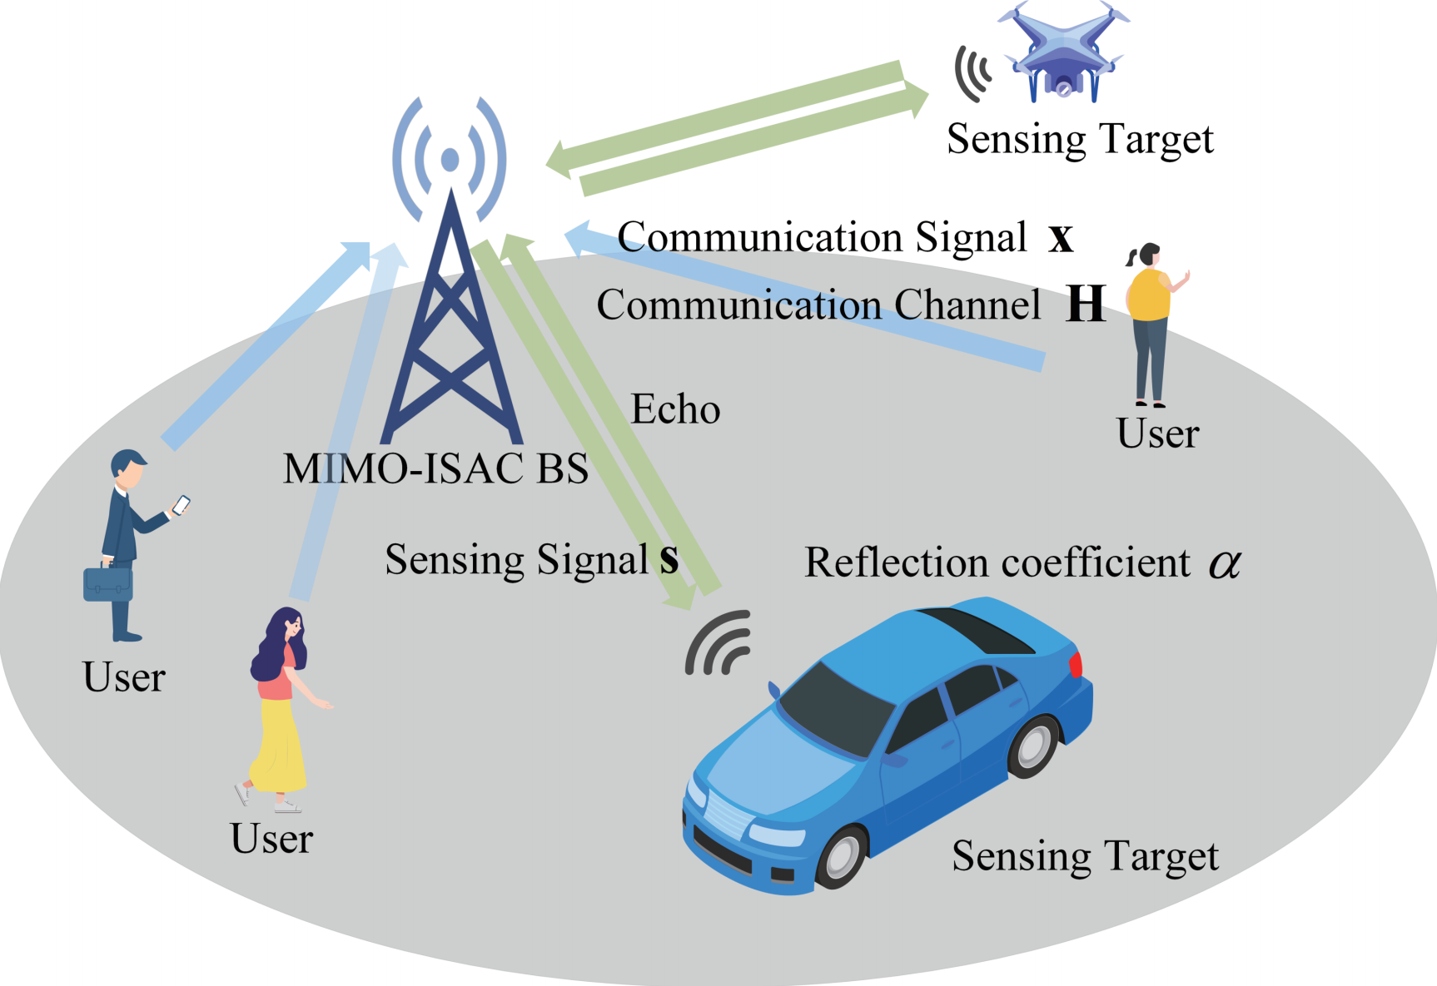
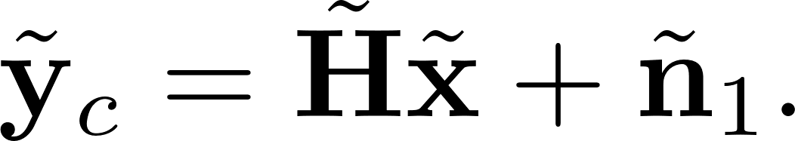
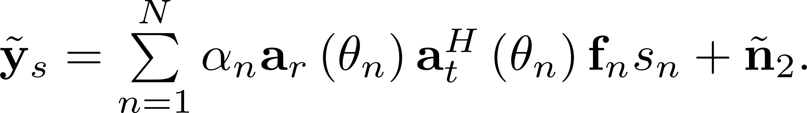

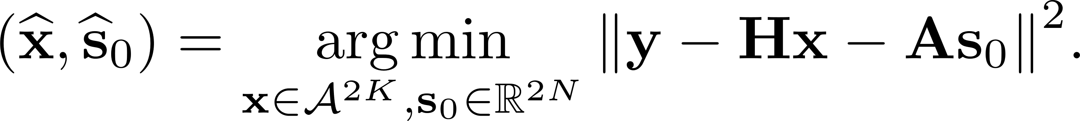
The Uplink Signal Detection For MIMO-ISAC
Received communication signal
Received sensing signal
Received at same time
Real-valued system
Target: Communication signal detection and
target parameter estimation
Figure: BS receives communication signals and sensing signals at the same time.
Mixed integer least squares problem (MILSP)

Slide 5

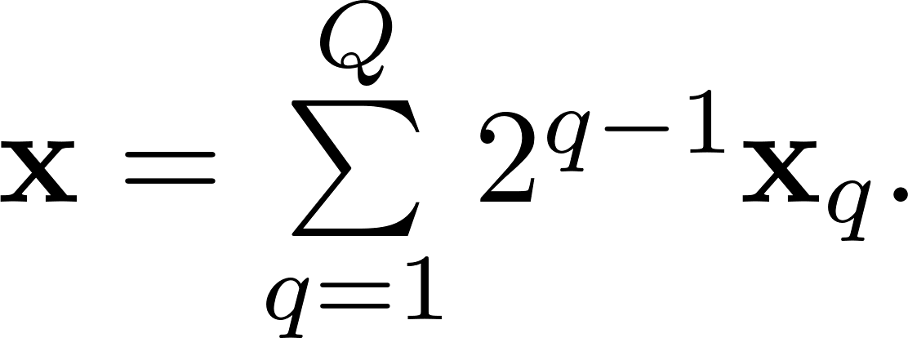
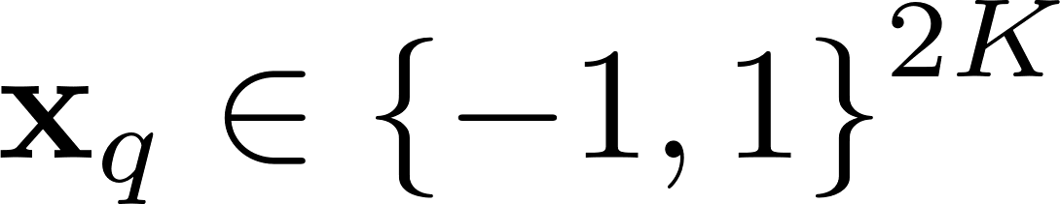
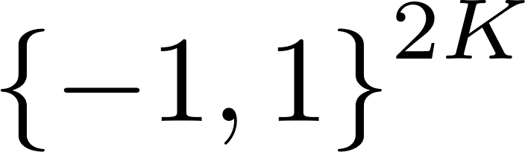
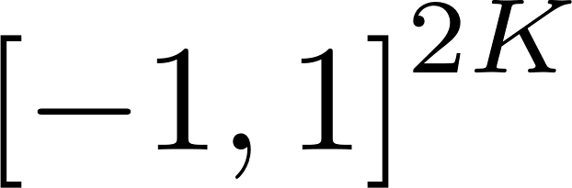
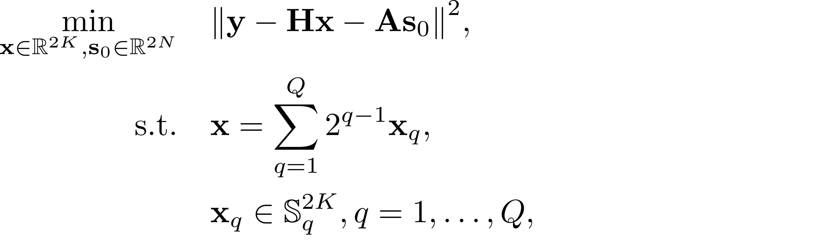
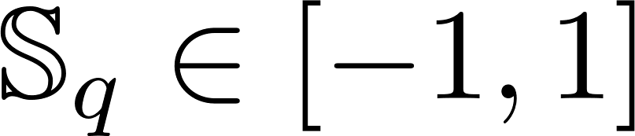
The Proposed NS-ADMM Algorithm
ADMM for MILSP
non-convex problem
How to handle discrete integers?
Communication signal is decomposed into a sum of multiple binary variables
Relaxing binary constraints
to box constraints

Slide 6
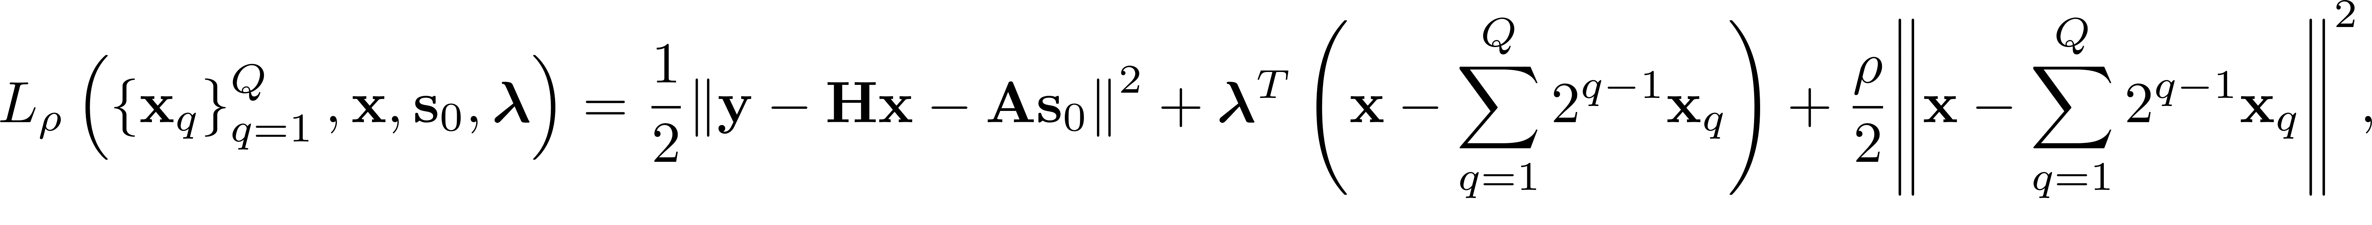
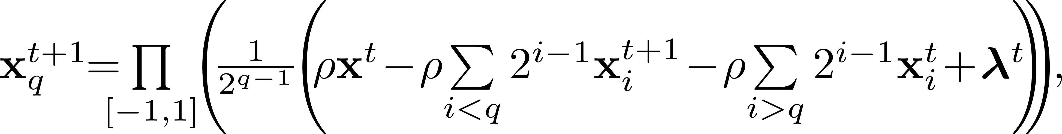
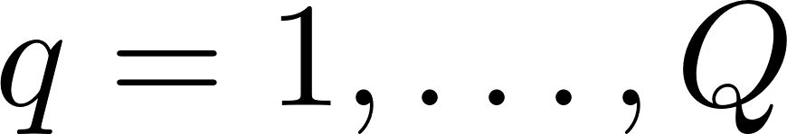
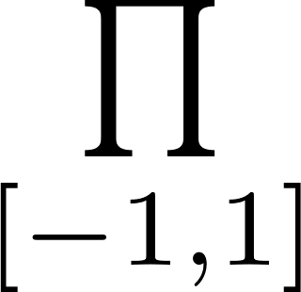
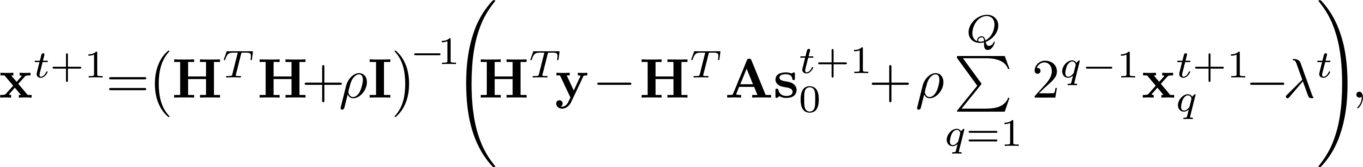
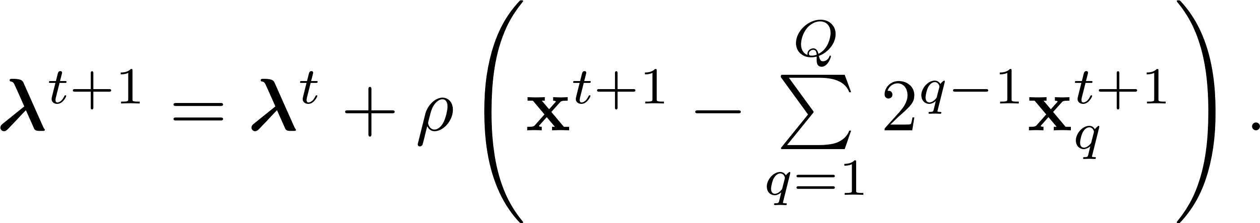
The Proposed NS-ADMM Algorithm
ADMM for MILSP
The augmented Lagrangian of the problem can be expressed as
Alternate optimization of variables by ADMM algorithm.
where
and
denotes projection operator.

Slide 7
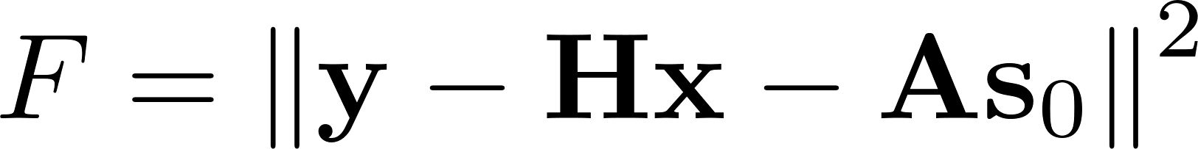
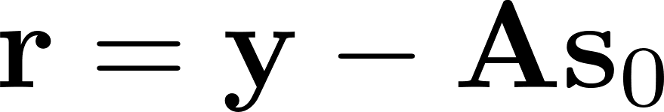
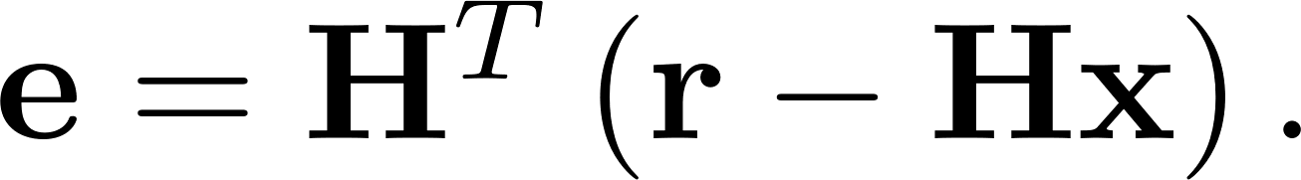
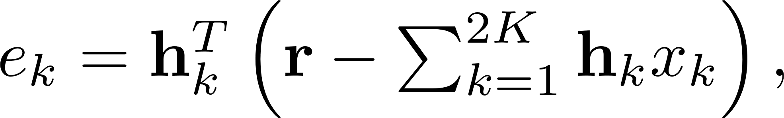
The Proposed NS-ADMM Algorithm
Neighborhood Search-aided ADMM
The above ADMM algorithm treats the original discrete integer problem as a continuous problem, which means a certain performance loss.
Utilize ADMM to provide the initial solution in every iteration.
This solution will be further corrected by neighborhood search.
The goal is to find a neighborhood vector that minimizes
Define and error vector
Consider one symbol neighborhood
Decompose the error vector as

Slide 8
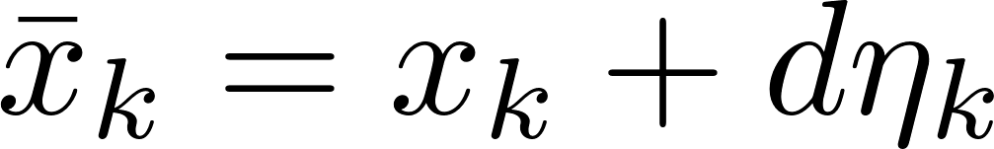

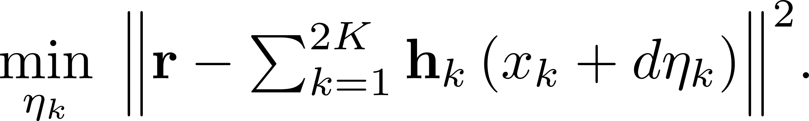



The Proposed NS-ADMM Algorithm
Neighborhood Search-aided ADMM
Replace the entry of the initial vector with a neighborhood point in the constellation as
The target of finding the neighborhood vector that minimizes can be expressed as
By setting the gradient about to zero, we can obtain
with gram matrix
The rounding operator ensures is an integer.

Slide 9

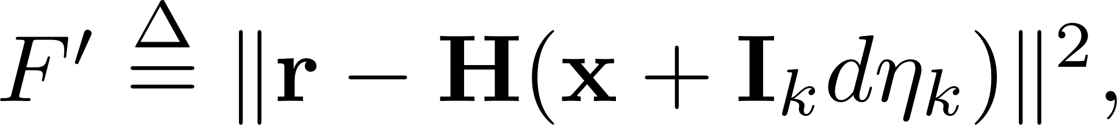
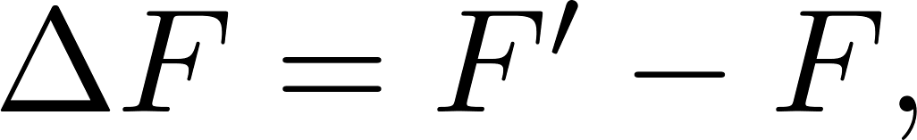
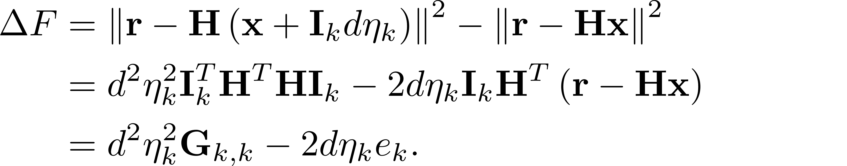

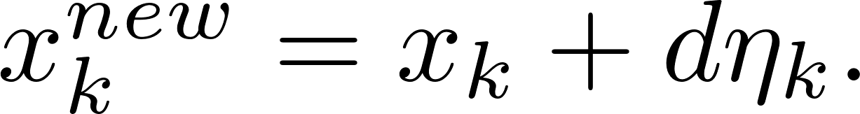
The Proposed NS-ADMM Algorithm
Neighborhood Search-aided ADMM
For each , leads to a change in the value of , and the changed is denoted as
Define which is deduced as
when we update the -th entry of the vector

Slide 10

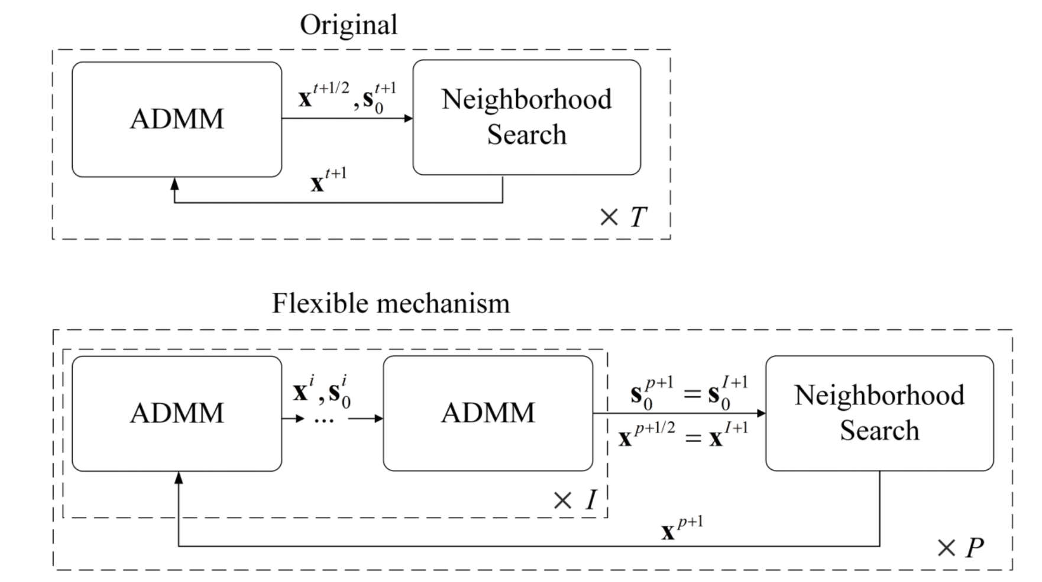
The Proposed NS-ADMM Algorithm
A flexible mechanism of the ADMM iterations
The estimation of is determined by ADMM iterations.
An accurate estimation of may not be readily obtained only with one ADMM iteration.
Figure: A flexible iteration mechanism of ADMM.

Slide 11
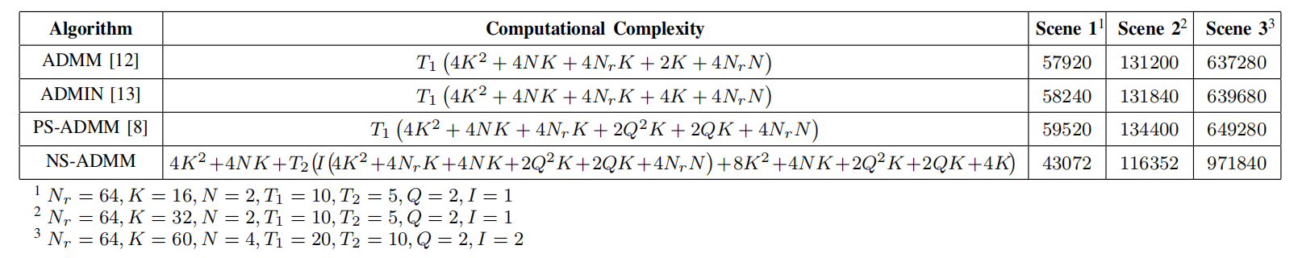

Simulation Results
Complexity Comparisons
Table: Real-valued multiplications comparison in three scenarios using 16-QAM
The proposed NS-ADMM algorithm has lower complexity in Scene 1 and Scene 2 but higher complexity in Scene 3 due to the flexible mechanism.
NS-ADMM has significant complexity advantages over other algorithms when exceeds 2.

Slide 12
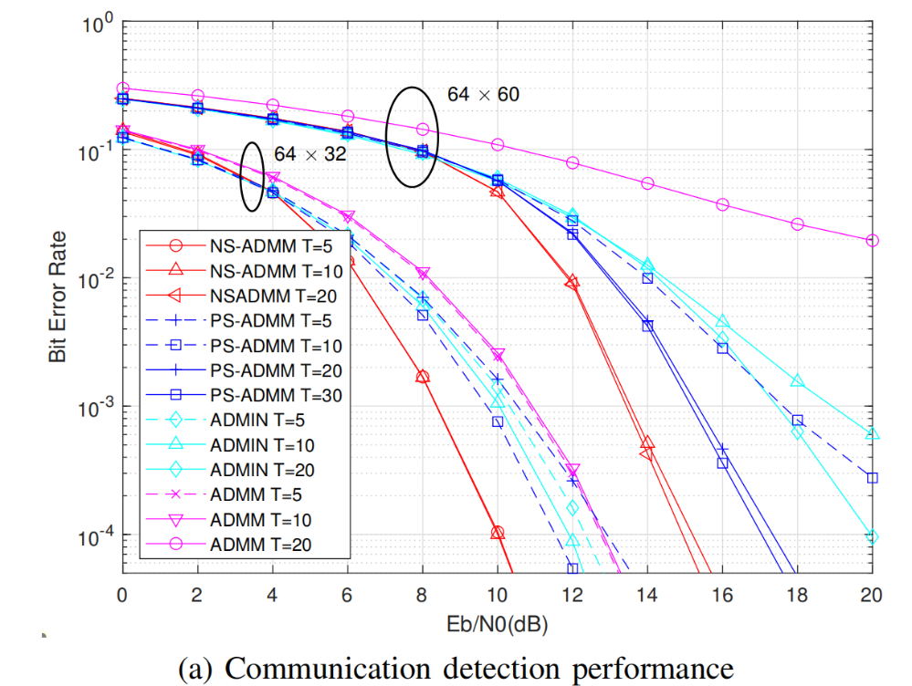
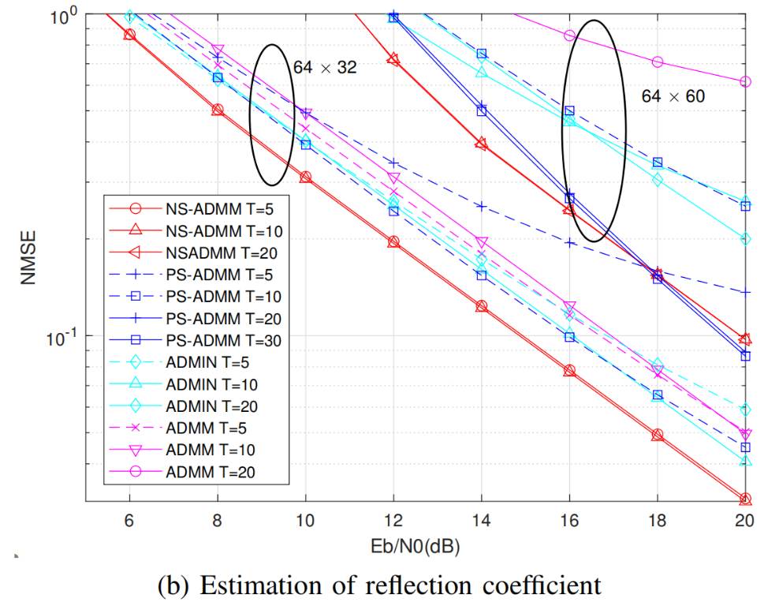
Simulation Results
Performance Comparisons
Figure: Comparisons of BER performance and reflection coefficient estimation using 16-QAM.
NS-ADMM algorithm has better BER and estimation performance.
NS-ADMM algorithm requires fewer iterations to achieve great performance.

