Slide 1


Joint Hybrid Beamforming and Reconfigurable Intelligent Surface Design for MIMO Systems
Yuanli Ma, Bin Yan, Zheng Wang, Zhen Gao
Southeast University
2026.05.09

Slide 2

Contents
01
Background
02
System model
03
Joint RIS phase shift and hybrid beamforming design
04
Complexity analysis
05
Simulations

Slide 3
1 Background
Hybrid beamforming for RIS-aided MIMO
MIMO with the wireless environment configured
Role: An alternative to the traditional digital beamforming
Target: Improve the sum rate
Challenge upon hybrid beamforming in RIS-aided MU-MIMO
The constant modulus constraints in the analog precoder and the RIS are non-convex.
The algorithm needs to take inter-user interference into consideration.
The algorithm needs to improve sum rate with low computational complexity.
Notes:
1 problem感觉优点生硬
2 图片里面的符号不符合本文章
1 nr>>nt

Slide 4


1 Background
High Complexity Burden For RIS Design!
For the sum rate maximization
For the MSE minimization
Computing the gradient of the sum rate costs O(${NK}^{2}$) computational complexity.
Computing the gradient of the MSE costs O(${MN}^{2}+N^{3}$) computational complexity.
Efficient low-complexity RIS design.

Slide 5
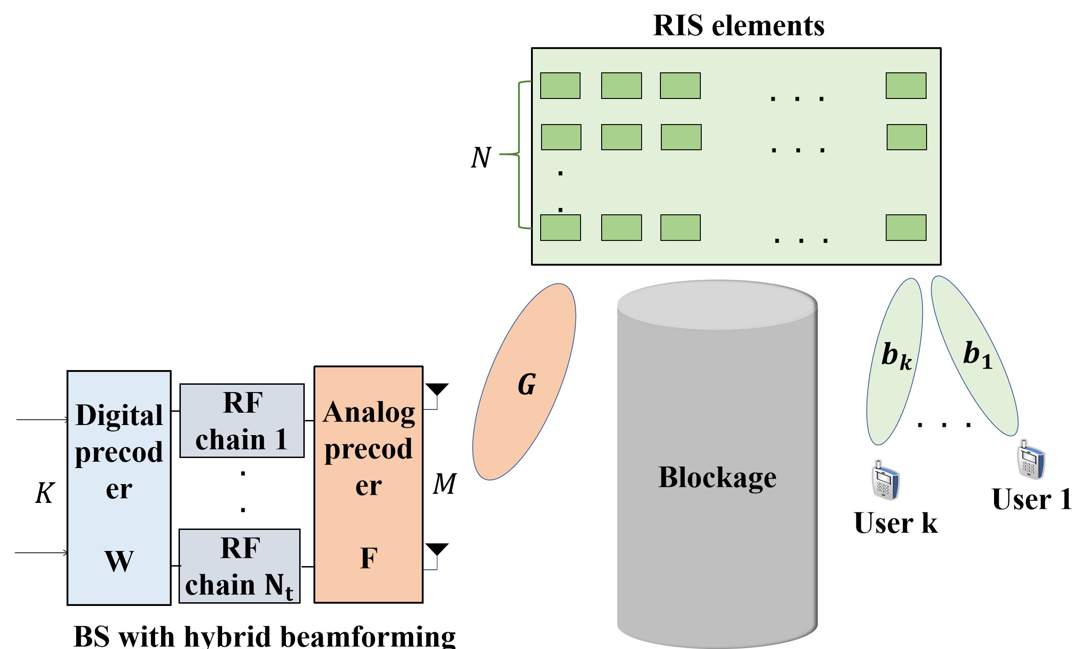

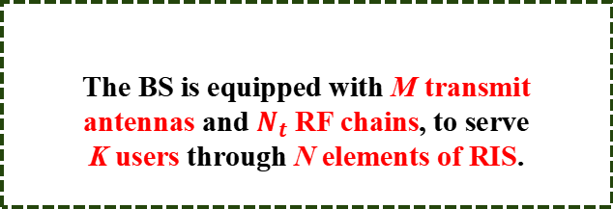
2 System model
A RIS-assisted communication system
Model
Signal
The BS is equipped with M transmit
antennas and $N_{t}$ RF chains, to serve
K users through N elements of RIS.
For simplicity, denoting
with

Slide 6


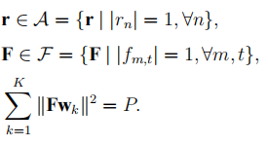
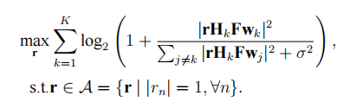
2 System model
The received SINR of the k-th user is given by:
Given Gaussian inputs, the sum rate of the k-th user turns out to be:
The constraints of hybrid beamforming
in RIS-aided communication are:
In particular, the RIS design can be
obtained by solving:
Notes:
1 order?

Slide 7









3 RIS phase shift and hybrid beamforming design
Why considering joint RIS phase shift
and hybrid beamforming design?
Rayleigh fading channel:
Performance bound
Approximation
The asymptotically orthogonal property of user channels indicates that:
M tends to infinity
The asymptotically orthogonal property of columns of the analog precoder indicates that:
The asymptotically orthogonal property of columns of the analog precoder indicates that:

Slide 8





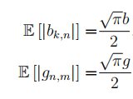




3 RIS phase shift and hybrid beamforming design
Unachievable
ideal situation
If M tends to infinity, for hybrid beamforming in RIS-aided MU-MIMO
systems, the sum rate R is upper bounded by
Upper bound
Proof
Denoting:
It can be maximized only when
However,
The problem leads to an indeterminate equation.
central limit theorem

Slide 9






3 RIS phase shift and hybrid beamforming design
Basic Solution
If M tends to infinity, for hybrid beamforming in RIS-aided MU-MIMO
systems, the sum rate R is lower bounded by
Lower bound
Proof
equations are completely solved.
equations are ignored, the phases of
these items are viewed as random.
is random phase
central limit theorem
has the same distribution as

Slide 10


3 RIS phase shift and hybrid beamforming design
Upper bound
Theoretical analysis
Lower bound
Similarly, the upper bound of channel power in fully digital (FD)
RIS-aided MU-MIMO systems as can be derived as
Hybrid beamforming structure can achieve channel power gain of which in FD structure.
Linear gain with M and square gain with N
on channel power.
Upper bound and lower bound at large M and N

Slide 11

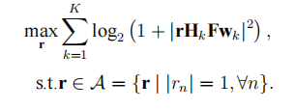




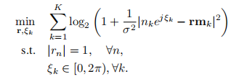


3 RIS phase shift and hybrid beamforming design
RIS problem approxiamation
Alternative GP method for RIS design
Get rid of the inter-user interference in RIS configuration
How to design algorithm to approach the
upper bound?
Denoting
Hybrid beamforming design
with is introduced auxiliary variable to increase degree of freedom of phase shift

Slide 12




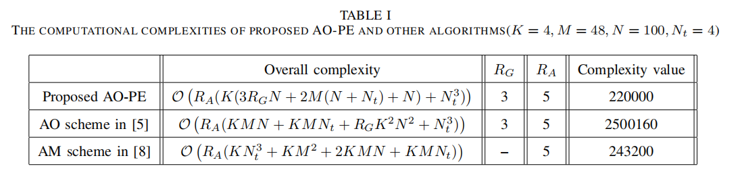
4 Complexity analysis
Complexity cost in RIS design
Complexity cost in hybrid beamforming
The complexity includes the computation of
construct
The complexity contains
gradient computation
How to judge complexity cost reduction?
The MMSE beamforming

Slide 13
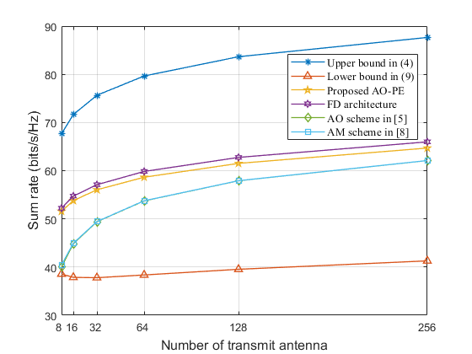
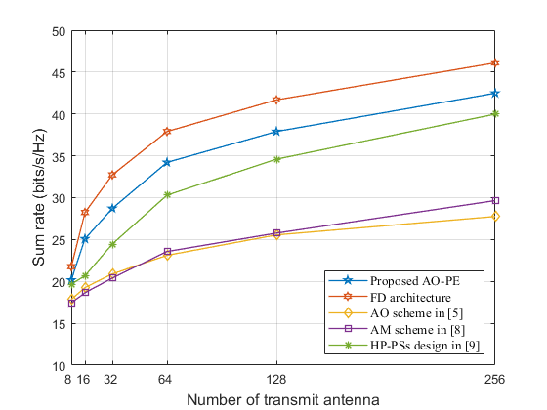
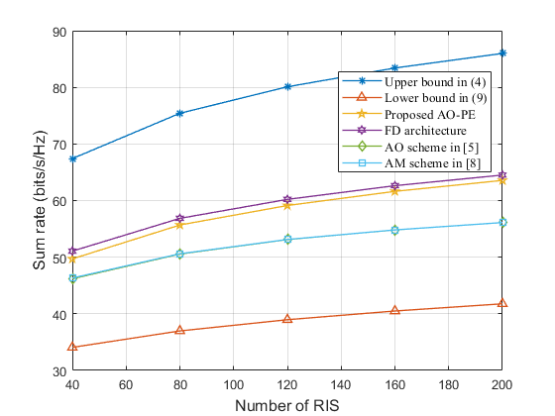
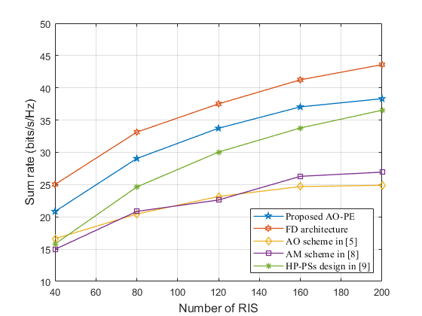
5 Simulations
Rayleigh fading channels
mmWave channels
It can be demonstrated that extending the sizes of transmit antenna and RIS brings linear gain and square gain on channel power.
Regardless of the sizes of transmit antenna array and RIS, the proposed AO-PE always attain better performance.
The FD architecture can attain the highest sum rate, but it suffers expensive RF chain hardware cost.
Notes:
performance

Slide 14
Thank you for your watching
Yuanli Ma, Bin Yan, Zheng Wang, Zhen Gao
Southeast University
2026.05.09

