Slide 1

Linear Detection Based on Block-Wise Low-Rank Matrix Approximation for XL-MIMO Systems
Xiaochen Ma, Lanxin He, Zheng Wang and Yongming Huang
Southeast University
2026.5.9

Slide 2

Contents
01
Background
02
System Model
03
Block-Wise Detection Scheme
04
Simulation
05
Conclusion

Slide 3
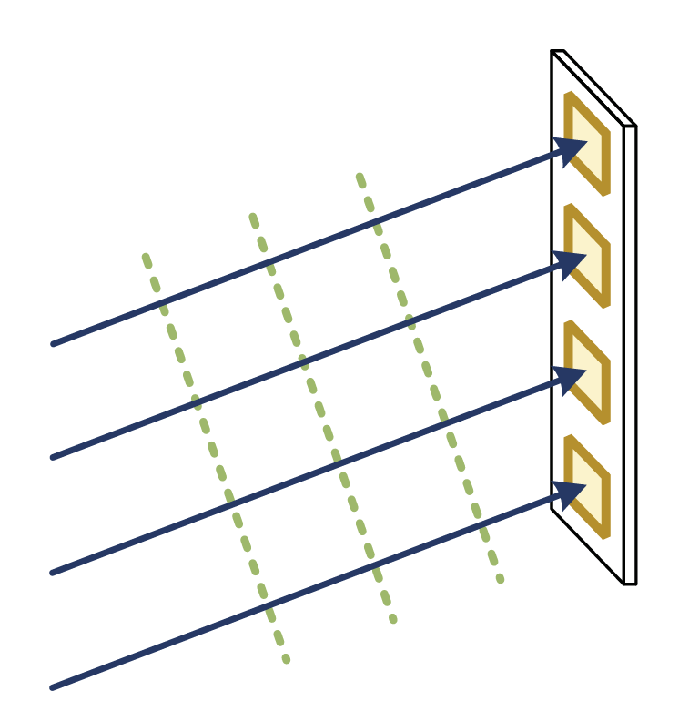
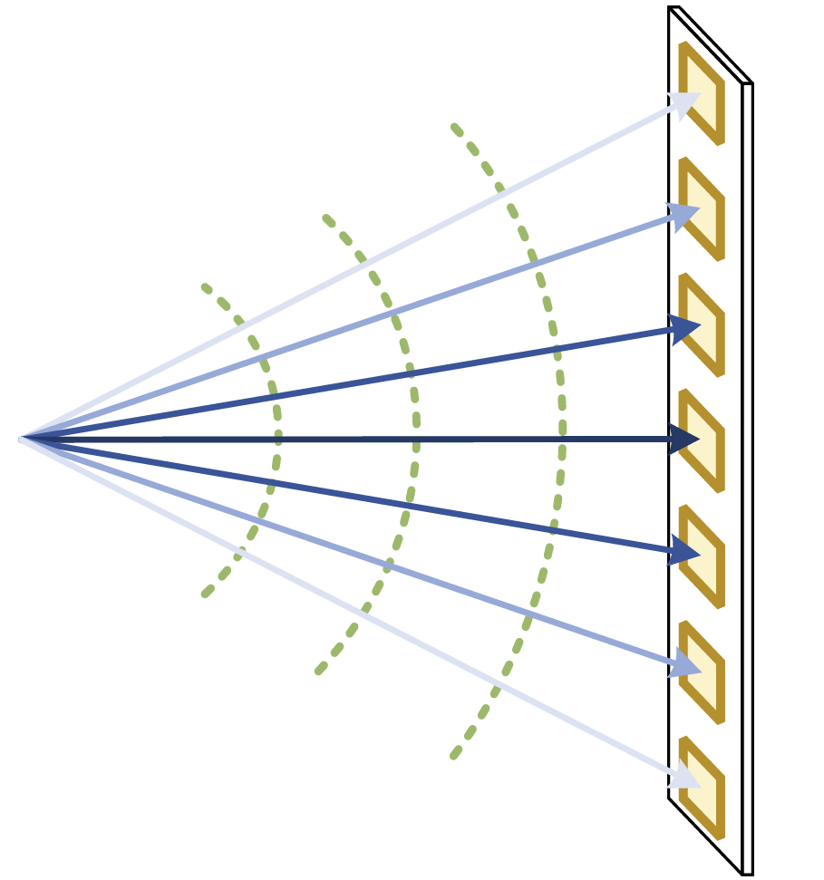
1 Background
Importance of XL-MIMO
with the growing number of antennas at the both sides of XL-MIMO systems
Function: significantly improve the spectral and energy efficiency
Role: a key pillar in 6G communication networks
Far-field
Near-field
Far-Field Array Response Vector
Rayleigh distance
Near-Field Array Response Vector
Uniform plane wave
Non-uniform spherical wave

Slide 4
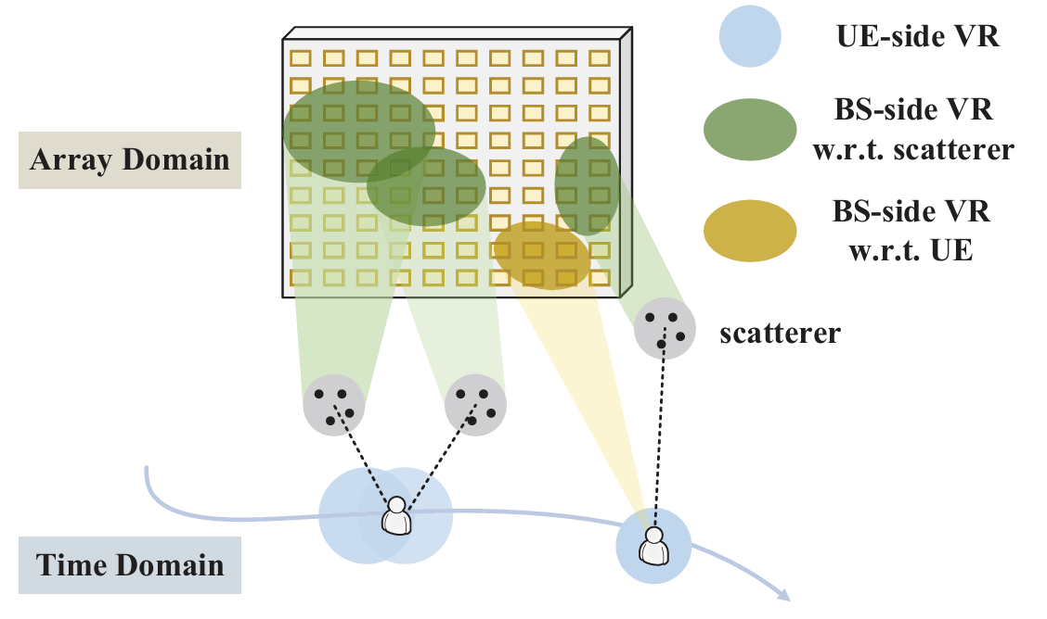


1 Background
Spatial non-stationarity
Different portions of the array may experience distinct propagation environment.
Visibility Region (VR) can be utilized to characterize spatial non-stationarity.
Challenge upon the Uplink Signal Detection
Linear Detection (ZF and MMSE)
Advantage:
achieve near-optimal ML detection performance
Disadvantage:
still with computational complexity
$$𝒪\left(NK^{2}\right)$$

Slide 5
1 Background
Low-rank Approximation
Truncated SVD (TSVD)
Low-rank matrix fitting (LMaFit)
optimal in the Frobenius norm sense
prohibitive SVD complexity
require prior knowledge of the truncation rank
alternating minimization procedure
the initial rank estimate need not be close to the exact rank
exploit the low-rank structure of the channel matrix

Slide 6
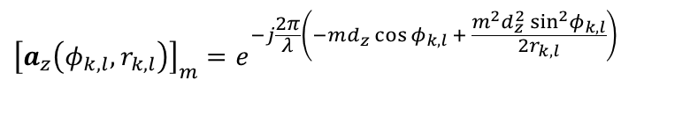

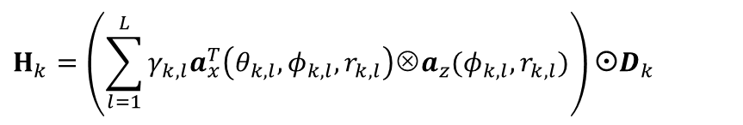
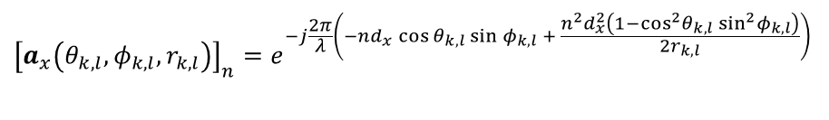

2 System model
System Model
Channel Model
$$M_{x}×M_{z}→N_{x}×N_{z}$$
$$H_{k}=\left(\sum_{l=1}^{L}{γ_{k,l}a_{x}^{T}\left(θ_{k,l},φ_{k,l},r_{k,l}\right)Υa_{z}(φ_{k,l},r_{k,l})}\right)D_{k}$$
$${\left[a_{x}\left(θ_{k,l},φ_{k,l},r_{k,l}\right)\right]}_{n}=e^{−j\frac{2π}{λ}\left(−nd_{x}\cos{θ_{k,l}}\sin{φ_{k,l}} + \frac{n^{2}d_{x}^{2}\left(1−\cos^{2}θ_{k,l} \sin^{2}φ_{k,l}\right)}{2r_{k,l}}\right)}$$
$${\left[a_{z}\left(φ_{k,l},r_{k,l}\right)\right]}_{m}=e^{−j\frac{2π}{λ}\left(−md_{z}\cos{φ_{k,l}} + \frac{m^{2}d_{z}^{2} \sin^{2}φ_{k,l}}{2r_{k,l}}\right)}$$
$$H=\left[H_{1},⋯,H_{K}\right]$$
Each user is assumed to be visible to B subarrays
$H_{k}$ exhibits the low-rank structure when $L<min\left(M_{x},M_{z}\right)$

Slide 7
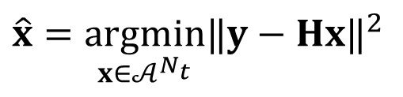
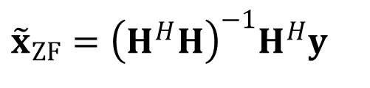






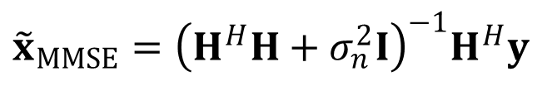


2 System model
Detection
$$\hat{x}=\underset{x∈𝒜^{N_{t}}}{\text{argmin}}​‖y−Hx‖^{2}$$
Exponentially increased complexity
Optimal ML
Linear Detection
$${\tilde{x}}_{ZF}={\left(H^{H}H\right)}^{−1}H^{H}y$$
$${\hat{x}}_{ZF}=Q({\tilde{x}}_{ZF})∈𝒜^{N_{t}}$$
$${\tilde{x}}_{MMSE}={\left(H^{H}H+σ_{n}^{2}I\right)}^{−1}H^{H}y$$
$${\hat{x}}_{MMSE}=Q({\tilde{x}}_{MMSE})∈𝒜^{N_{t}}$$
$G=H^{H}H$ → complicated matrix multiplication
$$H_{k}$$
$$H_{k,z}$$
$$H_{k,x}^{H}$$
To reduce the computational complexity
$$M_{z}×M_{x}$$
$$M_{z}×r$$
$$r×M_{x}$$

Slide 8


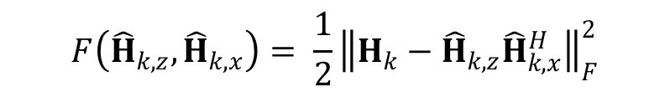
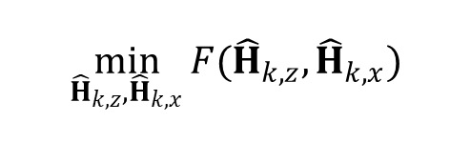

3 Block-wise LMaFit-based Linear Detection Scheme
Linear Detection
matrix multiplication
A. LMaFit
Rank-increasing adaptation strategy
$$\min_{{\hat{H}}_{k,z},{\hat{H}}_{k,x}}{F({\hat{H}}_{k,z},{\hat{H}}_{k,x})}$$
Residual matrix
$$F\left({\hat{H}}_{k,z},{\hat{H}}_{k,x}\right)= \frac{1}{2}{\left\|H_{k}−{\hat{H}}_{k,z}{\hat{H}}_{k,x}^{H}\right\|}_{F}^{2}$$
$$S^{(t)}=H_{k}−{\hat{H}}_{k}^{\left(t\right)}=H_{k}−{\hat{H}}_{k,z}^{(t)}{\hat{H}}_{k,x}^{(t)H}$$
Select the dominant residual direction
Directly optimizes the factor matrices
Complexity order
$$𝒪\left(M_{x}M_{z}\right)$$
How to construct Gram matrix

Slide 9
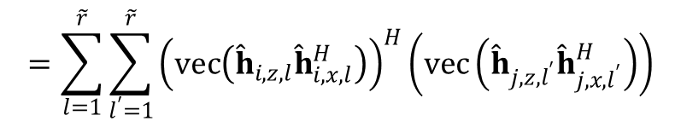


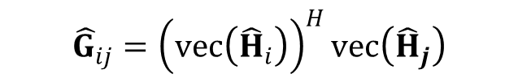


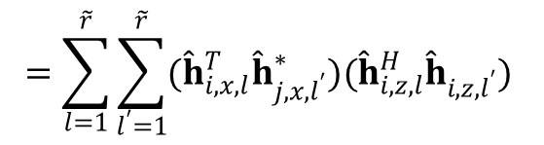

3 Block-wise LMaFit-based Linear Detection Scheme
B. Complexity Analysis
Dependent on the rank $\tilde{r}$
Gram matrix construction
$$𝒪\left({\tilde{r}}^{2}(M_{x}+M_{z})K^{2}\right)$$
$${\hat{G}}_{ij}={\left(vec\left({\hat{H}}_{i}\right)\right)}^{H}vec\left({\hat{H}}_{j}\right)$$
$$=\sum_{l=1}^{\tilde{r}}{\sum_{l^{′}=1}^{\tilde{r}}{{\left(vec\left({\hat{h}}_{i,z,l}{\hat{h}}_{i,x,l}^{H}\right)\right)}^{H}\left(vec\left({\hat{h}}_{j,z,l^{′}}{\hat{h}}_{j,x,l^{′}}^{H}\right)\right)}}$$
Reduce ${\tilde{r}}^{2}$ to $\frac{\tilde{r}(\tilde{r}+1)}{2}$
the conjugate symmetry between path-pair $(l,l^{′})$
$$=\sum_{l=1}^{\tilde{r}}{\sum_{l^{′}=1}^{\tilde{r}}{({\hat{h}}_{i,x,l}^{T}{\hat{h}}_{j,x,l^{′}}^{∗})({\hat{h}}_{i,z,l}^{H}{\hat{h}}_{i,z,l^{′}}) }}$$
Further complexity reduction
when the required $\tilde{r}$ increases
$$\hat{G}=\sum_{l=1}^{\tilde{r}}{\sum_{l^{′}=1}^{\tilde{r}}{{\left({\hat{H}}_{x,l }^{H}{\hat{H}}_{x,l^{′}}\right)}^{∗}\left({\hat{H}}_{z,l }^{H}{\hat{H}}_{z,l^{′}}\right)}}$$

Slide 10
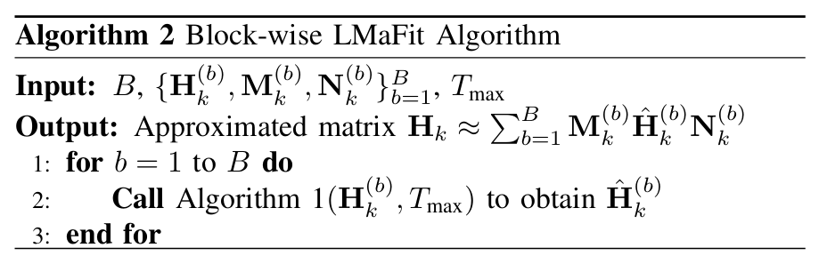
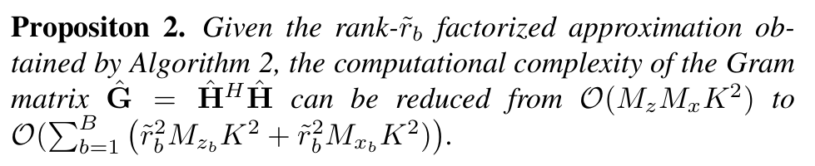

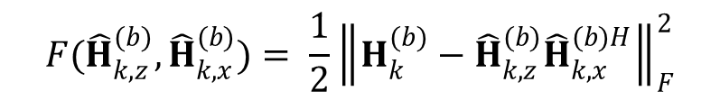
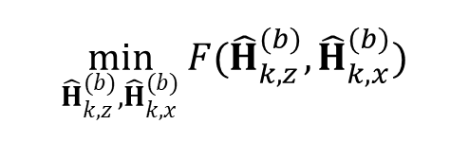

3 Block-wise LMaFit-based Linear Detection Scheme
A. Algorithm Description
$$M_{k}^{(b)}$$
Row selection matrices
$$N_{k}^{(b)}$$
Column selection matrices
Complexity of Gram matrix
Factorized optimization formulation
$$\min_{{\hat{H}}_{k,z}^{(b)},{\hat{H}}_{k,x}^{(b)}}{F({\hat{H}}_{k,z}^{(b)},{\hat{H}}_{k,x}^{(b)})}$$
Each block channel typically admits a smaller effective rank
$$F({\hat{H}}_{k,z}^{(b)},{\hat{H}}_{k,x}^{(b)})= \frac{1}{2}{\left\|H_{k}^{(b)}−{\hat{H}}_{k,z}^{(b)}{\hat{H}}_{k,x}^{(b)H}\right\|}_{F}^{2}$$
Reduce dimensionality in matrix multiplication

Slide 11
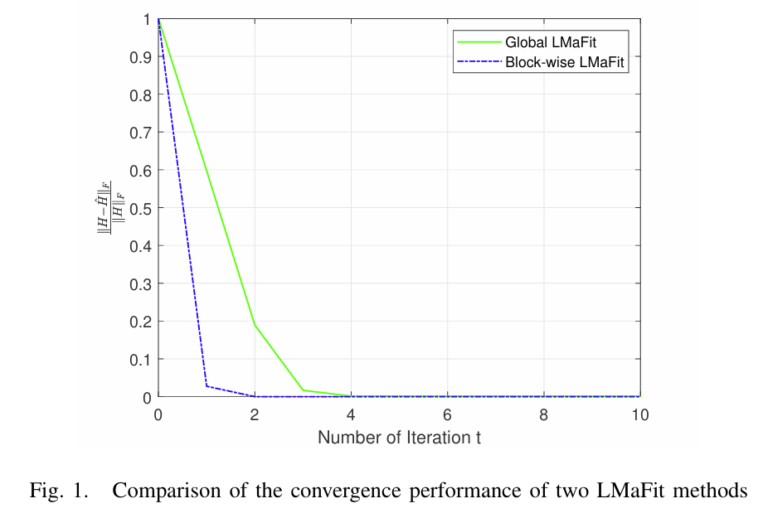

3 Block-wise LMaFit-based Linear Detection Scheme
B. Convergence Analysis
Compare two LMaFit methods
Stationary-point behavior
The block-wise LMaFit converges to a stationary point of the same global objectiveas the global LMaFit.
Per-iteration residual reduction behaviors
For a fixed residual matrix S(t), under optimal matrix approximations,
$${\left\|S_{block}^{(t+1)}\right\|}_{F}^{2}≤{\left\|S_{global}^{(t+1)}\right\|}_{F}^{2}$$

Slide 12
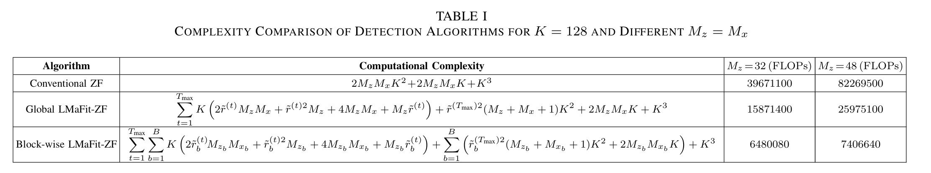
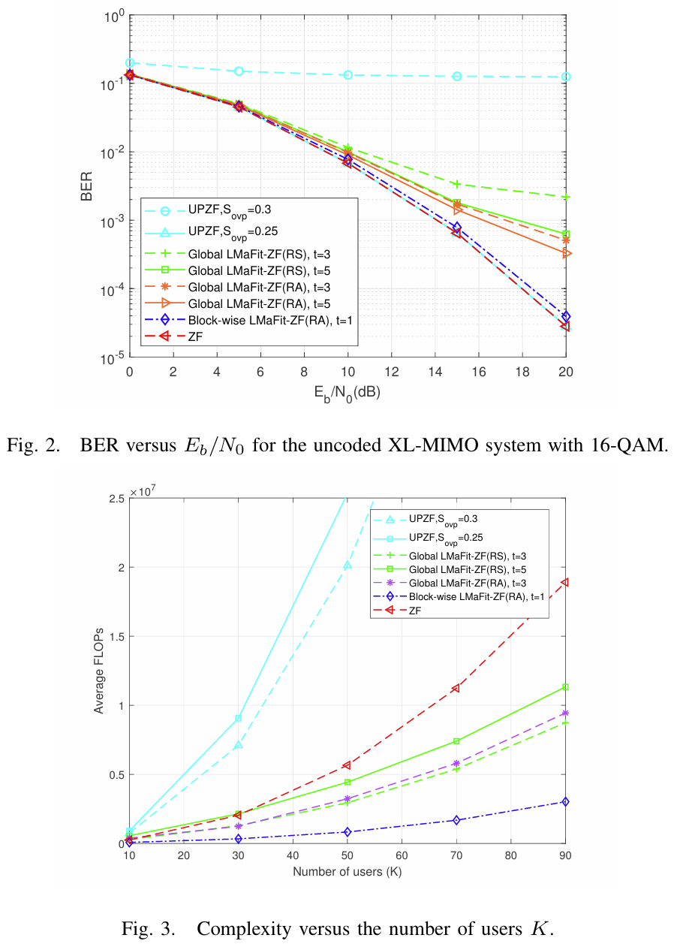
4 Simulations
Detection Performance
Variable | Value
Number of users | 32
Number of antennas at base station | 32×32
Number of paths | 8
Number of visible subarrays | 4
Block-wise LMaFit-ZF > Global LMaFit-ZF
ZF detection is applied as the baseline
Low-rank approximation representation reduce the computational complexity

Slide 13
5 Conclusion
Propose block-wise LMaFit-based low-complexity detection method in XL-MIMO systems.
XL-MIMO
New properties: near-field with non-uniform spherical wave and spatial channel non-stationarity
Low rank channel structure
Block-wise LMaFit-based Linear Detection
Reconstruct the channel matrix by low-rank approximation
Low-complexity Gram matrix construction
Achieves a ZF/MMSE detection performance with significantly complexity reduction

Slide 14
Thank you for your watching
Xiaochen Ma, Lanxin He, Zheng Wang and Yongming Huang
Southeast University
2026.5.9

