Slide 1
DATABASE MANAGEMENT SYSTEM PROJECT REVIEW
Department of Artificial Intelligence and Data Science
Academic Year: 2024 – 2025 (Even Semester)
Register Number : 2303811724321100
Name : SEVENHILLSVASA S
Year : II
Semester : IV
Section : B
Date : 04-06-2025

Slide 2
TITLE OF THE PROJECT
CRIME RECORD MANAGEMENT SYSTEM

Slide 3
PROBLEM IDENTIFIED
In 2023, police mishandled a burglary case
Vital evidence lost due to data mismanagement
No centralized platform for real-time updates
Limited data access slowed down case resolution

Slide 4
OBJECTIVE
Develop a unified, real-time crime tracking system
Ensure data integrity with duplicate prevention checks
Interactive UI enabling quick crime data access
Visualize case trends for proactive crime control

Slide 5
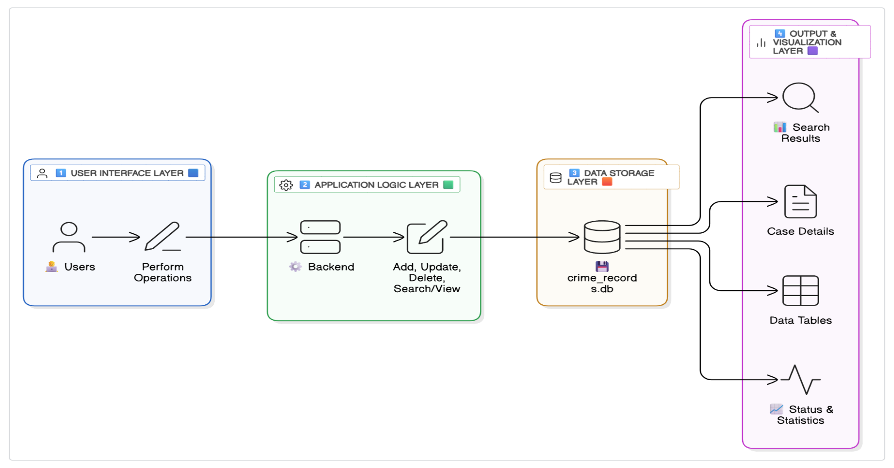
PROPOSED ARCHITECTURE

Slide 6
MODULE LIST
Data Management
Case Operations
Search And Filter
Data Visualization

Slide 7
MODULE IMPLEMENTED
✅ DATA MANAGEMENT
Sets up SQLite database and tables automatically (setup_db()).
Manages database connections efficiently (connect_db()).
Ensures data integrity with unique constraints on records.
Supports all CRUD operations via database queries.

Slide 8
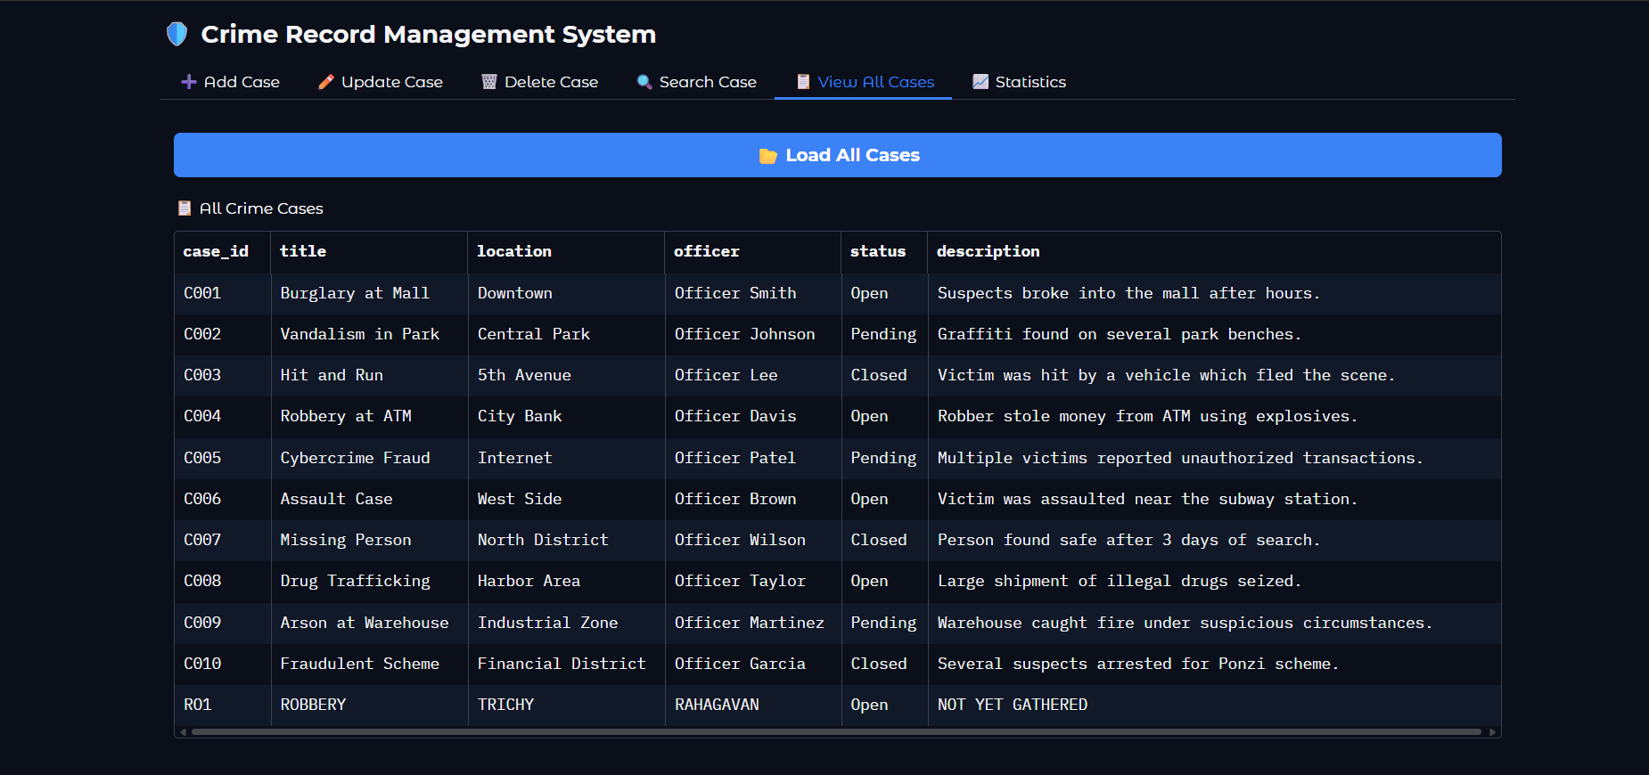
MODULE IMPLEMENTED

Slide 9
MODULE IMPLEMENTED
✅ CASE OPERATION
Adds new crime cases with duplicate prevention (insert_case())
Updates existing case records with validation (update_case())
Deletes cases safely from the database (delete_case())
Fetches specific cases by case ID (fetch_case_by_id())

Slide 10
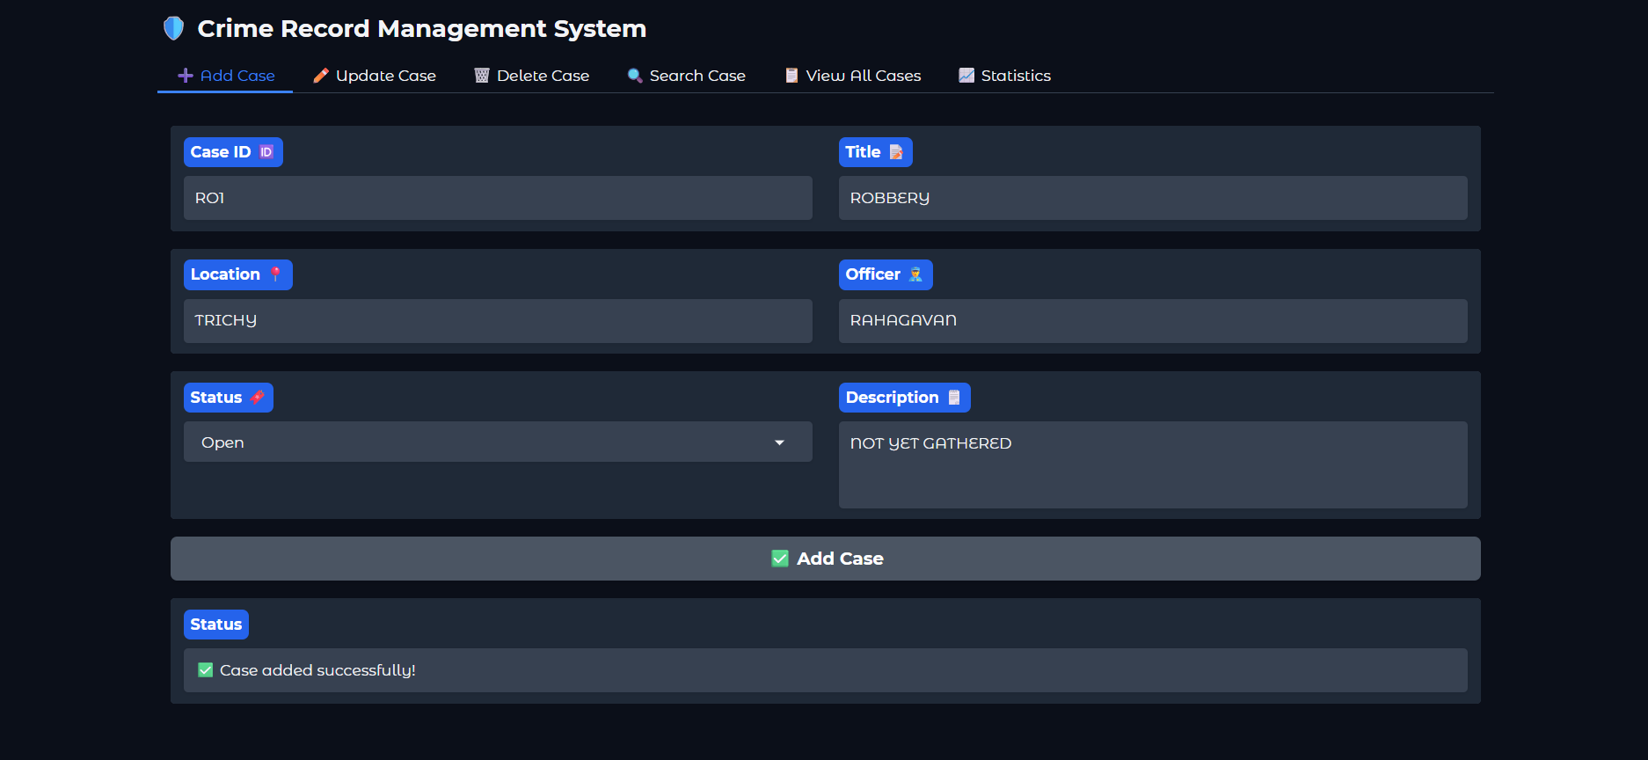
MODULE IMPLEMENTED

Slide 11
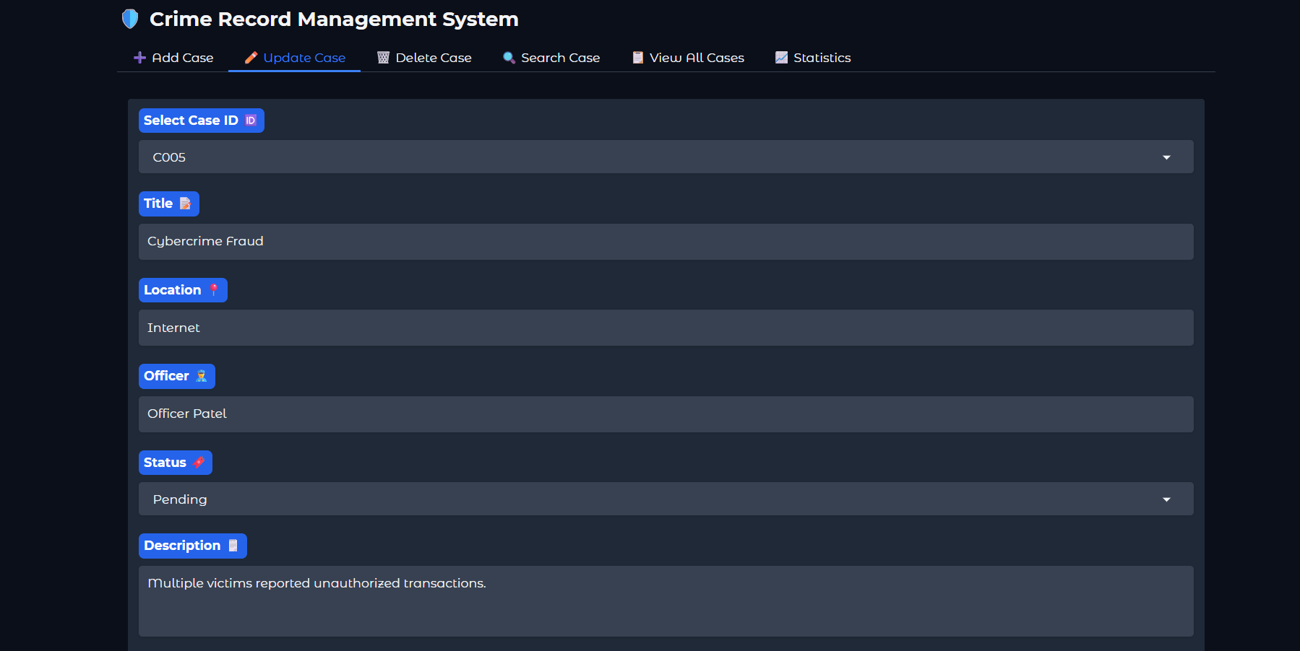
MODULE IMPLEMENTED

Slide 12
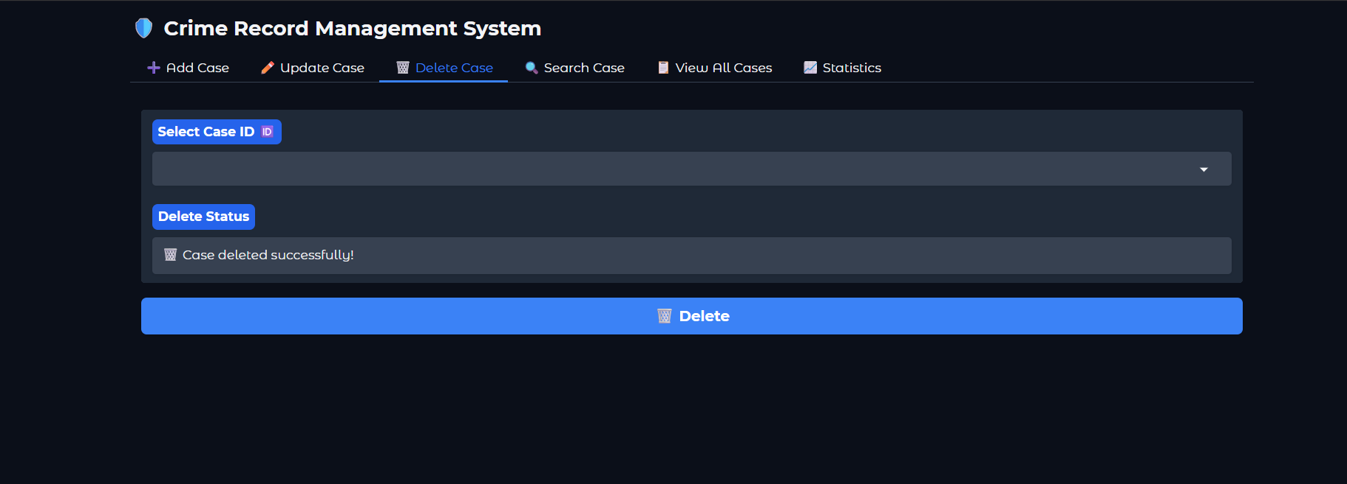
MODULE IMPLEMENTED

Slide 13
MODULE IMPLEMENTED
✅ SEARCH AND FILTER
Performs keyword search across all case fields (search_cases())
Filters cases by status, location, and officer attributes
Supports both partial and exact keyword matches
Returns filtered data for display in UI tables
.

Slide 14
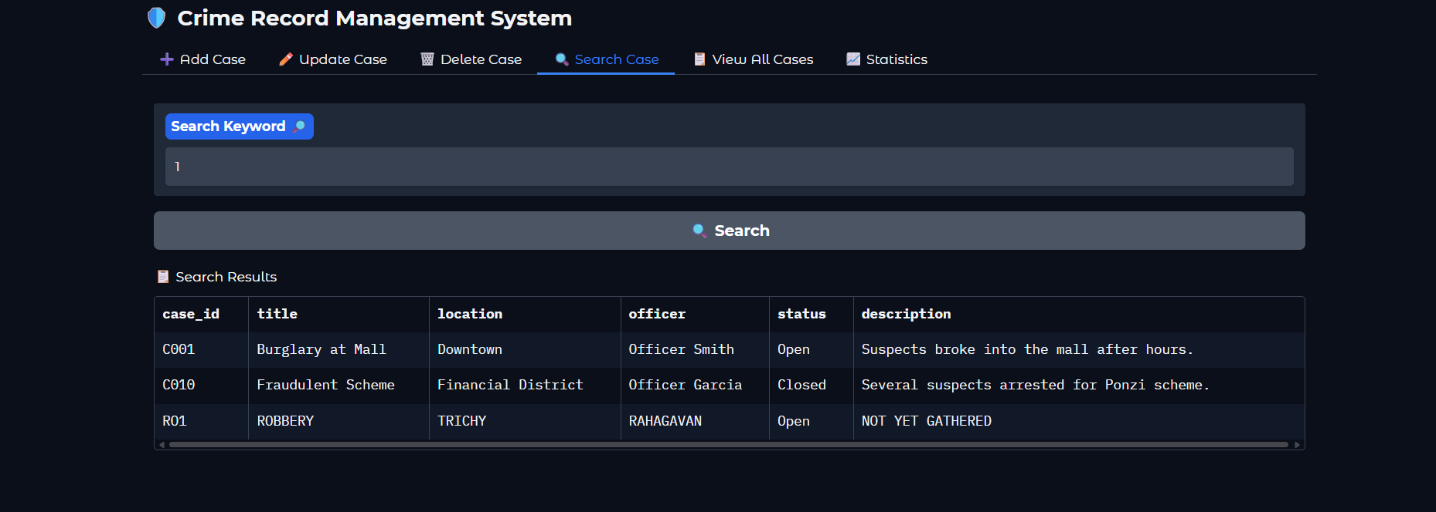
MODULE IMPLEMENTED

Slide 15
MODULE IMPLEMENTED
✅ DATA VISUALIZATION
Generates bar charts for case status distribution (plot_status_chart())
Fetches live data from database for chart updates (view_all())
Uses Matplotlib library for clear visualizations
Helps analyze trends and patterns in crime data
.

Slide 16
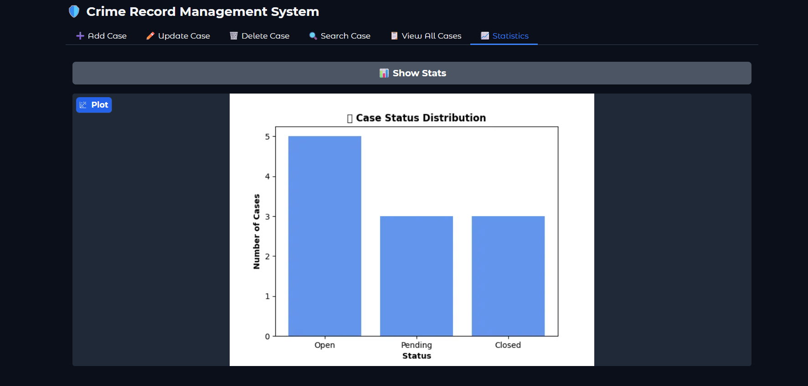
MODULE IMPLEMENTED

Slide 17
CONCLUSION
✅ Conclusion:
I built a basic crime record management system for managing cases.
It shows case data and allows adding, updating, deleting, and searching.
🚀 Future Scope:
Make it available online.
Add user logins for security.
Show more graphs and insights.

Slide 18
Thank You
Any queries???

