Slide 1
CGB1201 – JAVA PROGRAMMING
Department of Artificial Intelligence and Data Science
Academic Year: 2024 – 2025 (Odd Semester)
Register Number : 2303811724321100
Name : SEVENHILLSVASA S
Year : II
Semester : III
Section : B
Date : 03-12-2024

Slide 2
Title of the Project
LIBRARY MANAGEMENT SYSTEM

Slide 3
Problem Identification
Current Challenge:
Managing library operations like book borrowing, returning, and user management manually is time-consuming.
Impact:
Inefficiency in tracking books.
Difficult to monitor borrowed or reserved books.
Lack of a structured user and book management system.

Slide 4
Objective
To design a Library Management System that ensures:
Efficient book and user management.
Quick borrowing, returning, and reservation of books.
A user-friendly interface for librarians and users.

Slide 5
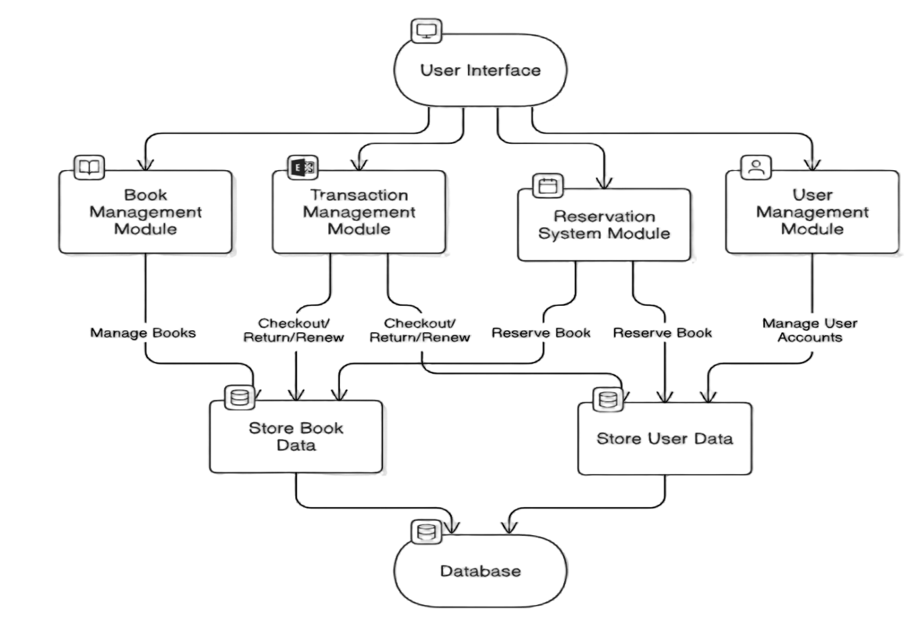
Proposed Architecture

Slide 6
Java Programming - Concepts Used
GUI Programming (AWT)
Exception Handling
Inheritance
Event Handling
Collections (HashMap, ArrayList)

Slide 7
List of Modules
Module 1: Book Management
Module 2: User Management
Module 3: Transaction Management
Module 4: Reservation System

Slide 8
Module Description
Module 1: Book Management
The Book Management module helps librarians manage the library's collection.
Key Functions:
add Book
remove Book
search Books

Slide 9
Module Description (Cont..)
Module 2: User Management
The User Management module allows the librarian to register new users and manage their roles.
Key Functions:
register User
cancel Membership

Slide 10
Module Description (Cont..)
Module 3: Transaction Management
The Transaction Management module tracks the borrowing, returning, and renewing of books.
Key Functions:
checkout Book
return Book
renew Book

Slide 11
Module Description (Cont..)
Module 4: Reservation System
The Reservation System lets members reserve books that are currently unavailable.
Key Function:
reserve Book

Slide 12
Source Code
private void searchBookLibrarian() {
String query = JOptionPane.showInputDialog("Enter book name to search:");
if (query != null && !query.isEmpty()) { boolean found = false;
query = query.trim().toLowerCase();
for (String book : books) {
if (book.toLowerCase().contains(query)){ found = true; break;
if (found) {
showMessage("Book found: " + query);
}
private void createLibrarianDashboard() {
Panel librarianPanel = new Panel()librarianPanel.setLayout(new GridLayout(6, 1, 10, 10));
Label lblTitle = new Label("Librarian Dashboard", Label.CENTER);
lblTitle.setFont(new Font("Arial", Font.BOLD, 16));
Button userMgmtBtn = new Button("User Management");
Button bookMgmtBtn = new Button("Book Management");
Button borrowMgmtBtn = new Button("Borrow/Return Books");
Button searchBtn = new Button("Search Books");

Slide 13
Source Code
private voidcreateBookManagementPage() {
Panel bookMgmtPanel = new Panel();
bookMgmtPanel.setLayout(new FlowLayout());
Label lblTitle = new Label("Book Management", Label.CENTER);
lblTitle.setFont(new Font("Arial", Font.BOLD, 16));
Label lblBook = new Label("Book Name:");
TextField txtBook = new TextField(20);
Button addBtn = new Button("Add Book");
Button deleteBtn = new Button("Delete Book");
private void renewBook() {
showMessage("Book Renewed.");
}
private void reserveBook() {
String bookName = JOptionPane.showInputDialog("Enter book name to reserve:");
if (bookName != null && !bookName.isEmpty()) {
reservedBooks.add(bookName);
showMessage("Book Reserved: " + bookName);
}
}
private void showMessage(String message) {
JOptionPane.showMessageDialog(this,

Slide 14
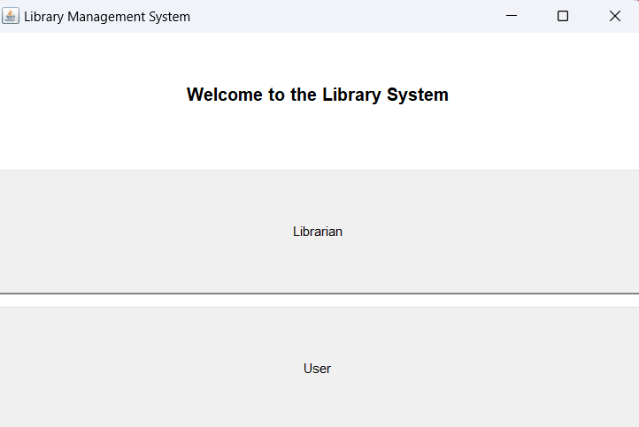
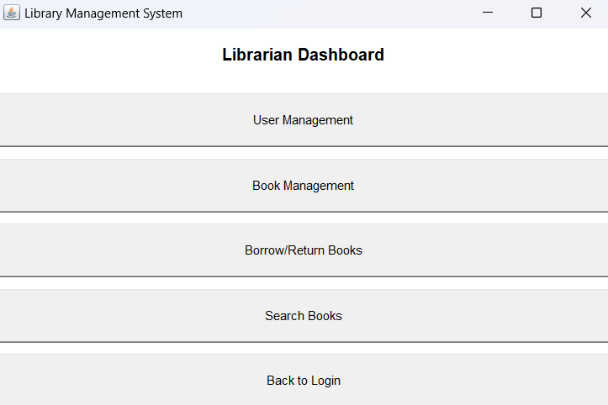
Results

Slide 15
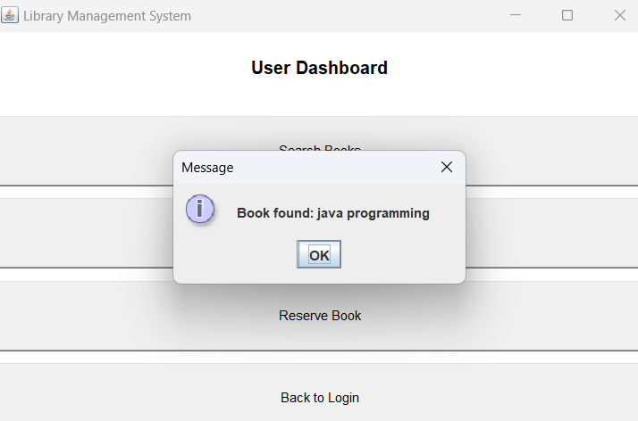
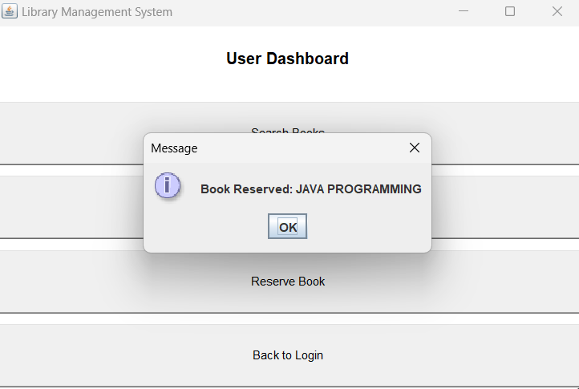
Results

Slide 16
Conclusion
The Library Management System simplifies library operations by automating book management, user registration, and transactions.
Future enhancement like cloud integration will improve system efficiency.

Slide 17
Thank You
ANY QUERIES???

