Slide 1


Slide 2
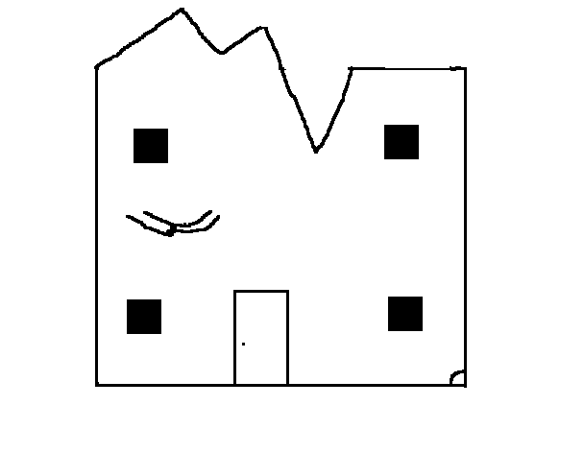
One stormy day there was a mouse . He needed a mouse hole so he went to this house and tried to nibble the wall. But it did not work so he used tools.
He tried a gun, a saw
a knife, screwdriver and a
laser. But nothing
worked.

Slide 3
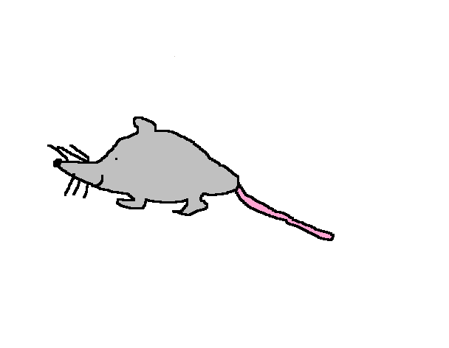
Then he heard the garage door opening. He was about to run, but it was to late, he saw an old lady and a snake plus a cat, so he ran as fast as he could possible do. When he looked behind, he saw the snake and the cat, so he ran to the attic, then the old lady got the snake and the cat.

Slide 4

Then after one day when the old lady was not at home , he tried again to make his mouse hole. But it still didn’t work, the old lady suddenly came through the front door, and then she dropped something, the mouse started to run like crazy, he was looking behind him, then he hit and crashed a wall and he made a perfect mouse hole.

