Slide 1
Playwright

Slide 2
Installation Node.js

Slide 3
Installation VS Code

Slide 4
Création du Workspace

Slide 5
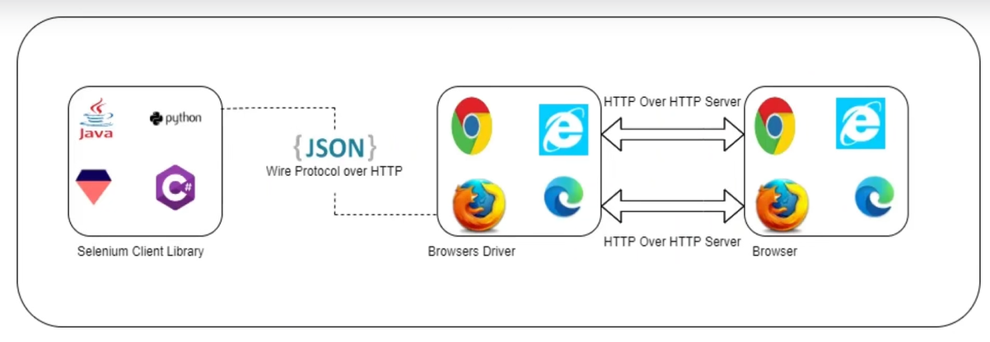
Architecture Playwright
Selenium

Slide 6
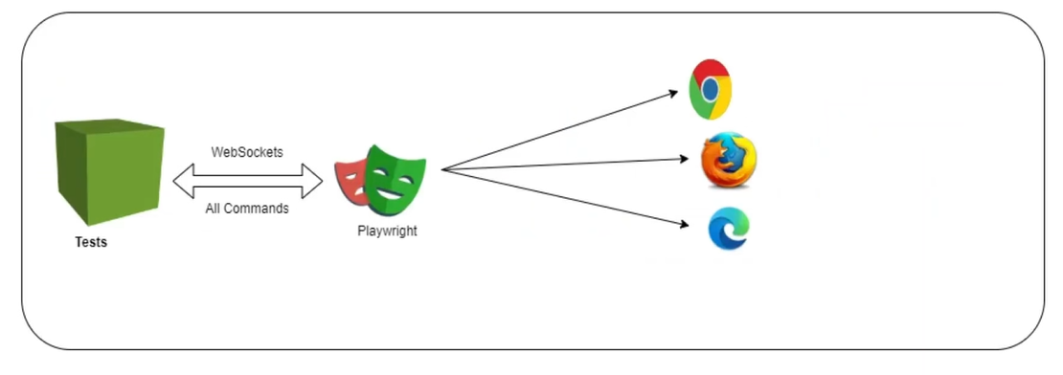
Architecture Playwright
Playwright

Slide 7
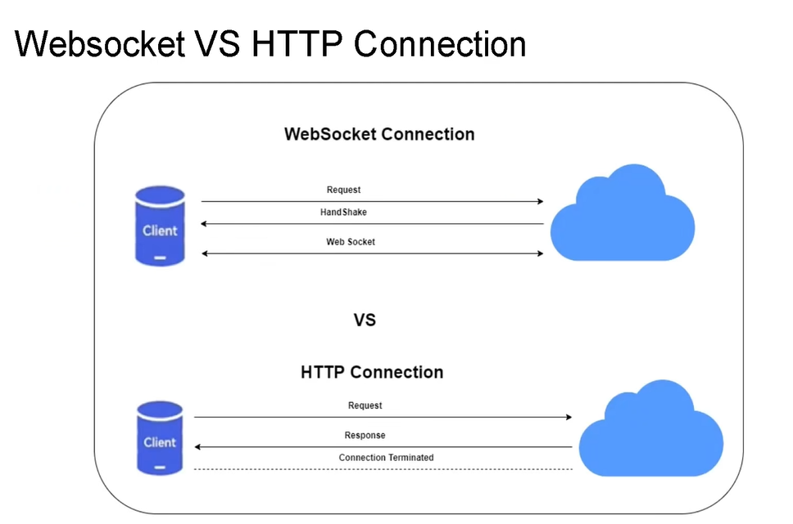

Slide 8
Création des dépendances – Initialisation du projet
Npm init playwright@latest

Slide 9
Vérification de la version du pw
Npx playwright --version

Slide 10
Mise à jour de la version PW
Npm install @playwright/test@1.49

Slide 11
Exécution du Test
Node_module appelle playwright.config.js et ce dernier execite les tests qui sont dans le folder « testDir: ‘./tests’,
Il execute par defaut les tests de la même suite d’une manière sequentielle.
Pour lancer un test : npx playwright test (en mode headless – sans affichage du navigateur et les étapes des tests).
Pour lancer les tests en mode head (avec affichage du browser) :
npx playwright test –headed

Slide 12
Exécution du Test
Pour lancer un test spécifique (un seul test) => on met test.only(‘’, {}), ou bien on clique seulement sur le bouton > run du test sur vs code
Pour lancer certains tests (ex : 2 tests files / 5) : npx playwright test first.spec.ts second.spec.ts
Ou bien : npx playwright test first second
Lancer le test en utilisant le titre du test : npx playwright test –g ‘myTest’
npx playwright test –project=chromium

Slide 13
Locators
ID => #id ou tagname#id
Ex : <input type=‘text’ name=‘username’ id=‘username’>
Page.locator(‘#username’)
Class => .class ou tagname.class
Ex : <input type=‘text’ name=‘username’ id=‘username’ class=‘input-fld’>
Page.locator(‘. input-fld’)
Attribut => [attribute=‘nameofatrri’]
Ex : <input type=‘password’ name=‘username’ id=‘username’>
Page.locator(‘[type=‘password’]’)

Slide 14
assertions
Simple expect
Expect.soft

Slide 15
Child windows
test.only("child windows handling", async ({ browser }) => {
const context = await browser.newContext();
const page = await context.newPage();
await page.goto("https://rahulshettyacademy.com/loginpagePractise");
const locator_link = page.getByRole("link", {
name: "Free Access to InterviewQues/ResumeAssistance/Material",
});
// before click a blank link ;;; must tell playwright that a page will be displayed
// switch to the new context for the second page
const [page_2] = await Promise.all([
context.waitForEvent("page"), // listen for any new page - don't use wait to make 2steps playing in parallel
await locator_link.click(),
]);
const red_parag = await page_2
.locator(".red")
.getByRole("link")
.textContent();
await page_2.close();
const domain = red_parag.split("@");
await page.locator("#username").fill(domain[1]);
//switch window-Tab
});

Slide 16
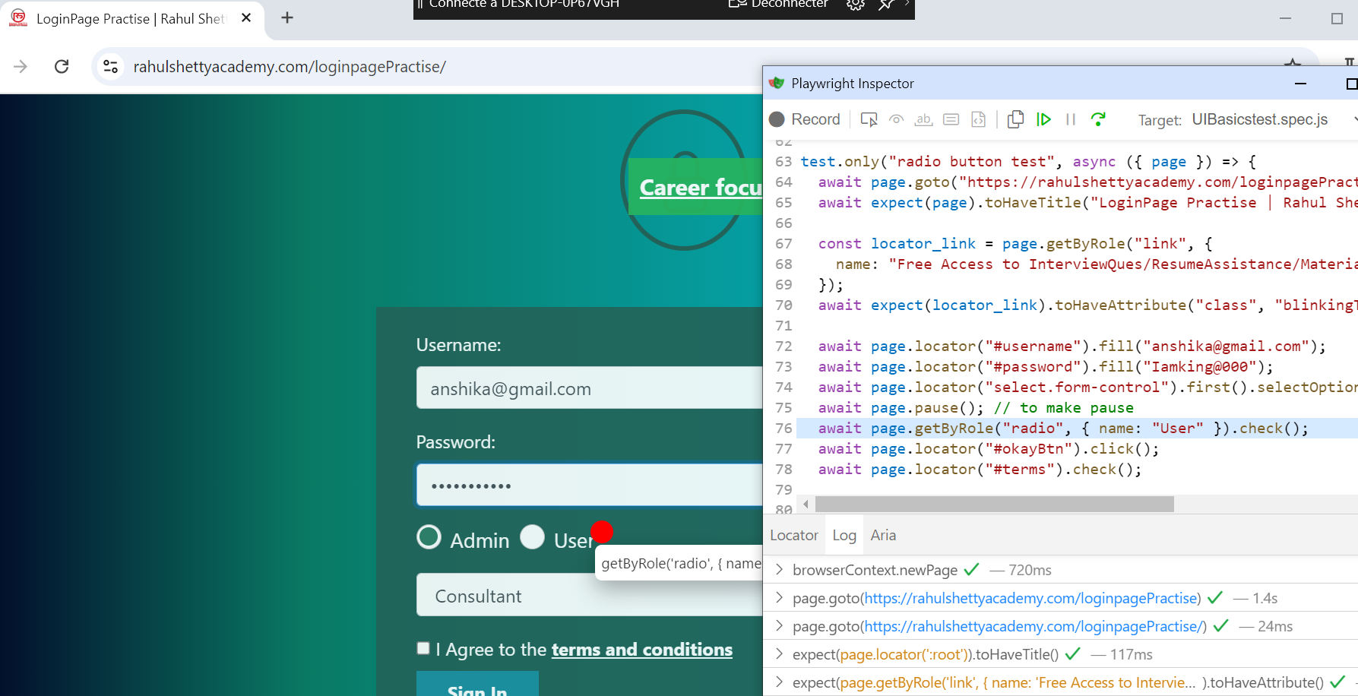
Debug
Npx playwright test tests/UIBasicstest.spec.js –debug

Slide 17
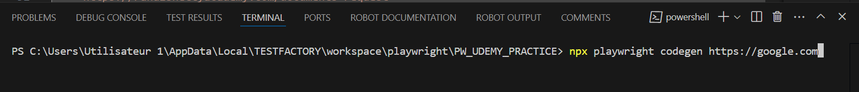
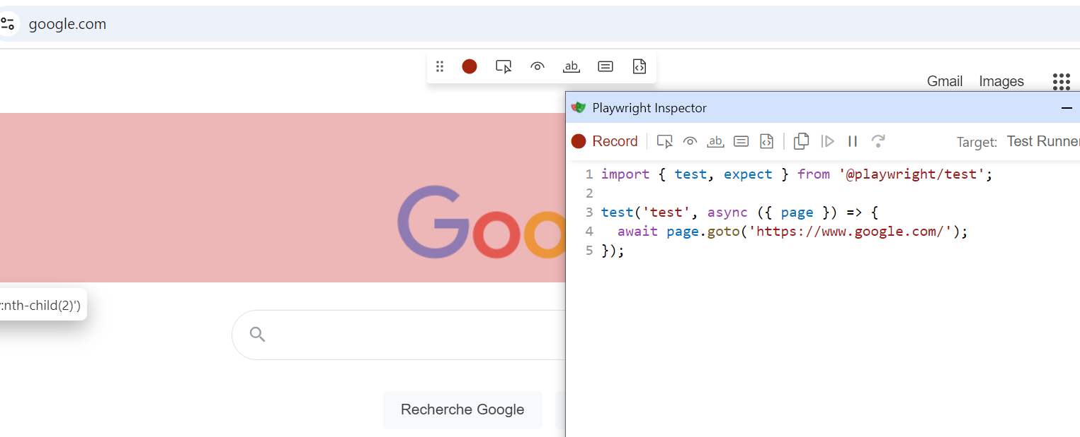
Codegen
Pour enregistrer un script auto

Slide 18
Codegen
Options
npx playwright codegen –browser firefox
Pour copier le code generé par codegen et creér un fichier pour le test : npx playwright codegen –o ./tests/codegenAuto.spec.ts
(-o : output)
npx playwright codegen –viewport-size=800,600
npx playwright codegen –device=« iPhone 11 pro »
npx playwright codegen –help

Slide 19
Traces
Npx playwright show-trace ./test-results/firstTest-first-test-chromium-retry1/trace.zip
Ou bien sur : trace.playwright.dev => upload the file
Npx playwright test –trace on-first-retry

Slide 20
Report
Screenshot

Slide 21
iFrame
test("frame handeling Validation", async ({ page }) => {
await page.goto("https://rahulshettyacademy.com/AutomationPractice/");
const framesPage = page.frameLocator("#courses-iframe");
await framesPage.locator('li a[href*="lifetimeaccess"]:visible').click();
await expect(framesPage.getByText("Join 13,522 Happy Subscibers!")).toHaveText("Join 13,522 Happy Subscibers!");
});

Slide 22
API
test.beforeAll("login", async ({ request }) => {
//const apiContext = await request.newContext();
const response = await request.post(
"https://rahulshettyacademy.com/api/ecom/auth/login",
{
data: {
userEmail: « email@gmail.com",
userPassword: « pw@000",
},
}
);
expect(response.ok()).toBeTruthy();
expect(response.status()).toEqual(200);
const loginResponseJSON = await response.json();
//expect(loginResponseJSON.status()).toEqual(200);
accessToken = loginResponseJSON.token;
console.log(accessToken);
});

Slide 23
Page Object

Slide 24
PO Manager

Slide 25
JSON Lib

Slide 26
retries
config

Slide 27
Serial and parallel execution
Par defaut : exécution des tests du même fichier se fait en serie.
Tests des différents fichiers se fait en parallel. En différents WORKERS.
1 worker => 1 test file
Pour exécuter les tests du même fichier en parallel :
test.describe.configure({mode:'parallel’});
Running 6 tests using 2 workers
Serial mode (dépendances des tests) : si le premier test est en echec => le reste de tests seront « skip ».
test.describe.configure({mode:'serial'});

Slide 28
Test Tag
test(`@Web connection test for product : ${data.productName}`, async ({})
Npx playwright test –-grep ‘’@Web’’

Slide 29
Allure report
Install => npm install -D allure-playwright
Check package.json file
Exécution : > npx playwright test --reporter=line,allure-playwright
allure generate ./allure-results -o ./allure-report
allure open ./allure-report

Slide 30
Custom scripts
In package.json file : add scripts => ex : "webTests": "npx playwright test --grep @Web",
Exécute the test by : npm run webTests

Slide 31
Jenkins
Java –jar jenkins.war –httpPort=8085
On the browser : localhost:8085/
In config : Ce build a des paramètres
Script
regression
webTests
APITests
safariNewConfig
Exécuter un script shell : npm run "$Script"
Exécuter une ligne de commande batch Windows : npm run "%Script%"

Slide 32
Type script
Let message : string = « Hello »;
Let age: number = 20;
Let isActive : boolean = false;
Let numbers: number[] = [1, 2, 3];
Let data: any = « hello there »;
>> exécution : tsc demo.ts (to convert the file to an js)
>> node demo.js

Slide 33
Typescript
Functions :
Function add(a:number, b:number): number{
Return a+b;
}
Object :
Let user: {name:string, age:number} = {name: »Bob », age:43}
We can not add a new attribut without declaration

Slide 34

Cucumber-js
In our playwright project we are using mocha framework
Feature (test suite)
Scenario (test case)
Given: conditions
When: steps
Then: results
Intallation : https://github.com/cucumber/cucumber-js
npm install @cucumber/cucumber
"dependencies": {
"@cucumber/cucumber": "^11.1.1",
Ajout du plugin vscode de cucumber : Cucumber (Gherkin) Full Support

Slide 35
Cucumber-js
We need to have 2 types of files
.Feature
.steps.js
Run test scenario without implementing steps.js
Npx cucumber-js –exit
Ou un specifique feature : npx cucumber-js features/ErrorValidation.feature --exit
Vs code will display Errors => use that squeleton in ur steps.js file
World constructor => this.

Slide 36
Tags in cucumber
@Regression
Feature: Ecommerce validation
@Regression
Scenario: Placing the order
Given a login to Ecommerce application with 'adilooq1@hotmail.fr' and "A123456789*a"
When add product "ADIDAS ORIGINAL" to Cart
Exécution :
npx cucumber-js --tags "@Regression" --exit

Slide 37
Parallel execution
In cucumber, we can not execute 2 features file parallely, but we can execute multiple scenarios parallely
npx cucumber-js features/Ecommerce.feature --parallel 2 --exit
2 presente how many scenarion we want to execute

Slide 38
Reporter
npx cucumber-js features/Ecommerce.feature --format html:features/reporter/cucumber-report.html --exit
Retry :
npx cucumber-js --tags '@Regression' --retry 1 --format html:features/reporter/cucumber-report.html –exit
To execute directly from package.json : npm run CucumberRegression

