Slide 1
IOT Weather Project

Slide 2
DHT11(3 pins)
VCC
GND
DAT
This is the data pin. It is used for bidirectional communication between the DHT11
sensor and the microcontroller or other devices. [ESP32 in our case]
This pin is how the DHT11 sends temperature and humidity data to the connected device.
It operates on a single-wire communication protocol, and the data is transmitted in a serial format.

Slide 3
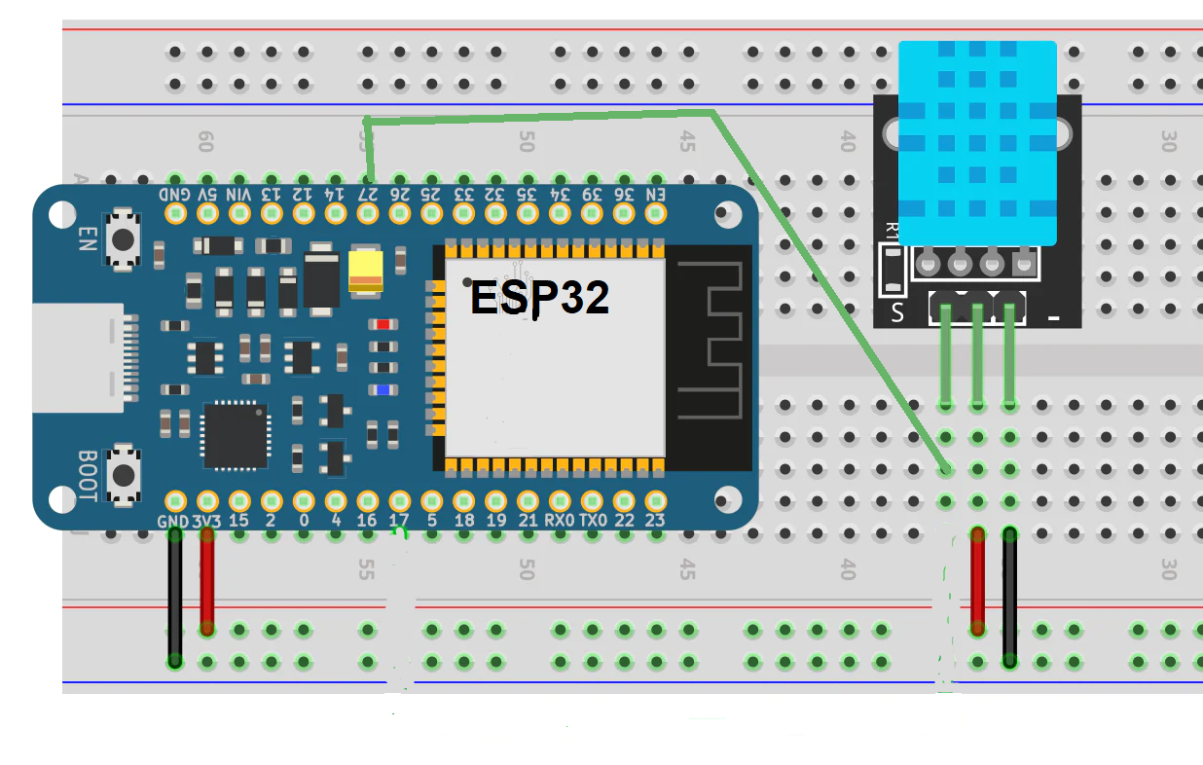
DHT11

Slide 4
BMP180(4 pins)
VCC
GND
SCL (Serial Clock Line):
This pin is used for the serial clock signal in the I2C
communication protocol.
It carries the clock signal generated by the microcontroller, and it synchronizes the data transfer between the microcontroller and the BMP180.
SDA (Serial Data Line):
This pin is used for the serial data signal in the I2C communication protocol.
It carries the actual data between the microcontroller and the BMP180.
Both the microcontroller and the BMP180 can read from and write to this line.

Slide 5
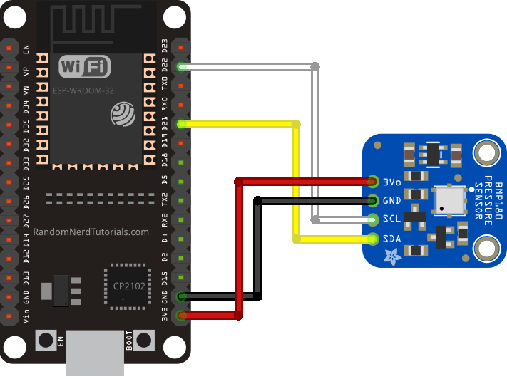
BMP180

Slide 6
SD Card Module(6 pins)
VCC
GND
MOSI (Master Out Slave In):
MOSI is the data line used for transmitting data from the microcontroller (master) to the SD card (slave). It stands for Master Out, Slave In.
MISO (Master In Slave Out):
MISO is the data line used for transmitting data from the SD card (slave) to the microcontroller (master). It stands for Master In, Slave Out.
CS (Chip Select):
This pin is used to select the SD card for communication. When this pin is pulled low, the SD card is active and ready for communication. It is sometimes labeled as "SS" (Slave Select) or "CE" (Chip Enable).
SCK (Serial Clock):
SCK is the clock signal used for synchronizing data transfer between the microcontroller and the SD card.
It is generated by the microcontroller and controls the timing of data transmission.

Slide 7
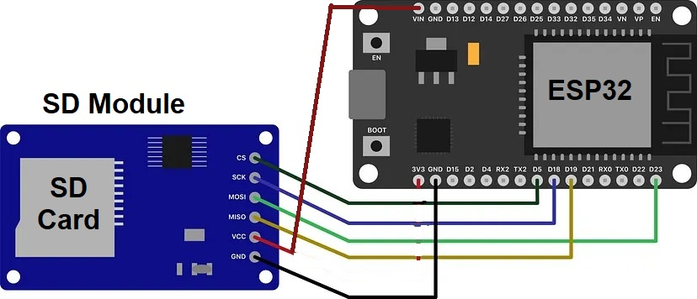
SD Card Module

Slide 8
What have we done ?
DHT11 to measure the temperature and the humidity.
BMP180 to measure the air pressure and the altitude.
SD Card Module to save recordings plus the datetime stamp
Web server to display sensors’ readings and control thresholds

Slide 9
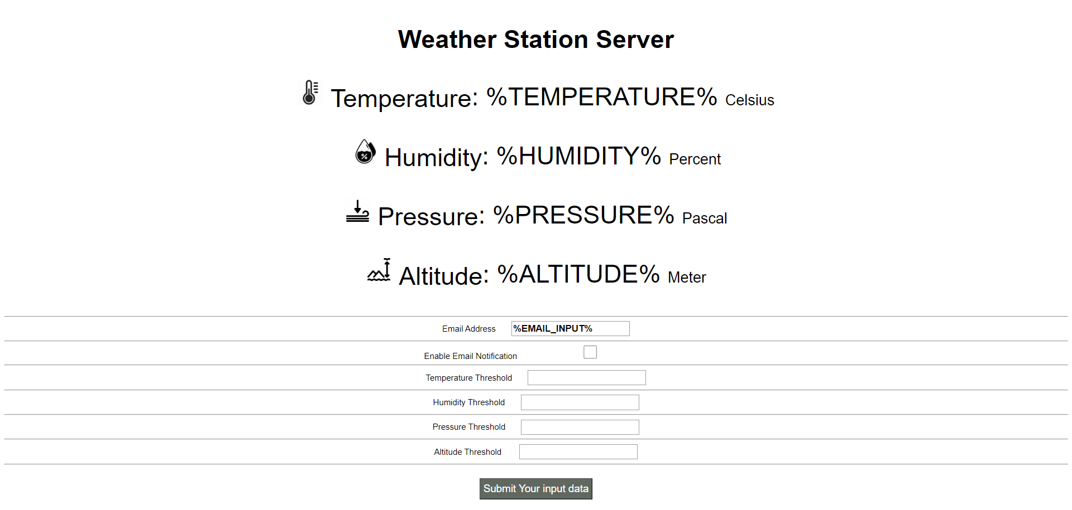
Weather Webserver

