Slide 1
EMPLOYEE DATA ANALYSIS USING EXCEL
STUDENT NAME : S.Esther Glory Nithya
REGISTER NO : 312205395(OR) asunm285b22323
DEPARTMENT : B.COM(GENERAL)
COLLEGE : SRIDEVI ARTS&SCIENCE COLLEGE, KRISHNAPURAM, PONNERI-601204

Slide 2
PROJECT TITLE
EMPLOYEE SALARY ANALYSIS USING EXCEL

Slide 3
AGENDA
1.Problem Statement
2.Project Overview
3.End Users
4.Our Solution and Proposition
5.Dataset description
6.Modelling approach
7.Results and discussions
8.conclusions

Slide 4
Problem statement
Employee salary statement is for to check in the organization the salary of the employee because of his work and dedications.

Slide 5
Project Overview
In the salary analysis it is to compare for the other employees salary and there work and field . In types of department.

Slide 6
Who are the end users
The employees are the end user for the company who knows the work and benefit to the company. The employees know the work and solutions to sought if there is the problem in the company employees can manage easily and handle in the proper way.

Slide 7
Our solution and its proposition
FILTERING- it is used to filter the data you need.
CHART-LINE CHART- it is easy to understand by visualization. And to compare with others.

Slide 8
Dataset description
1.Employee data set- Kaggle
2.26 features
3.Features –3 features
4.Name
5.Department
6.Salaries

Slide 9
Modelling
DATA COLLECTION- From edunet dash board.
DATA CLEANING- The needed data is used.
TECHNIQUES – Filter, line chart.
RESULTS- Easy to understand.
CHART&GRAPH- Easy to understand and visualization.

Slide 10
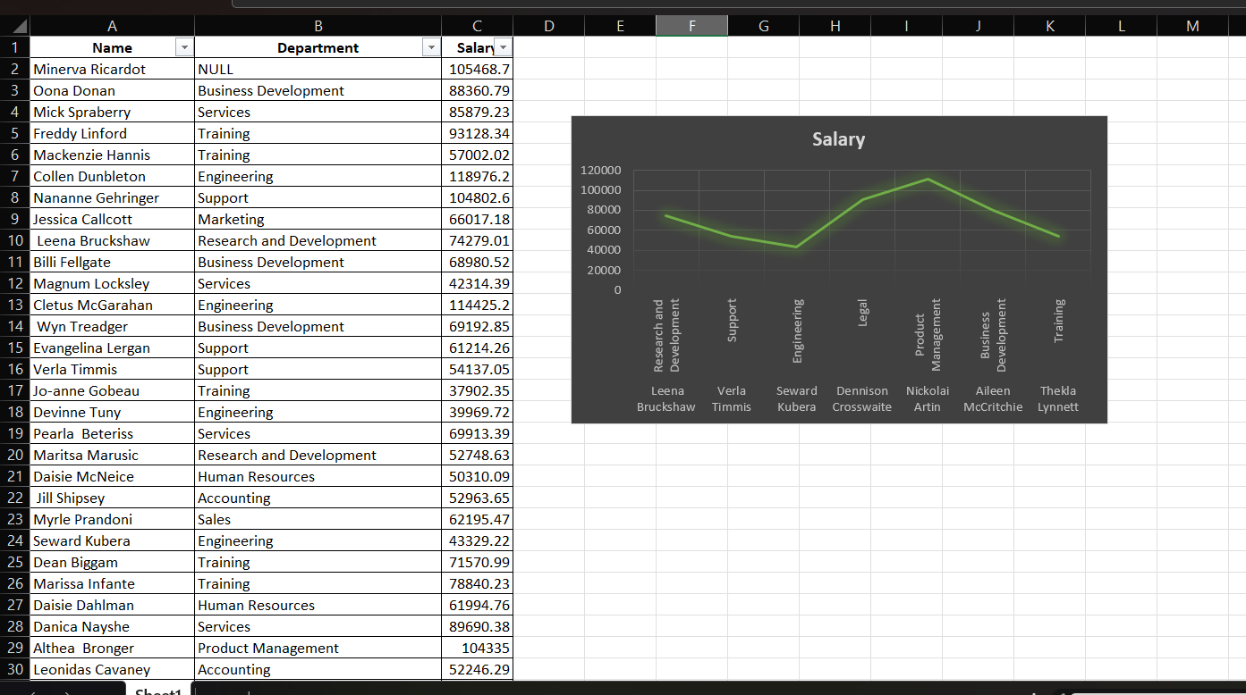
Results

Slide 11
Conclusion
IN THE CONCLUSION WE KNOW TO LEARN ABOUT THE EXCEL AND THE USAGE OF EXCEL.BY KNOWING THE IMPORTANT OF THE,CHART &GRAPHS ,AND FILTER.
ABOVE IS THE SUMMARY OF THE EMPLOYEE SALARY ANALYSIS USING EXCEL.

