Slide 1
Customer Identification Risk Certification Report
Scott Eugley
Final Project
Due: 10/20/2023
DSE 6003

Slide 2
Executive Summary
The risk of customer identification was evaluated for the customer survey file “Merr_Customer_Survery.xlsx”
Generally accepted statistical and scientific principles for risk evaluation and utilized probabilistic algorithms were applied, to review the risk under different scenarios
It has been determined that there is a significantly high risk of individuals being identified from the original variables in the dataset
Description of utility, data quality control, risk assessment methodology, and recommendations provided in Appendix 1, Appendix 2, Appendix 3, and Appendix 4, respectively

Slide 3
Data Description
Data collected from telecom company customer survey
5000 customers
Ages ranging from 18-79
Household income ranging from $9000/yr to $1,073,000/yr
Monthly credit card spending ranging from $0/mo to $3926.41/mo
Variables: Age, Gender, Monthly Credit Card Spending, Household Income, Debt-to-Income Ratio, Credit Debt

Slide 4
Customer Risk Identification Methodology
Step 1: Quality control of the data was performed. This was done by first looking at outliers and looking for extreme values in the dataset. Then missing or null values were redacted. Results of quality control can be found on Appendix 2
Step 2: The following quasi-identifiers were chosen: Age, Gender, Monthly Credit Card Spending, Household Income. We chose not to cover credit card debt and debt-to-income ratio in this report. If the risk is sufficiently low, we will consider these in the future
Step 3: Equivalence classes (ECs) for customers were established by grouping records that share identical sets of values for any specified number of quasi-identifiers.

Slide 5
Customer Risk Identification Methodology
Step 4: Due to the sensitivity of this personal data, we consider that the smallest EC has a size of at least 3 customers. This implies an acceptable threshold risk of about 0.33 (33%).
Step 5: The customer identification risk was measured against four possible attack scenarios:
Scenario 1: The adversary deliberately attempts to identify customer data
Scenario 2: The adversary inadvertently identifies customer data
Scenario 3: There is a data breach at the site of the recipient
Scenario 4: The most catastrophic scenario, where data becomes exposed to the public

Slide 6
Scenario 1: Deliberate Data Attack
This scenario describes a situation in which someone at the data recipient’s site attempts to identify the data. This could be a rogue staff member who wants to monetize the data for personal gain
The calculation of risk was identified using the following equation: Pr(re-id) = Pr(re-id | attempt) * Pr(attempt)
A low, medium, and high risk option were explored here. A high risk calculation of only 1/100 rogue employees, a medium risk calculation of 5/100 rogue employees and a conservative calculation of 10/100 rogue employees
Probability of correctly identifying a customer given an attack was made, is computed directly from the data set

Slide 7
Scenario 2: Inadvertent Data Attack
This describes a scenario in which someone who is handling the data recognizes a customer in the dataset. For example a data analyst who recognizes an acquaintance in the dataset.
The calculation of risk was identified using the following equation:
Pr(re-id) = Pr(re-id | acquaintance) * Pr(acquaintance)
Pr(acquaintance) = 1-(1-0.97)¹⁵⁰
This dataset represents a population of telecom customers, so they all have a phone plan. It has been estimated that 97% of Americans have a phone plan, so this was used as the prevalence value. On average people tend to have ~150 friends (Dunbar’s Number)
Probability of correctly identifying a customer, given that the adversary knows someone in the population covered by the dataset, is computed directly from the data set

Slide 8
Scenario 3: Data Breach
This scenario explores a situation in which the data recipient loses the data or a data breach occurs
Current evidence suggests that most breaches occur through losses or thefts of mobile devices, such as phones and laptops
Based on current evidence, we can assume that there is a 27% chance of data breach.
The calculation of risk was identified using the following equation: Pr(re-id) = Pr(re-id | breach) * Pr(breach)
Pr(breach) = 0.27
Probability of correctly identifying a customer given a data breach situation is computed directly from the data set

Slide 9
Scenario 4:Demonstration Attack
The last scenario considered in this report is when data is disclosed publicly. We assume that there is an adversary who has background information that can be used to launch an attack on the data, and that the adversary will attempt a customer identification attack
The calculation of risk was identified using the following equation: Pr(re-id) = Pr(re-id | attempt) * Pr(attempt)
Pr(attempt) = 1
Since data is public, we can assume Pr(attempt) to be 1
The calculation of risk is computed directly from the dataset

Slide 10
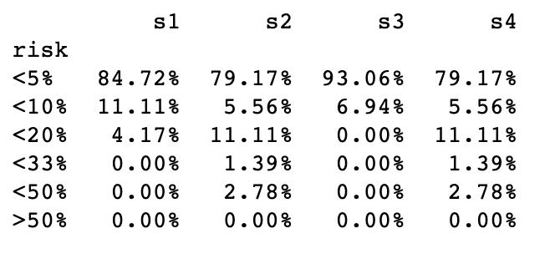
Results - Diagnostics
Percent of customers at each risk range for each scenario

Slide 11
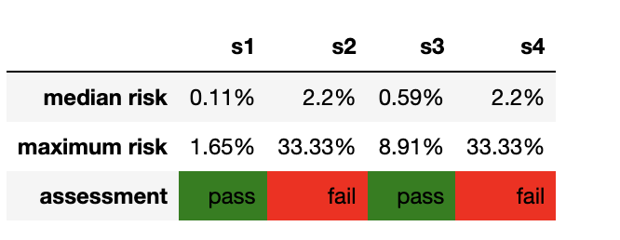
Results - Conclusion
Risk has been estimated to be reasonably low for scenarios 1 and 3 (deliberate attack and data breach) and pass our threshold risk of 33%. However, scenarios 2 and 4 (inadvertent and demonstration attacks) are borderline and were slightly over our risk threshold

Slide 12
Appendix 1 - Utility
This dataset contains telecom customer data and has been prepared for use in a partner credit card company
The prepared dataset contains household income, age, gender, and monthly credit card spending data
The data has been masked to ensure customer privacy, but also maintain utility.
Ages have been grouped into three different ranges from young, to middle-aged, to senior-aged.
Household income has been grouped into low, medium, and high income ranges
Monthly credit card spending has been grouped into low spending, medium spending, and high credit card spending
Grouping the data in this way has mitigated a lot of risk of reidentification, and still provides value to the recipient. For example the credit company could be trying to figure out who the primary audience for their new credit card would be
This telecom dataset is a relevant dataset for many fields, as 97% of Americans have a phone plan, which means this dataset is a good representation of the general population

Slide 13
Appendix 2 – Data Quality Control
After performing data quality control it was found that there were no extreme values, or values that seemed unreasonable
There were no missing or null values found in the quasi-identifier columns that were used in this dataset

Slide 14
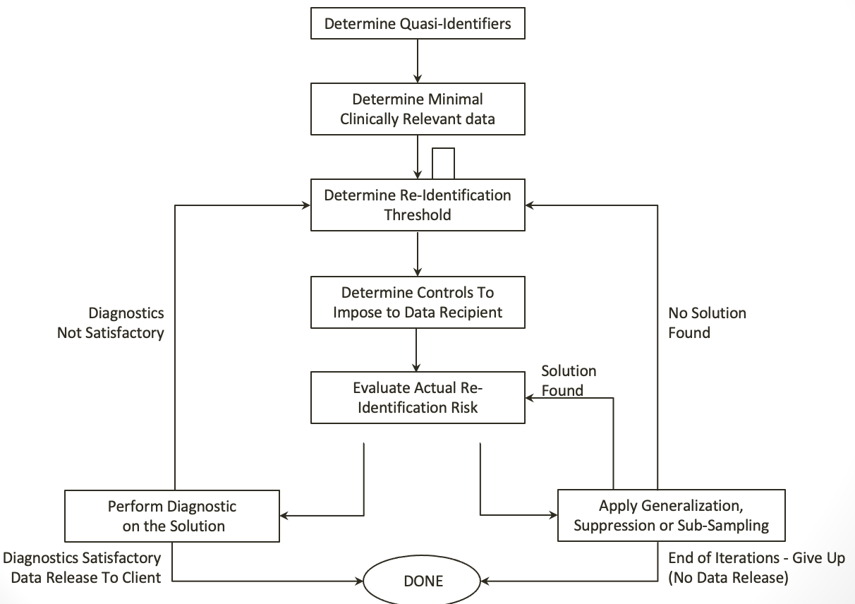
Appendix 3 - Customer Risk Assessment Methodology

Slide 15
Appendix 4 - Recommendations
It is recommended that ongoing delivery of data is based on secured procedures, such as encrypted email or secured FTP
Full documentation of data recipient’s data storage, data accessibility protocols and full data integration catalogue needs to be compiled for this project
Recommendations for lowering the risk of the existing dataset
Identify and correct errors
Identify and mask obvious outliers
Group ages
Group household incomes
Group monthly credit spending

Slide 16
References
Geiger, A. (2015, September 3). The WHYS and hows of generations research. Pew Research Center - U.S. Politics & Policy. https://www.pewresearch.org/politics/2015/09/03/the-whys-and-hows-of-generations-research/
Kokkotos, F. (n.d.). Patient Identification Risk Certification Report.
Statistical algorithm is available to regulators upon request

