Slide 1
GNNs for GRNs
BioAI hackathon 12.05.2025
Michał Denkiewicz

Slide 2




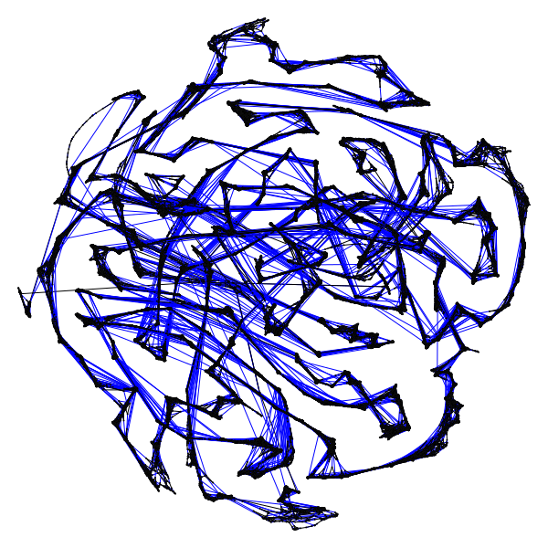
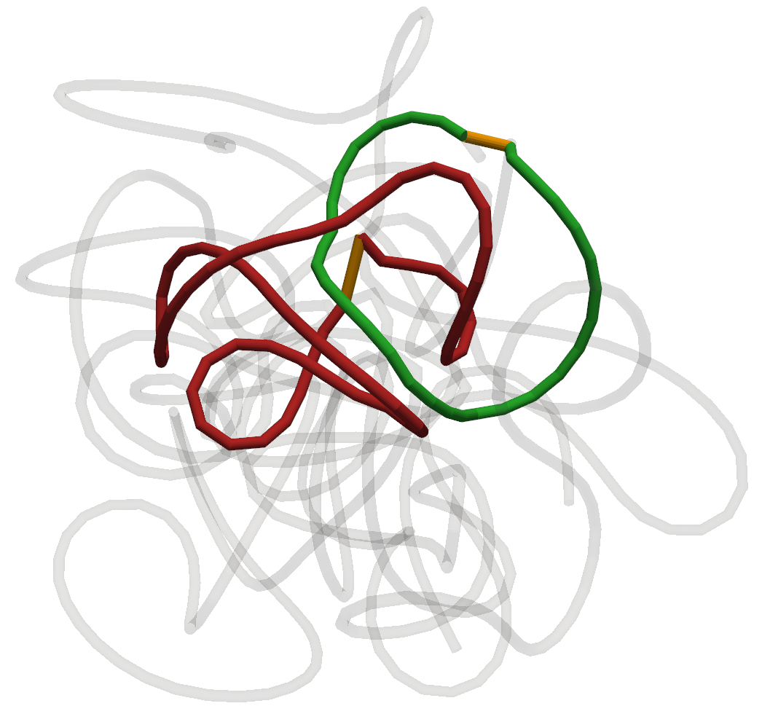
Michał Denkiewicz
Faculty of Mathematics and Information Science
Warsaw University of Technology
Background: Computer science, Interdisciplinary studies (Warsaw University)
Interests: Network Science and its application in 3D genomics, Complex Systems
In my work I use computational methods, primarily graph-based, to study and model the 3D structure of chromatin.

Slide 3
Goal: Create a GNN model that predicts a Gene Regulatory Network structure based on expression and 3D conformation data

Slide 4
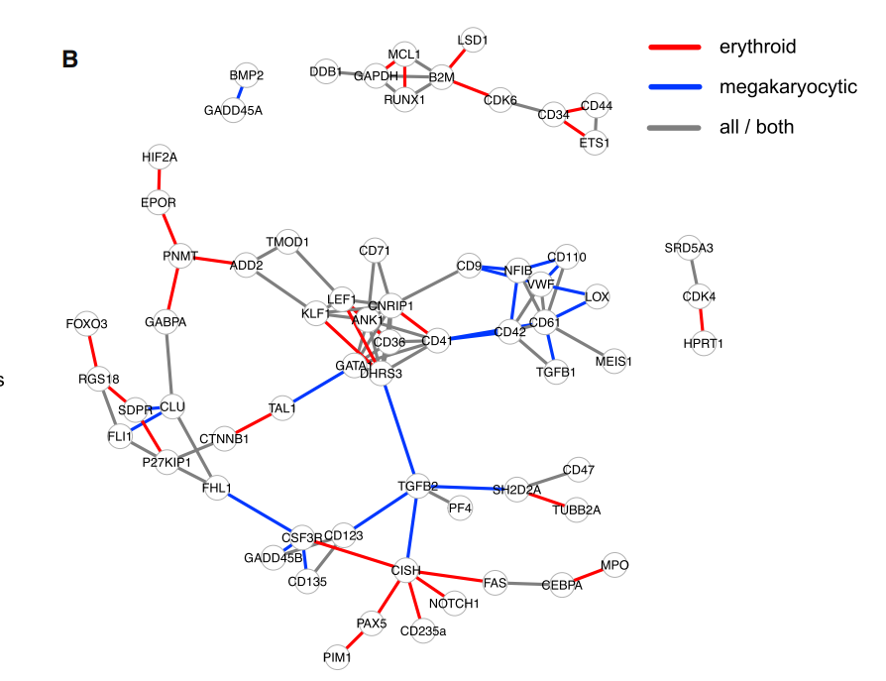
GRNs
Gene Regulatory Networks are directed heterogeneous graphs:
Vertices (nodes) are genes* and TFs
Edges (links) represent gene-TF interactions - can be either activation or inhibition
Represent high-level knowledge about genome regulation
https://www.cell.com/cell-systems/pdf/S2405-4712(17)30386-1.pdf

Slide 5
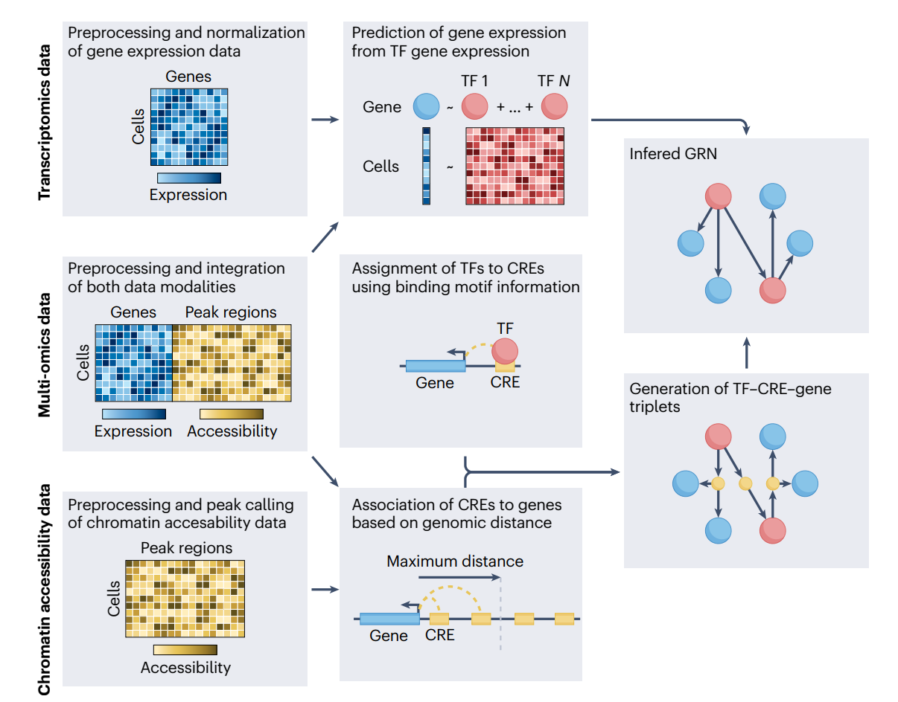
GRNs
https://www.sciencedirect.com/science/article/pii/S2452310021000184

Slide 6
GRNs
There are many methods for GRN discovery from scRNA-Seq
using e.g. Partial Information (PIDC), Tree ensembles (GENIE3), Granger Causality (SINCERITIES)
We focus on latest - GNNs, because:
It seems to make sense
It has been shown to make sense
We like it:)

Slide 7
GNNs
GNNs work with graph-structured data, where topology is more complicated than for linear time series or 2D images (e.g. in CNNs)
Important information is encoded in the topology
Message passing: Nodes exchange information (messages) with their neighbors during multiple iterations (layers), allowing each node to learn from its local graph structure.
Feature aggregation: Each node updates its own features by aggregating the features of its neighbors (e.g., via sum, mean, or attention-based mechanisms).
Most popular tools: PyTorch Geometric, Deep Graph Library
https://journalofbigdata.springeropen.com/articles/10.1186/s40537-023-00876-4

Slide 8
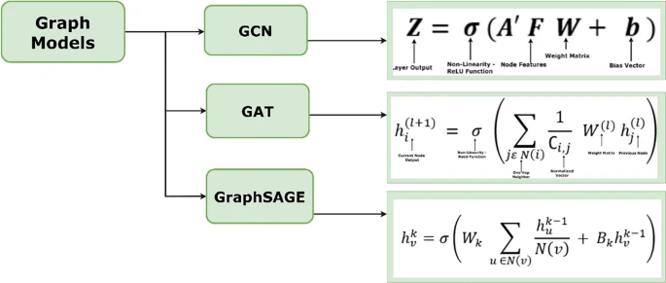
GNNs
https://journalofbigdata.springeropen.com/articles/10.1186/s40537-023-00876-4

Slide 9
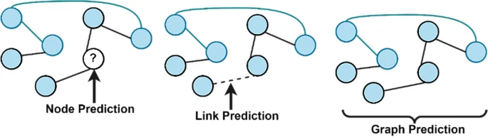
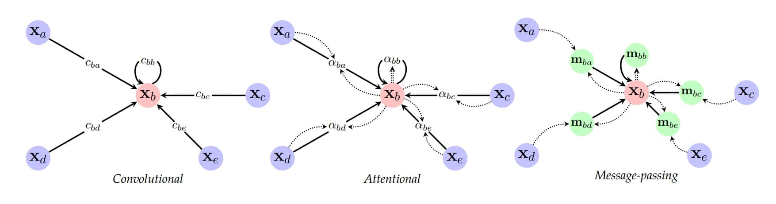
GNNs
https://journalofbigdata.springeropen.com/articles/10.1186/s40537-023-00876-4
https://blogs.nvidia.com/blog/what-are-graph-neural-networks/

Slide 10
What extra data can we add?

Slide 11
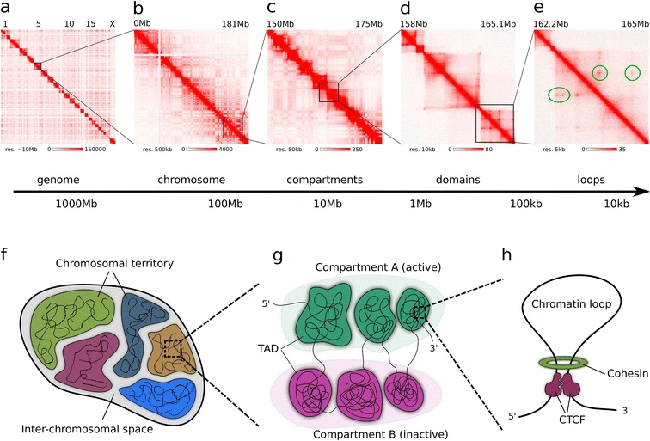
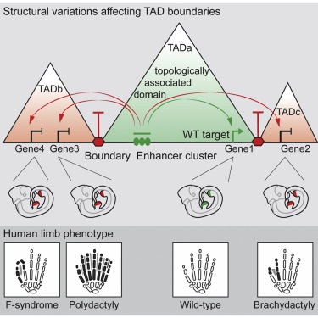
3D structure and its significance
L: Cremer, Marion, and Thomas Cremer. "Nuclear compartmentalization, dynamics, and function of regulatory DNA sequences." Genes, Chromosomes and Cancer 58, no. 7 (2019): 427-436.
P: Lupiáñez, Darío G., Katerina Kraft, Verena Heinrich, Peter Krawitz, Francesco Brancati, Eva Klopocki, Denise Horn et al. "Disruptions of topological chromatin domains cause pathogenic rewiring of gene-enhancer interactions." Cell 161, no. 5 (2015): 1012-1025.
Szalaj, Przemyslaw, and Dariusz Plewczynski. "Three-dimensional organization and dynamics of the genome." Cell biology and toxicology 34 (2018): 381-404.

Slide 12
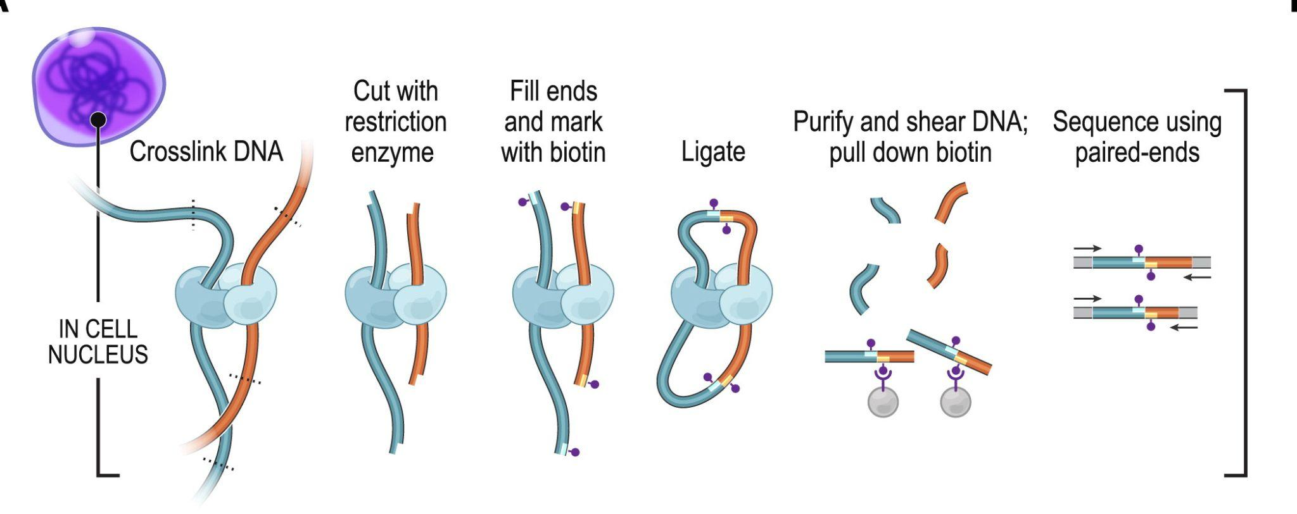
Chromosome conformation capture
A set of assays that study the 3D conformation of chromatin
population-level: Hi-C, HiChIP, ChIA-PET
single-cell: SPRITE
single-molecule: ChIA-Drop
Extract a contact matrix or a sparse set of contacts
Rao, Suhas SP, Miriam H. Huntley, Neva C. Durand, Elena K. Stamenova, Ivan D. Bochkov, James T. Robinson, Adrian L. Sanborn et al. "A 3D map of the human genome at kilobase resolution reveals principles of chromatin looping." Cell 159, no. 7 (2014): 1665-1680.

Slide 13
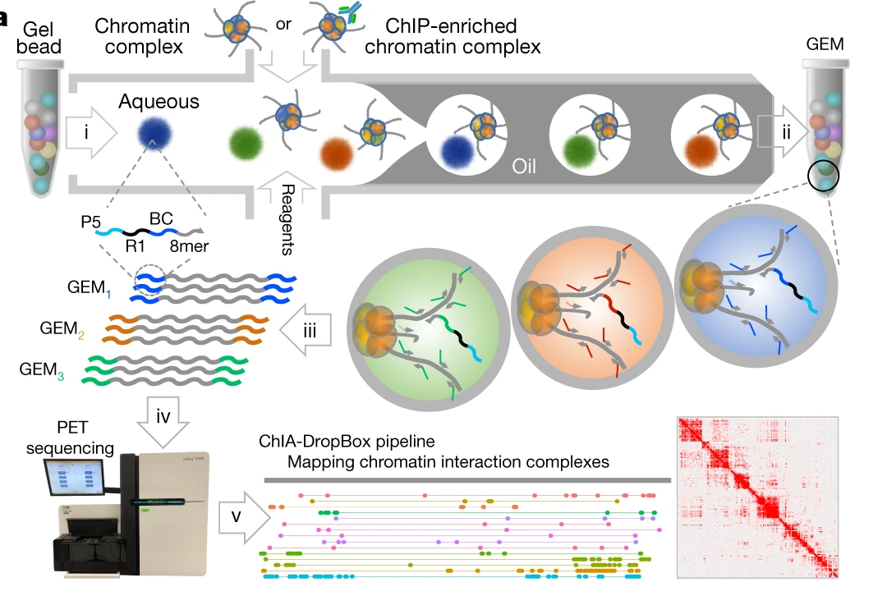
ChIA-Drop
Captures string interactions mediated by specific protein
Multiple cells, single molecule
Zheng, Meizhen, et al. "Multiplex chromatin interactions with single-molecule precision." Nature 566.7745 (2019): 558-562.

Slide 14
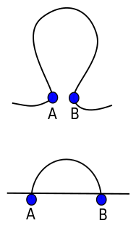
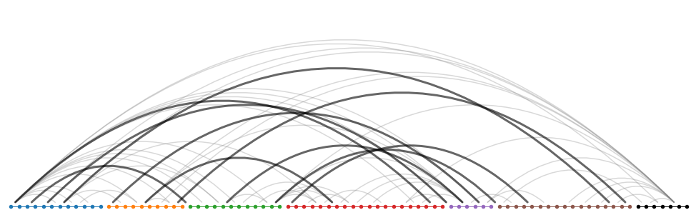
Graph representations of chromatin interactions
We can consider a set of chromatin interactions as a graph
Edges (links) = interactions (usually from loop calling tool) or pieces of chromatin strand
Vertices = interacting loci
Notes:
We can represent contacts/interactions or loops in a given region extracted from conformation capture experiments as a graph.
Here in particular we are using ChIA-PET assay targeting CTCF to obtain highly confident loops
This data can be represented as a network in a quite straightforward manner: each identified loop is turned into an edge in the graph, with its the endpoints (called anchors) represented as vertices (we actually add 2 represent an anchor by 2 vertices for technical reasons, but this obfuscates the gereral idea)
Moreover, what’s important, we connect vertices representig consecutive loci with an Edge, creating a graph represetation of the DNA strand itself.
Hence we get a single connected graph that represets the strcture of the region, which i show here with vertices arranged lineraly according to their genomic coordinates
Why is this useful to study structure? Can’t we just use a 3D model?
Chromatin does not have a fixed structure that we could describe the same way we do e.g. for protein.
Graph represetations abstract from particular 3D positions of segments of DNA (wchich is not well defined), and focus on topology.
We also don’t need to rely on particualrities and parameters of molecular dynamics model.

Slide 15
Deliverables
A GNN model training (or tuning) pipeline
Including 3D genomics data
A benchmark against
Raw comparison against existing method
Comparison for No3D vs 3D inputs - ideally 3D should be better;)
Between organisms-comparison
Possibly using BEELINE (Paratapa et al. 2020)

Slide 16
Thank You
Let’s get crackin'

